Slide 1
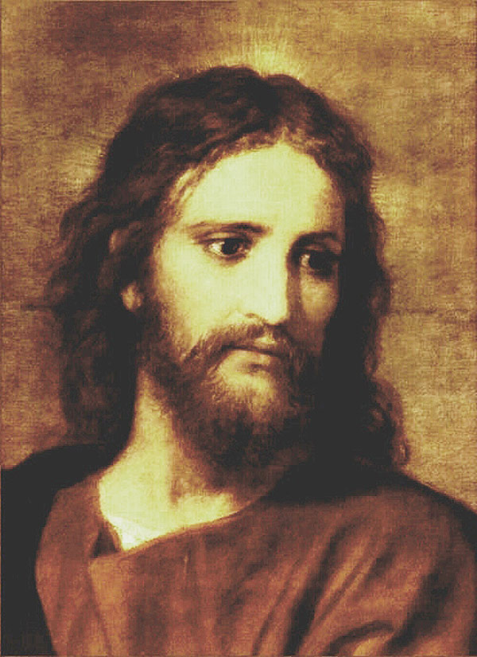
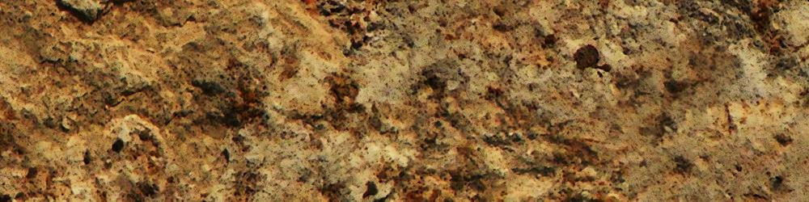
LOVE
HOLY SPIRIT
Brotherly Kindness
Godliness
Patience
Temperance
Knowledge
Virtue
Faith

Slide 2
HOLY SPIRIT
Brotherly Kindness
Godliness
Patience
Temperance
Knowledge
Virtue
Faith

Slide 3
HOLY SPIRIT
Brotherly Kindness
Godliness
Patience
Temperance
Knowledge
LOVE
LOVE
Virtue
Faith

Slide 4
LOVE
HOLY SPIRIT
Brotherly Kindness
Godliness
Patience
Temperance
Knowledge
Virtue
Faith

Slide 5
LOVE
HOLY SPIRIT
Brotherly Kindness
Godliness
Patience
Temperance
Knowledge
Virtue
Faith

Slide 6

LOVE
HOLY SPIRIT
Brotherly Kindness
Godliness
Patience
Temperance
Knowledge
Virtue
Faith = New Birth = Holy Ghost
SANCTIFICATION
JUSTIFICATION

Slide 7
LOVE
HOLY SPIRIT
Brotherly Kindness Faith
Godliness Faith
Patience Faith
Temperance Faith
Knowledge Faith
Virtue Faith
Faith = New Birth = Holy Ghost
SANCTIFICATION
JUSTIFICATION

