Slide 1
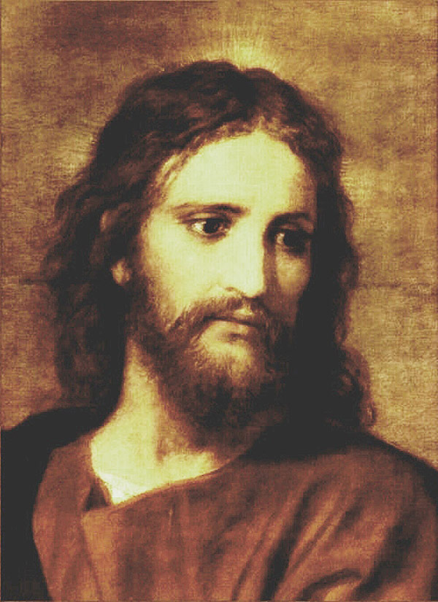
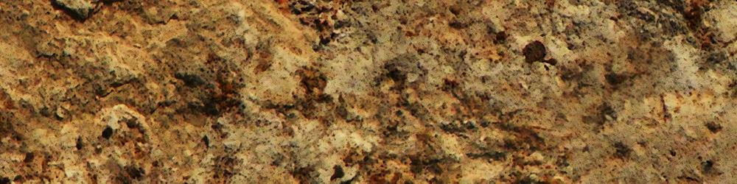
LOVE
HOLY SPIRIT
Brotherly Kindness
Godliness
Patience
Temperance
Knowledge
Virtue
Faith

Slide 2
HOLY SPIRIT
Brotherly Kindness
Godliness
Patience
Temperance
Knowledge
Virtue
Faith

Slide 3
HOLY SPIRIT
Brotherly Kindness
Godliness
Patience
Temperance
Knowledge
LOVE
LOVE
Virtue
Faith

Slide 4
LOVE
HOLY SPIRIT
Brotherly Kindness
Godliness
Patience
Temperance
Knowledge
Virtue
Faith

Slide 5
LOVE
HOLY SPIRIT
Brotherly Kindness
Godliness
Patience
Temperance
Knowledge
Virtue
Faith

Slide 6

LOVE
HOLY SPIRIT
Brotherly Kindness
Godliness
Patience
Temperance
Knowledge
Virtue
Faith
SANCTIFICATION
JUSTIFICATION

