Slide 1
DANIEL’S SEVENTY WEEKS
Brother Samuel Dale

Slide 2
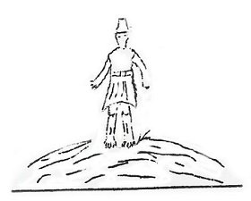
DANIEL’S SEVENTY WEEKS
Stone of Daniel 2:34
What Some People Believe
Raptured Saints
Jews Returning
Daniel 9:24
70 Weeks B.C. 538
A.D 33
69 ½ Weeks
3 ½ Years
3 ½ Years
7 Weeks
62 ½ weeks
2 Prophets Rev. 11:3
49 Years for the rebuilding of Jerusalem
434 Years to Messiah
7 Church Ages
Luke 21:24
Middle of Week Armageddon
Daniel 2:31

Slide 3
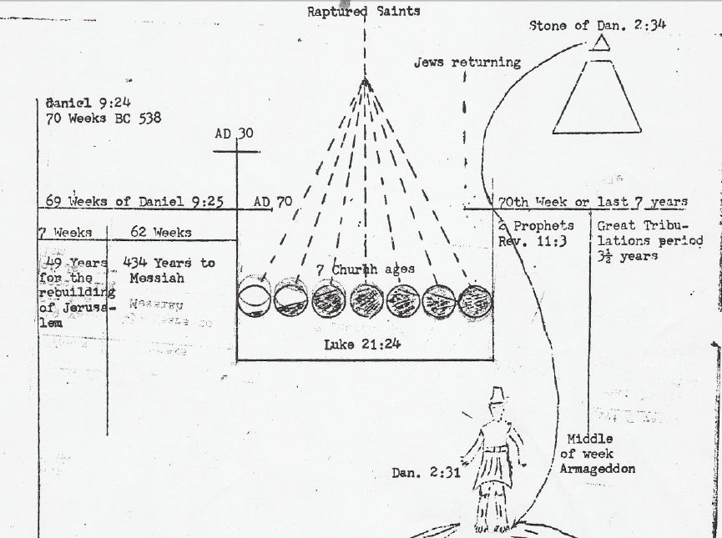
DANIEL’S SEVENTY WEEKS

Slide 4
DANIEL’S SEVENTY WEEKS
475 X 365.25 = 173493.75
173493.75 Divided By 360 = 481.9270833333333

Slide 5
DANIEL’S SEVENTY WEEKS
Timeline Comparison
“The Earthly Age of our Lord Jesus Christ” |01|02|03|04|05|06|07|08|09|10|11|12|13|14|15|16|17|18|19|20|21|22|23|24|25|26|27|28|29|30|31|32|33|
|04|03|02|01|01|02|03|04|05|06|07|08|09|10|11|12|13|14|15|16|17|18|19|20|21|22|23|24|25|26|27|28|29|30|31|32|33|
B.C.
Before Christ
A.D. (Anno Domini)
“Year of our Lord”
61-0806 THE.SEVENTIETH.WEEK.OF.DANIEL 80 Now, now, Jesus, Messiah, rode into the city of Jerusalem, triumph, on the back of a white mule on Palm Sunday, April the 2nd, A.D. 30. Jesus rode into Jerusalem on Palm Sunday, A.D. 30.
63-0323 THE.SIXTH.SEAL JEFFERSONVILLE.IN SATURDAY
« 146 Now, notice, for the Sixth Seal is the judgment Seal of the Word. Now, here, let's start out now and let's read Saint Matthew the 24th chapter. Now, I'd just like to give you something here I've just looked up to find. Now, Saint Matthew from 1 to 3, well, is where we're going to read first. And Jesus went out, and departed from the temple: and his disciples came to him for to shew him the building of the temple. And He said unto them, See ye not all these things? verily I say unto you, There shall not be one--be left here one stone upon another, that shall not be thrown down.
(Now)... and... (3rd verse)... as he set upon... mount... Olives, the disciples came to him privately, saying, Tell us, when these things shall be?... what shall be the sign of thy coming, and of the end of the world?
« 148 Now, let's stop there. These three verses, it took place actually on Tuesday afternoon, April the 4th, AD 30. And the first two verses took place on the afternoon of the--of April the 4th, at AD 30, and the 3rd verse taken place on Tuesday evening of the same day. See?

Slide 6
DANIEL’S SEVENTY WEEKS
LEVITICUS 25:8-10
» 8 † ¶ And thou shalt number seven sabbaths of years unto thee, seven times seven years; and the space of the seven sabbaths of years shall be unto thee forty and nine years.
» 9 † Then shalt thou cause the trumpet of the jubile to sound on the tenth day of the seventh month, in the day of atonement shall ye make the trumpet sound throughout all your land.
» 10 † And ye shall hallow the fiftieth year, and proclaim liberty throughout all the land unto all the inhabitants thereof: it shall be a jubile unto you; and ye shall return every man unto his possession, and ye shall return every man unto his family.
49 X 70 = 3,430 Years

Slide 7
DANIEL’S SEVENTY WEEKS
64-0830E QUESTIONS.AND.ANSWERS.4_ JEFFERSONVILLE.IN COD SUNDAY_
75 392. Ah... The church age ending and has blacked out, the Bride is called, we have already entered into the tribulation period?
No, no, no, you're... I wished that I could just have more time on that. See, see? The Bride, when she's taken from the church, then the church age will cease. Laodicea goes into chaos; the Bride goes to glory; and the tribulation period sets in upon the sleeping virgin for three and a half years while Israel is getting its prophecy; then tribulation sets in upon Israel; and then comes the battle of Armageddon which destroys all things. And then, the Bride returns back with the Groom for a thousand years, the Millennium reign; after that comes the white throne judgment; after that comes the new heavens and new earth and the new city coming down from God out of heaven. Eternity and time blends together.

