Slide 1
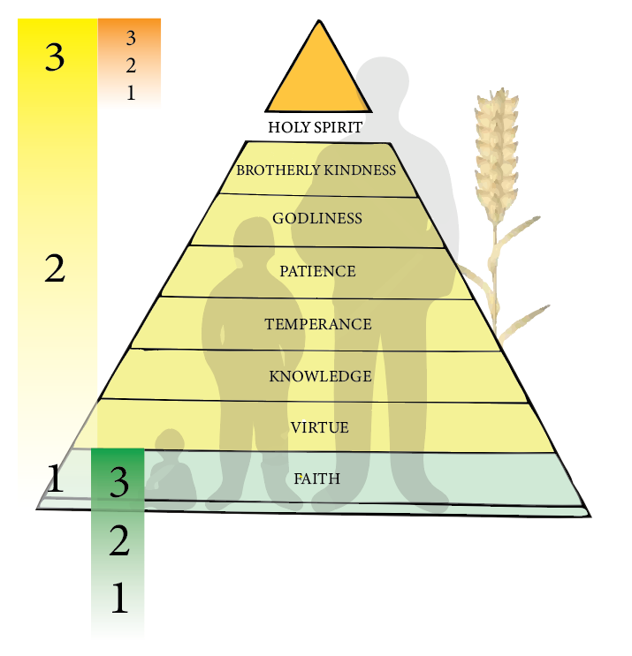
Body Change
SON OF MAN
SPECIAL ANOINTING
Sanctification
Justification
SANCTIFICATION
SON OF GOD
JUSTIFICATION
NEW BIRTH
SANCTIFICATION
JUSTIFICATION
Notes:
FAITH
Can you see God’s purpose in your life?
Do you stumble at parts of the Word like Eve did?
Are you willing to let Christ be the LORD of your HEART?
Are you willing to take correction?

