Slide 1
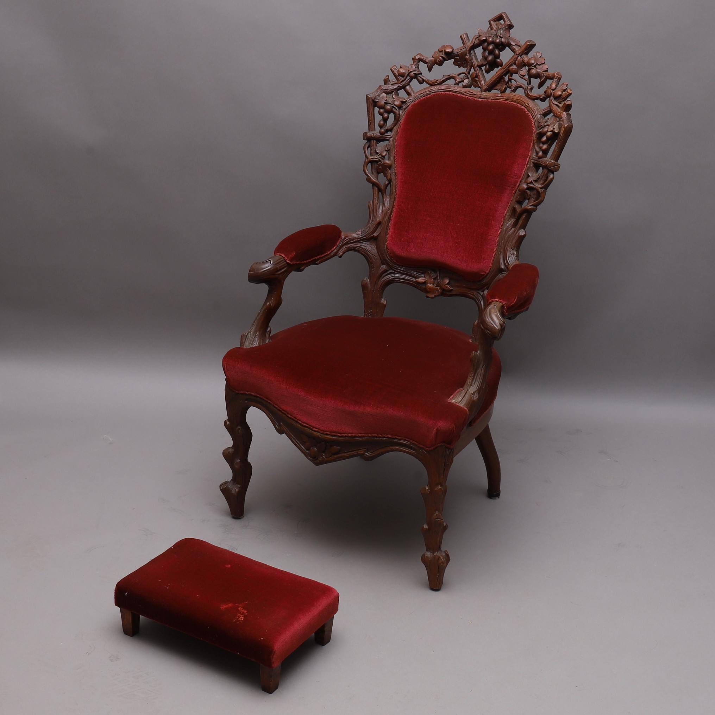
HEBREWS 2:8
Thou hast put all things in subjection under his feet. For in that he put all in subjection under him, he left nothing that is not put under him. But now we see not yet all things put under him.
Hebrews 1:13
But to which of the angels said he at any time, Sit on my right hand, until I make thine enemies thy footstool?
“But now we see not yet all things put under him.
That's, death. We don't see death, yet, because we're still dying. We see death.

Slide 2
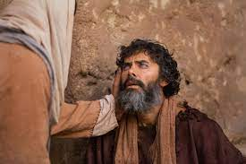
HEBREWS 2:9
» 9 † But we see Jesus, who was made a little lower than the angels for the suffering of death, crowned with glory and honour; that he by the grace of God should taste death for every man.
57-0825E HEBREWS.CHAPTER.TWO.2_ JEFFERSONVILLE.IN HEB SUNDAY_
The people were blind. They didn't know Him. They didn't recognize Him.
You say, "Blind? Could they have their sight?“
You can still have your sight and be blind.

Slide 3
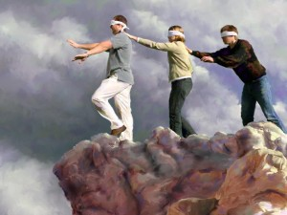
HEBREWS 2:9
» 9 † But we see Jesus, who was made a little lower than the angels for the suffering of death, crowned with glory and honour; that he by the grace of God should taste death for every man.
Matthew 15:12-14
» 12 † Then came his disciples, and said unto him, Knowest thou that the Pharisees were offended, after they heard this saying?
» 13 † But he answered and said, Every plant, which my heavenly Father hath not planted, shall be rooted up.
» 14 † Let them alone: they be blind leaders of the blind. And if the blind lead the blind, both shall fall into the ditch.

Slide 4
HEBREWS 2:9
» 9 † But we see Jesus, who was made a little lower than the angels for the suffering of death, crowned with glory and honour; that he by the grace of God should taste death for every man.
ISAIAH 42:16-18
» 16 † And I will bring the blind by a way that they knew not; I will lead them in paths that they have not known: I will make darkness light before them, and crooked things straight. These things will I do unto them, and not forsake them.
» 17 † They shall be turned back, they shall be greatly ashamed, that trust in graven images, that say to the molten images, Ye are our gods.
» 18 † Hear, ye deaf; and look, ye blind, that ye may see.
Revelation 3:18
I counsel thee to buy of me gold tried in the fire, that thou mayest be rich; and white raiment, that thou mayest be clothed, and that the shame of thy nakedness do not appear; and anoint thine eyes with eyesalve, that thou mayest see.

Slide 5
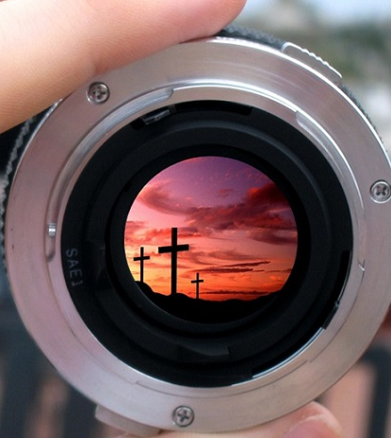
HEBREWS 2:9
» 9 † But we see Jesus, who was made a little lower than the angels for the suffering of death, crowned with glory and honour; that he by the grace of God should taste death for every man.
60-1209 THE.SARDISEAN.CHURCH.AGE_ JEFFERSONVILLE.IN ROJC 329-372 FRIDAY_
So when we receive Eternal Life, we're receiving part of that cosmic light that was back yonder before there was ever was a molecule. Uh-huh. That Light of God comes into our heart that lightens us that we see Jesus. The Bible said, "We don't see all things, but we see Jesus."

Slide 6
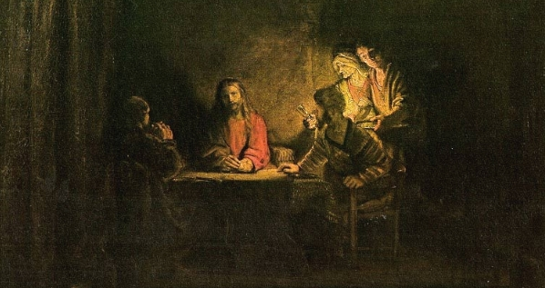
HEBREWS 2:9
» 9 † But we see Jesus, who was made a little lower than the angels for the suffering of death, crowned with glory and honour; that he by the grace of God should taste death for every man.
LUKE 24:30-31
» 30 † And it came to pass, as he sat at meat with them, he took bread, and blessed it, and brake, and gave to them.
» 31 † And their eyes were opened, and they knew him; and he vanished out of their sight.

Slide 7
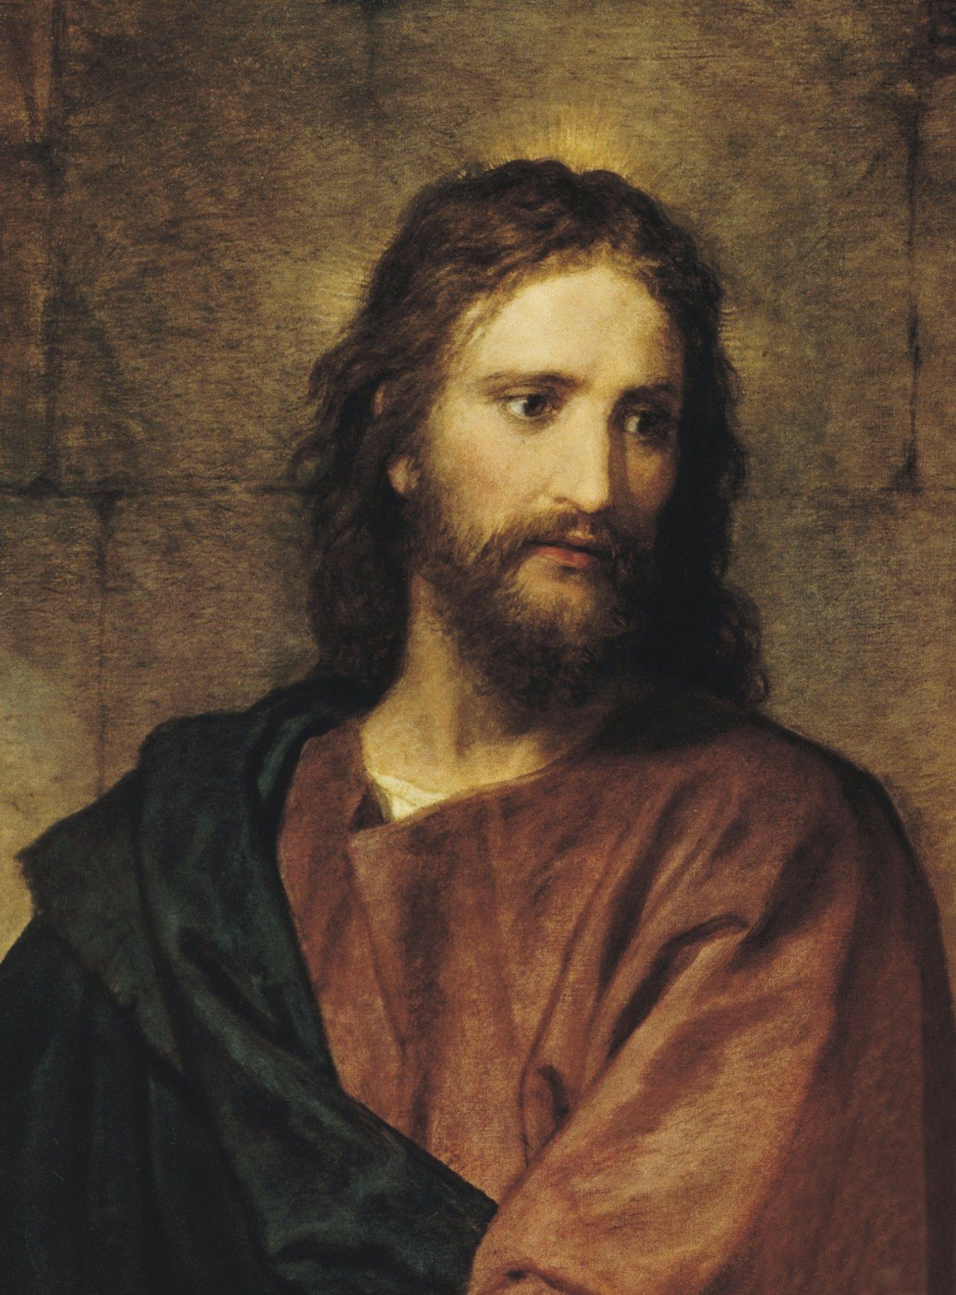
HEBREWS 2:9
» 9 † But we see Jesus, who was made a little lower than the angels for the suffering of death, crowned with glory and honour; that he by the grace of God should taste death for every man.
64-0213 THEN.JESUS.CAME.AND.CALLED_ TULARE.CA V-22 N-11 THURSDAY_
71 He was that, truly. He was that, plus God. See, He was the manifestation. Jesus is the body, the Boy, the Man; God was what dwelt in Him. God was in Him. He was a God-man. He was a Man, yet He was God manifested in flesh. When we see Jesus, we see God. That's what He said, "When you see the Father, see Me, you see the Father." Because, He was the reflection, because He was the Word, amen, that was in the beginning. Amen.

Slide 8

HEBREWS 2:9
» 9 † But we see Jesus, who was made a little lower than the angels for the suffering of death, crowned with glory and honour; that he by the grace of God should taste death for every man.
63-0428 LOOK_ PHOENIX.AZ SUNDAY_
133 What are you looking at? What are you seeing? We must see Jesus.
And the only way we see Jesus, see the Word.
This is the natural Symbol of the Spirit.
You know what I mean?
It is the Letter that the Spirit quickens.
See?
That is the Letter, that, and the Spirit quickens this Letter and makes It a reality. Yeah.

Slide 9
HEBREWS 2:9
» 9 † But we see Jesus, who was made a little lower than the angels for the suffering of death, crowned with glory and honour; that he by the grace of God should taste death for every man.
65-0425 GOD'S.PROVIDED.PLACE.OF.WORSHIP_ LOS.ANGELES.CA V-18 N-2 SUNDAY_
215 But, Lord, it does delight our hearts when we see Jesus glorified among us; when we see Him glorified, when we see His Word, which He is the Word; when we see we can read it here in the Bible, where He promised He would do it, then see Him work it right in us, O God, how it makes us feel humble, that we know that His living Presence...

Slide 10
HEBREWS 2:9
» 9 † But we see Jesus, who was made a little lower than the angels for the suffering of death, crowned with glory and honour; that he by the grace of God should taste death for every man.
63-0728 CHRIST.IS.THE.MYSTERY.OF.GOD.REVEALED_ JEFFERSONVILLE.IN V-3 N-7 SUNDAY_
« 233 † Look, Christ in you makes Him the center of Life of the revelation. See? Christ's Life in you makes Him the center of the revelation. Christ, in the Bible, makes the Bible the complete revelation of Christ. Christ in you makes you the complete revelation of the whole thing, see, what God is trying to do.
234 What is the new Birth then? You'd say, "Well, Brother Branham, what is the new Birth?" It is the revelation of Jesus Christ personally to you. Amen! See? Not you joined a church, you shook a hand, you done something different, you said a creed, you promised to live by a--a code of rules. But Christ, the Bible, He is the Word that was revealed to you. And no matter what anybody says, what takes place, it's Christ; pastor, priest, whatever it might be. It's Christ in you, that is the revelation that the Church was built upon.

Slide 11
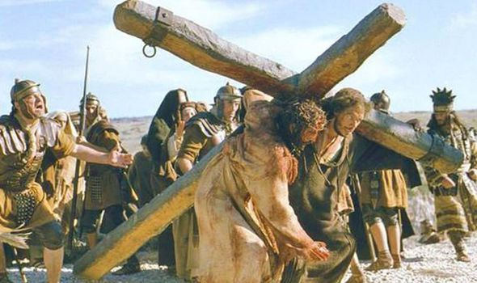
HEBREWS 2:9
» 9 † But we see Jesus, who was made a little lower than the angels for the suffering of death, crowned with glory and honour; that he by the grace of God should taste death for every man.

Slide 12
HEBREWS 2:9
» 9 † But we see Jesus, who was made a little lower than the angels for the suffering of death, crowned with glory and honour; that he by the grace of God should taste death for every man.
I John 2:2
And he is the propitiation for our sins: and not for ours only, but also for the sins of the whole world.
John 3:16
For God so loved the world, that he gave his only begotten Son, that whosoever believeth in him should not perish, but have everlasting life.
Revelation 22:17
And the Spirit and the bride say, Come. And let him that heareth say, Come. And let him that is athirst come. And whosoever will, let him take the water of life freely.
John 11:26
…And whosoever liveth and believeth in me shall never die. Believest thou this?

Slide 13
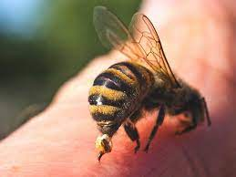
HEBREWS 2:9
» 9 † But we see Jesus, who was made a little lower than the angels for the suffering of death, crowned with glory and honour; that he by the grace of God should taste death for every man.
64-0312 WHEN.THEIR.EYES.WERE.OPENED.THEY.KNEW.HIM_ BEAUMONT.TX THURSDAY_
36 That's the reason God was made flesh, in order to die, that He could suffer and take the penalty upon Himself. He couldn't do it as long as He was Jehovah, in the spirit. God the Father, in spirit, could not do it. But when God was made flesh and dwelt among us, a human Being, then He could taste death, and takes the penalty that He had put upon all human beings. He took it upon Himself, and paid the price.

Slide 14
HEBREWS 2:9
» 9 † But we see Jesus, who was made a little lower than the angels for the suffering of death, crowned with glory and honour; that he by the grace of God should taste death for every man.
59-1121 THY.SEED.SHALL.POSSESS.THE.GATE.OF.HIS.ENEMY_ SAN.JOSE.CA SATURDAY_
« E-28 † Oh, that sting of death, you watch it in a person's face. I've held them in my arms and see them quiver and straighten out, then quiver and straighten out, and cry and scream for mercy, nothing like a sting of death.
But you know, when the bee of death begin to buzz around Him... You know, if a bee, a insect that's got a stinger, if he have ever sting deep enough, it pulls its stinger out. It hasn't got no more stinger after that.
And when death anchored its stinger in the virgin born Son of God, He pulled the stinger out of death. It doesn't have any more stinger in it. The only thing it is, is a bluff. A bee that has no stinger can buzz but he can't sting. It's been tried. Saint Paul said, when the bee begin to buzz around him, he said, "O death, where is your sting? Grave, where is your victory? Thanks be to God, Who gives us the victory through our Lord Jesus Christ." The true royal seed of Abraham, we possess the gate of every enemy. Amen.

Slide 15
HEBREWS 2:9
» 9 † But we see Jesus, who was made a little lower than the angels for the suffering of death, crowned with glory and honour; that he by the grace of God should taste death for every man.
I CORINTHIANS 15:55-57
» 55 † O death, where is thy sting? O grave, where is thy victory?
» 56 † The sting of death is sin; and the strength of sin is the law.
» 57 † But thanks be to God, which giveth us the victory through our Lord Jesus Christ.

Slide 16
HEBREWS 2:10
For it became him, for whom are all things, and by whom are all things, in bringing many sons unto glory, to make the captain of their salvation perfect through sufferings.
“The only way He could become the Captain of our salvation, He had to suffer.”
The brains of the army lays in its captains, the intelligence.
You follow your captain, if he's a right kind of a general.
If he's a right kind, if he's a four-star general, if he's proved, if he's been proven to be right, follow him. Though it may seem wrong, to you, go on to the front.
Do as he told you.
62-0311 THE.GREATEST.BATTLE.EVER.FOUGHT_ JEFFERSONVILLE.IN V-3 N-11 SUNDAY_
148 When I think of it! When I stood and watch Him do things, see Him reveal things, open up things, say, "It'll be this way and that way," there it is! Oh, look back here, and say, "Who is this great Captain?" Oh, I don't look back and see if it's Doctor So-and-so. I see what the Captain said. "He's the Captain of our salvation." Hallelujah! What is salvation? Deliverance! Glory! "He's the Captain of our deliverance."

Slide 17
HEBREWS 2:10
For it became him, for whom are all things, and by whom are all things, in bringing many sons unto glory, to make the captain of their salvation perfect through sufferings.
HEBREWS 5:8-9
Though he were a Son, yet learned he obedience by the things which he suffered;
And being made perfect, he became the author of eternal salvation unto all them that obey him;
SMYRNAEAN.CHURCH.AGE - CHURCH.AGE.BOOK CPT.4
In plain language, the very character of Jesus was perfected by suffering. And according to Paul He has left His church a measure of suffering that they, too, by their faith in God while suffering for Him, would come to a place of perfection. Why did He want this?
James 1:2-4,
"My brethren, count it all joy when ye fall into divers temptations;
Knowing this, that the trying of your faith worketh patience.
But let patience have her perfect work, that ye may be perfect and entire, wanting nothing."

Slide 18
HEBREWS 2:10
For it became him, for whom are all things, and by whom are all things, in bringing many sons unto glory, to make the captain of their salvation perfect through sufferings.
Luke 22:41-42
» 41 † And he was withdrawn from them about a stone's cast, and kneeled down, and prayed,
» 42 † Saying, Father, if thou be willing, remove this cup from me: nevertheless not my will, but thine, be done.
…
» 44 † And being in an agony he prayed more earnestly: and his sweat was as it were great drops of blood falling down to the ground.
SMYRNAEAN.CHURCH.AGE - CHURCH.AGE.BOOK CPT.4
Unless we suffer with Him we cannot reign with Him. You have to suffer to reign. The reason for this is that character simply is never made without suffering. Character is a VICTORY, not a gift. A man without character can't reign because power apart from character is Satanic. But power with character is fit to rule. And since He wants us to share even His throne on the same basis that He overcame and is set down in His Father's throne, then we have to overcome to sit with Him. And the little temporary suffering we go through now is not worthy to be compared to the tremendous glory that will be revealed in us when He comes. Oh, what treasures are laid up for those who are willing to enter into His kingdom through much tribulation.

Slide 19
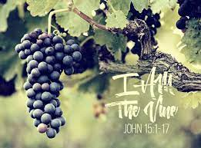
HEBREWS 2:11
For both he that sanctifieth and they who are sanctified are all of one: for which cause he is not ashamed to call them brethren,
Oh, don't you see the Vine and the Branch there? All One.
JOHN 15:1-5
» 1 † I am the true vine, and my Father is the husbandman.
» 2 † Every branch in me that beareth not fruit he taketh away: and every branch that beareth fruit, he purgeth it, that it may bring forth more fruit.
» 3 † Now ye are clean through the word which I have spoken unto you.
» 4 † Abide in me, and I in you. As the branch cannot bear fruit of itself, except it abide in the vine; no more can ye, except ye abide in me.
» 5 † I am the vine, ye are the branches: He that abideth in me, and I in him, the same bringeth forth much fruit: for without me ye can do nothing.

Slide 20
HEBREWS 2:11-12
For both he that sanctifieth and they who are sanctified are all of one: for which cause he is not ashamed to call them brethren,
Saying, I will declare thy name unto my brethren, in the midst of the church will I sing praise unto thee.
And He's not ashamed to be called our "Brother," for He was tempted just like we are tempted. And He can be the right kind of an intercessor, 'cause He stood the same kind of a temptation that you stand. And He took your place, knowing that you couldn't take it yourself.
So, don't you see, brother, sister? The whole thing is grace. All of it is grace. It's not what you do, anyhow. It's what He's already done for you. Now, you can't do one thing to merit your salvation. Your salvation is a gift. Christ became sin, that you might become righteous. And He's the right kind of a Chief Captain for our salvation, because He suffered just like we suffered. He's been tempted just like we're tempted. And He's not ashamed to be called "our Brother," because He knows what we go through with. Oh, blessed be His Name!

Slide 21
HEBREWS 2:13-14
» 13 † And again, I will put my trust in him. And again, Behold I and the children which God hath given me.
» 14 † Forasmuch then as the children are partakers of flesh and blood, he also himself likewise took part of the same; that through death he might destroy him that had the power of death, that is, the devil;
» 15 † And deliver them who through fear of death were all their lifetime subject to bondage.
60-0925 THAT.DAY.ON.CALVARY_ JEFFERSONVILLE.IN V-2 N-5 SUNDAY_
« 65 † That's what Calvary meant. Men that were in bondage were set free. Men that were once under fear of death can no longer fear death. A man who longs for a city whose Builder and Maker is God, he can step on the highway and set his face towards heaven, because he's free. Hallelujah. He's redeemed. He don't need to wander no more, for there's a way of knowing whether you are right or not. God gives us Life. Our sins are gone. That day at Calvary paid the price.

Slide 22
HEBREWS 2:13-14
» 13 † And again, I will put my trust in him. And again, Behold I and the children which God hath given me.
» 14 † Forasmuch then as the children are partakers of flesh and blood, he also himself likewise took part of the same; that through death he might destroy him that had the power of death, that is, the devil;
» 15 † And deliver them who through fear of death were all their lifetime subject to bondage.
60-0515M THE.REJECTED.KING_ JEFFERSONVILLE.IN V-2 N-23 SUNDAY_
« 164 † All fear of death... I say this with my Bible before me this morning. I've got a little boy there four years old, to be raised. I've got a nine year old girl and a teen-ager that I'm thankful for, that's turned the way of the Lord. God, let me live to bring them up in the admonition of God. Above that, the whole world seems to scream to me. Ninety year old women and men and all kinds, "If you hadn't have went, we wouldn't been here." And, God, let me press the battle. But if it comes to dying, I am no more... It would be a joy; it would be a pleasure to enter from this corruption and disgrace.

Slide 23
HEBREWS 2:13-15
» 15 † And deliver them who through fear of death were all their lifetime subject to bondage.
60-0515E ADOPTION.1_ JEFFERSONVILLE.IN AD.1 SUNDAY_
« 11 † And if there's anything that burns within my heart, and I hope it never leaves in my years to come, that I'll never forget what happened last Sunday morning, as a week. It has done something to me that's revolutionized my life. I--I do not fear. I--I have not one fear of death. Death has no fear at all. And it--it doesn't for you if you just understood. Now, maybe if... You'd have to have the experience to know it, because there's no way to explain it. You cannot find words, because it doesn't lay in the English dictionary, or no other dictionary; because it's in an eternity: no yesterday, no tomorrow, it's all present tense. And it's no, "I feel pretty good," and a hour from now, "I don't feel so well," and another hour, "feel good again." It's present tense all the time (See?), never a cease, just that glorious peace and something.

Slide 24
HEBREWS 2:16
» 16 † For verily he took not on him the nature of angels; but he took on him the seed of Abraham.
« 174 † Oh, my! He didn't become an Angel. He become the Seed of Abraham. "And we, being dead in Christ, take on Abraham's Seed, and are heirs according to the promise." See? He never took on the form of an Angel. He never become an Angel. He become a Man. He become the Seed of Abraham, and took the sting of death in His own flesh, to reconcile us back to God, and now sets there for an Intercessor. My, how could we reject It, friend?

Slide 25
HEBREWS 2:16
» 16 † For verily he took not on him the nature of angels; but he took on him the seed of Abraham.
Genesis 26:3-5
» 3 † Sojourn in this land, and I will be with thee, and will bless thee; for unto thee, and unto thy seed, I will give all these countries, and I will perform the oath which I sware unto Abraham thy father;
» 4 † And I will make thy seed to multiply as the stars of heaven, and will give unto thy seed all these countries; and in thy seed shall all the nations of the earth be blessed;
» 5 † Because that Abraham obeyed my voice, and kept my charge, my commandments, my statutes, and my laws.

Slide 26
HEBREWS 2:16
» 16 † For verily he took not on him the nature of angels; but he took on him the seed of Abraham.
Galatians 3:16
Now to Abraham and his seed were the promises made. He saith not, And to seeds, as of many; but as of one, And to thy seed, which is Christ.

Slide 27
HEBREWS 2:16
» 16 † For verily he took not on him the nature of angels; but he took on him the seed of Abraham.
65-0218 THE.SEED.IS.NOT.HEIR.WITH.THE.SHUCK_ JEFFERSONVILLE.IN V-6 N-4 THURSDAY_
« 53 † Here, the "Seed," one, one Seed; not seeds, but one Seed. These others were not seed of Abraham, because Abraham "Seed" was his faith Seed that God was speaking of, not his natural seed. Because, after Sarah died, Abraham married another woman and had seven sons, besides daughters. So it wouldn't be Abraham's seeds, it was Abraham "Seed," one. And that was Abraham's faith Seed, pointing to the Royal Seed that was to come through Abraham's faith; not Abraham's natural life, but Abraham's spiritual life; who took everything contrary to God's Word and called it as though it was not, and believed God; against hope, believed in hope. That's the real Seed that we're speaking of.

Slide 28
HEBREWS 2:16
» 16 † For verily he took not on him the nature of angels; but he took on him the seed of Abraham.
GALATIANS 3:28
» 28 † There is neither Jew nor Greek, there is neither bond nor free, there is neither male nor female: for ye are all one in Christ Jesus.
» 29 † And if ye be Christ's, then are ye Abraham's seed, and heirs according to the promise.

Slide 29
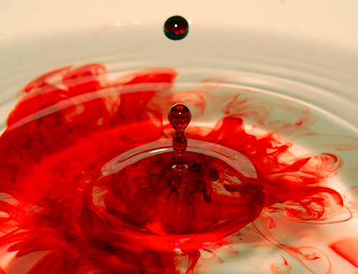
HEBREWS 2:16
» 16 † For verily he took not on him the nature of angels; but he took on him the seed of Abraham.
54-1212 HE.SWORE.BY.HIMSELF_ JEFFERSONVILLE.IN V-26 N-11 SUNDAY_
« 205 † What is the Seed of Abraham? "Abraham believed God." This little blood cell, a portion of it was in a shadow, atoning on Abraham. "He believed God; it was imputed to Him for righteousness." God called Abraham by sovereign grace, not because he was Abraham. He was just a man.
Now, look. And every one of God's children is called the same way. You can't save yourself. There's nothing you can do. If you're a sinner, you can't come to God 'less God called you. Jesus said, "No man can come to Me, except My Father calls him. And when the Father calls him, all that comes, I'll give Him Everlasting Life and I'll raise him up at the last day."

Slide 30
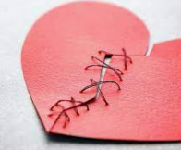
HEBREWS 2:17
Wherefore in all things it behoved him to be made like unto his brethren, that he might be a merciful and faithful high priest in things pertaining to God, to make reconciliation for the sins of the people.
Reconcile: restore friendly relations between. Cause to coexist in harmony; make or show to be compatible.
That He might be the Reconciler! See, there was enmity between God and man.
…
To reconcile, now, God, knowing justice, had to become unjustice, to feel what it was to be a sinner, to go back to reconcile, through "reconciliation," and have mercy on the people.

Slide 31
HEBREWS 2:17
Wherefore in all things it behoved him to be made like unto his brethren, that he might be a merciful and faithful high priest in things pertaining to God, to make reconciliation for the sins of the people.
DANIEL 9:24
Seventy weeks are determined upon thy people and upon thy holy city, to finish the transgression, and to make an end of sins, and to make reconciliation for iniquity, and to bring in everlasting righteousness, and to seal up the vision and prophecy, and to anoint the most Holy.
61-0730E THE.SIXFOLD.PURPOSE.OF.GABRIEL'S.VISIT.TO.DANIEL_ JEFFERSONVILLE.IN DA 45-88 SUNDAY_
« 86 † To make reconciliations for iniquity. "Iniquity" is "doing wrong," as they did at the cross. He made reconciliations, but it will not be applied to them. It was not applied to them, why? Because they were blinded and could not see it. And why did they blind? You say, "Well, maybe today because I'm blind..." You're willfully blind. They were blind because God blinded them, but you're blind because you're willfully blind. There's no reconciliation for you. "If you believe not I am He," said Jesus, "you'll die in your sins." That's right.

Slide 32
HEBREWS 2:18
For in that he himself hath suffered being tempted, he is able to succour them that are tempted.
God could not suffer in Spirit.
He had to become flesh, to feel the pain of sickness, to feel the temptation of lust, to feel the temptation of want, to feel the temptation of hunger, to feel the power of death.
That He might take it upon Hisself to stand in the Presence of the great Spirit Jehovah, the Spirit, not the Man; the Spirit, to make intercession to this life.
And Jesus took that, in order to make intercession for us, for He knows how it feels. When you get sick, He knows how you feel. When you're tempted, He knows how you feel.

Slide 33
HEBREWS 2:18
For in that he himself hath suffered being tempted, he is able to succour them that are tempted.
Now, did you ever notice when we vote for a president, every farmer will vote for a president that's been a farmer, for he knows the hard part of the farmer's life. See? He wants some man who understand.
And before God could ever understand; Him being that great Holiness.
How He could ever understand, after He condemned man?
By His holiness, He condemned man.
And the only way He will ever know how to justify man is to become man.

Slide 34
Summary of Hebrews
The Book of Hebrews was written to the Hebrew Church (in Hebrews 10 we learn had suffered many afflictions)
To Separate Law from Grace
Goals
  To Elevate Jesus as Superior
  To Challenge the Reader to Remain Faithful (Despite Persecution, etc.)
Four Major Sections (Comparing Jesus)
  Chapters 1&2 – Compare Jesus with Angels and the Torah
  Chapters 3&4 – Compare Jesus with Moses and the Promised Land
  Chapters 5-7 – Compare Jesus with Priests and Melchisedec
  Chapters 8-10 – Compare Jesus with Sacrifices and the Covenant
Chapters 11-13
  Follow the Great Models of Faith (Abraham, Sarah, etc.)
  Knowing that despite hardship and persecution, God will not abandon His people

Slide 35
Hebrews 3
HEBREWS 3:1-19
» 1 † Wherefore, holy brethren, partakers of the heavenly calling, consider the Apostle and High Priest of our profession, Christ Jesus;
» 2 † Who was faithful to him that appointed him, as also Moses was faithful in all his house.
» 3 † For this man was counted worthy of more glory than Moses, inasmuch as he who hath builded the house hath more honour than the house.
» 4 † For every house is builded by some man; but he that built all things is God.
» 5 † And Moses verily was faithful in all his house, as a servant, for a testimony of those things which were to be spoken after;
» 6 † But Christ as a son over his own house; whose house are we, if we hold fast the confidence and the rejoicing of the hope firm unto the end.

Slide 36
Hebrews 3
» 7 † Wherefore (as the Holy Ghost saith, To day if ye will hear his voice,
» 8 † Harden not your hearts, as in the provocation, in the day of temptation in the wilderness:
» 9 † When your fathers tempted me, proved me, and saw my works forty years.
» 10 † Wherefore I was grieved with that generation, and said, They do alway err in their heart; and they have not known my ways.
» 11 † So I sware in my wrath, They shall not enter into my rest.)
» 12 † Take heed, brethren, lest there be in any of you an evil heart of unbelief, in departing from the living God.
» 13 † But exhort one another daily, while it is called To day; lest any of you be hardened through the deceitfulness of sin.

Slide 37
Hebrews 3
» 14 † For we are made partakers of Christ, if we hold the beginning of our confidence stedfast unto the end;
» 15 † While it is said, To day if ye will hear his voice, harden not your hearts, as in the provocation.
» 16 † For some, when they had heard, did provoke: howbeit not all that came out of Egypt by Moses.
» 17 † But with whom was he grieved forty years? was it not with them that had sinned, whose carcases fell in the wilderness?
» 18 † And to whom sware he that they should not enter into his rest, but to them that believed not?
» 19 † So we see that they could not enter in because of unbelief.

