Slide 1
Hebrews 2:1-8
» 1 † Therefore we ought to give the more earnest heed to the things which we have heard, lest at any time we should let them slip.
» 2 † For if the word spoken by angels was stedfast, and every transgression and disobedience received a just recompence of reward;
» 3 † How shall we escape, if we neglect so great salvation; which at the first began to be spoken by the Lord, and was confirmed unto us by them that heard him;
» 4 † God also bearing them witness, both with signs and wonders, and with divers miracles, and gifts of the Holy Ghost, according to his own will?
» 5 † For unto the angels hath he not put in subjection the world to come, whereof we speak.
» 6 † But one in a certain place testified, saying, What is man, that thou art mindful of him? or the son of man, that thou visitest him?
» 7 † Thou madest him a little lower than the angels; thou crownedst him with glory and honour, and didst set him over the works of thy hands:
» 8 † Thou hast put all things in subjection under his feet. For in that he put all in subjection under him, he left nothing that is not put under him. But now we see not yet all things put under him.

Slide 2
Hebrews 2:9-14
» 9 † But we see Jesus, who was made a little lower than the angels for the suffering of death, crowned with glory and honour; that he by the grace of God should taste death for every man.
» 10 † For it became him, for whom are all things, and by whom are all things, in bringing many sons unto glory, to make the captain of their salvation perfect through sufferings.
» 11 † For both he that sanctifieth and they who are sanctified are all of one: for which cause he is not ashamed to call them brethren,
» 12 † Saying, I will declare thy name unto my brethren, in the midst of the church will I sing praise unto thee.
» 13 † And again, I will put my trust in him. And again, Behold I and the children which God hath given me.
» 14 † Forasmuch then as the children are partakers of flesh and blood, he also himself likewise took part of the same; that through death he might destroy him that had the power of death, that is, the devil;

Slide 3
Hebrews 2:15-18
» 15 † And deliver them who through fear of death were all their lifetime subject to bondage.
» 16 † For verily he took not on him the nature of angels; but he took on him the seed of Abraham.
» 17 † Wherefore in all things it behoved him to be made like unto his brethren, that he might be a merciful and faithful high priest in things pertaining to God, to make reconciliation for the sins of the people.
» 18 † For in that he himself hath suffered being tempted, he is able to succour them that are tempted.

Slide 4
Hebrews 2:3 » 3 † How shall we escape, if we neglect so great salvation; which at the first began to be spoken by the Lord, and was confirmed unto us by them that heard him;
54-0404E GOD.HAS.A.PROVIDED.WAY_ LOUISVILLE.KY V-25 N-9 SUNDAY_
And there's where all the types and the shadows of the Old Testament, all come and met in Jesus Christ. He paid the supreme price, ascended on high,
and sent back the Holy Ghost tonight,
which is God's provided Way of your escape.

Slide 5
** Hebrews 2:4 » 4 † God also bearing them witness, both with signs and wonders, and with divers miracles, and gifts of the Holy Ghost, according to his own will?
God always bears witness.
Your life will bear witness.
I don't know what your testimony is, but your life speaks so loud, your voice can't be heard.
But, your living, your every-day life will testify what you are. God bears witness. Yes.
The Holy Spirit is a seal, and a seal takes both sides of the paper.
They see you standing here and see you when you go away. Not only in church but at every-day work. You're sealed on both sides, inside and outside. By the joy that you have, and by the life that you live, you're sealed, in and outside, that you know you're saved and the world knows you're saved, by the life that you live, for God bears witness.

Slide 6
** Hebrews 2:4 » 4 † God also bearing them witness, both with signs and wonders, and with divers miracles, and gifts of the Holy Ghost, according to his own will?
both with signs and wonders, and with divers miracles, and gifts of the Holy Ghost, according to his own will?
Acts 3:4
And Peter, fastening his eyes upon him with John, said, Look on us. Brother, when the world knows that you've been with Jesus, when you can live such an unadulterated life in this present world and in this darkness, that the world knows and can see that you've been with Jesus; when a rugged, old vulgar prostitute of the street can become a lady, washed in the Blood of the Lamb; God is bearing witness that He lives.
81 Take a drunkard, who is so low-down that he would run around on his wife, that he would mistreat his children, and take the food from the table, to spend on a prostitute. Let him get with Jesus once. You'll see him returning, like Legion, who was in his right mind and clothed, to his babies and to his wife and to his loved ones.

Slide 7
** Hebrews 2:4 » 4 † God also bearing them witness, both with signs and wonders, and with divers miracles, and gifts of the Holy Ghost, according to his own will?
57-0325 THE.LAMB.AND.THE.DOVE_ OAKLAND.CA MONDAY_
…
It is a new birth and a change of heart that changes a man from a dying being to a resurrected, immortal Son of God taking His place on the seat of the believer's heart. It's a nature change.
« E-27 † Is not it true that the Bible said, "The rain falls on the just and unjust. The sun shines on the just and unjust"? You take a wheat field and the little heads are turning over; it's a drought. The old stinkweeds, and the brier vine, and the sticktights, and all of them in the field, they're just as thirsty as the wheat. It's a vision I saw once. And they were all needing rain. And when the showers came, the little wheat raised up its head and rejoiced; and the stink weed raised up its head and rejoiced; the creeper raised up its head and rejoiced. They were just as proud to get the rain as the rest of them, but, brother, one of them was bearing the fruit of wheat, and the other was bearing the fruit of something else.
« E-28 † And the Holy Spirit falls into a meeting, and sometimes the believer and unbeliever worship by the same Spirit; but the fruit of the Spirit proves what you are (Uh-huh.), not the reaction of the Spirit, not to speak with tongues, not to shout; that goes with it too; that all goes with it. But unless the fruit of the Spirit bears record with God's Word, you're just got a outward demonstration.

Slide 8
** Hebrews 2:5 For unto the angels hath he not put in subjection the world to come, whereof we speak.
…the great Angels that ministers in the Heavens, Gabriel, Michael, Woodworm, and the tens of thousands times tens of thousands of Angels of Heaven; or the tens of hundreds of prophets that's been on the earth, every one of them;
He's never put any of them to have control over the world to come, that we speak of. Not a one!
He never said, "Isaiah, you'll control the world."
He never put the world in subjection to Elijah. Neither did He put it to Gabriel, or any angel, any ministering spirit.

Slide 9
Hebrews 2:6 But one in a certain place [David] testified, saying, What is man, that thou art mindful of him? or the son of man, that thou visitest him?
Who are you, anyhow? What does that job you got mean? Or what does that little house we own mean? What does the car we own mean?
But, blessed be the Lord! You've got a soul that's born again. You'll live forever and ever, because He become you, that you through His grace might become Him, and make a place for you.
Oh, we who think that we got a change of clothes, and a few groceries in the house, what are we? God could take it in a second. Your very breath holds in His hand.
And here in our midst to heal the sick, to proclaim and profess, and to foretell, and every time perfect. And even concerned enough to bring a little, dead fish back to its life again, in the midst of us. Jehovah around us, Jehovah in us, the great and mighty I AM.

Slide 10
Hebrews 2:7 Thou madest him a little lower than the angels; thou crownedst him with glory and honour, and didst set him over the works of thy hands:
“An angel said that God made Him lower than an Angel, that He might crown Him; and He might suffer and taste death, to be exalted up again.”
Matthew 23:10-12
» 10 † Neither be ye called masters: for one is your Master, even Christ.
» 11 † But he that is greatest among you shall be your servant.
» 12 † And whosoever shall exalt himself shall be abased; and he that shall humble himself shall be exalted.

Slide 11
Hebrews 2:7 Thou madest him a little lower than the angels; thou crownedst him with glory and honour, and didst set him over the works of thy hands:
…"A body has thou made Me,"
the body of the Lord Jesus Christ,
made lower than the Angels to taste death;
and none but the very highest of High, Christ; the Prince of Peace, the King of kings, the Lord of lord, the Creator, every star in the universe.
O God! He became lower than His creation, that He might redeem man (homeless, helpless man), and give them a home in Heaven.
He left the glories of Heaven.
He left the highest Name that could be called.
And when He was on earth, man give Him the lowest name that they could give Him, said, "He was an illegitimate baby, to start with."
Born in a manger, wrapped in rags off the back of a yoke of an ox.
No place to go, had no home to go to. And was called, "Beelzebub," the chief of the devils. He was mistreated. He was spit on. He was made fun of.
He was rejected, and went to the lowest pits, and stooped to "The vilest of prostitutes." That's what man done to Him.

Slide 12
Hebrews 2:7 Thou madest him a little lower than the angels; thou crownedst him with glory and honour, and didst set him over the works of thy hands:
But God raised Him up so high that He'd have to look down to see Heaven. Man give Him the lowest seat, give Him the worst place, the lowest name. God raised Him up and give Him the highest Seat, and the highest Name. That's the difference what man done with the Son of God, and what God done with the Son of God.
He stooped, that we might be lifted. He become us, that we through His grace might become Him. He come to the homeless, and became homeless Hisself, that we might have a home. He came to the sick and was made sick Hisself, that we might be healed. He came to the sinner, "and made sin, Himself," that we might be saved.
No wonder He was exalted. No wonder He is who He is tonight. God has exalted Him, and all the powers in Heavens and earth is give to Him.

Slide 13
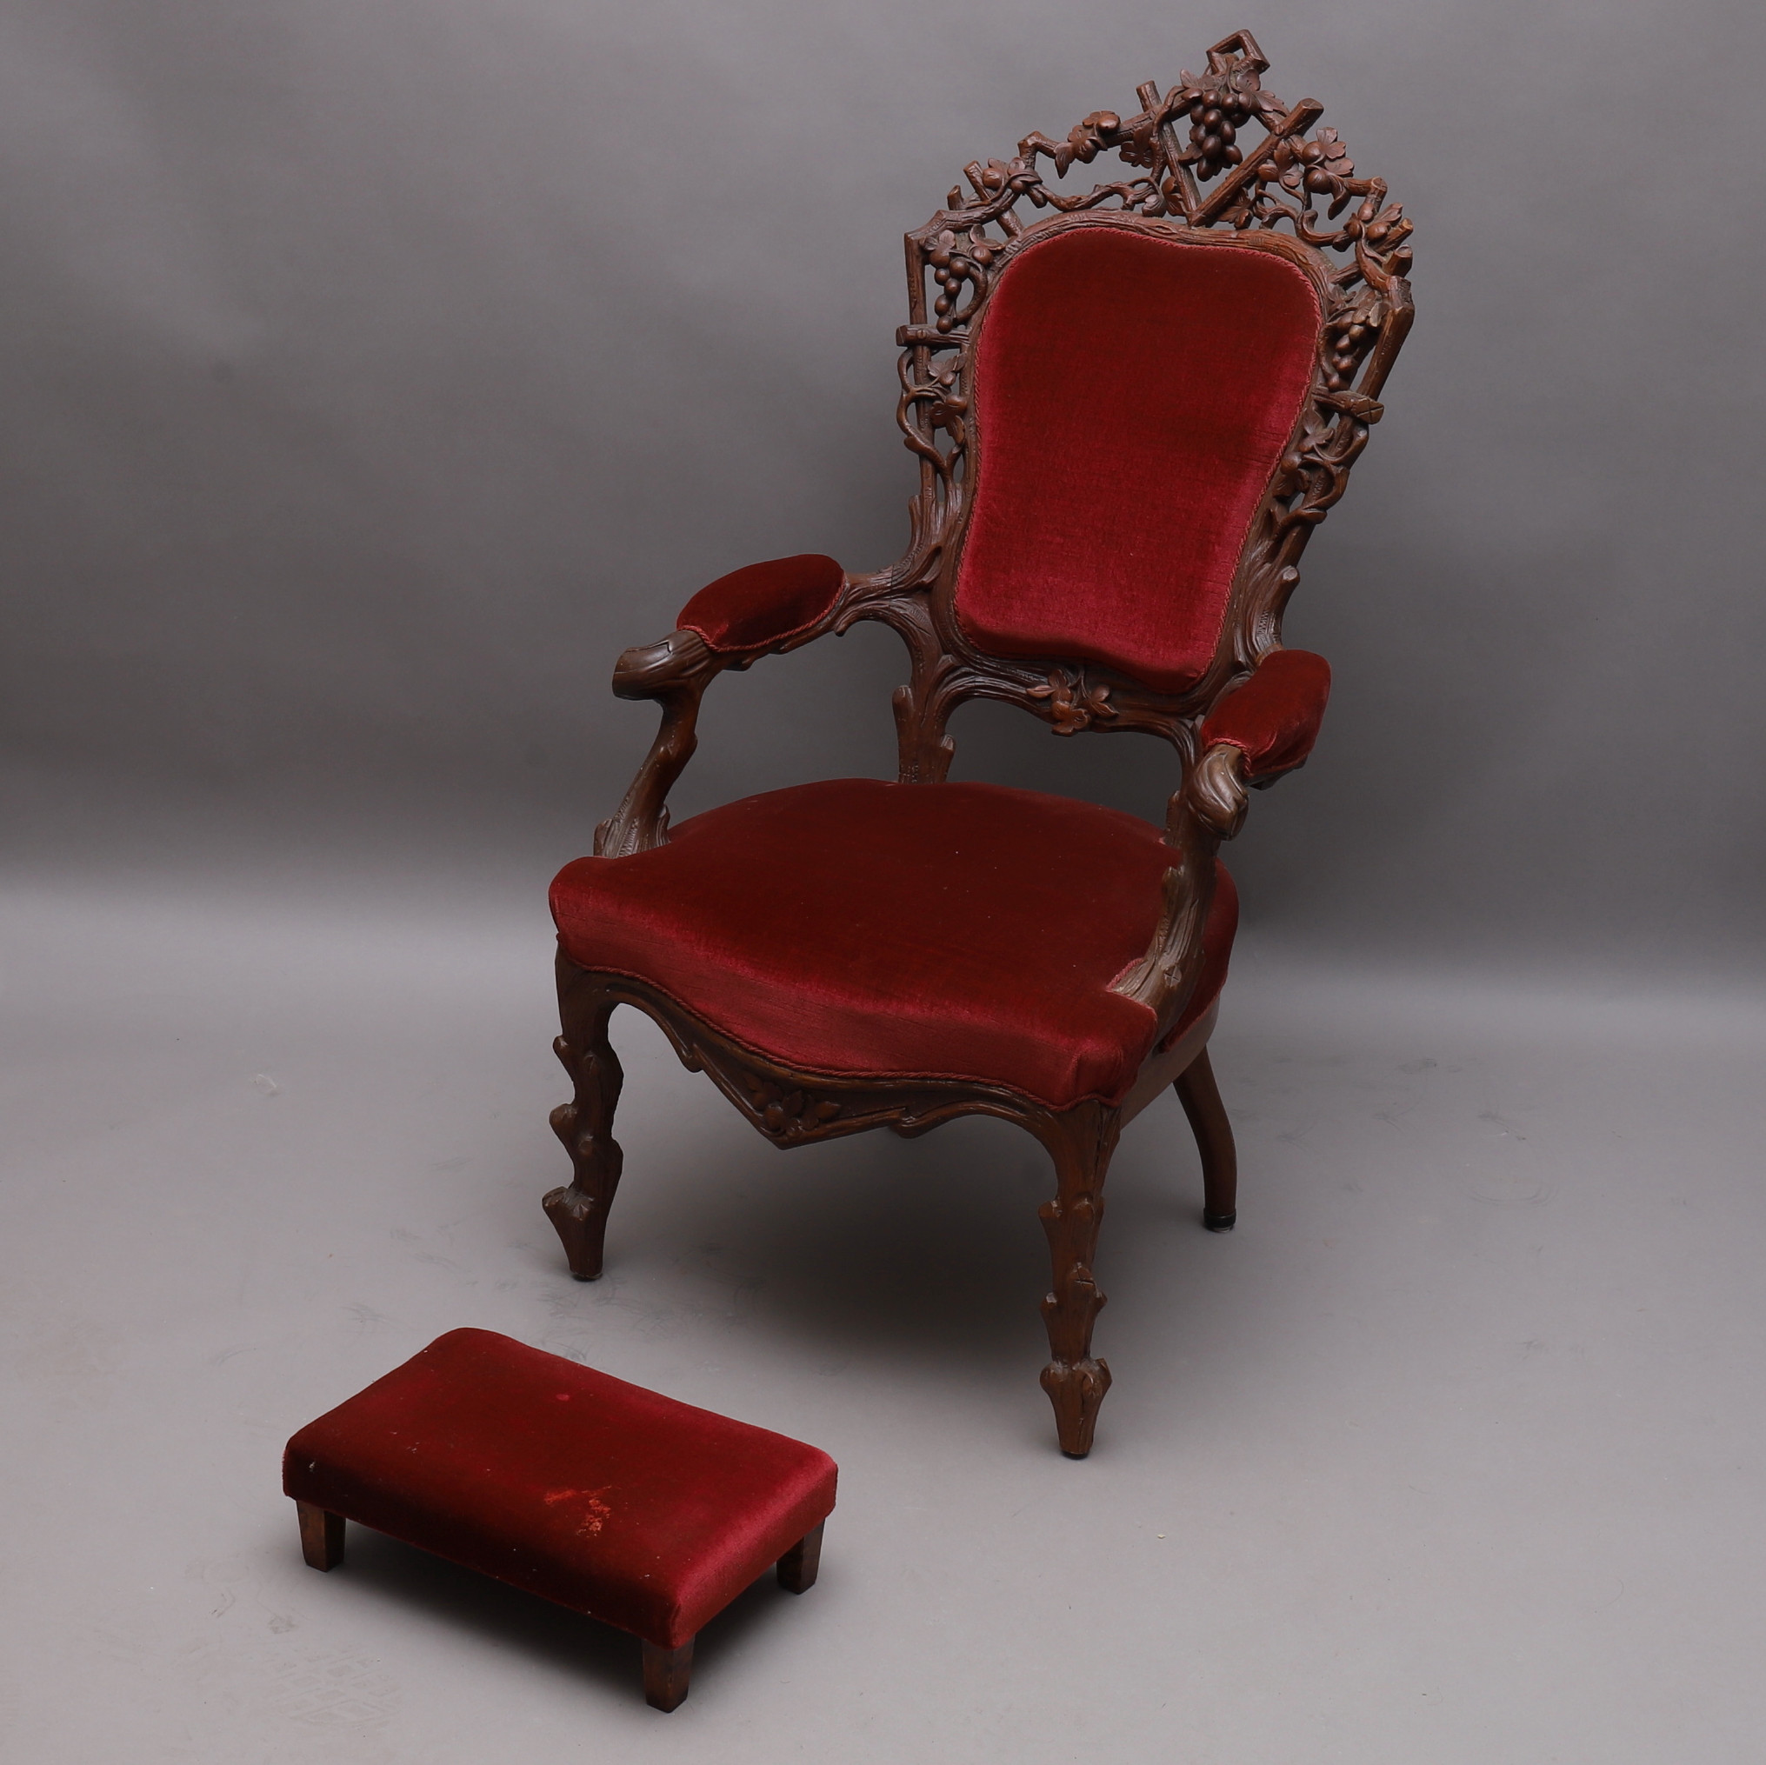
HEBREWS 2:8 Thou hast put all things in subjection under his feet. For in that he put all in subjection under him, he left nothing that is not put under him. But now we see not yet all things put under him.
Hebrews 1:13
But to which of the angels said he at any time, Sit on my right hand, until I make thine enemies thy footstool?
“But now we see not yet all things put under him.
That's, death. We don't see death, yet, because we're still dying. We see death.

Slide 14
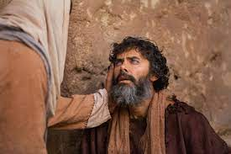
HEBREWS 2:9 » 9 † But we see Jesus, who was made a little lower than the angels for the suffering of death, crowned with glory and honour; that he by the grace of God should taste death for every man.
57-0825E HEBREWS.CHAPTER.TWO.2_ JEFFERSONVILLE.IN HEB SUNDAY_
« 155 † Look here, friend. Don't, never forget this. When Jesus was going, walking up the hill, death was buzzing around His head.
156 Let's take our picture to Jerusalem, two thousand years ago. And how could you reject It? I hear a sound coming through the street. What is it? It's a bumping of something. It's an old rugged cross coming down, going out the gates of Damascus, bumping over the cobblestones. Them big cobblestones are still there. Bumping over these big cobblestone, bumpity-bump. I see the spatting of the Blood on the street. What is it? It's a Man that's done no harm; nothing but good.
The people were blind. They didn't know Him. They didn't recognize Him.
You say, "Blind? Could they have their sight?“
You can still have your sight and be blind.

Slide 15
HEBREWS 2:9 » 9 † But we see Jesus, who was made a little lower than the angels for the suffering of death, crowned with glory and honour; that he by the grace of God should taste death for every man.
…people are blind tonight. A certain church that don't believe in Divine healing, walked up to me one time, and said, "Smite me blind. Smite me blind." It was at Brother Wright's house. Said, "Smite me blind." Said, "Paul smote a man blind, one time." Said, "Smite me blind."
159 I said, "Friend, the Devil has already done it. You're already blind. Sure, you are."
160 He said, "Heal this little girl and I'll believe you."
161 I said, "Save that sinner and I'll believe you." Certainly.
162 "Oh," he said, "he has to believe."
163 I said, "Same thing here, it has to come through the sovereign grace of God."
164 The Devil, the--the god of this world, has blinded the eyes of the people. "They've got eyes but they can't see," the Bible said.

Slide 16
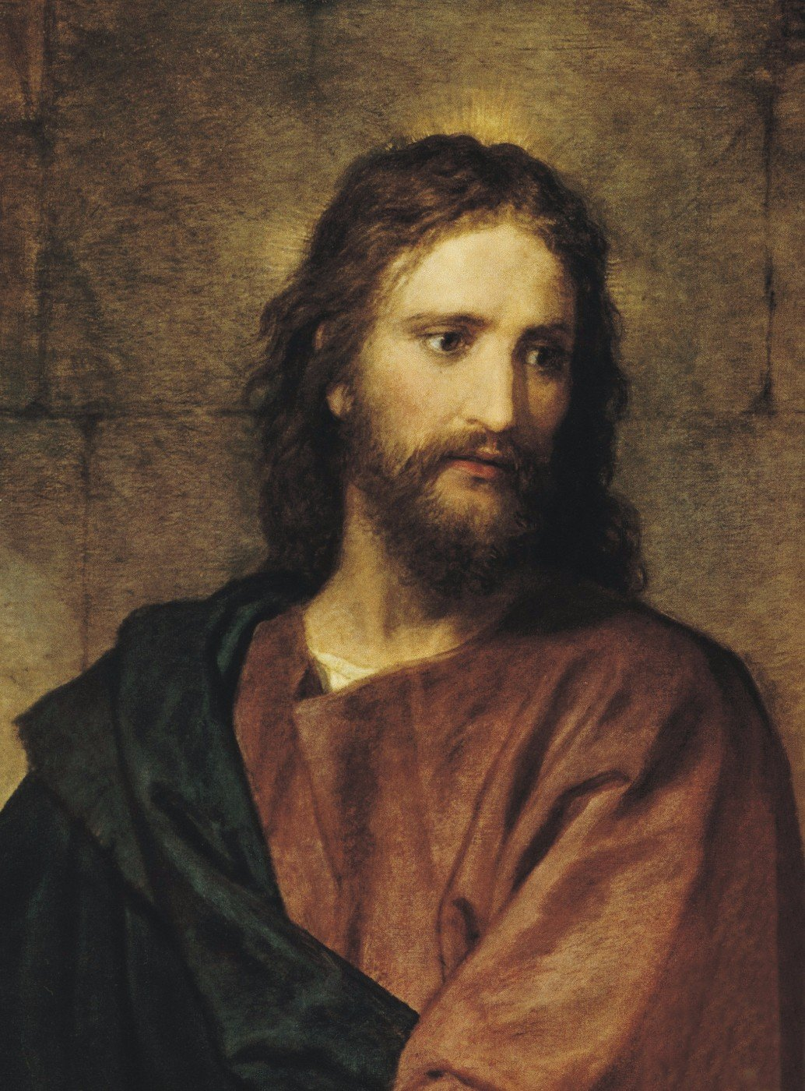
HEBREWS 2:9 » 9 † But we see Jesus, who was made a little lower than the angels for the suffering of death, crowned with glory and honour; that he by the grace of God should taste death for every man.
We don't see all things.
But we do see Jesus, who was made a little lower than the angels for the suffering of death

Slide 17
HEBREWS 2:9 » 9 † But we see Jesus, who was made a little lower than the angels for the suffering of death, crowned with glory and honour; that he by the grace of God should taste death for every man.
64-0213 THEN.JESUS.CAME.AND.CALLED_ TULARE.CA V-22 N-11 THURSDAY_
71 He was that, truly. He was that, plus God. See, He was the manifestation. Jesus is the body, the Boy, the Man; God was what dwelt in Him. God was in Him. He was a God-man. He was a Man, yet He was God manifested in flesh. When we see Jesus, we see God. That's what He said, "When you see the Father, see Me, you see the Father." Because, He was the reflection, because He was the Word, amen, that was in the beginning. Amen.

Slide 18
HEBREWS 2:9 » 9 † But we see Jesus, who was made a little lower than the angels for the suffering of death, crowned with glory and honour; that he by the grace of God should taste death for every man.
63-0428 LOOK_ PHOENIX.AZ SUNDAY_
133 What are you looking at? What are you seeing? We must see Jesus. And the only way we see Jesus, see the Word.
This is the natural Symbol of the Spirit. You know what I mean? It is the Letter that the Spirit quickens. See? That is the Letter, that, and the Spirit quickens this Letter and makes It a reality. Yeah.

Slide 19
HEBREWS 2:9 » 9 † But we see Jesus, who was made a little lower than the angels for the suffering of death, crowned with glory and honour; that he by the grace of God should taste death for every man.
65-0425 GOD'S.PROVIDED.PLACE.OF.WORSHIP_ LOS.ANGELES.CA V-18 N-2 SUNDAY_
215 But, Lord, it does delight our hearts when we see Jesus glorified among us; when we see Him glorified, when we see His Word, which He is the Word; when we see we can read it here in the Bible, where He promised He would do it, then see Him work it right in us, O God, how it makes us feel humble, that we know that His living Presence...

Slide 20
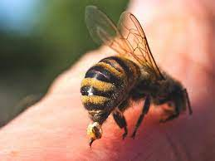
HEBREWS 2:9 » 9 † But we see Jesus, who was made a little lower than the angels for the suffering of death, crowned with glory and honour; that he by the grace of God should taste death for every man.
…this bee stinging around Him. What did it do? It finally stung Him.
But, brother, anyone knows, that an insect or a bee, if it ever stings you once, that finishes the stinging business. It can't sting no more. Because, when it leaves, it pulls its stinger out.
That's the reason God had to be made flesh. He took the stinger of death into His flesh, and He pulled the stinger out of death. Blessed be the Name of the Lord! Death can hum and sting, but it can't hurt you.
169 Paul, when he felt that bee humming around him, death was coming right on. He said, "O death, where is your sting?" He could point to Calvary where it was left in the flesh of Emmanuel. "Where is thy victory? But thanks be to God who gives us the victory through our Lord Jesus Christ." Yes.

Slide 21
HEBREWS 2:9 » 9 † But we see Jesus, who was made a little lower than the angels for the suffering of death, crowned with glory and honour; that he by the grace of God should taste death for every man.
I CORINTHIANS 15:55-57
» 55 † O death, where is thy sting? O grave, where is thy victory?
» 56 † The sting of death is sin; and the strength of sin is the law.
» 57 † But thanks be to God, which giveth us the victory through our Lord Jesus Christ.

Slide 22
HEBREWS 2:10 For it became him, for whom are all things, and by whom are all things, in bringing many sons unto glory, to make the captain of their salvation perfect through sufferings.
“The only way He could become the Captain of our salvation, He had to suffer.”
The brains of the army lays in its captains, the intelligence.
You follow your captain, if he's a right kind of a general.
If he's a right kind, if he's a four-star general, if he's proved, if he's been proven to be right, follow him. Though it may seem wrong, to you, go on to the front.
Do as he told you.
62-0311 THE.GREATEST.BATTLE.EVER.FOUGHT_ JEFFERSONVILLE.IN V-3 N-11 SUNDAY_
148 When I think of it! When I stood and watch Him do things, see Him reveal things, open up things, say, "It'll be this way and that way," there it is! Oh, look back here, and say, "Who is this great Captain?" Oh, I don't look back and see if it's Doctor So-and-so. I see what the Captain said. "He's the Captain of our salvation." Hallelujah! What is salvation? Deliverance! Glory! "He's the Captain of our deliverance."

Slide 23
HEBREWS 2:10 For it became him, for whom are all things, and by whom are all things, in bringing many sons unto glory, to make the captain of their salvation perfect through sufferings.
HEBREWS 5:8-9
Though he were a Son, yet learned he obedience by the things which he suffered;
And being made perfect, he became the author of eternal salvation unto all them that obey him;
SMYRNAEAN.CHURCH.AGE - CHURCH.AGE.BOOK CPT.4
In plain language, the very character of Jesus was perfected by suffering. And according to Paul He has left His church a measure of suffering that they, too, by their faith in God while suffering for Him, would come to a place of perfection. Why did He want this?
James 1:2-4,
"My brethren, count it all joy when ye fall into divers temptations;
Knowing this, that the trying of your faith worketh patience.
But let patience have her perfect work, that ye may be perfect and entire, wanting nothing."

Slide 24
HEBREWS 2:10 For it became him, for whom are all things, and by whom are all things, in bringing many sons unto glory, to make the captain of their salvation perfect through sufferings.
Luke 22:41-42
» 41 † And he was withdrawn from them about a stone's cast, and kneeled down, and prayed,
» 42 † Saying, Father, if thou be willing, remove this cup from me: nevertheless not my will, but thine, be done.
…
» 44 † And being in an agony he prayed more earnestly: and his sweat was as it were great drops of blood falling down to the ground.
SMYRNAEAN.CHURCH.AGE - CHURCH.AGE.BOOK CPT.4
Unless we suffer with Him we cannot reign with Him. You have to suffer to reign. The reason for this is that character simply is never made without suffering. Character is a VICTORY, not a gift. A man without character can't reign because power apart from character is Satanic. But power with character is fit to rule. And since He wants us to share even His throne on the same basis that He overcame and is set down in His Father's throne, then we have to overcome to sit with Him. And the little temporary suffering we go through now is not worthy to be compared to the tremendous glory that will be revealed in us when He comes. Oh, what treasures are laid up for those who are willing to enter into His kingdom through much tribulation.

Slide 25
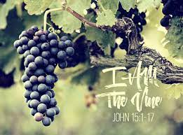
HEBREWS 2:11 For both he that sanctifieth and they who are sanctified are all of one: for which cause he is not ashamed to call them brethren,
Oh, don't you see the Vine and the Branch there? All One. JOHN 15:1-5
» 1 † I am the true vine, and my Father is the husbandman.
» 2 † Every branch in me that beareth not fruit he taketh away: and every branch that beareth fruit, he purgeth it, that it may bring forth more fruit.
» 3 † Now ye are clean through the word which I have spoken unto you.
» 4 † Abide in me, and I in you. As the branch cannot bear fruit of itself, except it abide in the vine; no more can ye, except ye abide in me.
» 5 † I am the vine, ye are the branches: He that abideth in me, and I in him, the same bringeth forth much fruit: for without me ye can do nothing.

Slide 26
HEBREWS 2:11-12 For both he that sanctifieth and they who are sanctified are all of one: for which cause he is not ashamed to call them brethren, Saying, I will declare thy name unto my brethren, in the midst of the church will I sing praise unto thee.
And He's not ashamed to be called our "Brother," for He was tempted just like we are tempted. And He can be the right kind of an intercessor, 'cause He stood the same kind of a temptation that you stand. And He took your place, knowing that you couldn't take it yourself.
So, don't you see, brother, sister? The whole thing is grace. All of it is grace. It's not what you do, anyhow. It's what He's already done for you. Now, you can't do one thing to merit your salvation. Your salvation is a gift. Christ became sin, that you might become righteous. And He's the right kind of a Chief Captain for our salvation, because He suffered just like we suffered. He's been tempted just like we're tempted. And He's not ashamed to be called "our Brother," because He knows what we go through with. Oh, blessed be His Name!

Slide 27
HEBREWS 2:13-14 » 13 † And again, I will put my trust in him. And again, Behold I and the children which God hath given me. » 14 † Forasmuch then as the children are partakers of flesh and blood, he also himself likewise took part of the same; that through death he might destroy him that had the power of death, that is, the devil; » 15 † And deliver them who through fear of death were all their lifetime subject to bondage.
60-0925 THAT.DAY.ON.CALVARY_ JEFFERSONVILLE.IN V-2 N-5 SUNDAY_
« 65 † That's what Calvary meant. Men that were in bondage were set free. Men that were once under fear of death can no longer fear death. A man who longs for a city whose Builder and Maker is God, he can step on the highway and set his face towards heaven, because he's free. Hallelujah. He's redeemed. He don't need to wander no more, for there's a way of knowing whether you are right or not. God gives us Life. Our sins are gone. That day at Calvary paid the price.

Slide 28
HEBREWS 2:13-14 » 13 † And again, I will put my trust in him. And again, Behold I and the children which God hath given me. » 14 † Forasmuch then as the children are partakers of flesh and blood, he also himself likewise took part of the same; that through death he might destroy him that had the power of death, that is, the devil; » 15 † And deliver them who through fear of death were all their lifetime subject to bondage.
60-0515M THE.REJECTED.KING_ JEFFERSONVILLE.IN V-2 N-23 SUNDAY_
« 164 † All fear of death... I say this with my Bible before me this morning. I've got a little boy there four years old, to be raised. I've got a nine year old girl and a teen-ager that I'm thankful for, that's turned the way of the Lord. God, let me live to bring them up in the admonition of God. Above that, the whole world seems to scream to me. Ninety year old women and men and all kinds, "If you hadn't have went, we wouldn't been here." And, God, let me press the battle. But if it comes to dying, I am no more... It would be a joy; it would be a pleasure to enter from this corruption and disgrace.

Slide 29
HEBREWS 2:13-15 » 15 † And deliver them who through fear of death were all their lifetime subject to bondage.
60-0515E ADOPTION.1_ JEFFERSONVILLE.IN AD.1 SUNDAY_
« 11 † And if there's anything that burns within my heart, and I hope it never leaves in my years to come, that I'll never forget what happened last Sunday morning, as a week. It has done something to me that's revolutionized my life. I--I do not fear. I--I have not one fear of death. Death has no fear at all. And it--it doesn't for you if you just understood. Now, maybe if... You'd have to have the experience to know it, because there's no way to explain it. You cannot find words, because it doesn't lay in the English dictionary, or no other dictionary; because it's in an eternity: no yesterday, no tomorrow, it's all present tense. And it's no, "I feel pretty good," and a hour from now, "I don't feel so well," and another hour, "feel good again." It's present tense all the time (See?), never a cease, just that glorious peace and something.

Slide 30
HEBREWS 2:16 » 16 † For verily he took not on him the nature of angels; but he took on him the seed of Abraham.
« 174 † Oh, my! He didn't become an Angel. He become the Seed of Abraham. "And we, being dead in Christ, take on Abraham's Seed, and are heirs according to the promise." See? He never took on the form of an Angel. He never become an Angel. He become a Man. He become the Seed of Abraham, and took the sting of death in His own flesh, to reconcile us back to God, and now sets there for an Intercessor. My, how could we reject It, friend?

Slide 31
HEBREWS 2:16 » 16 † For verily he took not on him the nature of angels; but he took on him the seed of Abraham.
Genesis 26:3-5
» 3 † Sojourn in this land, and I will be with thee, and will bless thee; for unto thee, and unto thy seed, I will give all these countries, and I will perform the oath which I sware unto Abraham thy father;
» 4 † And I will make thy seed to multiply as the stars of heaven, and will give unto thy seed all these countries; and in thy seed shall all the nations of the earth be blessed;
» 5 † Because that Abraham obeyed my voice, and kept my charge, my commandments, my statutes, and my laws.

Slide 32
HEBREWS 2:16 » 16 † For verily he took not on him the nature of angels; but he took on him the seed of Abraham.
Galatians 3:16
Now to Abraham and his seed were the promises made. He saith not, And to seeds, as of many; but as of one, And to thy seed, which is Christ.

Slide 33
HEBREWS 2:16 » 16 † For verily he took not on him the nature of angels; but he took on him the seed of Abraham.
65-0218 THE.SEED.IS.NOT.HEIR.WITH.THE.SHUCK_ JEFFERSONVILLE.IN V-6 N-4 THURSDAY_
« 53 † Here, the "Seed," one, one Seed; not seeds, but one Seed. These others were not seed of Abraham, because Abraham "Seed" was his faith Seed that God was speaking of, not his natural seed. Because, after Sarah died, Abraham married another woman and had seven sons, besides daughters. So it wouldn't be Abraham's seeds, it was Abraham "Seed," one. And that was Abraham's faith Seed, pointing to the Royal Seed that was to come through Abraham's faith; not Abraham's natural life, but Abraham's spiritual life; who took everything contrary to God's Word and called it as though it was not, and believed God; against hope, believed in hope. That's the real Seed that we're speaking of.

Slide 34
HEBREWS 2:16 » 16 † For verily he took not on him the nature of angels; but he took on him the seed of Abraham.
GALATIANS 3:28
» 28 † There is neither Jew nor Greek, there is neither bond nor free, there is neither male nor female: for ye are all one in Christ Jesus.
» 29 † And if ye be Christ's, then are ye Abraham's seed, and heirs according to the promise.

Slide 35
HEBREWS 2:16 » 16 † For verily he took not on him the nature of angels; but he took on him the seed of Abraham.
54-1212 HE.SWORE.BY.HIMSELF_ JEFFERSONVILLE.IN V-26 N-11 SUNDAY_
« 205 † What is the Seed of Abraham? "Abraham believed God." This little blood cell, a portion of it was in a shadow, atoning on Abraham. "He believed God; it was imputed to Him for righteousness." God called Abraham by sovereign grace, not because he was Abraham. He was just a man.
Now, look. And every one of God's children is called the same way. You can't save yourself. There's nothing you can do. If you're a sinner, you can't come to God 'less God called you. Jesus said, "No man can come to Me, except My Father calls him. And when the Father calls him, all that comes, I'll give Him Everlasting Life and I'll raise him up at the last day."

Slide 36
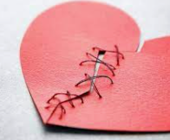
HEBREWS 2:17 Wherefore in all things it behoved him to be made like unto his brethren, that he might be a merciful and faithful high priest in things pertaining to God, to make reconciliation for the sins of the people.
Reconcile: restore friendly relations between. Cause to coexist in harmony; make or show to be compatible.
That He might be the Reconciler! See, there was enmity between God and man.
…
To reconcile, now, God, knowing justice, had to become unjustice, to feel what it was to be a sinner, to go back to reconcile, through "reconciliation," and have mercy on the people.

Slide 37
HEBREWS 2:17 Wherefore in all things it behoved him to be made like unto his brethren, that he might be a merciful and faithful high priest in things pertaining to God, to make reconciliation for the sins of the people.
DANIEL 9:24
Seventy weeks are determined upon thy people and upon thy holy city, to finish the transgression, and to make an end of sins, and to make reconciliation for iniquity, and to bring in everlasting righteousness, and to seal up the vision and prophecy, and to anoint the most Holy.
61-0730E THE.SIXFOLD.PURPOSE.OF.GABRIEL'S.VISIT.TO.DANIEL_ JEFFERSONVILLE.IN DA 45-88 SUNDAY_
« 86 † To make reconciliations for iniquity. "Iniquity" is "doing wrong," as they did at the cross. He made reconciliations, but it will not be applied to them. It was not applied to them, why? Because they were blinded and could not see it. And why did they blind? You say, "Well, maybe today because I'm blind..." You're willfully blind. They were blind because God blinded them, but you're blind because you're willfully blind. There's no reconciliation for you. "If you believe not I am He," said Jesus, "you'll die in your sins." That's right.

Slide 38
HEBREWS 2:18 For in that he himself hath suffered being tempted, he is able to succour them that are tempted.
God could not suffer in Spirit.
He had to become flesh, to feel the pain of sickness, to feel the temptation of lust, to feel the temptation of want, to feel the temptation of hunger, to feel the power of death.
That He might take it upon Hisself to stand in the Presence of the great Spirit Jehovah, the Spirit, not the Man; the Spirit, to make intercession to this life.
And Jesus took that, in order to make intercession for us, for He knows how it feels. When you get sick, He knows how you feel. When you're tempted, He knows how you feel.

Slide 39
HEBREWS 2:18 For in that he himself hath suffered being tempted, he is able to succour them that are tempted.
Now, did you ever notice when we vote for a president, every farmer will vote for a president that's been a farmer, for he knows the hard part of the farmer's life. See? He wants some man who understand.
And before God could ever understand; Him being that great Holiness.
How He could ever understand, after He condemned man?
By His holiness, He condemned man.
And the only way He will ever know how to justify man is to become man.

Slide 40
Hebrews 3
HEBREWS 3:1-19
» 1 † Wherefore, holy brethren, partakers of the heavenly calling, consider the Apostle and High Priest of our profession, Christ Jesus;
» 2 † Who was faithful to him that appointed him, as also Moses was faithful in all his house.
» 3 † For this man was counted worthy of more glory than Moses, inasmuch as he who hath builded the house hath more honour than the house.
» 4 † For every house is builded by some man; but he that built all things is God.
» 5 † And Moses verily was faithful in all his house, as a servant, for a testimony of those things which were to be spoken after;
» 6 † But Christ as a son over his own house; whose house are we, if we hold fast the confidence and the rejoicing of the hope firm unto the end.

Slide 41
Hebrews 3
» 7 † Wherefore (as the Holy Ghost saith, To day if ye will hear his voice,
» 8 † Harden not your hearts, as in the provocation, in the day of temptation in the wilderness:
» 9 † When your fathers tempted me, proved me, and saw my works forty years.
» 10 † Wherefore I was grieved with that generation, and said, They do alway err in their heart; and they have not known my ways.
» 11 † So I sware in my wrath, They shall not enter into my rest.)
» 12 † Take heed, brethren, lest there be in any of you an evil heart of unbelief, in departing from the living God.
» 13 † But exhort one another daily, while it is called To day; lest any of you be hardened through the deceitfulness of sin.

Slide 42
Hebrews 3
» 14 † For we are made partakers of Christ, if we hold the beginning of our confidence stedfast unto the end;
» 15 † While it is said, To day if ye will hear his voice, harden not your hearts, as in the provocation.
» 16 † For some, when they had heard, did provoke: howbeit not all that came out of Egypt by Moses.
» 17 † But with whom was he grieved forty years? was it not with them that had sinned, whose carcases fell in the wilderness?
» 18 † And to whom sware he that they should not enter into his rest, but to them that believed not?
» 19 † So we see that they could not enter in because of unbelief.

