Slide 1
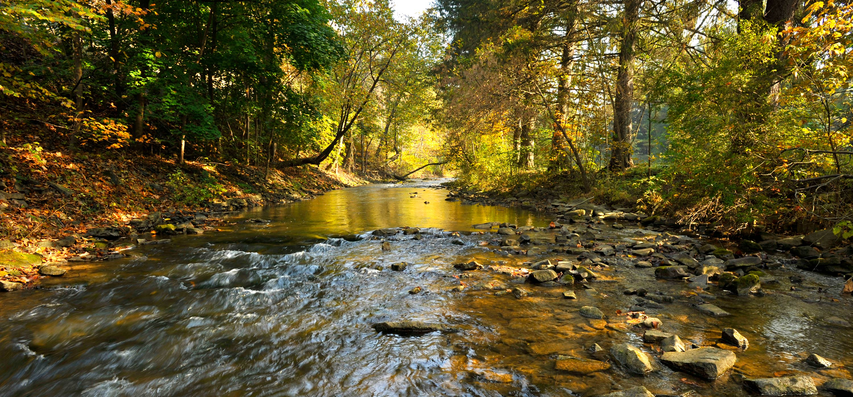

Slide 2
Open Channels

Slide 3
Open Channels
(Spending Time With God)
1) Read the Bible
2) Pray
3) Listen to / Read Sermons
4) Come to Church / Fellowship
5) Meditate
6) Worship

Slide 4
61-0428 - Getting In The Spirit
You know stagnated water gets these little wiggletails in it. That’s what’s the matter with the Church today: a little wiggle in here and wiggle out there. Everything…“Days of miracles is past. No such a thing as Divine healing.” Can’t sit still five minutes in a meeting. Oh, my goodness. Stagnated water, beaver dam, blow it out. Amen. There is a fountain filled with Blood, drawn from Emmanuel’s veins. Where sinners plunged beneath the flood, lose all their guilty stains.

Slide 5
62 Prophet said, “Get down there and dig all them logs out.” “Well, I tell you then, prophet, should we go back and have another mighty rushing wind?” “Nope.” “Shall we start another latter rain?” “Nope, nope. Just clean out the channel. That’s all you have to do.” We got the people, just clean out the channel. The people’s all right. Get the channels cleaned out so the Holy Spirit can come in. All your fanaticisms, and isms, and everything else that’s in the church, clean the thing out. The Rock’s already smitten, the waters are fresh, running, but our ecclesiastical systems has dammed up the stream.

Slide 6
He said, “Clean those things out. You won’t have to have another rushing wind. You won’t hear neither wind nor see any rain, but yet there’ll be water there.” Oh, brother. Not a new system, not a new system we need. What we need is clean out the system we got. Not make another Assemblies of God or another Oneness, but just clean out the Oneness and Assemblies we got. Get all the logs out of it. All the differences, the fussing, and stewing, and things like that away from them, the waters will go to flowing back again. There’ll be love, joy, joy like a river, just flowing all over everybody, just in love with one another.

Slide 7
63-0601 - Come, Follow Me
93 But there’s one thing that you just don’t inherit. You’ve got to accept It. That’s Eternal Life. And you’ll only do that by following Jesus, by a born-again experience. Don’t neglect that.
94 Little story one time I heard, of a man who was, oh, he was poor. And he—he always wanted to…It’s a little fairy story, like. It always stuck with me, though. And one day he picked a flower. And the flower was magic, and the flower answered to him, and said, “You’ve been poor all your life.” He said,
“Now ask what you will, and it’ll be given to you.”
95 He said, “That yonder’s mountain would open up, and I could go therein and find the gold in the mountain.”

Slide 8
96 “Well,” he said, “you will have to take me with you wherever you go. See? You’ll have to take me with you. So, wherever I am, then you can ask what you will.”
97 He walked to the mountain, and the mountain opened up, and he went in. The shelves was full of gold and diamonds, as the little fairy story goes. He laid the flower down on a—on a table, or, a rock. And he run and grabbed a great big gem, and he said, “I must go show this to my friends. And now I’m a rich man. I have everything now. I must show this.”
98 And so the flower spoke, “But,” said, “you have forgot the main thing.”
99 So he runs back and picks up, said, “Well, maybe I’ll—I’ll get a piece of gold. I’ll get a piece of silver.” And so he said, “I’ll—I’ll hurry out, to tell the people how rich I am, and what all I’ve got.”

Slide 9
100 And he got to the door, and the flower said, “But you forgot the main thing.”
101 So he runs back again. He said, “In here we find all kinds of materials.” So, he picked up a stone. He said, “I’ll go, take this stone and show the people what kind of a stone this mountain is made out of, so I can find my way back to it.” See?
102 And he started out the door, and the flower said, for the…its final time, “You have forgot the main thing.”
“Oh,” he said, “oh, shut up.”
103 See, he didn’t want to hear it any more, “Forgot the main thing,” and he ran out the door. And when he did, the door closed behind him, with the flower on the inside. The main thing was the flower. See? The main thing was the flower.

Slide 10
63-0601 - Come, Follow Me
115 And He was the Transmitter that said, “He that heareth My Words, and believeth on Him that sent Me, has Eternal Life.” See? “Verily I say unto you, he that heareth My Words, and believeth on Him that sent Me, hath Eternal Life.” Now, that Word has went out from a Transmitter. He said, one day, “Verily I say unto you, if you say to this mountain, ‘Be moved,’ and don’t doubt in your heart, but believe that what you have said will come to pass, you can have what you said.”

Slide 11
116 Now, if you can just be the station to pick That up, by some control inside of you, by faith, it’ll move you right into the cycle of God, to the new Birth, and be born again. Then you’ll always be in contact, to hear that Voice that will always warn you when danger is along. When things are wrong, going wrong, It’ll always be a warning to you. And then, instead of someday being like that rich young boy that we’re speaking of; be a man like apostle Peter, Paul, or somebody that won souls for Jesus Christ. You do that, kids.

Slide 12
Open Flues
62-0311 - The Greatest Battle Ever Fought
159 God will heal you right in this atmosphere of the Holy Ghost, where He sent you. God will give it to you. Just believe it. Amen. Open up them flues of the soul and body, senses, and conscience, and just let God’s Words penetrate first, take that mind. There is the battleground.
160 Not say, “Well, if I could feel it, if I’d feel the glory of God falling! Oh!” That has nothing to do with it; not a thing.

Slide 13
161 Open up that mind. That’s the battleground. There is where the battle sets in array, right here in the front line, your mind. Open it up, and say, “I…Every doubt, I doubt my doubts.” Amen. “I’m doubting my doubts now. I’m believing God’s Word. Here I come, Satan.” Something is going to take place. Sure, it will. Yes, sir.

Slide 14
Matthew 7:7-8 Ask, and it shall be given you; seek, and ye shall find; knock, and it shall be opened unto you: For every one that asketh receiveth; and he that seeketh findeth; and to him that knocketh it shall be opened.
Matthew 6:31-34 Therefore take no thought, saying, What shall we eat? or, What shall we drink? or, Wherewithal shall we be clothed? (For after all these things do the Gentiles seek:) for your heavenly Father knoweth that ye have need of all these things. But seek ye first the kingdom of God, and his righteousness; and all these things shall be added unto you. Take therefore no thought for the morrow: for the morrow shall take thought for the things of itself. Sufficient unto the day is the evil thereof.

Slide 15
Read The Bible
2 Timothy 2:15 Study to shew thyself approved unto God, a workman that needeth not to be ashamed, rightly dividing the word of truth.

Slide 16
Pray
1 Thessalonians 5:17 Pray without ceasing.
1 Timothy 2:8 I will therefore that men pray every where, lifting up holy hands, without wrath and doubting.
54-0723 - The Prophet Elisha
You don’t watch, you let down in your prayer life. You say, “Well, I’m a Christian.” Well, that’s the more sign you should pray, more than ever. Read the Bible every day. Pray every day. Don’t make any decisions too harshly or too quickly, without first considering God about it.

Slide 17
Listen to / Read Sermons
Romans 10:17 So then faith cometh by hearing, and hearing by the word of God.

Slide 18
Come to Church / Fellowship
Hebrews 10:24-25 And let us consider one another to provoke unto love and to good works: Not forsaking the assembling of ourselves together, as the manner of some is; but exhorting one another: and so much the more, as ye see the day approaching.

Slide 19
Meditate
Philippians 4:6-9 Be careful (Anxious) for nothing; but in every thing by prayer and supplication with thanksgiving let your requests be made known unto God. And the peace of God, which passeth all understanding, shall keep your hearts and minds through Christ Jesus. Finally, brethren, whatsoever things are true, whatsoever things are honest, whatsoever things are just, whatsoever things are pure, whatsoever things are lovely, whatsoever things are of good report; if there be any virtue, and if there be any praise, think on these things. Those things, which ye have both learned, and received, and heard, and seen in me, do: and the God of peace shall be with you.

Slide 20
Worship
Ephesians 5:18-21 And be not drunk with wine, wherein is excess; but be filled with the Spirit; Speaking to yourselves in psalms and hymns and spiritual songs, singing and making melody in your heart to the Lord; Giving thanks always for all things unto God and the Father in the name of our Lord Jesus Christ; Submitting yourselves one to another in the fear of God.
Colossians 3:16 Let the word of Christ dwell in you richly in all wisdom; teaching and admonishing one another in psalms and hymns and spiritual songs, singing with grace in your hearts to the Lord.
Psalm 22:3 But thou art holy, O thou that inhabitest the praises of Israel.

Slide 21
63-0728 - Christ Is The Mystery Of God Revealed
187 How did He…? What happened in the prefigure now? He opened Adam’s side and took part of his flesh, which was Adam, to make Eve. The Bride has to be the Word, for He is the Word. She cannot stand on creeds. She cannot stand on denomination. She cannot stand on good behavior. She has to stand alone on the Word, because She is part of It. She was taken from Christ. See?

Slide 22
63-0728 - Christ Is The Mystery Of God Revealed
188 And to be sure, that, the whole Rapture now: Luther was a part, Wesley was a part, the prophets was a part. If they’re—aren’t a part…Just in the revelation that they was making up, the body, feet, toes, arms, and so forth, until the Head (which we get to that in a few minutes), see, that makes the entire Rapture. It’s the Body of the Word, which is Christ. Amen! 189 Outside of That, you’re lost. I don’t care how good you are, or what your relationship is, or what your fellowship is, or what your organization is, you’re lost, outside of that Word being in you. 190 “If ye abide in Me, the Word, My Word abide in you, then you ask what you will,” because you and the Word are the same.

Slide 23
63-0728 - Christ Is The Mystery Of God Revealed
He has the preeminences. He’s got the rulership. You’re a—you’re a prisoner to Him. The world is dead. You have nothing more…You see the rest of the people living the way they do, but yet you do not do it. You’re a prisoner. You’re yoked with Him. “My yoke is easy.” Yoked with Christ, with His Word. “I do that only which the…pleases the Father. And if you can’t believe that I am He, then believe the Word.” So perfect! Notice.

Slide 24
