Slide 1
Review of Hebrews 1:1-7
Though God has variously revealed Himself in the past, Old Testament prophetic revelation has now received its end-times climax in Jesus Christ.
Paul sets forth Christ’s greatness
Heir of all things
The One who is both Creator and Heir is also a perfect reflection of God (the express image of His person, etc.).
His Word is so powerful that all He has made is sustained by that Word.
It is this Person who has provided purification for sins and taken His seat at the right hand of the Majesty in heaven (cf. 8:1; 10:12; 12:2).
He has a position and eminence far beyond anything the angels can claim.

Slide 2
Review of Hebrews 1:1-7
Hebrews 1:1-7
1. God, who at sundry times and in divers manners spake in time past unto the fathers by the prophets,
2. Hath in these last days spoken unto us by his Son, whom he hath appointed heir of all things, by whom also he made the worlds;
3. Who being the brightness of his glory, and the express image of his person, and upholding all things by the word of his power, when he had by himself purged our sins, sat down on the right hand of the Majesty on high;
4. Being made so much better than the angels, as he hath by inheritance obtained a more excellent name than they.
5. For unto which of the angels said he at any time, Thou art my Son, this day have I begotten thee? And again, I will be to him a Father, and he shall be to me a Son?
6. And again, when he bringeth in the firstbegotten into the world, he saith, And let all the angels of God worship him.
7. And of the angels he saith, Who maketh his angels spirits, and his ministers a flame of fire.

Slide 3
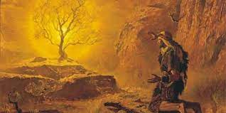
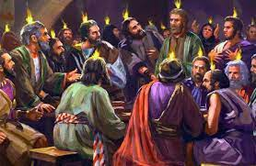
1:7 And of the angels he saith, Who maketh his angels spirits, and his ministers a flame of fire.
Psalm 104:4 Who maketh his angels spirits; his ministers a flaming fire:
Jeremiah 20:9
Then I said, I will not make mention of him, nor speak any more in his name. But his word was in mine heart as a burning fire shut up in my bones, and I was weary with forbearing, and I could not stay.
Job 32:18
For I am full of matter, the spirit within me constraineth me.
Psalm 39:3
My heart was hot within me, while I was musing the fire burned: then spake I with my tongue,
Acts 4:20 For we cannot but speak the things which we have seen and heard.

Slide 4
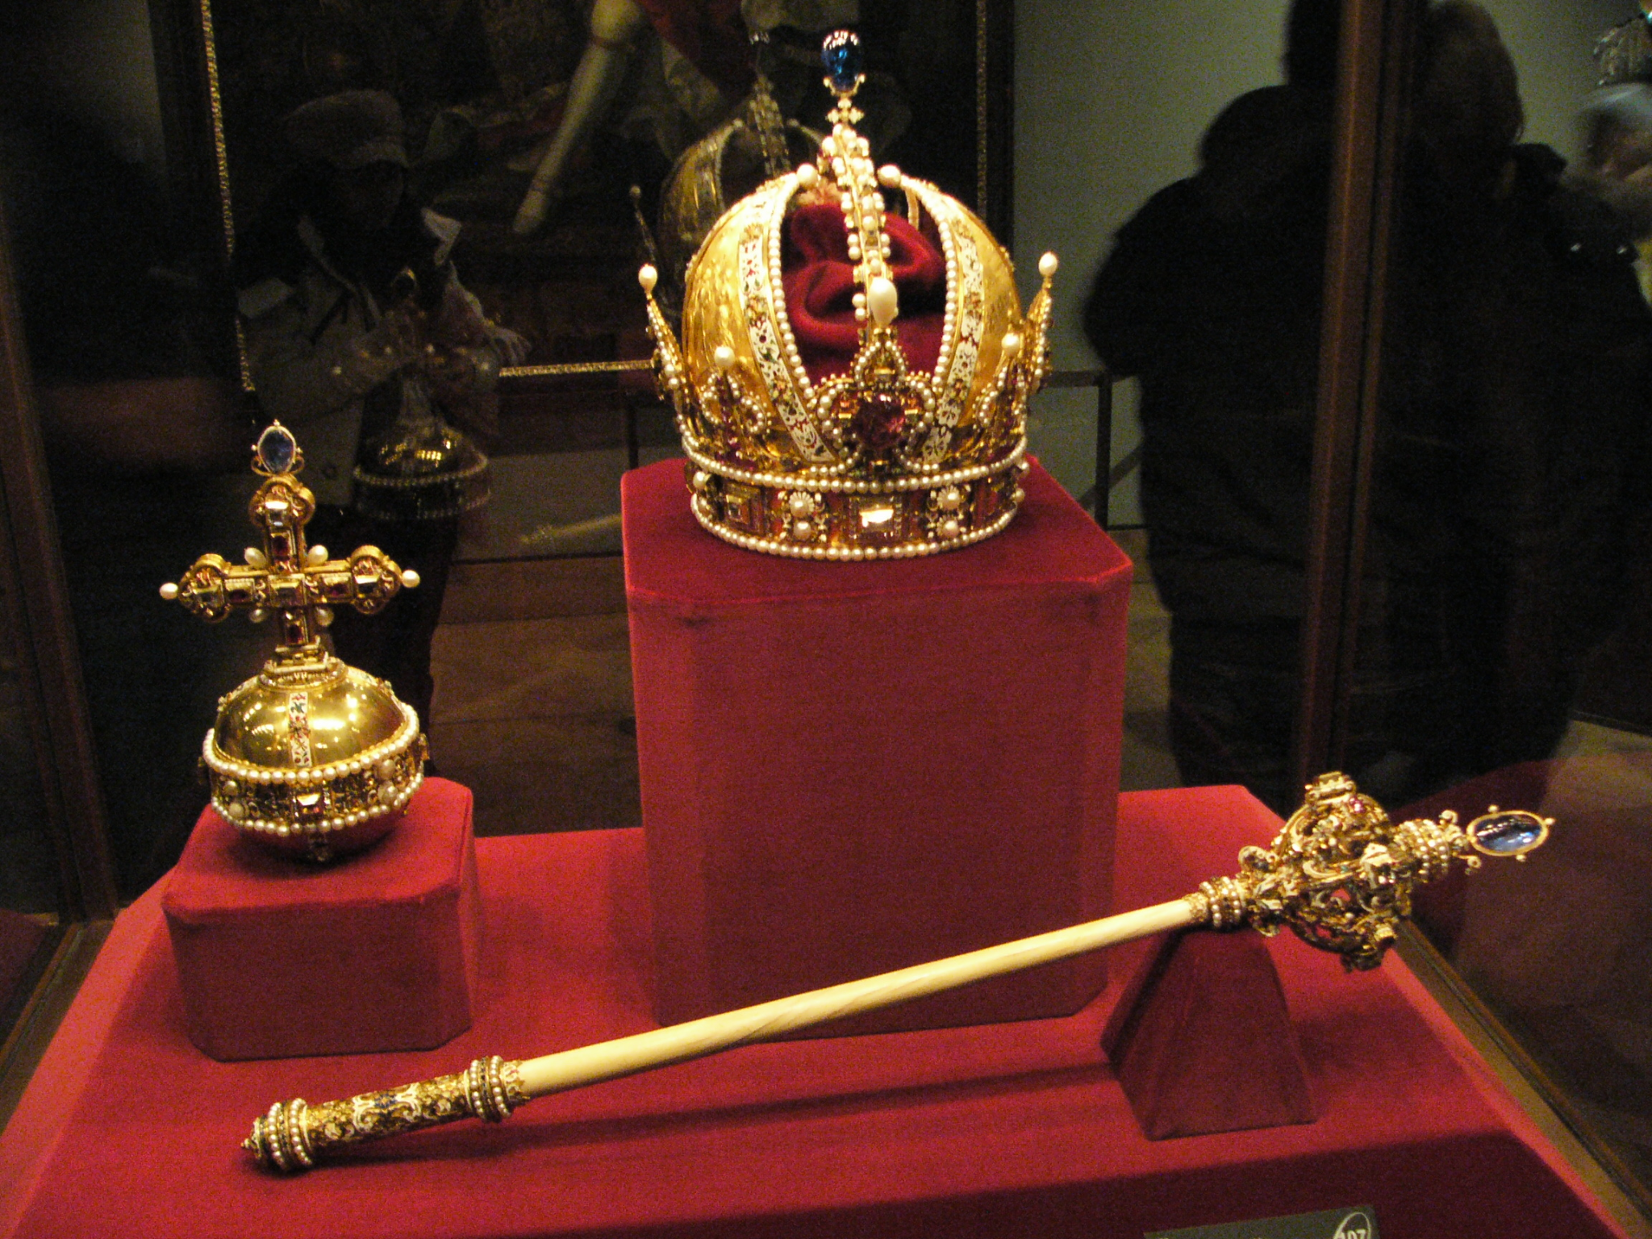
1:8 But unto the Son he saith, Thy throne, O God, is for ever and ever: a sceptre of righteousness is the sceptre of thy kingdom.
Quoting David
Psalm_45:6-7 6. Thy throne, O God, is for ever and ever: the sceptre of thy kingdom is a right sceptre. 7. Thou lovest righteousness, and hatest wickedness: therefore God, thy God, hath anointed thee with the oil of gladness above thy fellows.
Symbol of Authority, Divine Power, Dominion

Slide 5
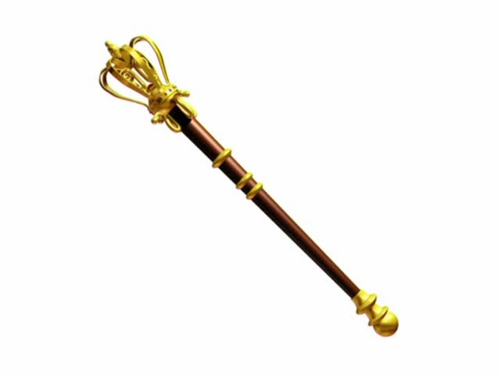
Hebrews 1:8 But unto the Son he saith, Thy throne, O God, is for ever and ever: a sceptre of righteousness is the sceptre of thy kingdom.
…a ceremonial or ornamental staff that was also a sign of authority or sovereignty.
Scepter. Long staff with an ornamental head and other decorations used to represent royal authority;
a shorter staff was used as a battle mace to symbolize royal military power.
His Righteousness
NLT - You rule with a scepter of justice.
NIRV - Your kingdom will be ruled by what is right.

Slide 6
** Hebrews 1:9
Thou hast loved righteousness, and hated iniquity; therefore God, even thy God, hath anointed thee with the oil of gladness above thy fellows.
RIGHTEOUSNESS (Hebrew צדק, tsdq;, צְדָקָה, tsedaqah;, צַדִּיק, tsaddiq; Greek δικαιοσύνη, dikaiosynē, δίκαιος, dikaios). The quality, state, and characteristic of being in the right.
The English word “righteousness” refers to the quality of being righteous or in the right and is cognate to “just,” “justness,” and “justice.”
Satan's Eden is established in sin, because Satan is sin. God is righteousness, and God's kingdom was established in righteousness, and peace, and Life. And Satan's establishment is in sin, and, religious sin.
…the beginning of righteousness is God's revealed Truth, and the entire Church of the living God is built upon that.
Righteousness is the attribute of salvation.
It's up to us to see that all God's righteousness is fulfilled." And what is His righteousness? His Word.

Slide 7
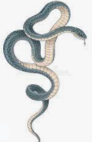
** Hebrews 1:9
Thou hast loved righteousness, and hated iniquity; therefore God, even thy God, hath anointed thee with the oil of gladness above thy fellows.
INIQUITY - to know not to do something and to do it anyway, and vice versa - …the crooked (AVON) BEHAVIOR and its CONSEQUENCES - …the crooked (AVON) CHARACTER of your ACTIONS
HEBREW LEXICON -- STRONG'S NUMBER 5771
5771 » 'avon {aw-vone'} or 'avown (2 Kings 7:9, Psalm 51:5 [7]) {aw-vone'} !A'[ from 5753; TWOT -- 1577a; n m
1) perversity, depravity, iniquity, guilt/punishment of iniquity
1a) iniquity
1b) guilt of iniquity, guilt (as great), guilt (of condition)
1c) consequence of/punishment for iniquity
twisting and distorting the will of God

Slide 8
** Hebrews 1:9
Thou hast loved righteousness, and hated iniquity; therefore God, even thy God, hath anointed thee with the oil of gladness above thy fellows.
INIQUITY (AVON) is related to AVAH: TO BE BENT
HEBREW LEXICON -- STRONG'S NUMBER 5753
Click here to view all verses that use this Hebrew word.
5753 » 'avah {aw-vaw'} h"w'[ a primitive root; TWOT -- 1577; v
1) to bend, twist, distort
1a) (Niph) to be bent, be bowed down, be twisted, be perverted
1b) (Piel) to twist, distort
1c) (Hiph) to do perversely
2) to commit iniquity, do wrong, pervert
2a) (Qal) to do wrong, commit iniquity
2b) (Hiph) to commit iniquity
twisting and distorting the will of God

Slide 9
Hebrews 1:9
Thou hast loved righteousness, and hated iniquity; therefore God, even thy God, hath anointed thee with the oil of gladness above thy fellows.
And iniquity is something that you know that you ought to do and will not do it. That's right.
"Iniquity" is "something that you've done wrong that you knowed better, that you ought not have done it." "If I conceive iniquity in my heart, God will not hear me.“
Iniquity is something that you know that you ought to do and you won't do it. You know better, but won't do it. It's iniquity, see. You know they should stay with the Word of God, but for the church's sake, or somebody else's sake, or something else, you'll stray from the Word of God and do what the organization says. "Well, I don't know. My church says we should do it this a-way, and I believe it this a-way.“ See, and it's right before you that you shouldn't do it. That's iniquity. "Depart from Me, you that work iniquity.“
Jesus said, "You workers of iniquity, I didn't even know you." And iniquity is something that you know that you ought to do and will not do it. That's right. And every man knows that he's got to be borned again by the Spirit of God.
Iniquity, what is iniquity? Iniquity is something that you know it's wrong, and still holding to it. When you know your creeds are wrong, and you still hold to it, that's iniquity.

Slide 10
Hebrews 1:9
Thou hast loved righteousness, and hated iniquity; therefore God, even thy God, hath anointed thee with the oil of gladness above thy fellows.
Psalm 32:5 I acknowledged my sin unto thee, and mine iniquity have I not hid. I said, I will confess my transgressions unto the LORD; and thou forgavest the iniquity of my sin. Selah.
Isaiah 65:5-7
» 5 † Then said I, Woe is me! for I am undone; because I am a man of unclean lips, and I dwell in the midst of a people of unclean lips: for mine eyes have seen the King, the LORD of hosts.
» 6 † Then flew one of the seraphims unto me, having a live coal in his hand, which he had taken with the tongs from off the altar:
» 7 † And he laid it upon my mouth, and said, Lo, this hath touched thy lips; and thine iniquity is taken away, and thy sin purged.

Slide 11
Hebrews 1:9
Thou hast loved righteousness, and hated iniquity; therefore God, even thy God, hath anointed thee with the oil of gladness above thy fellows.
THOU HAST LOVED RIGHTEOUSNESS
AND HATED INIQUITY
THEREFORE GOD HATH ANOINTED THEE

Slide 12
Hebrews 1:9
Thou hast loved righteousness, and hated iniquity; therefore God, even thy God, hath anointed thee with the oil of gladness above thy fellows.
57-0307 GOD.KEEPS.HIS.WORD.2_ PHOENIX.AZ THURSDAY_
« E-57 † I have no prejudice against anybody. Any of these teachers from California, and all around, that's passing through the land with all these fantastics, God knows, that nearly every one of them that I know, I've set down with pleading tears and saying, "Brother, look here, that's not..."
"Oh, we're anointed with the oil of gladness."
I said, "Not oil out of your body, nothing can come out of your body that can do you any good." And the whole armor of God is supernatural. What is the armor of God? Love, joy, peace, long suffering, goodness, meekness, gentleness, patience, faith. Nothing... So all the natural work is done as the sacrifice of Christ. We just believe it. It's by faith. Nothing you have to see, nothing you have to feel; you got to believe it. Jesus never did say, "Did you see it? Did you feel it?" He said,"Did you believe it?" Did you believe it?
65-0217 A.MAN.RUNNING.FROM.THE.PRESENCE.OF.THE.LORD_ JEFFERSONVILLE.IN V-5 N-8 WEDNESDAY_
We love You, Lord Jesus. Make that so real in our hearts, Lord. Pour in the oil of gladness, this week, Lord, in our souls. Give us a bathing, a washing of the Word, by the water of the Word, dividing unto us Truth.

Slide 13
Hebrews 1:9
» 9 † Thou hast loved righteousness, and hated iniquity; therefore God, even thy God, hath anointed thee with the oil of gladness above thy fellows.
John 3:34 For he whom God hath sent speaketh the words of God: for God giveth not the Spirit by measure unto him.
Colossians 2:9 For in him dwelleth all the fulness of the Godhead bodily.
Isaiah 61:1 The Spirit of the Lord GOD is upon me; because the LORD hath anointed me to preach good tidings unto the meek; he hath sent me to bind up the brokenhearted, to proclaim liberty to the captives, and the opening of the prison to them that are bound;

Slide 14
Hebrews 1:9
Thou hast loved righteousness, and hated iniquity; therefore God, even thy God, hath anointed thee with the oil of gladness above thy fellows.
Anointed by the Word. He is the Anointing.
64-0418B A.PARADOX_ TAMPA.FL SATURDAY_
Now, what is it? Christ coming to His Body. Christ is the Word. We all know the anointing is Christ, that comes on the Word, that makes the Word live. Is that right? [Congregation says, "Amen."--Ed.] That is the anointing. Christ is the anointing, the Spirit that comes upon the Word, that quickens the Word, to make it live. Now, the Word is in your heart. You believe in Divine healing, whatevermore. See? And Christ, the anointing, coming to His Body. See the--the connection there? Just like husband and wife to become one. Now, the church has got to get to the ministry, until the church and Christ become one. He can anoint you for every blessing that's in the Bible. All of it is yours. Everything is promised at this age is yours. When we leave anything out... See? Then, if anointing strikes that, it will--it will anoint it. It's just here.

Slide 15
** Hebrews 1:9
Thou hast loved righteousness, and hated iniquity; therefore God, even thy God, hath anointed thee with the oil of gladness above thy fellows.
Anointed for a Purpose
"The gladness of our Lord Jesus may be viewed, first, as the gladness which he had IN his work.“ – Charles SPURGEON
Luke 2:49
And he said unto them, How is it that ye sought me? wist ye not that I must be about my Father's business?
John 4:32
But he said unto them, I have meat to eat that ye know not of. …
» 34 † Jesus saith unto them, My meat is to do the will of him that sent me, and to finish his work.
PSALM 40:7-8
7 † Then said I, Lo, I come: in the volume of the book it is written of me,
8 † I delight to do thy will, O my God: yea, thy law is within my heart.

Slide 16
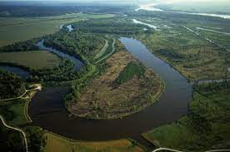
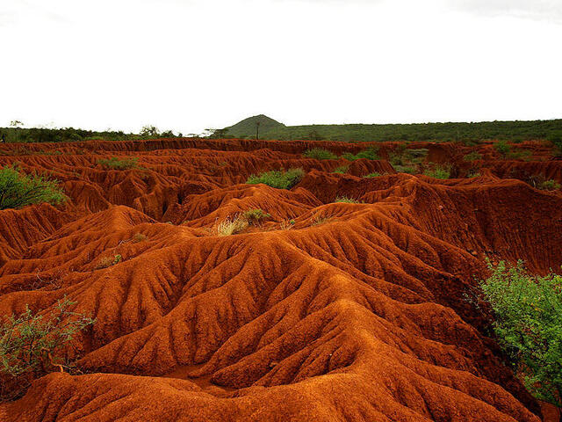
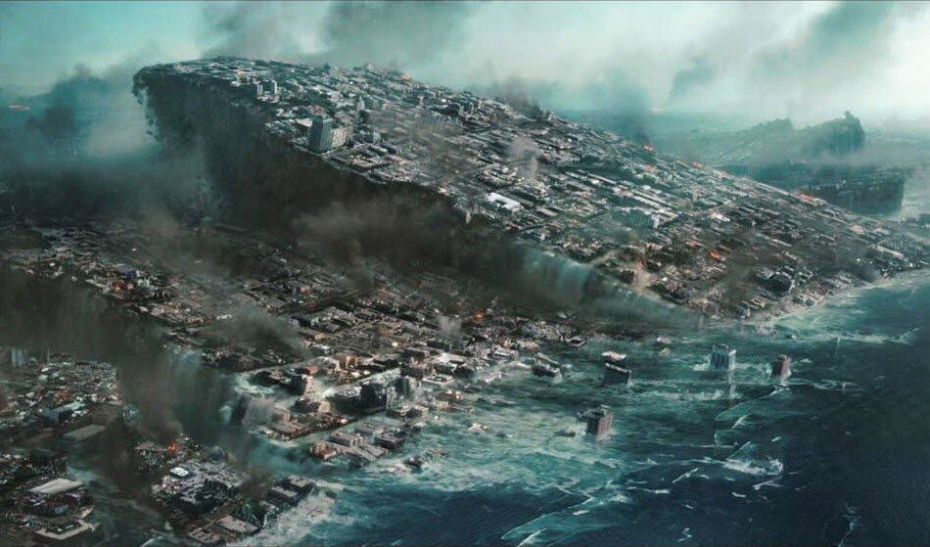
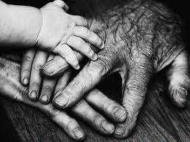
Hebrews 1:10-11 And, Thou, Lord, in the beginning hast laid the foundation of the earth; and the heavens are the works of thine hands: They shall perish; but thou remainest; and they all shall wax old as doth a garment; And as a vesture shalt thou fold them up, and they shall be changed: but thou art the same, and thy years shall not fail.

Slide 17
HEBREWS 1:7-13
…
» 7 † And of the angels he saith, Who maketh his angels spirits, and his ministers a flame of fire.
» 8 † But unto the Son he saith, Thy throne, O God, is for ever and ever: a sceptre of righteousness is the sceptre of thy kingdom.
» 9 † Thou hast loved righteousness, and hated iniquity; therefore God, even thy God, hath anointed thee with the oil of gladness above thy fellows.
» 10 † And, Thou, Lord, in the beginning hast laid the foundation of the earth; and the heavens are the works of thine hands:
» 11 † They shall perish; but thou remainest; and they all shall wax old as doth a garment;
» 12 † And as a vesture shalt thou fold them up, and they shall be changed: but thou art the same, and thy years shall not fail.
» 13 † But to which of the angels said he at any time, Sit on my right hand, until I make thine enemies thy footstool?

Slide 18
Hebrews 1:13 But to which of the angels said he at any time, Sit on my right hand, until I make thine enemies thy footstool?
Hebrews 1:3 Who being the brightness of his glory, and the express image of his person, and upholding all things by the word of his power, when he had by himself purged our sins, sat down on the right hand of the Majesty on high;
Where Did He Sit?

Slide 19
Seated on His Throne
54-0516 QUESTIONS.AND.ANSWERS.LAW.HAVING.A.SHADOW_ JEFFERSONVILLE.IN SUNDAY_
« E-64 † What did the prophets all say Jesus would do, when He come? Rule the nations with a rod of iron. Is that right? They failed to see His first coming to the Gentiles; when He returns, then, He does rule all nations. He will come. He isn't up on His throne now. He's setting on God's throne. "He that overcomes shall sit with Me on My throne, as I have overcome, and set on My Father's throne." Now, He's wanting to come back. And who... Where is His earthly throne? The throne of David. God said He'd give Him the throne of David, in the Millennium. He'll sit on David's throne, and we'll see Him, the great King of kings, setting there. There He is. Now, He's setting on His Father's throne, in other words, He's setting in God's power, in Spirit, now. But when He comes back, He'll set in a earthly body (Hallelujah!) on David's throne. Now, He's setting in the majesty of Father now. When we say, "Father": it's Jesus, It's the Spirit of God, by the Holy Spirit, in us. Now, He's on His Father's throne, right hand of majesty. We use the body name, "Jesus Christ," Who appeared, the Holy Spirit, which is God. "Whatever you ask the Father in My name, that will I do; for I and My Father are one."

Slide 20
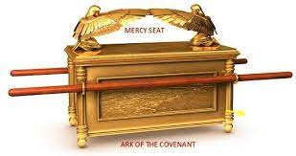
Old Testament – The Mercy Seat
In the Center of the “Three Room House”

Slide 21
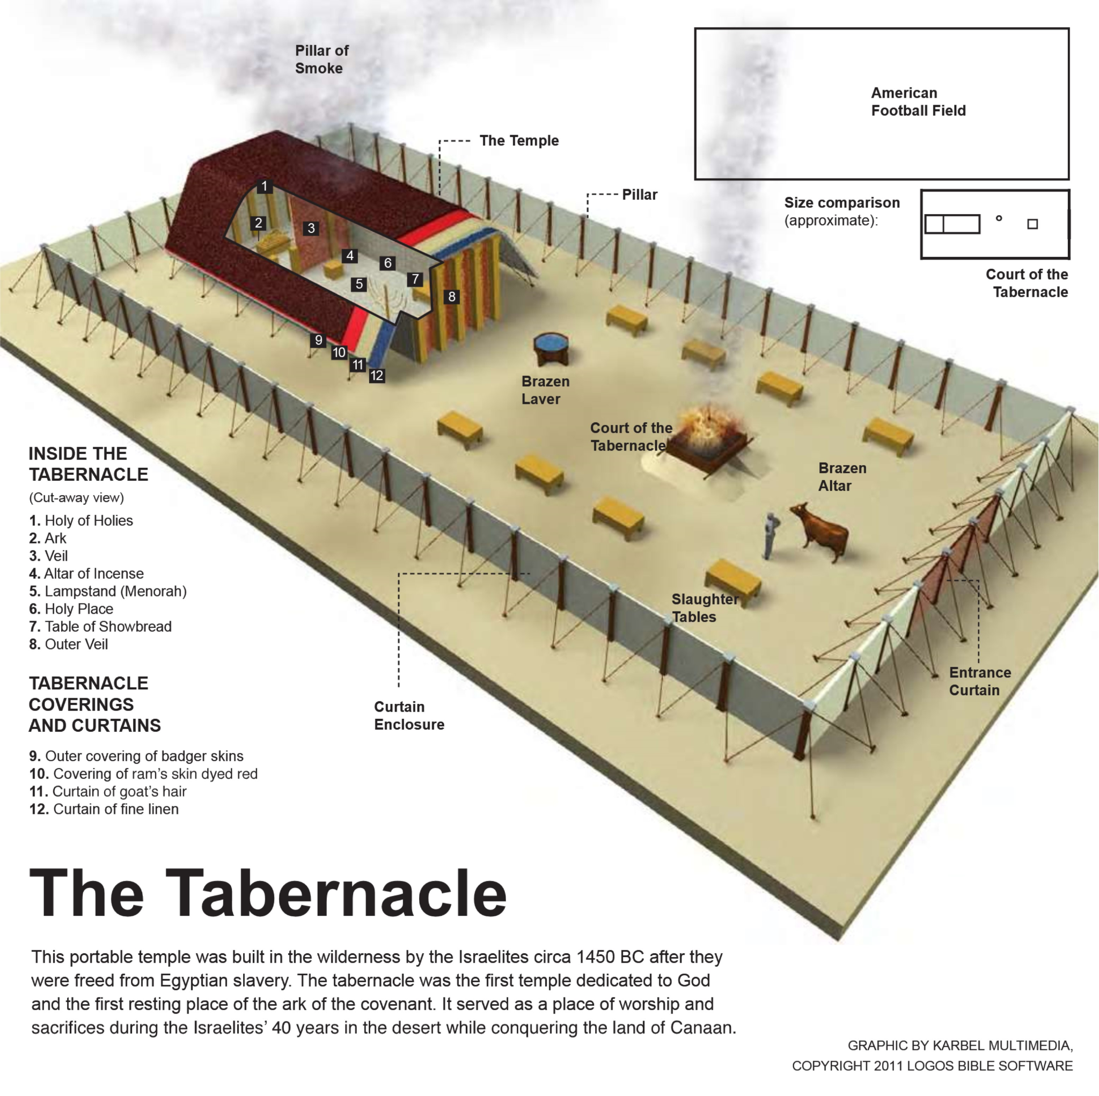
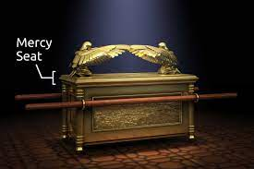
Hebrews 1:13 But to which of the angels said he at any time, Sit on my right hand, until I make thine enemies thy footstool?
61-0108 REVELATION.CHAPTER.FOUR.3_ JEFFERSONVILLE.IN ROJC 645-716 SUNDAY_
« 308 † Now, "the mercy seat." Now, the mercy seat's in the heart, seat where the shining forth of His--His Glory in all of His children, the Shekinah Glory in the human heart. Here is the human heart. Is that right? Is that the mercy seat? How do you come through it into That through these different systems? Through self-will, self-will. Comes into here, and through there, comes out what? Shekinah Glory. What--what is the Shekinah Glory? Is God's Presence. And when a man's walking, or a woman, he's reflecting the Shekinah Glory. He don't go into gambling dens and--and carry on, and go out here and deny the Word. No matter what the people says, he's got his heart set on one thing: God. And if he's truly called of God then Jesus Christ reflects Himself through him with the Shekinah Glory, doing the same things He did back there; manifest the same Gospel, preaching the same Word, same Word being made manifest in the same measure it was then, just like it was truly at Pentecost it's measured back again. Oh, my!

Slide 22
Hebrews 1:13 But to which of the angels said he at any time, Sit on my right hand, until I make thine enemies thy footstool?
61-0101_Revelation, Chapter Four #2_Jeffersonville, Indiana, USA #114
114. You say, “I got to ... all right. I can tell dirty jokes, it don't condemn me.” Why? You ain't got nothing it can condemn. No one's there to take it out. No one's there to condemn you. “Well, I'll tell you,” the women say, “I can have short hair. It don't condemn me.” It's no wonder! See? “No, I can wear shorts, I can do this.” A man said, “It don't hurt me to smoke cigars. And it don't hurt me to play some cards and shoot some dice (and whatever they do). It don't hurt me.” They still belong to the church, see, “Don't hurt me to do this.” Why? Why? There's nothing there to judge you. But when Christ comes in, you've created an altar on your heart, and your sins are taken daily! The great St. Paul said, “I die daily. Nevertheless I live; not me but Christ liveth in me.” There's the inner veil. Oh, brother, sister!

Slide 23
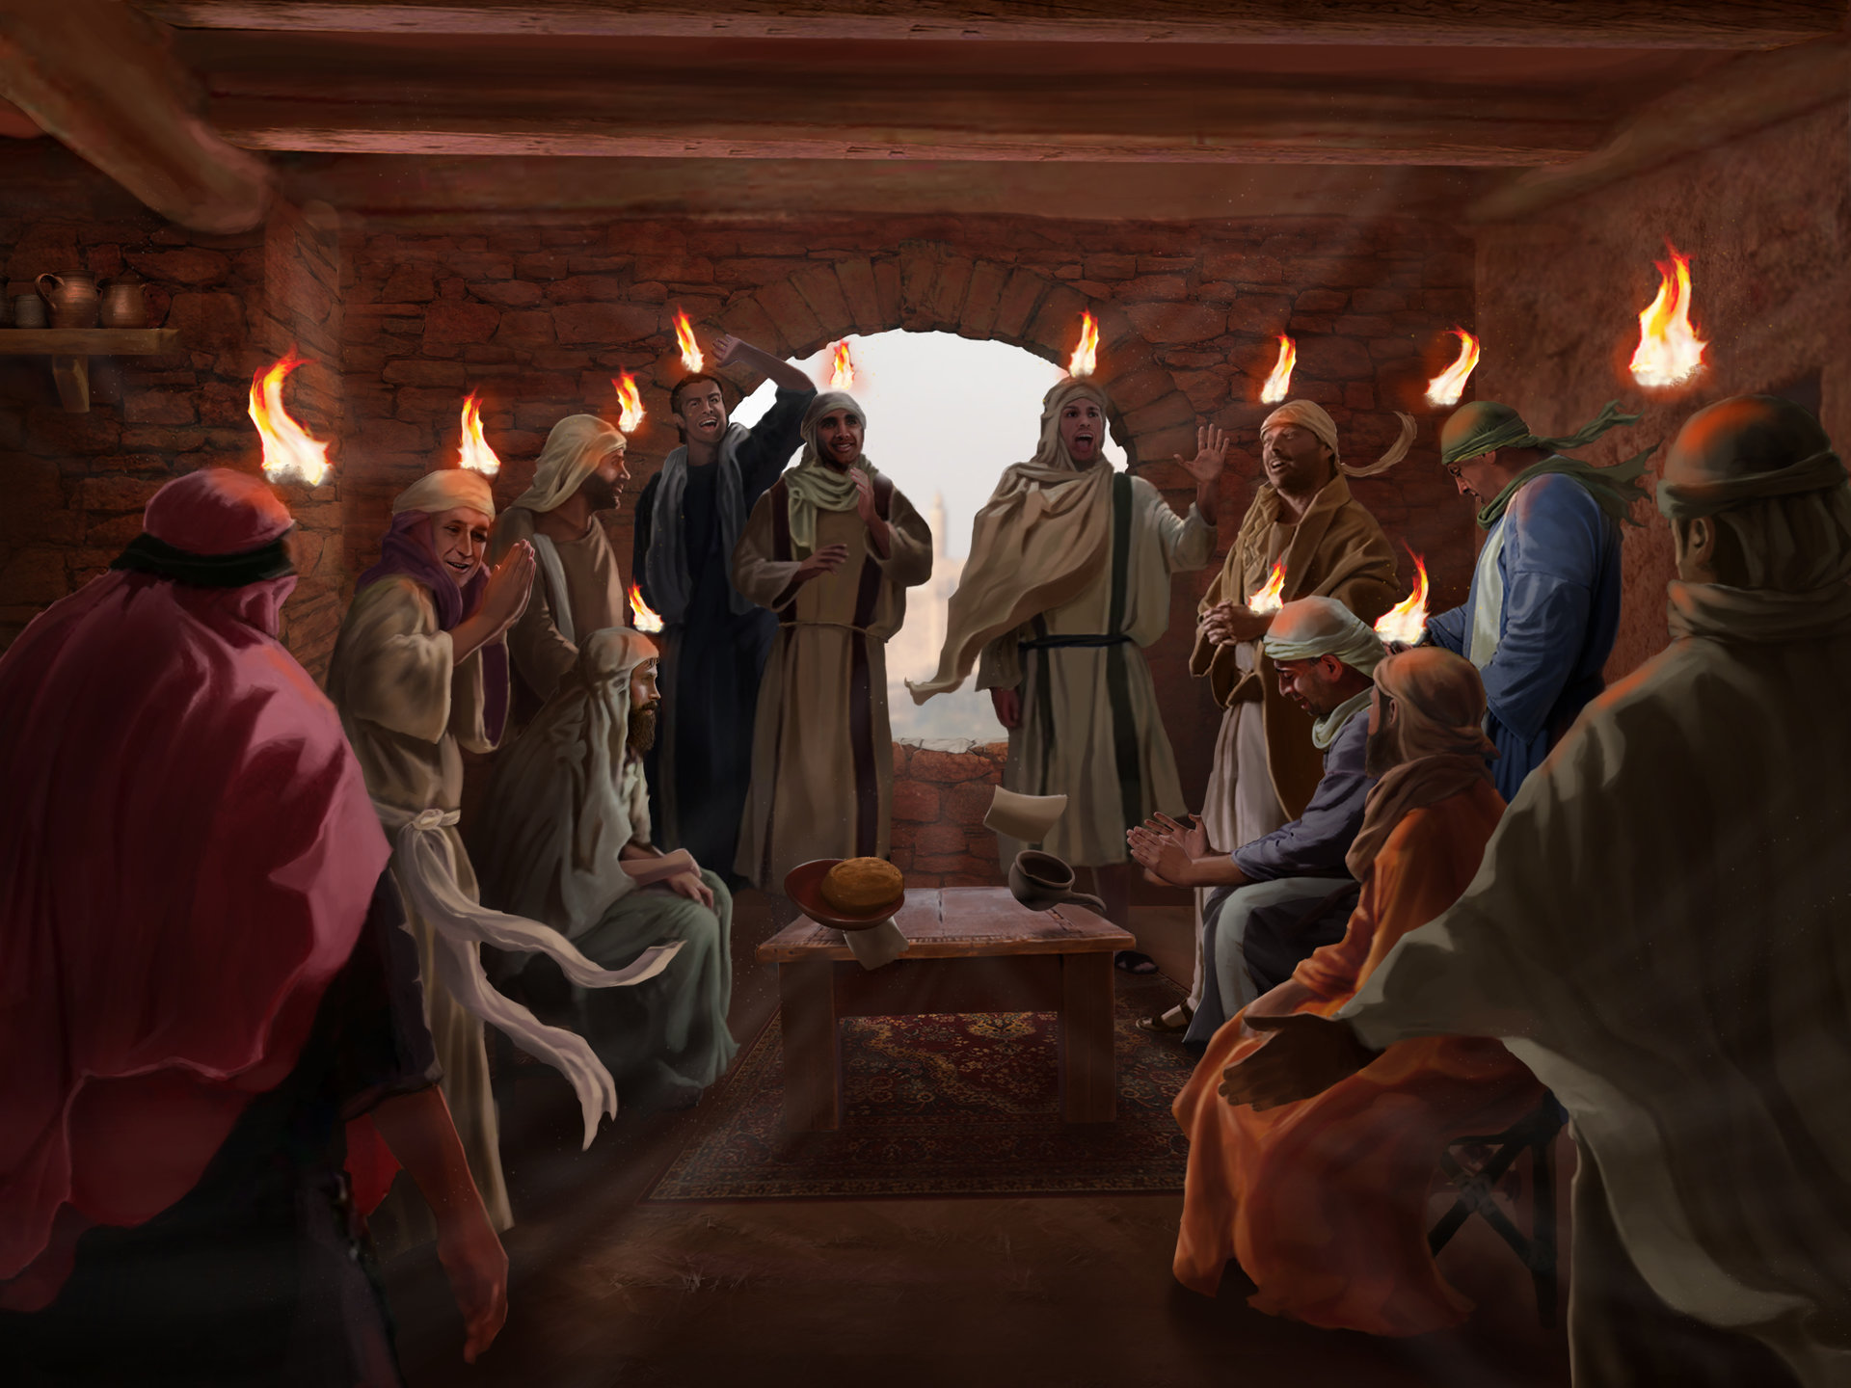
Hebrews 1:13 But to which of the angels said he at any time, Sit on my right hand, until I make thine enemies thy footstool?
Acts 2:32-37
32. This Jesus hath God raised up, whereof we all are witnesses.
33. Therefore being by the right hand of God exalted, and having received of the Father the promise of the Holy Ghost, he hath shed forth this, which ye now see and hear.
34. For David is not ascended into the heavens: but he saith himself, The LORD said unto my Lord, Sit thou on my right hand,
35. Until I make thy foes thy footstool.
36. Therefore let all the house of Israel know assuredly, that God hath made that same Jesus, whom ye have crucified, both Lord and Christ.
37. Now when they heard this, they were pricked in their heart, and said unto Peter and to the rest of the apostles, Men and brethren, what shall we do ?

Slide 24
Hebrews 1:13 But to which of the angels said he at any time, Sit on my right hand, until I make thine enemies thy footstool?
55-0221 CHRIST_ PHOENIX.AZ MONDAY_
« E-47 † And through the Blood you become a part of Him, into the same cell that He came out of. And the very Presence and part of God comes into you. By faith you purchase it. And that same Holy Spirit that was in the Lord Jesus Christ comes into you. And then you are sons and daughters of God, adopted by the Lord Jesus Christ into the Body of Christ. Amen. That'd make the Methodist shout.
Think of it, brother, how that God in His infinite mercy, purchasing us through the Blood of Jesus. And now, setting at the right hand of the Majesty ("right hand" means "in power and authority") that as a High Priest, to make intercessions upon anything that we confess that He has done. After once coming into the fellowship, sign your name on the check, say, "Here it is." There you get it? We believe that we get what we ask for, 'cause we've judged God to keep His Word.

Slide 25
Hebrews 1:13 But to which of the angels said he at any time, Sit on my right hand, until I make thine enemies thy footstool?
57-0821 HEBREWS.CHAPTER.ONE_ JEFFERSONVILLE.IN HEB WEDNESDAY_
What does right hand mean? Not, God has got a right hand that somebody is setting on it. Right hand means the "power and authority," got the authority of everything in Heaven and earth. And all the Heavens and earth is made by Him. 59-0815 AS.THE.EAGLE.STIRRETH.UP.HER.NEST_ CHAUTAUQUA.OH SATURDAY_
He's setting at the right hand of God on God's throne. That's not His throne. He's coming back to reign on His throne; it's the throne of David; He's to take His throne. He's setting on God's throne, waiting till the last enemy is made His footstool. He will return someday, bringing the precious souls with Him to take on immortality, to live in a glorified body, live through a Millennium, and then forever with Him.

Slide 26
Hebrews 1:13 But to which of the angels said he at any time, Sit on my right hand, until I make thine enemies thy footstool?
Revelation 1:16 And he had in his right hand seven stars… « 79-2 † EPHESIAN.CHURCH.AGE - CHURCH.AGE.BOOK CPT.3
There He is with the seven stars in His right hand.
The right hand or arm signifies the power and authority of God.
Psalms 44:3, "For they got not the land in possession by their own sword, neither did their own arm save them: but Thy right hand, and Thine arm, and the light of Thy countenance, because Thou hadst a favour unto them.“
In that right hand of power are seven stars, who, according to Revelation 1:20, are the seven church messengers.
This signifies that the very power and authority of God are behind His messengers to every age. They go forth in the fire and power of the Holy Ghost with the Word.

Slide 27
Hebrews 1:13 But to which of the angels said he at any time, Sit on my right hand, until I make thine enemies thy footstool?
Revelation 3:21 To him that overcometh will I grant to sit with me in my throne, even as I also overcame, and am set down with my Father in his throne.
64-0617_The Identified Christ Of All Ages_Topeka, Kansas USA #25
25. Then when He died, rose, ascended, and sent back the Holy Spirit, that was the Son of God. God is a spirit, and through the church age it's been Son of God. And then in the millennium it's Son of David, sitting on the throne, ruling. He has ascended up. “He that overcomes shall sit with me on my throne, as I have overcome and sit down on my Father's throne.” He's sitting on the Father's throne now. But in the millennium He sits upon his own throne because He is the Son of David. Son of man, Son of God, Son of David, see—it's just perfectly.

Slide 28
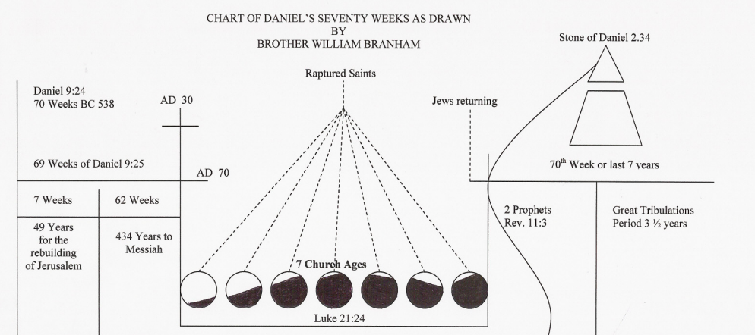
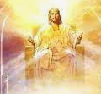
Hebrews 1:13 But to which of the angels said he at any time, Sit on my right hand, until I make thine enemies thy footstool?
Son of Man -> Son of God -> Son of David
Christ as High Priest

Slide 29
Hebrews 1:13 But to which of the angels said he at any time, Sit on my right hand, until I make thine enemies thy footstool?
61-0101_Revelation, Chapter Four #2_Jeffersonville, Indiana, USA #115
115. Hurry, I know.... Oh, no, I just can't finish it, I'm past time. Let's see. Let me.... No, I better not. See, I want to take the twenty-four elders, and I know I'm holding you all off from your dinner. We'll just.... Let's see, that.... How many says take the twenty-four elders? All right, just a minute. “Twenty-four elders (then let's get them right quick now), around about the throne,” and were twenty... around the throne. Now you see.... Where's the throne at now? In the heart. In the heart of who? The members of the seven church ages. Christ! Speak a word against their action, you're condemned. You'll answer for it in the day of judgement. And who will judge the earth? Saints shall judge the earth. Who did Daniel see coming with tens of thousand times ten thousands? The Saints. The books were opened... sinners. Another book was opened which was the book of life, the sleeping virgin. Oh, my, can't they see that? The sleeping church, them that went out to meet the Bridegroom, they let the oil go out of the lamp; never entered into this, never let Christ take control so He could work miracles, and speak with tongues, and do wonders and things to prove that He lived in His church.

Slide 30
Hebrews 1:13 But to which of the angels said he at any time, Sit on my right hand, until I make thine enemies thy footstool?
61-0101_Revelation, Chapter Four #2_Jeffersonville, Indiana, USA #107
106. Now, now, what is the outer courts? That's the flesh, see. That's the first thing you come to, the flesh. You've got to consume that first. You've got to pass beyond the flesh. “I don't feel like getting up and going to church. The roads are too slick. It's too hot. Oh, church, I don't know.” That's the flesh. All right. Now, you got to consume and walk through that. God has to get through that. The next time He comes, He has to come into the soul, that's the nature. “Oh, what will the Joneses say about me? Oh, my! You know, my church will kick me out if I do something like that, see.” But you got to walk through that.
107. And when you walk through that, then He goes into the heart and there's where He's throned. That's the Holy Spirit in you.

Slide 31
Hebrews 1:13 But to which of the angels said he at any time, Sit on my right hand, until I make thine enemies thy footstool?
60-1127E_The Queen Of The South_Shreveport, Louisiana, USA #56
56. That isn't life, that's death. What makes a.... What would a beautiful young woman want to do a thing like that? What would a man, maybe with his wife home baby sitting, too, and him up there pulling after her, another man's wife. Why do they drink? What causes people to sin? Is because they're thirsty. That's right. When God made a human heart, He made a little place in there for Himself. He made you so you'd thirst. Not thirst for that, but thirst for Him. How dare a man or a woman, citizen of any country, to try to quench that holy thirst with the things of the world. That's the reason they do it because ... you don't need another drink, you don't need a cigarette, you smokers, you don't need another drink, you people who drink, you don't need another party, you need God is what you need, to thirst for righteousness. God made that place and made you to thirst. That's part of you. He made that little place in your heart to throne Himself and to satisfy your thirsting.

Slide 32
Hebrews 1:13 But to which of the angels said he at any time, Sit on my right hand, until I make thine enemies thy footstool?
63-0321_The Fourth Seal_Jeffersonville, Indiana, USA #14 14. And then we find out that in the revealing of the seals that the Lamb had left his mediatorial work as an intercessor, and had come forth now to claim his rights—all that He had redeemed by his death. And then no one could open the book; no one understood it. It was a book of redemption. And God, the Father, Spirit, had it in his hand, because Christ was at the throne as a mediator, the only mediator. Therefore, there could be no saint, no Mary, no Joseph, no nothing else on that altar, because it was blood; and only the blood of Jesus could make the atonement. So nothing else could be standing as a mediator. That's right. There was nothing else.
63-0318_The First Seal_Jeffersonville, Indiana, USA #109 109. And notice, every time Joseph left... when Joseph rose up from that right hand of that throne... Watch! Glory! There sat Joseph by the right hand of Pharaoh. And when Joseph raised up to leave that throne, the trumpet sounded. “Bow the knee, everybody! Joseph is coming!” When that Lamb leaves the throne yonder on His days of mediatorial work, when He leaves the throne up there and takes that Book of Redemption and walks forth, every knee will bow and every tongue confess! There He is!

Slide 33
Hebrews 1:13-14 But to which of the angels said he at any time, Sit on my right hand, until I make thine enemies thy footstool? Are they not all ministering spirits, sent forth to minister for them who shall be heirs of salvation?
Are they not all ministering spirits, sent forth to minister for them who shall be heirs of salvation?
You are the heirs of salvation

Slide 34
Hebrews 2:1 Therefore we ought to give the more earnest heed to the things which we have heard, lest at any time we should let them slip.
What type of people ought we to be, when we see the great Jehovah come down and do the things that He does, and see them compared, Scripture by Scripture, that they're the Truth?
And we sit around sometimes like a warts on a log, and just so unconcerned.
We ought to be busy, every minute, trying to get people to Christ.
We ought to be lively stones.
We should never be slothful like we are.
We'll go up to church, and we'll see the Lord Jesus do something, or bless us in such a way, and then we'll go back out and say, "Very nice meeting."

Slide 35
Hebrews 2:1 Therefore we ought to give the more earnest heed to the things which we have heard, lest at any time we should let them slip.
And then when we see those things take place, that we do see take place enough, we should never let these things slip. We just let it go through our fingers. That's what's the matter with the great Pentecostal church today. They've let the very cream of the crop slip through their fingers, when they had it in their hands. But, look what they done, they done like the rest the churches. "They've run in the gain, in the way of Korah, and perished; and the way of Cain, and perished in the gainsaying of Korah."

Slide 36
Hebrews 2:1 Therefore we ought to give the more earnest heed to the things which we have heard, lest at any time we should let them slip.
LET IT SLIP by FIGHTING/DIVISIONS How did the Indians lose this country to the white man? Is because they were disunified. If they had made one big forefront... But they were fighting one among each other. They would have held their grounds if they'd have all come together. 35 How are we going to lose it? - Because we're disunified. - How we lose our experience with God, is because we disunify. We set up one, and call this the--the Methodist, and this the Baptist, and this the Assemblies, and this the Oneness, and this the something-else, and the church of God, and the Nazarene, the Pilgrim Holiness. We disunify the Body of Christ. We should never be divided. We might differ in ideas, but let's be heart-in-heart brothers. God wants us to be. He died for the entire Church of God. And we do not want to be disunified.

Slide 37
Hebrews 2:2-3 » 2 † For if the word spoken by angels was stedfast, and every transgression and disobedience received a just recompence of reward; » 3 † How shall we escape, if we neglect so great salvation; which at the first began to be spoken by the Lord, and was confirmed unto us by them that heard him;
"If the word spoken by the angels was steadfast..." Now, angel is the "messenger." The word angel means the "messenger." And just got through, in the 1st book here, "God, in sundry times and divers manner, spoke to the fathers by the prophets." That was God's messengers.
They were God's angels. A messenger is an angel; or an angel is the messenger, rather.

Slide 38
Hebrews 2:2-3 » 2 † For if the word spoken by angels was stedfast, and every transgression and disobedience received a just recompence of reward; » 3 † How shall we escape, if we neglect so great salvation; which at the first began to be spoken by the Lord, and was confirmed unto us by them that heard him;
A messenger!
You are a messenger, this morning. You're...
You are a messenger of good news or a messenger of bad news.
Oh, isn't it beautiful, to know that we are ambassadors, that we are angels, the messengers of the resurrection?
And we are God's messengers to the sinful world, that Christ lives. In our hearts, He lives. In our spirits, He lives. And He brings us from the low debauched life of sin, and exalts us up, and gives us a "hallelujah" in our soul, and makes us new creatures.

Slide 39
Hebrews 2:2-3 » 2 † For if the word spoken by angels was stedfast, and every transgression and disobedience received a just recompence of reward; » 3 † How shall we escape, if we neglect so great salvation; which at the first began to be spoken by the Lord, and was confirmed unto us by them that heard him;
THEIR WORD was STEADFAST And now, in the Old Testament, "if the word spoken by angels were steadfast," that way it had to be right.
In the Old Testament, before a prophet's word could be made manifest, it had to be examined and proved. They wasn't loose with it, like we are today.
Just go out and have any kind of a sensation, or anything else, "Oh, glory to God, that's it!" You're mistaken.
The Bible said, that, "In the last days, the Devil will impersonate Christianity, so close, till it'll deceive the very Elected if possible." That's right. So, we must test it.
URIM THUMMIM
Light Flashed across the stones (when a prophet prophesied)
The Bible is God’s Urim Thummim
When a prophet speaks it must flash with the Bible

Slide 40
Hebrews 2:3 » 3 † How shall we escape, if we neglect so great salvation; which at the first began to be spoken by the Lord, and was confirmed unto us by them that heard him;
How shall we escape
If Elijah's voice brought destruction, because he was an angel of the Lord, how will we escape when the Voice of Christ speaking through?
Or, how can we fail when you're prayed for, if It's the Voice of Christ?
Where is your escape?
Oh, you say, "Bless God, I belong to the Methodist church. I'm a Presbyterian. I'm a Pentecostal." That doesn't have one thing to do with It. And you get on a side-line and want to call It "spiritualism, or some mental telepathy, or some devil," or something. Shame on them!
And when we see Him come down, to continue to confirm His Word, how shall we escape if we sucker to some church, or some organization, or denomination, or some little pet theory of our own? You better turn loose. "For every sin received a just recompense under the angels, how much more when the Son of God is speaking from

Slide 41
Hebrews 2:3 » 3 † How shall we escape, if we neglect so great salvation; which at the first began to be spoken by the Lord, and was confirmed unto us by them that heard him;
How shall we escape
If Elijah's voice brought destruction, because he was an angel of the Lord, how will we escape when the Voice of Christ speaking through?
Or, how can we fail when you're prayed for, if It's the Voice of Christ?
Where is your escape?
Oh, you say, "Bless God, I belong to the Methodist church. I'm a Presbyterian. I'm a Pentecostal." That doesn't have one thing to do with It. And you get on a side-line and want to call It "spiritualism, or some mental telepathy, or some devil," or something. Shame on them!
And when we see Him come down, to continue to confirm His Word, how shall we escape if we sucker to some church, or some organization, or denomination, or some little pet theory of our own? You better turn loose. "For every sin received a just recompense under the angels, how much more when the Son of God is speaking from the Heavens, to make manifest His Word! How shall we escape, if we neglect so great a salvation?"

Slide 42
Hebrews 2:3 » 3 † How shall we escape, if we neglect so great salvation; which at the first began to be spoken by the Lord, and was confirmed unto us by them that heard him;
54-0404E GOD.HAS.A.PROVIDED.WAY_ LOUISVILLE.KY V-25 N-9 SUNDAY_
And there's where all the types and the shadows of the Old Testament, all come and met in Jesus Christ. He paid the supreme price, ascended on high, and sent back the Holy Ghost tonight, which is God's provided Way of your escape.

Slide 43
** Hebrews 2:4 » 4 † God also bearing them witness, both with signs and wonders, and with divers miracles, and gifts of the Holy Ghost, according to his own will?
God also bearing them witness God always bears witness.
Your life will bear witness.
I don't know what your testimony is, but your life speaks so loud, your voice can't be heard.
But, your living, your every-day life will testify what you are. God bears witness. Yes.
The Holy Spirit is a seal, and a seal takes both sides of the paper.
They see you standing here and see you when you go away. Not only in church but at every-day work. You're sealed on both sides, inside and outside. By the joy that you have, and by the life that you live, you're sealed, in and outside, that you know you're saved and the world knows you're saved, by the life that you live, for God bears witness.

Slide 44
** Hebrews 2:4 » 4 † God also bearing them witness, both with signs and wonders, and with divers miracles, and gifts of the Holy Ghost, according to his own will?
both with signs and wonders, and with divers miracles, and gifts of the Holy Ghost, according to his own will?
Acts 3:4
And Peter, fastening his eyes upon him with John, said, Look on us. Brother, when the world knows that you've been with Jesus, when you can live such an unadulterated life in this present world and in this darkness, that the world knows and can see that you've been with Jesus; when a rugged, old vulgar prostitute of the street can become a lady, washed in the Blood of the Lamb; God is bearing witness that He lives.
81 Take a drunkard, who is so low-down that he would run around on his wife, that he would mistreat his children, and take the food from the table, to spend on a prostitute. Let him get with Jesus once. You'll see him returning, like Legion, who was in his right mind and clothed, to his babies and to his wife and to his loved ones.

Slide 45
** Hebrews 2:4 » 4 † God also bearing them witness, both with signs and wonders, and with divers miracles, and gifts of the Holy Ghost, according to his own will?
Lady Maccabee in Oklahoma And when this little preacher give her story, in such a way, till he had the people setting on the end of their seats, listening what would be next.
When he got down to that: very vile, dirty, low-down, till the laws wouldn't even want to fool with her, she was so low.
The very Devil in hell would reject such a person, nearly, the way he told the story.
Then he said, "Gentlemen, of the religions of the world, has your religion got anything that would clean the hands of Lady Maccabee?“
Everybody set still. Then he clapped his hands together, and jumped up in the air.
He said, "Glory be to God! The Blood of Jesus Christ won't only clean her hands, but It'll clean her heart and make her His Bride."

Slide 46
** Hebrews 2:5 For unto the angels hath he not put in subjection the world to come, whereof we speak.
…the great Angels that ministers in the Heavens, Gabriel, Michael, Woodworm, and the tens of thousands times tens of thousands of Angels of Heaven; or the tens of hundreds of prophets that's been on the earth, every one of them;
He's never put any of them to have control over the world to come, that we speak of. Not a one!
He never said, "Isaiah, you'll control the world."
He never put the world in subjection to Elijah. Neither did He put it to Gabriel, or any angel, any ministering spirit.

Slide 47
Hebrews 2:6 But one in a certain place [David] testified, saying, What is man, that thou art mindful of him? or the son of man, that thou visitest him?
What is man, that thou art mindful of him?
Who are you, anyhow? What does that job you got mean? Or what does that little house we own mean? What does the car we own mean?
Pretty little girl, you little sassy thing, what does that little look that you have now? You young men with a shiny, slick hair, straight shoulders; you'll bend down someday, when stooped with age.
But, blessed be the Lord! You've got a soul that's born again. You'll live forever and ever, because He become you, that you through His grace might become Him, and make a place for you.
Oh, we who think that we got a change of clothes, and a few groceries in the house, what are we? God could take it in a second. Your very breath holds in His hand.
And here in our midst to heal the sick, to proclaim and profess, and to foretell, and every time perfect. And even concerned enough to bring a little, dead fish back to its life again, in the midst of us. Jehovah around us, Jehovah in us, the great and mighty I AM.

