Slide 1
WHY HELL IS NOT ETERNAL
A Study From The Bible & The Message Perspective

Slide 2
Matthew 25:34-46
34 Then shall the King say unto them on his right hand, Come, ye blessed of my Father, inherit the kingdom prepared for you from the foundation of the world:
35 For I was an hungred, and ye gave me meat: I was thirsty, and ye gave me drink: I was a stranger, and ye took me in:
36 Naked, and ye clothed me: I was sick, and ye visited me: I was in prison, and ye came unto me.

Slide 3
Matthew 25:34-46
37 Then shall the righteous answer him, saying, Lord, when saw we thee an hungred, and fed thee? or thirsty, and gave thee drink?
38 When saw we thee a stranger, and took thee in? or naked, and clothed thee?
39 Or when saw we thee sick, or in prison, and came unto thee?

Slide 4
Matthew 25:34-46
40 And the King shall answer and say unto them, Verily I say unto you, Inasmuch as ye have done it unto one of the least of these my brethren, ye have done it unto me.
41 Then shall he say also unto them on the left hand, Depart from me, ye cursed, into everlasting fire, prepared for the devil and his angels:
42 For I was an hungred, and ye gave me no meat: I was thirsty, and ye gave me no drink:

Slide 5
Matthew 25:34-46
43 I was a stranger, and ye took me not in: naked, and ye clothed me not: sick, and in prison, and ye visited me not.
44 Then shall they also answer him, saying, Lord, when saw we thee an hungred, or athirst, or a stranger, or naked, or sick, or in prison, and did not minister unto thee?
45 Then shall he answer them, saying, Verily I say unto you, Inasmuch as ye did it not to one of the least of these, ye did it not to me.
46 And these shall go away into everlasting punishment: but the righteous into life eternal.

Slide 6
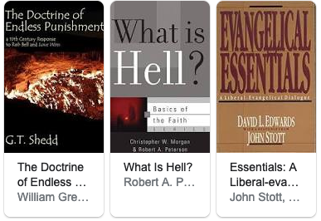
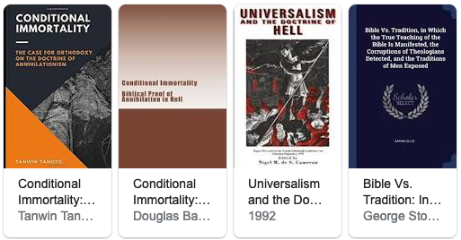
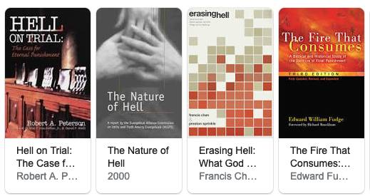
THE TOPIC OF HELL IS POPULAR AMONGST CHRISTIANS AND NON-CHRISTIANS

Slide 7
HELL IS ALSO KNOWN IN THE BIBLE AS:
Hades
Sheol

Slide 8
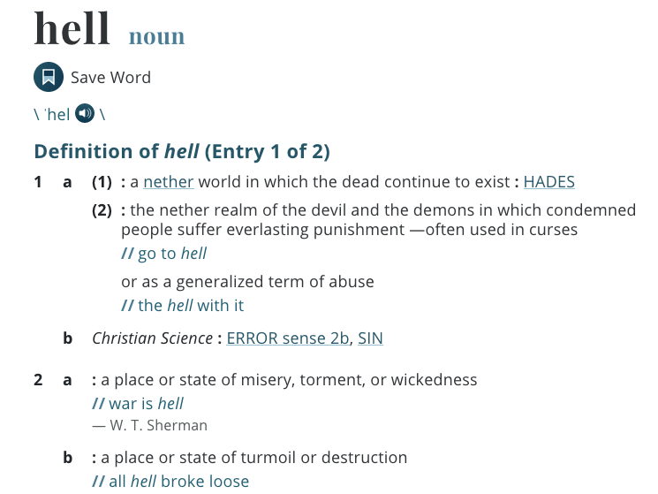
DEFINE HELL:

Slide 9
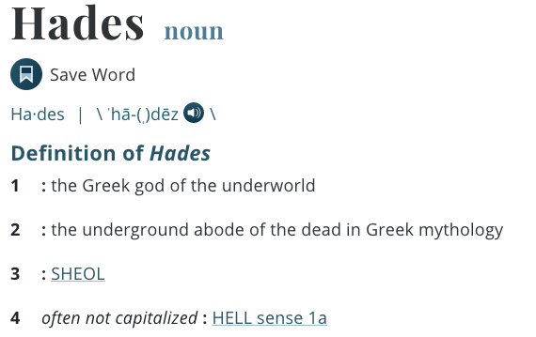
DEFINE HADES:

Slide 10
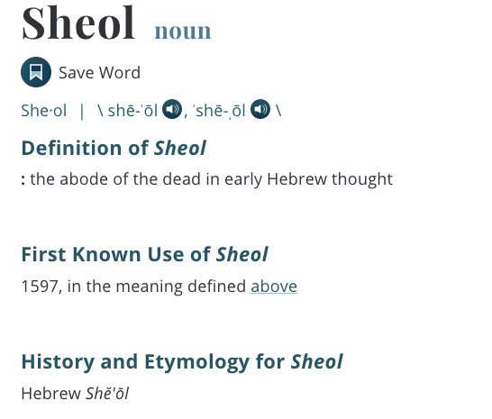
DEFINE SHEOL:

Slide 11
DID YOU KNOW?
In Greek mythology, Hades is both the land of the dead and the god who rules there. Hades the god (who the Greeks also called Pluto) is the brother of Zeus and Poseidon, who rule the skies and the seas. The realm called Hades, where he rules with his wife Persephone, is the region under the earth, full of mineral wealth and fertility and home to dead souls.

Slide 12
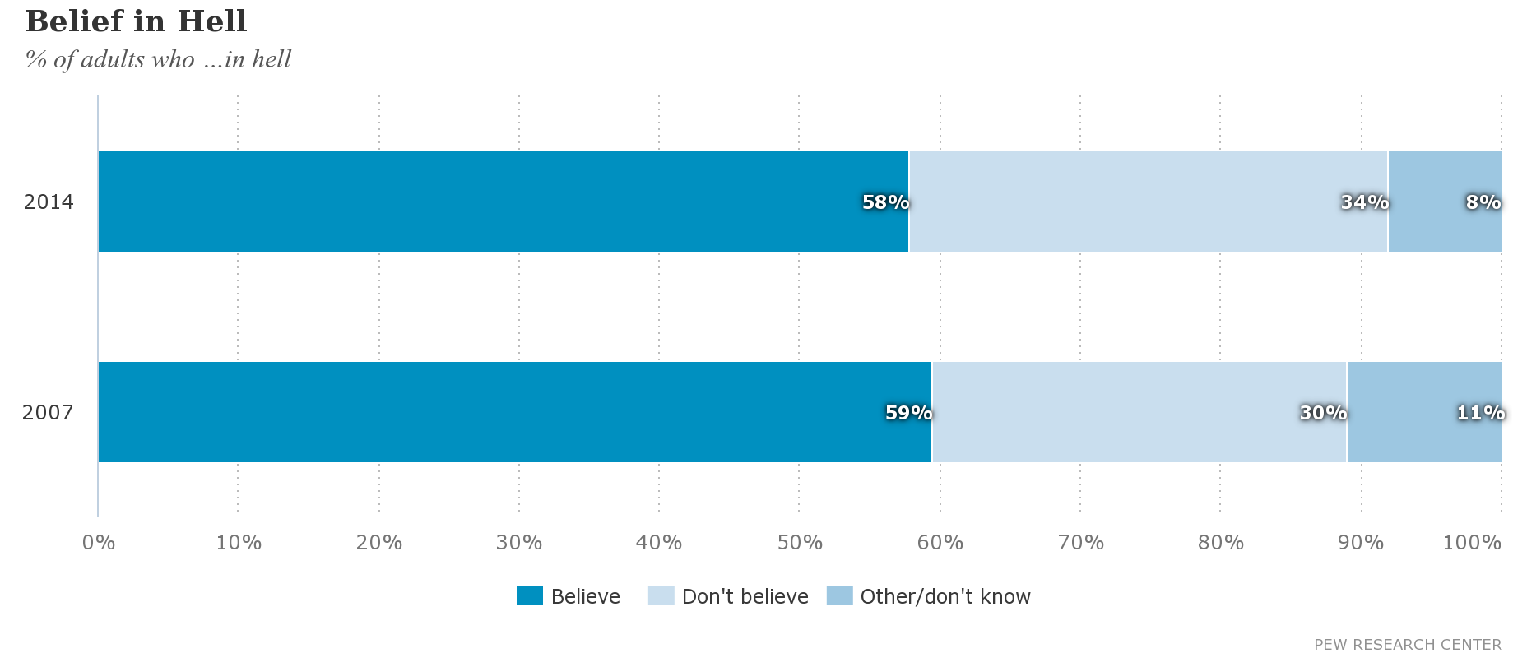
% OF ADULTS WHO BELIEVE IN HELL

Slide 13
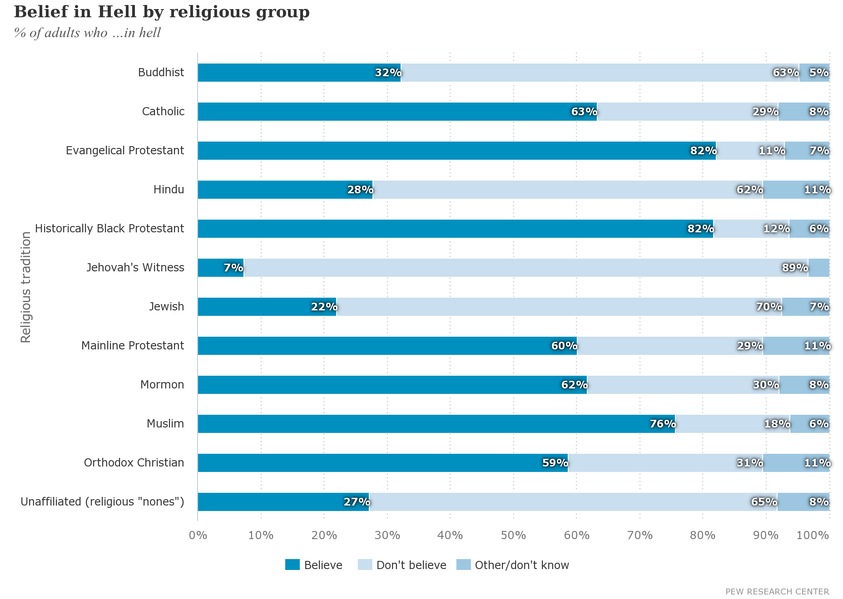
BELIEF IN HELL BY RELIGIOUS GROUP

Slide 14
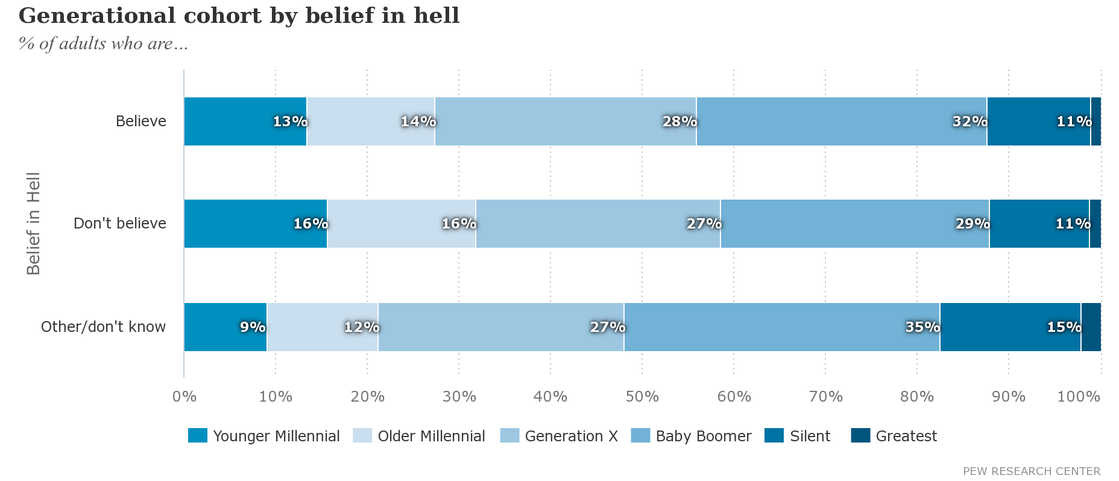
GENERATIONAL COHORT BY BELIEF IN HELL

Slide 15
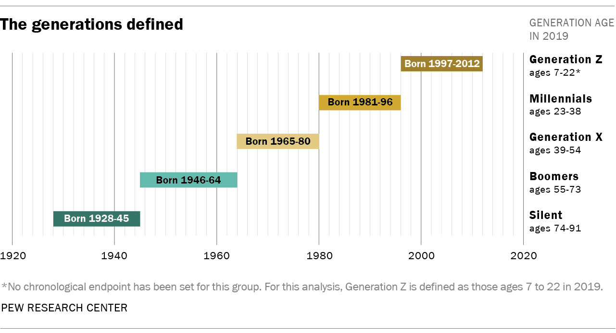
THE GENERATIONS DEFINED

Slide 16
Let’s Define The Word ‘Eternal’

Slide 17
ETERNAL
From Strong’s Concordance
Original Word - αἰώνιος
Transliterated Word - aiōnios
Phonetic Spelling - ahee-o'-nee-os
Strong's Definition - From G165; perpetual (also used of past time or past and future as well): - eternal for ever everlasting world (began).

Slide 18
ETERNAL
From Thayer’s Dictionary
Without beginning and end, that which always has been and always will be
Without beginning
Without end, never to cease, everlasting

Slide 19
The Word Eternal Used In Matthew 25
Matthew 25:41 KJVS
[41] Then shall he say also unto them on the left hand, Depart from me, ye cursed, into everlasting fire, prepared for the devil and his angels:
Matthew 25:46 KJVS
[46] And these shall go away into everlasting punishment: but the righteous into life eternal.
In Verse 41 - Hell Was Not Prepared For Man, But For The Devil And His Angels
In Verse 46 Jesus Makes A Clear Distinction Between The Outcome Of The Unrighteous And The Righteous
The Same Greek Word Was Used But There Has To Be A Clear Distinction Between Both Parties Regarding Their Life. Otherwise Both Parties Would End Up With Eternal Life And The Same Reward???

Slide 20
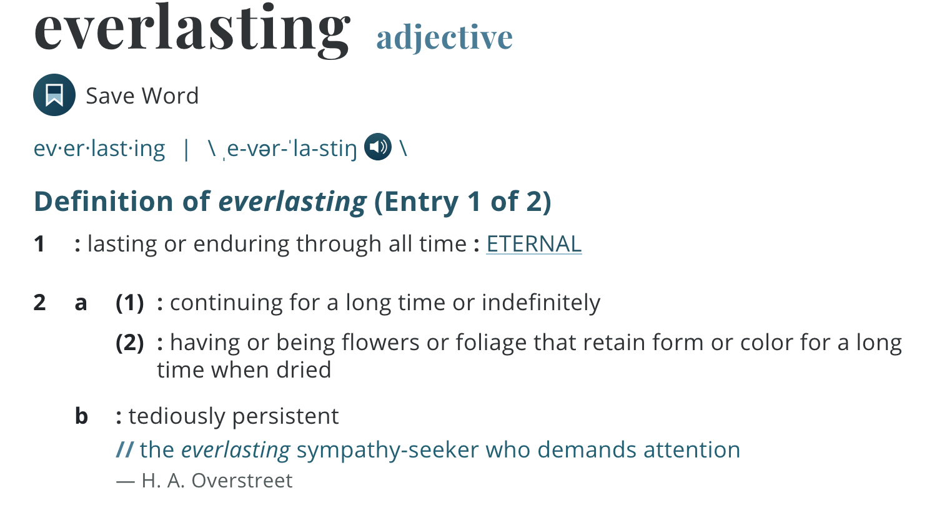
LET’S DEFINE THE WORD EVERLASTING
Oxford Dictionary - Lasting forever or a very long time.

Slide 21
LET’S SEE WHAT THE PROPHET SAYS:
62-1111e - "Why I'm Against Organized Religion"
28 And there’s no Scripture that says there is an Eternal hell. Cause, Eternal never did begin, neither does it ever end. So the Bible said “hell was created for the devil and his angels,” so it isn’t Eternal. There was a time when it wasn’t, and there’ll be a time when it’s not, again. But they may be punished in there, through fire and brimstone, and the pits of fire, for aeons of time, but it finally will end because hell is not Eternal.

Slide 22
LET’S SEE WHAT THE PROPHET SAYS:
And if there was an Eternal hell, you’d have to have Eternal Life to live in an Eternal hell. And if it was Eternal, it always was, and you always was in hell and you’ll always be in hell. See, so there is no such a thing.
29 So, you see, Eternal is “never had a beginning or an end.” And there’s only one form of Eternal Life, and that is in God, comes from the Greek word Zoe, which means “God’s Own Life.” And when we are born again of the Spirit of God, we become Eternal with God, because we have part of His Life, which makes us sons and daughters to God, then we have Eternal Life.

Slide 23
LET’S SEE WHAT THE PROPHET SAYS:
57-0925-Questions And Answers On Hebrews #1
30 See the difference? The wicked has everlasting punishment, but everlasting is “a space of time.” Now, if it would have been the same, it would have been written, “And these shall go away into everlasting punishment, the other shall go away into everlasting life.” See? Or, “They shall go away into Eternal punishment, and the other one into Eternal life.” See, if there’s an Eternal punishment, to be punished forever and ever, then there’s an Eternal…he’s got Eternal Life;

Slide 24
LET’S SEE WHAT THE PROPHET SAYS:
57-0925 - Questions And Answers On Hebrews #1
And the only one Eternal Life, and that comes from God. Everything without a beginning has no end, everything with a beginning has an end. See what I mean?
John 10:28 KJVS
[28] And I give unto them eternal life; and they shall never perish, neither shall any man pluck them out of my hand.

Slide 25
ETERNAL LIFE CONTINUED
John 12:25 KJVS
[25] He that loveth his life shall lose it; and he that hateth his life in this world shall keep it unto life eternal.
Romans 6:23 KJVS
[23] For the wages of sin is death; but the gift of God is eternal life through Jesus Christ our Lord.

Slide 26
FIRST DEATH & SECOND DEATH
The Last Three Verses Tie Together With This Verse:
Revelation 20:13-15 KJVS
[13] And the sea gave up the dead which were in it; and death and hell delivered up the dead which were in them: and they were judged every man according to their works.
[14] And death and hell were cast into the lake of fire. This is the second death.
[15] And whosoever was not found written in the book of life was cast into the lake of fire.

Slide 27
FIRST DEATH & SECOND DEATH
The First Death Or Death
It is the death that you die after your life leaves this earth.
The Second Death
It’s the death that takes place in the lake of fire (Which is not Hell)

Slide 28
FIRST DEATH & SECOND DEATH
The Second Death
This second death is complete annihilation because death and hell go into this lake of fire as well.
This is where death (first death), hell, and all unrighteous will be completely destroyed never to exist ever again.

Slide 29
OUR GOD IS A CONSUMING FIRE
Hebrews 12:28-29
28Wherefore we receiving a kingdom which cannot be moved, let us have grace, whereby we may serve God acceptably with reverence and godly fear:
29For our God is a consuming fire.

Slide 30
ALL SOULS BELONG TO GOD
Ezekiel 18:4
[4] Behold, all souls are mine; as the soul of the father, so also the soul of the son is mine: the soul that sinneth, it shall die. (Completely Annihilate)
Matthew 10:28
28And fear not them which kill the body, but are not able to kill the soul: but rather fear him which is able to destroy both soul and body in hell. - (Render Useless, Mar, Separation)

Slide 31
ALL SOULS BELONG TO GOD
So if God is a consuming fire and all souls are His that means that He can do whatever he wants with men’s souls.
There are souls that will utterly and completely be destroyed by this lake of fire who He is the source of.
This is because of the choice that those souls made here on earth. (FREE MORAL AGENCY)
ALL SOULS BELONG TO GOD, BUT ALL SOULS ARE NOT PART OF GOD

Slide 32
ALL SOULS BELONG TO GOD
So if those souls, hell, and death are all eternal, then that means God lives in hell and in death and in those souls that are to be destroyed… (WE KNOW HE DOESN’T)
We know this is not the case because light (Who God is the source of) and Darkness cannot dwell together.

Slide 33
LIGHT & DARKNESS CANNOT CO-EXIST
2 Corinthians 6:14-15
14Be ye not unequally yoked together with unbelievers: for what fellowship hath righteousness with unrighteousness? and what communion hath light with darkness?
15And what concord hath Christ with Belial? or what part hath he that believeth with an infidel?

Slide 34
WHO HAS THIS ETERNAL LIFE AND WHO DOESN’T
1 John 3:15 KJVS
[15] Whosoever hateth his brother is a murderer: and ye know that no murderer hath eternal life (ZOE) abiding in him.
1 John 5:11-12 KJVS
[11] And this is the record, that God hath given to us eternal life (ZOE), and this life (ZOE) is in his Son.
[12] He that hath the Son hath life (ZOE); and he that hath not the Son of God hath not life. (ZOE)

Slide 35
WHO HAS THIS ETERNAL LIFE AND WHO DOESN’T
CAB - The Smyrnaean Church Age"
You might wonder now, when you can use that word, “eternal,” and not use it the way we have been taught. That is easy. When it applies to God it means to be without beginning or end, and ever enduring and never ceasing. And when you talk of eternal life you have that in mind which is the life of God. “This is the record, that God has given us eternal life, and that life is in the Son. He that hath the Son hath life.” Now then, only sons of God have life eternal, the kind that never had a beginning, but always was. That is right.

Slide 36
WHO HAS THIS ETERNAL LIFE AND WHO DOESN’T
CAB - The Smyrnaean Church Age"
You have something in you right now that is eternal — without beginning or end. It is the Spirit of God. It is a part of God Himself. It is the life of God.
Now if a sinner is going to go to hell and then suffer the same as you are going to heaven and enjoy heaven, then he has the same kind of life you have already.

Slide 37
SATAN IS TO BE CAST INTO THE LAKE OF FIRE
Revelation 20:10 KJVS
[10] And the devil that deceived them was cast into the lake of fire and brimstone, where the beast and the false prophet are, and shall be tormented day and night for ever and ever.
This For Ever And Ever In This Verse Sounds Like It’s For Eternity But...

Slide 38
SATAN IS TO BE CAST INTO THE LAKE OF FIRE
Revelation 20:13-15 KJVS
[13] And the sea gave up the dead which were in it; and death and hell delivered up the dead which were in them: and they were judged every man according to their works.
[14] And death and hell were cast into the lake of fire. This is the second death.
[15] And whosoever was not found written in the book of life was cast into the lake of fire.

Slide 39
SATAN IS TO BE CAST INTO THE LAKE OF FIRE
Compare Revelation 20:10 to this verse:
Revelation 22:5 KJVS
[5] And there shall be no night there; and they need no candle, neither light of the sun; for the Lord God giveth them light: and they shall reign for ever and ever.

Slide 40
THE PHRASE FOR EVER AND EVER
The phrase Ever and Ever sounds like it could just mean eternity and even in the Greek it denotes that.
But it also means a space of time. See below:

Slide 41
THE PHRASE FOR EVER AND EVER
For Ever And Ever
Original Word
αἰών
Transliterated Word
aiōn
Phonetic Spelling
ahee-ohn'
for ever, an unbroken age, perpetuity of time, eternity
the worlds, universe
period of time, age

Slide 42
THE PHRASE FOR EVER AND EVER
For Ever And Ever
This Same Phrase Is Used In Both Revelations 20:10 and Revelations Revelation 20:13-15 That We Just Read.

Slide 43
THE PHRASE FOR EVER AND EVER
57-0925 - "Questions And Answers On Hebrews #1"
229 Now, to get the word “forever” look at the aeon—aeon. Did you notice here in the Bible? How many’s ever heard it said, “And aeons and ae-…”? How many knows that aeon is “a space of time”? Why, sure, anybody knows that aeon is “a space of time.”

Slide 44
THE PHRASE FOR EVER AND EVER
230 “And they shall burn for aeons,” that’s spaces of time. “Cast into the lake of fire, and shall burn for aeons.” Aeons means the “spaces of time.” They may burn for a hundred million years in punishment but, finally, they have to come to an end; to be extinct, altogether. See, because everything that is not perfect is the perverted off of the Perfect; and it had a beginning, so it must have an end.

Slide 45
THE PHRASE FOR EVER AND EVER
231 But we who believe on the Lord Jesus Christ has Zoe, “God’s Own Life” in us, and have Eternal Life. Not have life forever and ever, the sinner has life forever and ever, but we have “Eternal Life.”

Slide 46
SATAN HAS HIS TIME IN HELL BEFORE BEING CAST INTO THE LAKE OF FIRE
Revelation 20:2-3 KJVS
[2] And he laid hold on the dragon, that old serpent, which is the Devil, and Satan, and bound him a thousand years,
[3] And cast him into the bottomless pit, and shut him up, and set a seal upon him, that he should deceive the nations no more, till the thousand years should be fulfilled: and after that he must be loosed a little season.

Slide 47
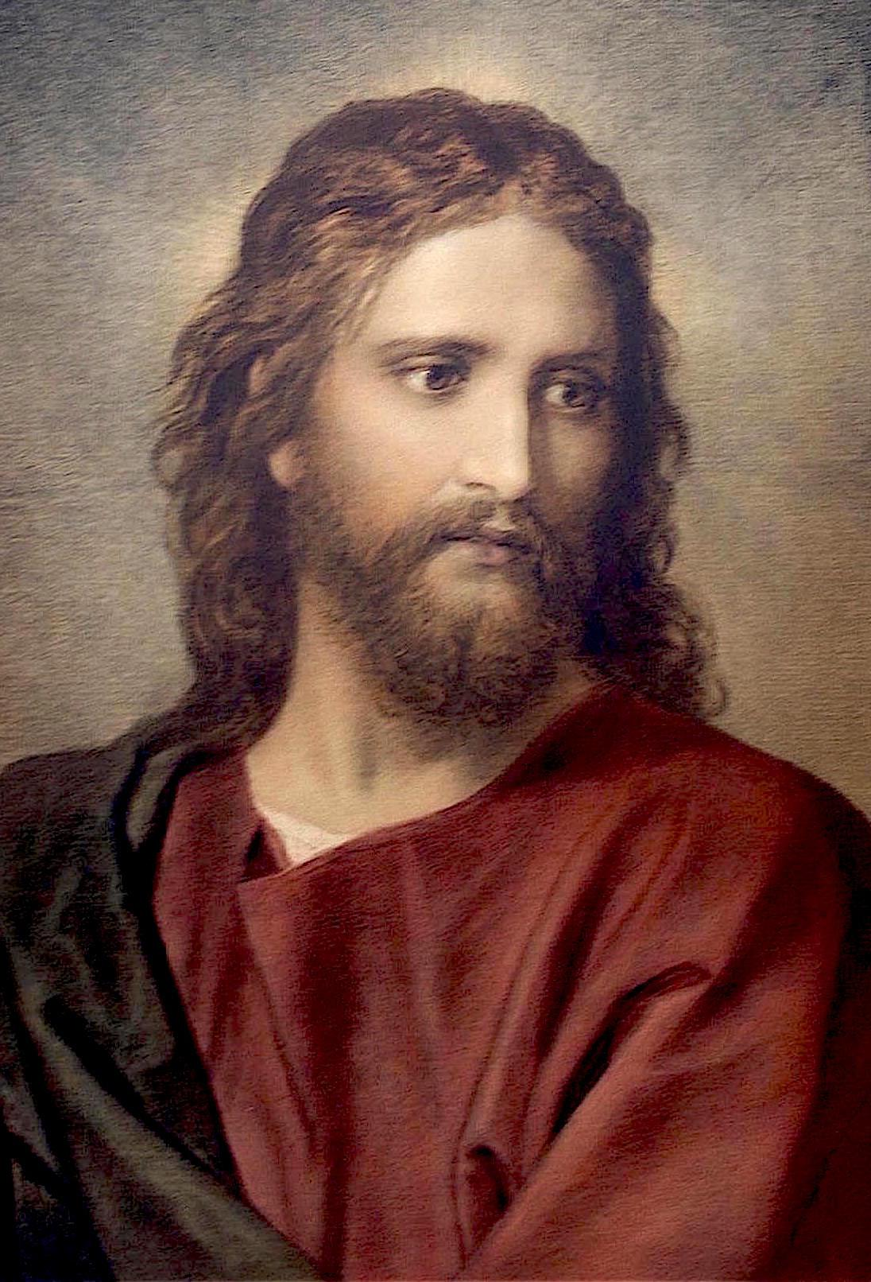
In Summary
God is the only source of eternal life (no beginning and no end)

Slide 48
In Summary
There is no way that death, hell, and sinners will live eternally being punished.

Slide 49
In Summary
Death, Hell, And Sinners have a beginning therefore they have to have an end. God who is eternal life never had a beginning and never will have an end.

Slide 50
In Summary
The sinner at this time is being tormented in hell right now, but that torment will have to cease according to Revelation 20:13

Slide 51
In Summary
Satan is heading to the same place not to be tormented day and night throughout all eternity, but to also be annihilated for good.

Slide 52
In Summary
By You Having Eternal Life In Your Soul, You Have Already Conquered Death, Hell, Satan, And The Second Death. NONE OF THESE THINGS CAN HARM THE BELIEVER

Slide 53
CAB - The Smyrnaean Church Age"
We all know that the second death is the lake of fire. Revelation 20:14, “And death and hell were cast into the lake of fire. This is the second death.” Of course that means all those who were therein, were cast into the lake of fire. Now then, I want to bring out something here for you. It no doubt will cause people to comment on my strange doctrine. But I stand here on the authority of the Word of God and deny that the unbeliever goes to an eternal hell and burns there eternally.

