Slide 1
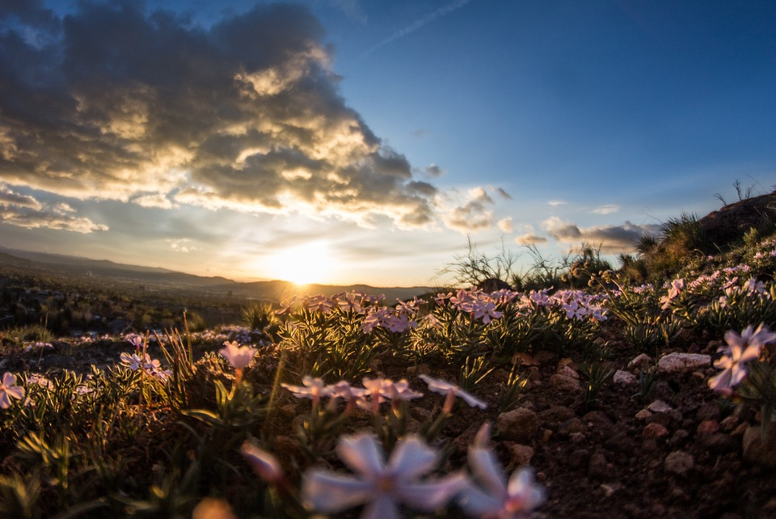
THE HIDDEN KINGDOM IN PLAIN VIEW

Slide 2
The Phrase “The Kingdom Of God”
The Phrase The Kingdom of God started to be used at the time of John The Baptist coming.
The phrase is used interchangeably with the phrases The Kingdom of Heaven or The Kingdom

Slide 3
The Phrase “The Kingdom Of God”
MATTHEW 3:1-2 - In those days came John the Baptist, preaching in the wilderness of Judaea, And saying, Repent ye: for the kingdom of heaven is at hand.
MATTHEW 4:17 - From that time Jesus began to preach, and to say, Repent: for the kingdom of heaven is at hand.

Slide 4
Meaning Of “The Kingdom Of God”
A kingdom or territory
Used in the N.T. to refer to the rule of the Messiah
Royal power, kingship, dominion, rule; not to be confused with an actual kingdom but rather the right or authority to rule over a kingdom

Slide 5
Jesus Did Not Establish A Physical Kingdom
John 6:14-15
14 Then those men, when they had seen the miracle that Jesus did, said, This is of a truth that prophet that should come into the world.
15 When Jesus therefore perceived that they would come and take him by force, to make him a king, he departed again into a mountain himself alone.

Slide 6
The Jews Were Looking For A Physical Kingdom When Messiah Would Appear
Luke 19:10-11
10 For the Son of man is come to seek and to save that which was lost.
11 And as they heard these things, he added and spake a parable, because he was nigh to Jerusalem, and because they thought that the kingdom of God should immediately appear.

Slide 7
The Disciples Were Still Looking For A Physical Kingdom
ACTS 1:6-8
6 When they therefore were come together, they asked of him, saying, Lord, wilt thou at this time restore again the kingdom to Israel?
7 And he said unto them, It is not for you to know the times or the seasons, which the Father hath put in his own power.
8 But ye shall receive power, after that the Holy Ghost is come upon you: and ye shall be witnesses unto me both in Jerusalem, and in all Judaea, and in Samaria, and unto the uttermost part of the earth.

Slide 8
Jesus Standing Before Pilate
JOHN 18:36-37
36 Jesus answered, My kingdom is not of this world: if my kingdom were of this world, then would my servants fight, that I should not be delivered to the Jews: but now is my kingdom not from hence.
37 Pilate therefore said unto him, Art thou a king then? Jesus answered, Thou sayest that I am a king. To this end was I born, and for this cause came I into the world, that I should bear witness unto the truth. Every one that is of the truth (Kingdom) heareth my voice.

Slide 9
The Kingdom Of God Is Not Seen Physically
LUKE 17:20-21
20 And when he was demanded of the Pharisees, when the kingdom of God should come, he answered them and said, The kingdom of God cometh not with observation:
21 Neither shall they say, Lo here! or, lo there! for, behold, the kingdom of God is within you.

Slide 10
The KoG Is Not Material But Within You
The Smyrnean Church Age - Church Age Book
“The Laodicean Age is one of vast wealth where often the criterion of spirituality is an abundance of earthly goods. My, how rich the church is in goods. But how poor in Spirit. "Blessed be ye poor, for yours is the kingdom of God. The kingdom of God is NOT meat and drink." It is not material. It is WITHIN us. A rich man is rich in God, not in worldly things.”

Slide 11
The KoG Is A Spiritual Kingdom
58-1221E THE.UNITY.OF.ONE.GOD.IN.THE.ONE.CHURCH
God's Kingdom is not of this earth. God's Kingdom is in our hearts. It's the spiritual Kingdom, that we're born into It. Jesus said, "The Kingdom of God comes, but not without violence. And the Kingdom of God is within you." The Holy Spirit, God's Kingdom, moving in the man, and governing and controlling him, that's the Kingdom.

Slide 12
The Kingdom Of God Is Power
I CORINTHIANS 4:20
20 For the kingdom of God is not in word, but in power. - The Word Killeth but the Spirit Giveth Life
Acts 1:8
But ye shall receive power (dunamis), after that the Holy Ghost is come upon you:

Slide 13
The Kingdom Of God Is Power
62-0211 Oneness
What is the Kingdom of God? Is within you. The Kingdom's in you. And when the Word comes in there, what does this Word begin? It turns Itself into power, making It say just exactly what It said. You stay with the Word. There it is, see. And It makes It power. "Jesus Christ the same yesterday, today, and forever."

Slide 14
What The Kingdom Of God Is Not
Romans 14:17
17 For the kingdom of God is not meat and drink; but righteousness, and peace, and joy in the Holy Ghost.
Faith Without Works Is Dead & Works Without Faith Are Dead Also

Slide 15
What The Kingdom Of God Is Not
64-0308 THE.TOKEN
God's Blood-bound promises, makes us free from sin and shame, and different from the rest of the world. You don't have to dress different; anybody can dress different. You have to be, on the inside, different. The Life is on the inside; not dressing, wearing. "The Kingdom of God is not meat and drink, or wearing of apparel; but it's the long-suffering, goodness, gentleness, patience, in the Holy Ghost.”

Slide 16
What The Kingdom Of God Is Not
58-0928M THE.BAPTISM.OF.THE.HOLY.SPIRIT
Then we're going to come over on the Armenian side. What did they get? Works: that's the holiness groups. Works... "Bless God, I'll let my hair grow out," the women, and, "Oh, praise God, I won't even wear a short-sleeved shirt," the men will and so forth like that. That has nothing to do with the Kingdom.

Slide 17
What The Kingdom Of God Is Not
58-0928M THE.BAPTISM.OF.THE.HOLY.SPIRIT
No, sir. You can let your hair grow long; you can wear dresses whatever you want to; or you can do this, that, or the other, and it won't have nothing at all to do with it. You're not saved because of your clothes. If so, God would just have made some patterns of such. Jesus wouldn't have had to die. You're saved because that God saved you by grace. And you do these things just in appreciation. Common decency will tell you that. You do those things in appreciation.

Slide 18
Not Far From The Kingdom
Mark 12:28-34
Jesus said to a Scribe there that he was not far from the Kingdom because of his knowledge of the Word.
Being Close To The Kingdom Does Not Mean You Are In The Kingdom

Slide 19
How Do You Receive This Kingdom?
John 3:1-8
Jesus speaking to Nicodemus
Verse 3 - Jesus answered and said unto him, Verily, verily, I say unto thee, Except a man be born again, he cannot see the kingdom of God.

Slide 20
How Do You Receive This Kingdom?
63-0731 - "There Is Only One Way Provided By God For Anything"
You are born into the Kingdom of God. How? By the Holy Ghost. That’s God’s witness. He gives witness by the Word of God, that we’ve passed from death unto Life, because we are in the Kingdom of God.

Slide 21
How Do You Receive This Kingdom?
John 3:1-8
Jesus speaking to Nicodemus
Verse 5 - Jesus answered, Verily, verily, I say unto thee, Except a man be born of water and of the Spirit, he cannot enter into the kingdom of God.

Slide 22
How Do You Receive This Kingdom?
50-0818 IT.SHALL.BE.EVEN.AS.IT.WAS.TOLD.ME
No matter what it looks like here... We don't look at what we see; we look at what we do not see. Is that right? Anyhow, "to see" doesn't mean "to look at." The word "see" means "to understand." Jesus said, "Except a man be borned of water and Spirit, he cannot see the Kingdom of God." In other words, he can't understand the Kingdom of God until he's borned again. See? You have to accept it by faith. And then when He comes into you, you understand it.

Slide 23
This Kingdom Can’t Be Seen Or Explained
John 3:1-8
Jesus speaking to Nicodemus
Verse 8 - The wind bloweth where it listeth, and thou hearest the sound thereof, but canst not tell whence it cometh, and whither it goeth: so is every one that is born of the Spirit.

Slide 24
This Kingdom Can’t Be Seen Or Explained
59-1223 QUESTIONS.AND.ANSWERS
"Verily, verily, I say unto you, except a man be borned again he cannot see the Kingdom of God." Now, you couldn't see the Kingdom of God, because the Kingdom of God is the Holy Spirit. "Some standing here will not taste of death till they see the Kingdom coming in power," He said.

Slide 25
This Kingdom Can’t Be Seen Or Explained
59-1223 QUESTIONS.AND.ANSWERS
Then, "The Kingdom of God," the Bible said, "is within you." It's within you, the Holy Spirit, and you can't see that with your eyes. So "see" means "to understand."

Slide 26
This Kingdom Can’t Be Seen Or Explained
60-0604 TO.WHOM.SHALL.WE.GO
Now, that translation there is really "understand"--understand the Kingdom of God. The Kingdom of God's within you, so you couldn't actually see it, 'less you see it operating. But the only way you'll ever be able to understand it; you've got to be borned again.

Slide 27
This Kingdom Can’t Be Seen Or Explained
60-0604 TO.WHOM.SHALL.WE.GO
To be borned again, you've been filled with God's Spirit; then you're in Christ. And when you're in Christ, the Holy Spirit that wrote the Bible, that manifested Christ, is in you to recognize His own Self.

Slide 28
This Kingdom Of God Is The Word
62-1216 THE.FALLING.APART.OF.THE.WORLD
Now, God's Kingdom is not of this world. And when Christ was here, He give us the program of this Kingdom. He gave us the program of God's Kingdom, the Father's Kingdom, which is His Word. Now, if you want to know how you get into that Kingdom, this Word's got it.

Slide 29
The Kingdom Of God Is A Mystery Now Revealed
Mark 4:11 | Luke 8:10
Unto you it is given to know the mystery of the kingdom of God
Unto you it is given to know the mysteries of the kingdom of God:

Slide 30
The Kingdom Of God Is A Mystery Now Revealed
Colossians 1:26-27
26 Even the mystery which hath been hid from ages and from generations, but now is made manifest to his saints:
27 To whom God would make known what is the riches of the glory of this mystery among the Gentiles; which is Christ in you, the hope of glory:

Slide 31
The Kingdom Of God Is A Mystery Now Revealed
Revelation 10:7
But in the days of the voice of the seventh angel, when he shall begin to sound, the mystery of God should be finished, as he hath declared to his servants the prophets.

Slide 32
This Spiritual Kingdom Must Now Manifest Itself In Its Fullness
GENESIS 1:26
And God said, Let us make man in our image, after our likeness: and let them have dominion over the fish of the sea, and over the fowl of the air, and over the cattle, and over all the earth, and over every creeping thing that creepeth upon the earth.

Slide 33
This Spiritual Kingdom Must Now Manifest Itself In Its Fullness
The Smyrnaean Church Age
Unless we suffer with Him we cannot reign with Him. You have to suffer to reign. The reason for this is that character simply is never made without suffering. Character is a VICTORY, not a gift. A man without character can't reign because power apart from character is Satanic.

Slide 34
This Spiritual Kingdom Must Now Manifest Itself In Its Fullness
The Smyrnaean Church Age
But power with character is fit to rule. And since He wants us to share even His throne on the same basis that He overcame and is set down in His Father's throne, then we have to overcome to sit with Him.

Slide 35
This Spiritual Kingdom Must Now Manifest Itself In Its Fullness
Character - Moral excellence and firmness
Having good Character is the way you behave when others are not watching you.
If you don’t know how to rule over your earth (body), how can you rule and reign over the planet earth.

Slide 36
That’s Why
These Virtues
Need To Be
Established
In The
Believer’s Life
After The Kingdom
Has Come In
The Believer.

Slide 37
The Kingdom In You Will Call Forth A Resurrection
All of the Subjects & Partakers Of This Kingdom Must Resurrect In Complete Fullness. Then We Which Are Alive & Remain Shall Be Caught Up With Them.
I Thessalonians 4:13-17

Slide 38
The Kingdom In You Will Call Forth A Resurrection
I Thessalonians 4:16-17
16 For the Lord himself shall descend from heaven with a shout, with the voice of the archangel, and with the trump of God: and the dead in Christ shall rise first:
17 Then we which are alive and remain shall be caught up together with them in the clouds, to meet the Lord in the air:

Slide 39
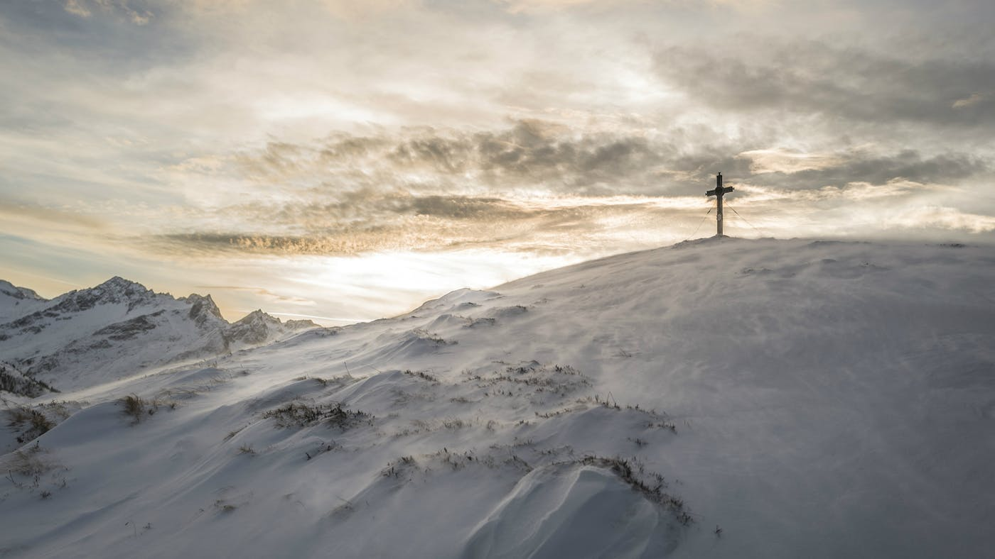
Satan Builds His Kingdom With No Sure Foundation From The Head Down To The Feet.
Heady | High Minded | No Humility
Romanism & Christianity

Slide 40
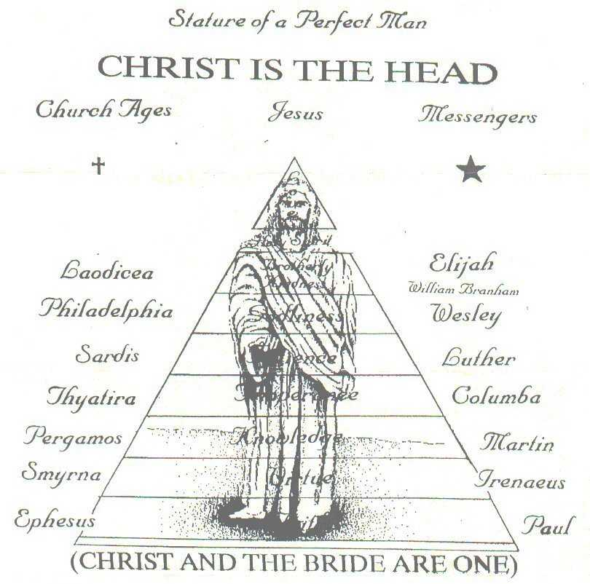
Christ Builds His
Kingdom From
The Feet
To The Head.
It Has To Start
Humble & Meek

Slide 41
Romanism & Christianity
That’s Why Satan’s Kingdom Will Not Stand Forever

Slide 42
Satan’s Kingdom Cannot Stand
DANIEL 2:35
Then was the iron, the clay, the brass, the silver, and the gold, broken to pieces together, and became like the chaff of the summer threshingfloors; and the wind carried them away, that no place was found for them: and the stone that smote the image became a great mountain, and filled the whole earth.

Slide 43
Satan’s Kingdom Cannot Stand
DANIEL 2:44
And in the days of these kings shall the God of heaven set up a kingdom, which shall never be destroyed: and the kingdom shall not be left to other people, but it shall break in pieces and consume all these kingdoms, and it shall stand for ever.

Slide 44
The Hidden Kingdom Coming In Plain View
64-0802 The Future Home
God already took up His abode, potentially. The Kingdom of God is in the earth now, in the hearts of His saints. It’s His attributes that He begin in the beginning. Now His attributes is redeemed. What’s He waiting? To redeem the earth, to set His attributes on it, to fulfill exactly His predestinated plan.

Slide 45
The Hidden Kingdom Coming In Plain View
63-0728 Christ Is The Mystery
Then, our Headship is a Kingdom. “The Kingdom of God is within you,” said the Bible, Jesus. The Kingdom! We are not a denomination. We belong to a Kingdom, and the Kingdom is the Word of God made Spirit and Life in our own life,

Slide 46
The Hidden Kingdom Coming In Plain View
63-0728 Christ Is The Mystery
bringing to pass every promise in this day, as it did in that day when the Word and God was one. And the Word and God is one in His Church today, making It the Headship of the Body that is redeemed, to bring the Message in the last day; and be taken up from the dead, in the resurrection, to go back and restore again, as Adam and Eve, in the beginning in the garden of Eden.

Slide 47
Seek Ye First The Kingdom Of God
Jesus Himself Commanded Us To Seek The Kingdom Of God First Above Anything Else
MATTHEW 6:33
But seek ye first the kingdom of God, and his righteousness; and all these things shall be added unto you.

Slide 48
Giving It All Up For The KoG’s Sake
Luke 18:28-30
28 Then Peter said, Lo, we have left all, and followed thee.
29 And he said unto them, Verily I say unto you, There is no man that hath left house, or parents, or brethren, or wife, or children, for the kingdom of God's sake,
30 Who shall not receive manifold more in this present time, and in the world to come life everlasting.

Slide 49
The Lord’s Prayer Is The Bride’s Prayer
MATTHEW 6:9-13
9 After this manner therefore pray ye: Our Father which art in heaven, Hallowed be thy name.
10 Thy kingdom come. Thy will be done in earth, as it is in heaven.
11 Give us this day our daily bread.

Slide 50
The Lord’s Prayer Is The Bride’s Prayer
MATTHEW 6:9-13
12 And forgive us our debts, as we forgive our debtors.
13 And lead us not into temptation, but deliver us from evil: For thine is the kingdom, and the power, and the glory, for ever. Amen.

