Slide 1
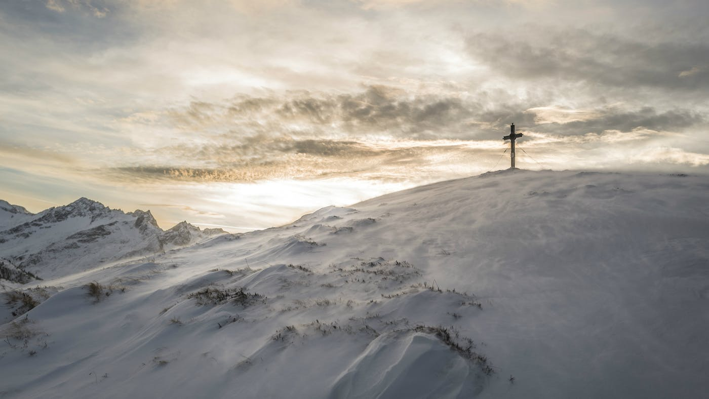
THE KINGDOM OF GOD
Is It External or Internal?

Slide 2
The Phrase The Kingdom of God started to be used at the time of John The Baptist coming.
The phrase is used interchangeably with the phrases The Kingdom of Heaven or The Kingdom
It was first used in Matthew 3:2
MATTHEW 3:1
» 1 † ¶ In those days came John the Baptist, preaching in the wilderness of Judaea, MATTHEW 3:2» 2 † And saying, Repent ye: for the kingdom of heaven is at hand.
MATTHEW 4:17
» 17 † From that time Jesus began to preach, and to say, Repent: for the kingdom of heaven is at hand.

Slide 3
932 » basileia {bas-il-i'-ah} basileiva from 935; TDNT -- 1:564,97; n f
AV -- kingdom (of God) 71 -- kingdom (of heaven) (32) -- kingdom (general or evil) (20) -- (Thy or Thine) kingdom (6) -- His kingdom (6) -- the kingdom (5) -- (My) kingdom (4) -- misc (18) [162]
royal power, kingship, dominion, rule; not to be confused with an actual kingdom but rather the right or authority to rule over a kingdom
a kingdom or territory
used in the N.T. to refer to the rule of the Messiah

Slide 4
Matthew 6:25-34
25 Therefore I say unto you, Take no thought for your life, what ye shall eat, or what ye shall drink; nor yet for your body, what ye shall put on. Is not the life more than meat, and the body than raiment?
26 Behold the fowls of the air: for they sow not, neither do they reap, nor gather into barns; yet your heavenly Father feedeth them. Are ye not much better than they?
27 Which of you by taking thought can add one cubit unto his stature?
28 And why take ye thought for raiment? Consider the lilies of the field, how they grow; they toil not, neither do they spin:
29 And yet I say unto you, That even Solomon in all his glory was not arrayed like one of these.

Slide 5
Matthew 6:25-34
30 Wherefore, if God so clothe the grass of the field, which to day is, and to morrow is cast into the oven, shall he not much more clothe you, O ye of little faith?
31 Therefore take no thought, saying, What shall we eat? or, What shall we drink? or, Wherewithal shall we be clothed?
32 (For after all these things do the Gentiles seek:) for your heavenly Father knoweth that ye have need of all these things.
33 But seek ye first the kingdom of God, and his righteousness; and all these things shall be added unto you.
34 Take therefore no thought for the morrow: for the morrow shall take thought for the things of itself. Sufficient unto the day is the evil thereof.

Slide 6
« 118-3 † SMYRNAEAN.CHURCH.AGE - CHURCH.AGE.BOOK CPT.4
Here is where you have to believe again in the love, and goodness and wisdom of God. This, too, is needful. Remember He admonished, "Take no thought for the morrow, what ye shall eat or what ye shall put on. Your Father knoweth the things ye have need of. He Who clothes the lily and feeds the sparrow shall do much more for you. These physical things are not the true basic necessities of your life, for a man's life consisteth not of the things he possesses. But rather seek ye first the kingdom of God and His righteousness and all material necessities will be added unto you.”

Slide 7
« 118-3 † SMYRNAEAN.CHURCH.AGE - CHURCH.AGE.BOOK CPT.4
The people of God are not material minded. They are Christ-minded. They do not seek the treasures that are below; they seek those above. It is absolutely true, the majority of Christians are NOT wealthy. Rather they are on the poor side. It was so in Jesus' day. It was true in Paul's day and it should be true today. Oh, it is not too true today for the Laodicean Age is one of vast wealth where often the criterion of spirituality is an abundance of earthly goods. My, how rich the church is in goods. But how poor in Spirit. "Blessed be ye poor, for yours is the kingdom of God. The kingdom of God is NOT meat and drink." It is not material. It is WITHIN us. A rich man is rich in God, not in worldly things.

Slide 8
Luke 18:28-30
28 Then Peter said, Lo, we have left all, and followed thee.
29 And he said unto them, Verily I say unto you, There is no man that hath left house, or parents, or brethren, or wife, or children, for the kingdom of God's sake,
30 Who shall not receive manifold more in this present time, and in the world to come life everlasting.

Slide 9
Is The Kingdom of God External? What The Kingdom Is Not
John 6:14-15
14 Then those men, when they had seen the miracle that Jesus did, said, This is of a truth that prophet that should come into the world.
15 When Jesus therefore perceived that they would come and take him by force, to make him a king, he departed again into a mountain himself alone.

Slide 10
The People of Israel Were Looking For An External Kingdom
Luke 19:10-11
10 For the Son of man is come to seek and to save that which was lost.
11 And as they heard these things, he added and spake a parable, because he was nigh to Jerusalem, and because they thought that the kingdom of God should immediately appear.
Mark 15:43 ???
43 Joseph of Arimathaea, an honourable counsellor, which also waited for the kingdom of God, came, and went in boldly unto Pilate, and craved the body of Jesus.

Slide 11
Is The Kingdom of God External? What The Kingdom Is Not
LUKE 17:20-21
20 And when he was demanded of the Pharisees, when the kingdom of God should come, he answered them and said, The kingdom of God cometh not with observation:
21 Neither shall they say, Lo here! or, lo there! for, behold, the kingdom of God is within you.

Slide 12
Is The Kingdom of God External? What The Kingdom Is Not
ACTS 1:6-8
6 When they therefore were come together, they asked of him, saying, Lord, wilt thou at this time restore again the kingdom to Israel?
7 And he said unto them, It is not for you to know the times or the seasons, which the Father hath put in his own power.
8 But ye shall receive power, after that the Holy Ghost is come upon you: and ye shall be witnesses unto me both in Jerusalem, and in all Judaea, and in Samaria, and unto the uttermost part of the earth.

Slide 13
Is The Kingdom of God External? What The Kingdom Is Not
John 18:33-38
33 Then Pilate entered into the judgment hall again, and called Jesus, and said unto him, Art thou the King of the Jews?
34 Jesus answered him, Sayest thou this thing of thyself, or did others tell it thee of me?
35 Pilate answered, Am I a Jew? Thine own nation and the chief priests have delivered thee unto me: what hast thou done?

Slide 14
Is The Kingdom of God External? What The Kingdom Is Not
John 18:33-38
36 Jesus answered, My kingdom is not of this world: if my kingdom were of this world, then would my servants fight, that I should not be delivered to the Jews: but now is my kingdom not from hence.
37 Pilate therefore said unto him, Art thou a king then? Jesus answered, Thou sayest that I am a king. To this end was I born, and for this cause came I into the world, that I should bear witness unto the truth. Every one that is of the truth (Kingdom) heareth my voice.
38 Pilate saith unto him, What is truth? And when he had said this, he went out again unto the Jews, and saith unto them, I find in him no fault at all.

Slide 15
Is The Kingdom of God External? What The Kingdom Is Not
58-1221E THE.UNITY.OF.ONE.GOD.IN.THE.ONE.CHURCH _ JEFFERSONVILLE.IN V-16 N-8 SUNDAY_
« 45 † God's Kingdom is not of this earth. God's Kingdom is in our hearts. It's the spiritual Kingdom, that we're born into It. Jesus said, "The Kingdom of God comes, but not without violence. And the Kingdom of God is within you." The Holy Spirit, God's Kingdom, moving in the man, and governing and controlling him, that's the Kingdom.

Slide 16
Is The Kingdom of God External? What The Kingdom Is Not
Let’s Read Romans Chapter 14
Romans 14:17
17 For the kingdom of God is not meat and drink; but righteousness, and peace, and joy in the Holy Ghost.

Slide 17
Is The Kingdom of God External? What The Kingdom Is Not
64-0308 THE.TOKEN_ DALLAS.TX V-19 N-12 SUNDAY_
« 117 † God, God's Blood-bound promises, makes us free from sin and shame, and different from the rest of the world. You don't have to dress different; anybody can dress different. You have to be, on the inside, different. The Life is on the inside; not dressing, wearing. "The Kingdom of God is not meat and drink, or wearing of apparel; but it's the long-suffering, goodness, gentleness, patience, in the Holy Ghost.”

Slide 18
Is The Kingdom of God External? What The Kingdom Is Not
58-0928M THE.BAPTISM.OF.THE.HOLY.SPIRIT_ JEFFERSONVILLE.IN V-5 N-2 SUNDAY_
« 63 † That's why we different with the Baptist, the Methodists, and the so-called Calvinistic thinking people. But Calvinism's right.
Then we're going to come over on the Arminian side. What did they get? Works: that's the holiness groups. Works... "Bless God, I'll let my hair grow out," the women, and, "Oh, praise God, I won't even wear a short-sleeved shirt," the men will and so forth like that. That has nothing to do with the Kingdom. No, sir. You can let your hair grow long; you can wear dresses whatever you want to; or you can do this, that, or the other, and it won't have nothing at all to do with it.

Slide 19
Is The Kingdom of God External? What The Kingdom Is Not
58-0928M THE.BAPTISM.OF.THE.HOLY.SPIRIT_ JEFFERSONVILLE.IN V-5 N-2 SUNDAY_
You're not saved because of your clothes. If so, God would just have made some patterns of such. Jesus wouldn't have had to die. You're saved because that God saved you by grace. And you do these things just in appreciation. Common decency will tell you that. You do those things in appreciation.
Works is what I do for God. If I never preach another sermon and live here a hundred and fifty years, I'm still saved. Sure. I'm not saved because I'm a preacher. I'm saved because it's the grace of God that saved me. There wasn't one thing I could do to merit it.

Slide 20
Not Far From The Kingdom…
Mark 12:28-34
28 And one of the scribes came, and having heard them reasoning together, and perceiving that he had answered them well, asked him, Which is the first commandment of all?
29 And Jesus answered him, The first of all the commandments is, Hear, O Israel; The Lord our God is one Lord:
30 And thou shalt love the Lord thy God with all thy heart, and with all thy soul, and with all thy mind, and with all thy strength: this is the first commandment.

Slide 21
Not Far From The Kingdom…
Mark 12:28-34
31 And the second is like, namely this, Thou shalt love thy neighbour as thyself. There is none other commandment greater than these.
32 And the scribe said unto him, Well, Master, thou hast said the truth: for there is one God; and there is none other but he:
33 And to love him with all the heart, and with all the understanding, and with all the soul, and with all the strength, and to love his neighbour as himself, is more than all whole burnt offerings and sacrifices.
34 And when Jesus saw that he answered discreetly, he said unto him, Thou art not far from the kingdom of God.

Slide 22
Not Far From The Kingdom…
The Rejected King 60-0515
And the little nurse came in to the bedside where I was reading the Bible, and she was a new nurse on the floor, and she said, "How do you do?" She said, "I believe that you're Rev. Branham here for a--a physical checkup."I said, "I am."And she said, "May I rub your back, a--a make you feel a little better, with the alcohol?"And I said, "You may do it."And while she was rubbing on my back, she said, "What denomination of church do you belong to?"And I said, "Oh, I belong to the oldest denomination that there is."And she said, "What denomination is that?"I said, "It's the one that was organized before the world was ever organized.""Oh," she said, "what... I don't believe I know just that..." She said, "I belong to a certain church. Is it that organization?”

Slide 23
Not Far From The Kingdom…
The Rejected King 60-0515
I said, "No, ma'am. That was only about two hundred years ago, that organization. But this organization started when the morning stars sang together and the sons of God shouted for joy, "When they seen the coming of a Saviour to redeem mankind.” And she just stopped rubbing my back, and I was stooped a little over this way so the lady could rub (And she was from near Corydon down here.) and we got to talking, and she said, "Sir, I've always believed that if God ever was God, He's still God today just like He was in the old days." She said, "Though my church flatly denies that, but I believe that it is the truth."And I said, "You're not far from the Kingdom of God, young woman."She said, "If He ever was a Healer, isn't He still a Healer?"I said, "He most certainly is, my sister."

Slide 24
Not Far From The Kingdom…
62-0623 PERSEVERANT_ SOUTH.GATE.CA SATURDAY_
« E-6 † The day after our meetings in Phoenix there's a little lady came up, and said, "Brother Branham, since the meetings," said, "I let my hair grow. "I said, "You're not far from the Kingdom now. "She--she said, "My sister had a wheelbarrow full of these shorts and things. She was going to throw them in the garbage can, and the next sister come along and got them." And said, "She said was finished with those things."So I said, "That's all right. I believe the church will come back on its feet someday. If it keeps going like that, it'll get all right.”

Slide 25
Not Far From The Kingdom…
62-0623 PERSEVERANT_ SOUTH.GATE.CA SATURDAY
I met a man not long ago that said, "Why don't you leave off of those women?"I said, "Well, I don't know."He said, "People regard you as a prophet."I said, "I'm not."He said, "But they regard you that. Why don't you teach them deep things, how to receive deep spiritual gifts?"I said, "How can I teach them algebra when they won't even know their ABC's?" You know what ABC stands for, don't you? Always Believe Christ. And that's--that's right. That's the first ABC's. Let them learn how to do that, and then we'll teach something a little different, you know. And so, when we get that, why, we're coming pretty close to the--to the Kingdom.

Slide 26
Not Far From The Kingdom…
55-0222 JEHOVAH.JIREH_ PHOENIX.AZ TUESDAY_
« E-52 † Now, I'm not a latter day rain; I--I'm just your brother. I don't care whether you're first rain, second rain, middle rain, all rain, or--or no rain, it don't make any difference to me. I love you just the same, and we are brothers.He said, "Well," said...All this big church said, "Our best members went over there."I said, "They did?" I said, "What'd they go for?" I said, "That man came over and pull them away?""No."I said, "Well, what'd they go for? You said they's your best members." I said, "'Cause they were hungry.

Slide 27
Not Far From The Kingdom…
55-0222 JEHOVAH.JIREH_ PHOENIX.AZ TUESDAY_
If you'd quit teaching so much theology and calling each one, "Doctor, Ph.D., D.D.D., and get God back in the Church, get some little old boy with a pair of overalls on, and long hair, go to preaching the Gospel, it'd be different." Now, that's right. I don't care if he don't know his ABC's, or split peas from coffee. Let me tell you, brother, as long as he knows Jesus Christ, he may talk through his nose, and holler "hit" and "hain't," but as long as he's got God with him, something will happen in your church, I'll tell you that. I'd rather have that, than all the Ph.D.s and everything else; that's psychology. I want to know God in the power of His resurrection. That's right. Now...He said, "I guess you're about right."I said, "You're not far from the kingdom now." Amen.

Slide 28
How Do You Enter Into This Kingdom?
John 3:1-8
1 † ¶ There was a man of the Pharisees, named Nicodemus, a ruler of the Jews:
2 † The same came to Jesus by night, and said unto him, Rabbi, we know that thou art a teacher come from God: for no man can do these miracles that thou doest, except God be with him.
3 † Jesus answered and said unto him, Verily, verily, I say unto thee, Except a man be born again, he cannot see the kingdom of God.

Slide 29
How Do You Enter Into This Kingdom?
4 † Nicodemus saith unto him, How can a man be born when he is old? can he enter the second time into his mother's womb, and be born?
5 † Jesus answered, Verily, verily, I say unto thee, Except a man be born of water and of the Spirit, he cannot enter into the kingdom of God.
6 † That which is born of the flesh is flesh; and that which is born of the Spirit is spirit.
7 † Marvel not that I said unto thee, Ye must be born again.
8 † The wind bloweth where it listeth, and thou hearest the sound thereof, but canst not tell whence it cometh, and whither it goeth: so is every one that is born of the Spirit.

Slide 30
The Word Is Both Water & Spirit?
Ephesians 5:26
25Husbands, love your wives, even as Christ also loved the church, and gave himself for it; 26That he might sanctify and cleanse it with the washing of water by the word,
JOHN 6:63-71
» 63 † It is the spirit that quickeneth; the flesh profiteth nothing: the words that I speak unto you, they are spirit, and they are life.
» 64 † But there are some of you that believe not. For Jesus knew from the beginning who they were that believed not, and who should betray him.
» 65 † And he said, Therefore said I unto you, that no man can come unto me, except it were given unto him of my Father.

Slide 31
The Word Is Both Water & Spirit?
» 66 † From that time many of his disciples went back, and walked no more with him.
» 67 † Then said Jesus unto the twelve, Will ye also go away?
» 68 † Then Simon Peter answered him, Lord, to whom shall we go? thou hast the words of eternal life.
» 69 † And we believe and are sure that thou art that Christ, the Son of the living God.
» 70 † Jesus answered them, Have not I chosen you twelve, and one of you is a devil?
» 71 † He spake of Judas Iscariot the son of Simon: for he it was that should betray him, being one of the twelve.

Slide 32
Examples Of The Word Being Water
ISAIAH 55:10-11
» 10 † For as the rain cometh down, and the snow from heaven, and returneth not thither, but watereth the earth, and maketh it bring forth and bud, that it may give seed to the sower, and bread to the eater:
» 11 † So shall my word be that goeth forth out of my mouth: it shall not return unto me void, but it shall accomplish that which I please, and it shall prosper in the thing whereto I sent it.

Slide 33
Examples Of The Word Being Water
HOSEA 6:1-3
» 1 † ¶ Come, and let us return unto the LORD: for he hath torn, and he will heal us; he hath smitten, and he will bind us up.
» 2 † After two days will he revive us: in the third day he will raise us up, and we shall live in his sight.
» 3 † Then shall we know, if we follow on to know the LORD: his going forth is prepared as the morning; and he shall come unto us as the rain, as the latter and former rain unto the earth.

Slide 34
Examples Of The Word Being Water
HEBREWS 10:19-22
» 19 † ¶ Having therefore, brethren, boldness to enter into the holiest by the blood of Jesus, 20 † By a new and living way, which he hath consecrated for us, through the veil, that is to say, his flesh; 21 † And having an high priest over the house of God; HEBREWS 10:22» Let us draw near with a true heart in full assurance of faith, having our hearts sprinkled from an evil conscience, and our bodies washed with pure water.

Slide 35
How Do You Enter Into This Kingdom?
(Better Yet, How Does This Kingdom Enter Into You?)
63-0731 - "There Is Only One Way Provided By God For Anything"
148 You are born into the Kingdom of God. How? By the Holy Ghost. That’s God’s witness. He gives witness by the Word of God, that we’ve passed from death unto Life, because we are in the Kingdom of God. That’s God’s.
50-0818 IT.SHALL.BE.EVEN.AS.IT.WAS.TOLD.ME_ CLEVELAND.OH FRIDAY_« E-23 † No matter what it looks like here... We don't look at what we see; we look at what we do not see. Is that right? Anyhow, "to see" doesn't mean "to look at." The word "see" means "to understand." Jesus said, "Except a man be borned of water and Spirit, he cannot see the Kingdom of God." In other words, he can't understand the Kingdom of God until he's borned again. See? You have to accept it by faith. And then when He comes into you, you understand it.

Slide 36
How Do You Enter Into This Kingdom?
(Better Yet, How Does This Kingdom Enter Into You?)
59-1223 QUESTIONS.AND.ANSWERS_ JEFFERSONVILLE.IN COD WEDNESDAY_
« 99 † Now, in there that subconscious (See?), that's where your mind... Now, Jesus said, "Except a man be borned again..." (Now, that's not what I wanted.) "Verily, verily, I say unto you, except a man be borned again he cannot see the Kingdom of God." Now, you couldn't see the Kingdom of God, because the Kingdom of God is the Holy Spirit. "Some standing here will not taste of death till they see the Kingdom coming in power," He said. Then, "The Kingdom of God," the Bible said, "is within you." It's within you, the Holy Spirit, and you can't see that with your eyes. So "see" means "to understand."
Have you ever looked at anything, looking right at it, say, "Well, I just don't see it." See? "I just don't see it." You mean you don't understand it. See, see? You don't understand it. To see is "to understand." But with your eyes you look at anything. But with what's inside of you, you understand with, you see with that. See? With the eyes of God you look...

Slide 37
How Do You Enter Into This Kingdom?
(Better Yet, How Does This Kingdom Enter Into You?)
Remember we read in Luke 17:20-21 – 20 And when he was demanded of the Pharisees, when the kingdom of God should come, he answered them and said, The kingdom of God cometh not with observation:
21 Neither shall they say, Lo here! or, lo there! for, behold, the kingdom of God is within you.
The Kingdom of God Is A Mystery
Mark 4:11 - And he said unto them, Unto you it is given to know the mystery of the kingdom of God: but unto them that are without, all these things are done in parables:
Luke 8:10 - Unto you it is given to know the mysteries of the kingdom of God: but to others in parables; that seeing they might not see, and hearing they might not understand.

Slide 38
How Do You Enter Into This Kingdom?
(Better Yet, How Does This Kingdom Enter Into You?)
The Kingdom of God Is A Mystery, Now Revealed…
Colossians 1:25-27
25 Whereof I am made a minister, according to the dispensation of God which is given to me for you, to fulfil the word of God;
Even the mystery which hath been hid from ages and from generations, but now is made manifest to his saints:
To whom God would make known what is the riches of the glory of this mystery among the Gentiles; which is Christ in you, the hope of glory:

Slide 39
How Do You Enter Into This Kingdom?
(Better Yet, How Does This Kingdom Enter Into You?)
It’s Difficult To Explain Your New Birth Yet You Know It’s Taken Place
Hebrews 11:1-3
1 Now faith is the substance of things hoped for, the evidence of things not seen.
2 For by it the elders obtained a good report.
3 Through faith we understand that the worlds were framed by the word of God, so that things which are seen were not made of things which do appear. - Quanta
James 2:5 - Hearken, my beloved brethren, Hath not God chosen the poor of this world rich in faith, and heirs of the kingdom which he hath promised to them that love him?

Slide 40
How Do You Enter Into This Kingdom?
(Better Yet, How Does This Kingdom Enter Into You?)
60-0604 TO.WHOM.SHALL.WE.GO_ JEFFERSONVILLE.IN SATURDAY_
« E-43 † Nicodemus asked the question, "How can I be borned again? I'm an old man--enter into my mother's womb the second time?"
He said, "Except a man be borned again, he cannot see the Kingdom of God."
Now, that translation there is really "understand"--understand the Kingdom of God. The Kingdom of God's within you, so you couldn't actually see it, 'less you see it operating. But the only way you'll ever be able to understand it; you've got to be borned again. To be borned again, you've been filled with God's Spirit; then you're in Christ. And when you're in Christ, the Holy Spirit that wrote the Bible, that manifested Christ, is in you to recognize His own Self. Amen. That's why you must come to Him.
The Kingdom of God Is Made Up Of Attributes That Cannot Be Seen Or Understood By The Natural Man

Slide 41
How Do You Enter Into This Kingdom?
(Better Yet, How Does This Kingdom Enter Into You?)
59-1223 QUESTIONS.AND.ANSWERS_ JEFFERSONVILLE.IN COD WEDNESDAY_
« 101 † And now, hold your point now. Here's a good one if you're ready for it: The Christian looks at things that he doesn't see with his eyes (See?), for we look at the unseen. See? How do you look at it? With your inside eyes. You see it by faith. And now, to prove that: the whole Christian armor is made up of unseen qualities. What is a Christian armor? Somebody says, "Seeing is believing." That person would never be a Christian, because the armor of the Christian is made up of this: love. Did you ever see it? You seen it in action, but you never seen love. If you can, pull your part of love out and let me see what it looks like. See? Look, love, joy, peace, long suffering, goodness, meekness, faith--faith, gentleness (See?); the whole Christian armor is unseen with the natural eye, but it is understood by the heart. There you are. There you are.

Slide 42
The Kingdom of God Is Not In Word But In Power
I CORINTHIANS 4:19-20
19 But I will come to you shortly, if the Lord will, and will know, not the speech of them which are puffed up, but the power.
20 For the kingdom of God is not in word, but in power.
That is why the letter of the Word and the quotes of the Message could kill you if that power is not there to guide you to put these things together in their proper place and in a balanced way.
What Is This Power?
ACTS 1:8 » But ye shall receive power (dunamis), after that the Holy Ghost is come upon you: and ye shall be witnesses unto me both in Jerusalem, and in all Judaea, and in Samaria, and unto the uttermost part of the earth.

Slide 43
The Kingdom of God Is Not In Word But In Power
LUKE 9:27 » But I tell you of a truth, there be some standing here, which shall not taste of death, till they see the kingdom of God.
62-0211 ONENESS_ JEFFERSONVILLE.IN V-10 N-2 SUNDAY_
« 186 † Listen closely. First Corinthians 4:20, says, "The Kingdom of God is His Word made power." If you want to put that down, First Corinthians 4:20. The Kingdom of God is God's Word made power. What is the Kingdom of God? Is within you. The Kingdom's in you. And when the Word comes in there, what does this Word begin? It turns Itself into power, making It say just exactly what It said.
187 You can't say "It says this," and It says This, and make It work. You got to say the same thing It says. That makes a confession. Not saying, "Well, It's polished up a little here, I'll have more wisdom, I'll be in better standing over here."
188 You stay with the Word. There it is, see. And It makes It power. "Jesus Christ the same yesterday, today, and forever." Jesus said, in Saint John 14:12, "If ye abide in Me and My Words in you." No, I beg your pardon, that wasn't what He said there. He said, "He that believeth in Me, the works that I do shall he do also. If ye abide in Me and My Word in you, you can ask what you will and it shall be done unto you. If ye abide in Me and My Word in you."

Slide 44
The Kingdom of God Is Not In Word But In Power
62-1216 THE.FALLING.APART.OF.THE.WORLD_ JEFFERSONVILLE.IN V-10 N-6 SUNDAY_
« 202 † Now, God's Kingdom is not of this world. And when Christ was here, He give us the program of this Kingdom. He gave us the program of God's Kingdom, the Father's Kingdom, which is His Word. Now, if you want to know how you get into that Kingdom, this Word's got it. If you come in at any other door... You got to come in the same door the rest of them come in by. If you try to make some other entrance, why, you're the same as a thief and a robber. And He said, "Whosoever shall add one word to This, or take one Word from It, the same will be taken (his part) out of the Book of Life." So if you claim you had your name on the Book of Life, if you did, don't get it taken off.
203 When, Peter on the Day of Pentecost opened the door to the Kingdom. He did. The Kingdom had just been set up at Jerusalem. I want some man to tell me that the Church begin at Rome. I want somebody to prove that to me. The Church never begin at Rome, the Church begin in Jerusalem. The Kingdom was set up on the Day of Pentecost. And when man wanted to know how to get into this Kingdom, Peter said, "Repent, every one of you, and be baptized in the Name of Jesus Christ for the remission of your sins, and you shall receive the gift of the Holy Ghost." Cause that's what puts them into the Kingdom. Any other policy, through denomination or a handshake, or anything else, is false messiah. No matter how popular you are, and how prominent you'll be, and you might be a deacon, even a pastor or a bishop, or elder or state overseer, no matter what you are, it's false till you come back to God's humble Lamb and His Kingdom.

Slide 45
The Kingdom Has To Be Established Inwardly First Then It Can Manifest Outwardly and Reign Properly
Adam in that Genesis 1:26 man was that perfect Kingdom with eternal life in his soul and that is what God is trying to bring us back to. Eternal Life = New Birth
GENESIS 1:26 » And God said, Let us make man in our image, after our likeness: and let them have dominion over the fish of the sea, and over the fowl of the air, and over the cattle, and over all the earth, and over every creeping thing that creepeth upon the earth.
The Smyrnaean Church Age - Unless we suffer with Him we cannot reign with Him. You have to suffer to reign. The reason for this is that character simply is never made without suffering. Character is a VICTORY, not a gift. A man without character can't reign because power apart from character is Satanic. But power with character is fit to rule. And since He wants us to share even His throne on the same basis that He overcame and is set down in His Father's throne, then we have to overcome to sit with Him.

Slide 46
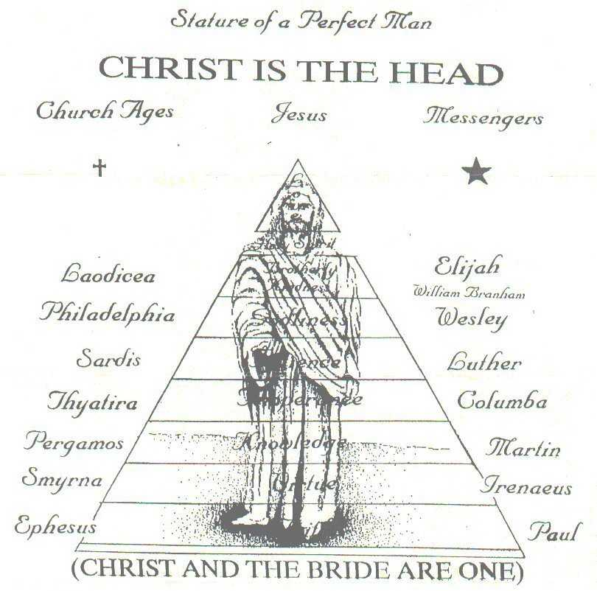
That’s Why These Virtues Need To Be Established In The Believer’s Life After That Kingdom Has Come In The Believer.
(Stature of a Perfect Man)------------------------------------>

Slide 47
Romanism & Christianity according to Bro. Branham ---→

Slide 48
Satan Builds His Kingdom With No Sure Foundation From The Head Down To The Feet. That’s Why It Falls Apart / Christ Builds His Kingdom From The Feet To The Head.

Slide 49
The Kingdom Has To Be Established Inwardly First Then It Can Manifest Outwardly and Reign Properly
DANIEL 2:35 » Then was the iron, the clay, the brass, the silver, and the gold, broken to pieces together, and became like the chaff of the summer threshingfloors; and the wind carried them away, that no place was found for them: and the stone that smote the image became a great mountain, and filled the whole earth.
DANIEL 2:44 » And in the days of these kings shall the God of heaven set up a kingdom, which shall never be destroyed: and the kingdom shall not be left to other people, but it shall break in pieces and consume all these kingdoms, and it shall stand for ever.

Slide 50
The Kingdom Has To Be Established Inwardly First Then It Can Manifest Outwardly and Reign Properly
Let’s Read DANIEL 7:13-27

Slide 51
The Kingdom Has To Be Established Inwardly First Then It Can Manifest Outwardly and Reign Properly
64-0802 - "The Future Home Of The Heavenly Bridegroom And The Earthly Bride"
God already took up His abode, potentially. The Kingdom of God is in the earth now, in the hearts of His saints. It’s His attributes that He begin in the beginning. Now His attributes is redeemed. What’s He waiting? To redeem the earth, to set His attributes on it, to fulfill exactly His predestinated plan. Do you see it? 63-0728 - "Christ Is The Mystery Of God Revealed"
Then, our Headship is a Kingdom. “The Kingdom of God is within you,” said the Bible, Jesus. The Kingdom! We are not a denomination. We belong to a Kingdom, and the Kingdom is the Word of God made Spirit and Life in our own life, bringing to pass every promise in this day, as it did in that day when the Word and God was one. And the Word and God is one in His Church today, making It the Headship of the Body that is redeemed, to bring the Message in the last day; and be taken up from the dead, in the resurrection, to go back and restore again, as Adam and Eve, in the beginning in the garden of Eden. The threefold mystery of God, His Body! Oh, my!

Slide 52
THE KINGDOM OF GOD
Is It External or Internal?
I Say It’s Both But It Has To Begin Internally Within You In Order To Manifest Externally.

Slide 53
The Lord’s Prayer
MATTHEW 6:9-13
9 After this manner therefore pray ye: Our Father which art in heaven, Hallowed be thy name.
10 Thy kingdom come. Thy will be done in earth, as it is in heaven.
11 Give us this day our daily bread.
12 And forgive us our debts, as we forgive our debtors.
13 And lead us not into temptation, but deliver us from evil: For thine is the kingdom, and the power, and the glory, for ever. Amen.

