Slide 1
MARK 16:15
» 15 † And he said unto them, Go ye into all the world, and preach the gospel to every creature.
MARK 16:16
» 16 † He that believeth and is baptized shall be saved; but he that believeth not shall be damned.

Slide 9
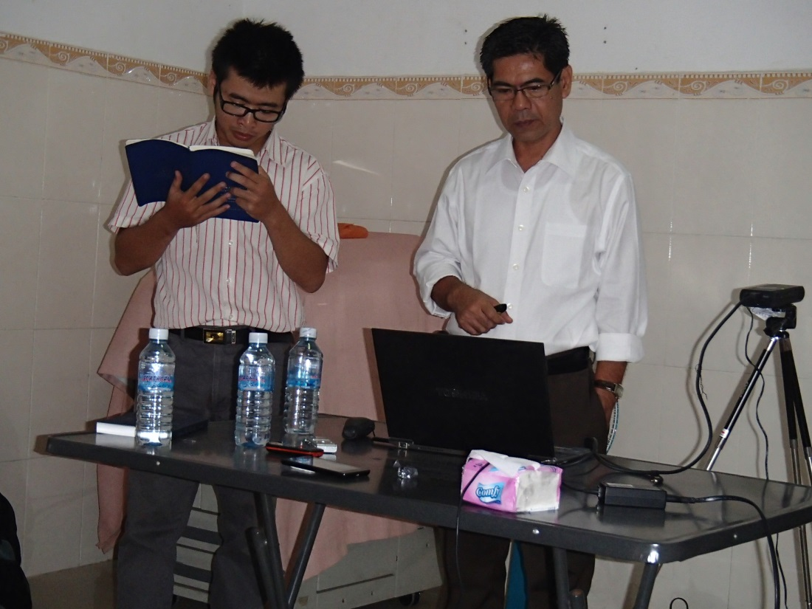
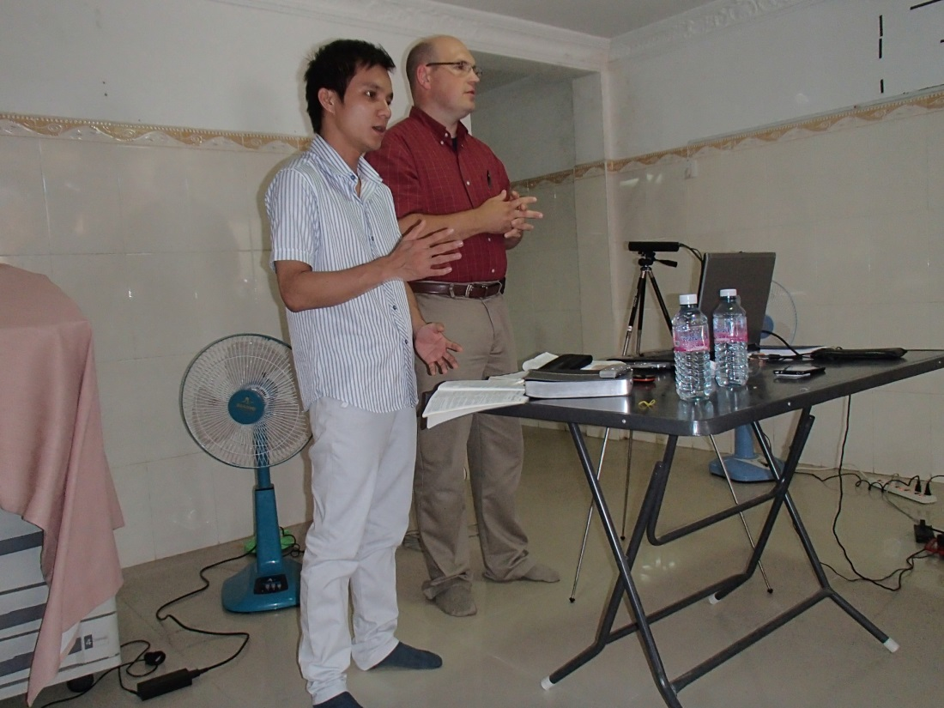
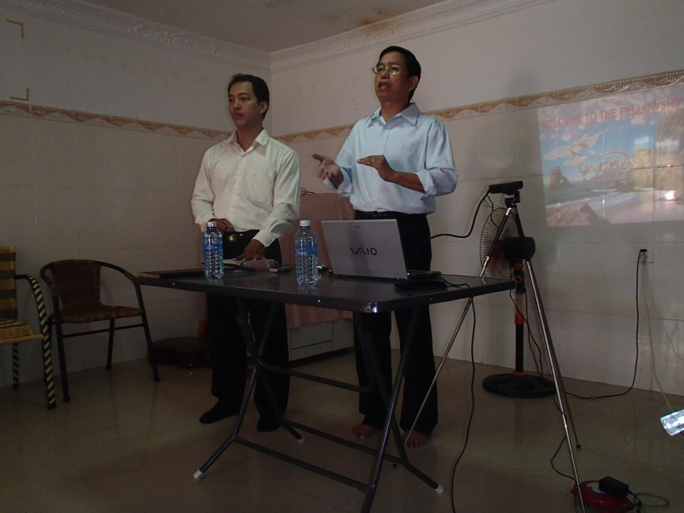
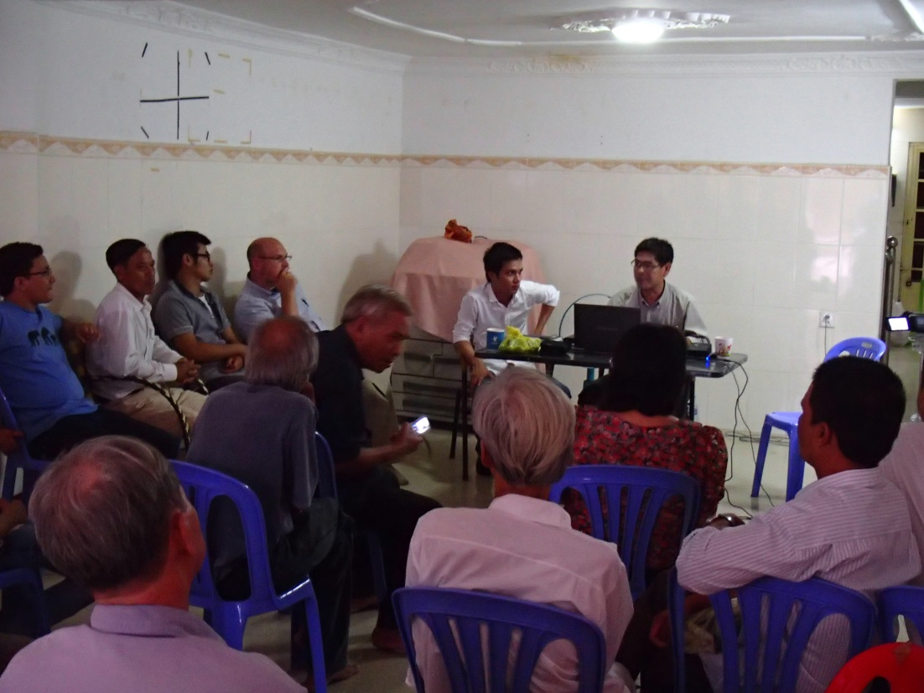

Slide 13
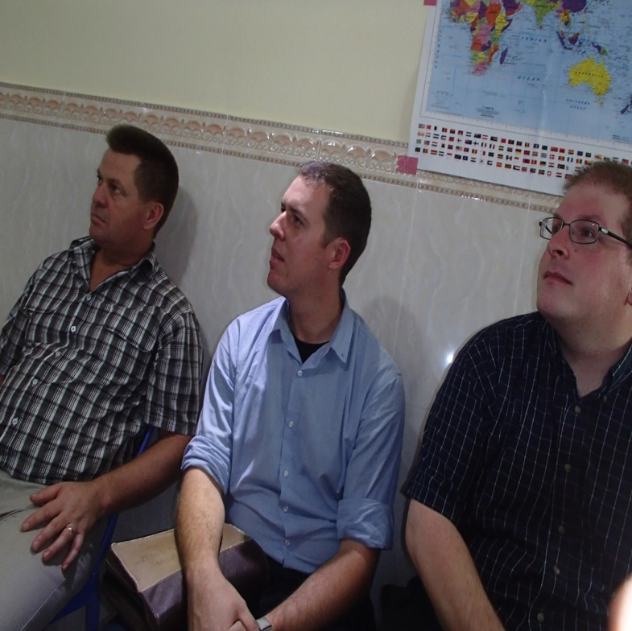
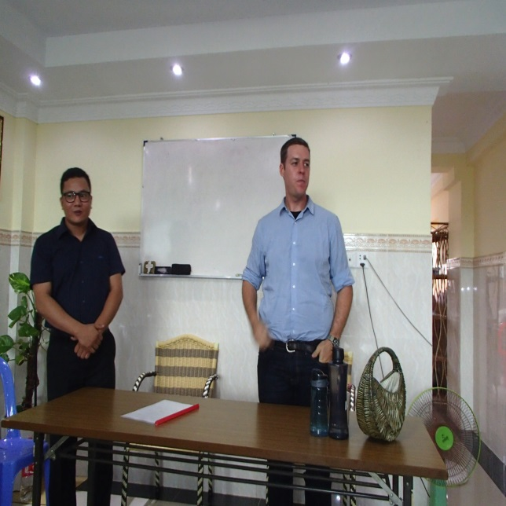
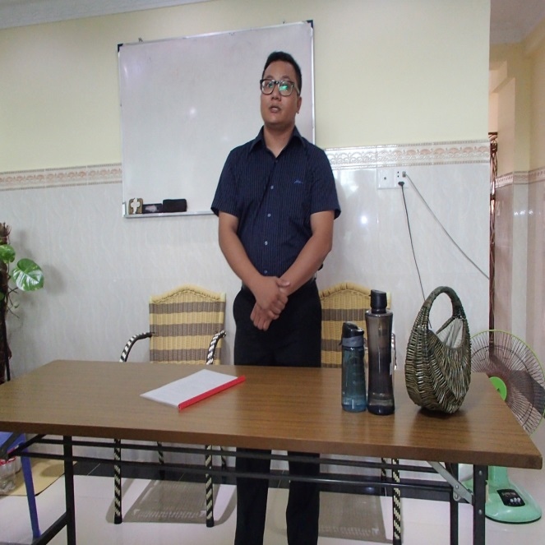
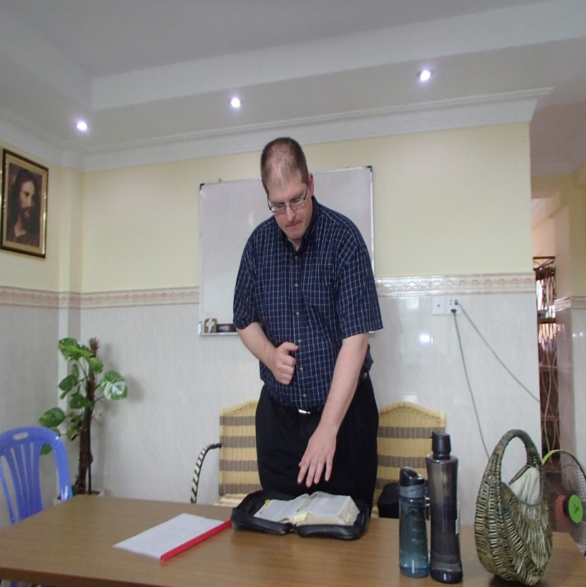
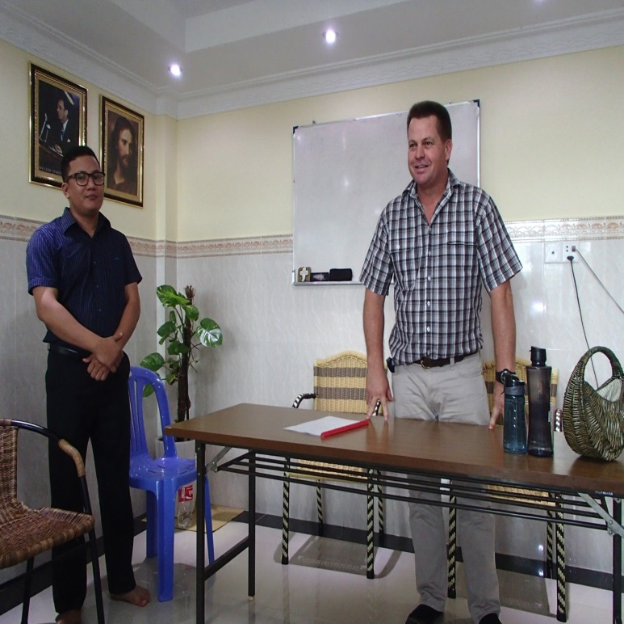
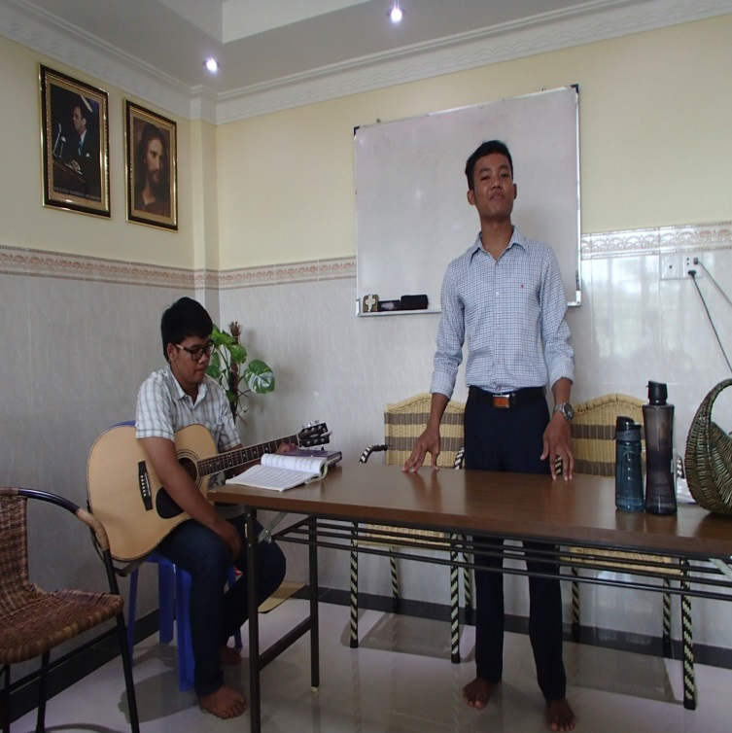

Slide 14
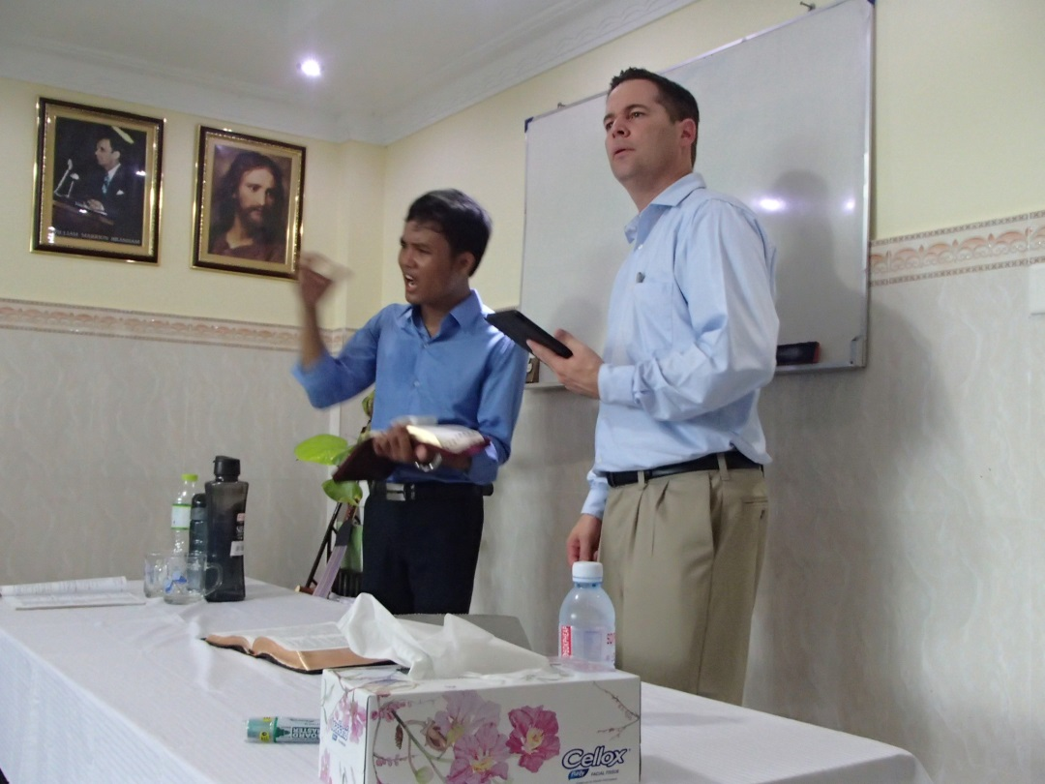
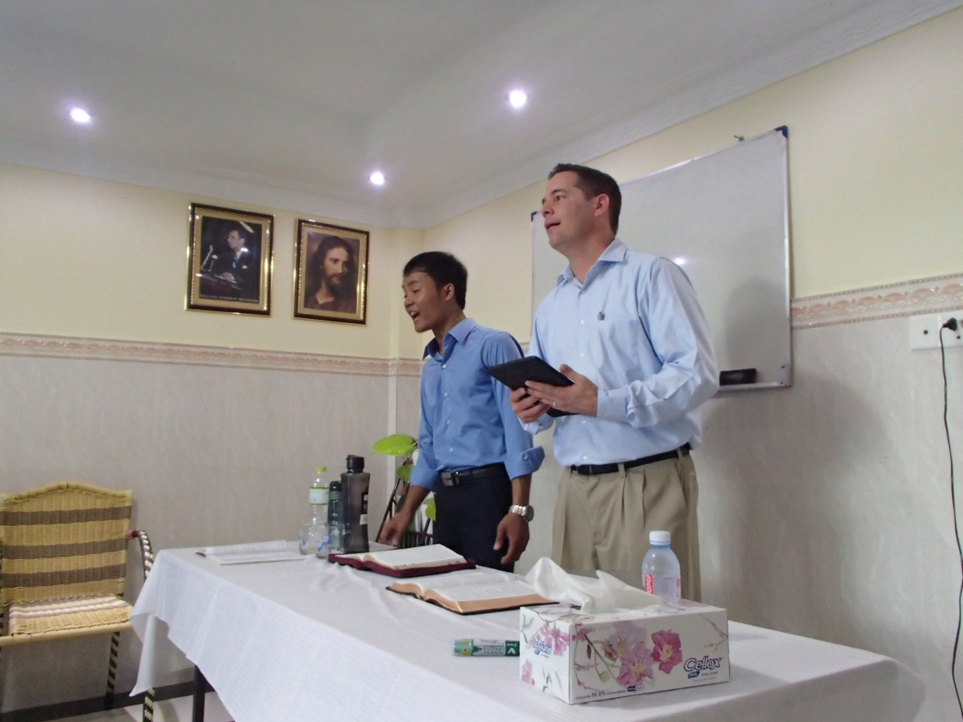

Slide 15
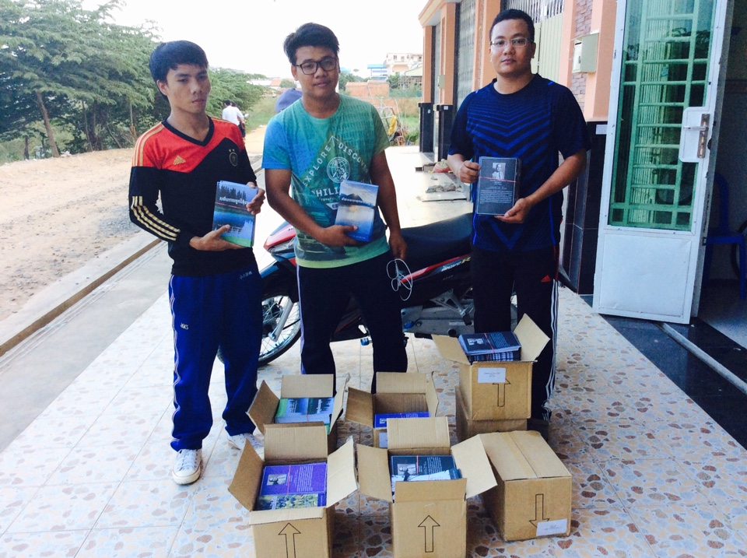
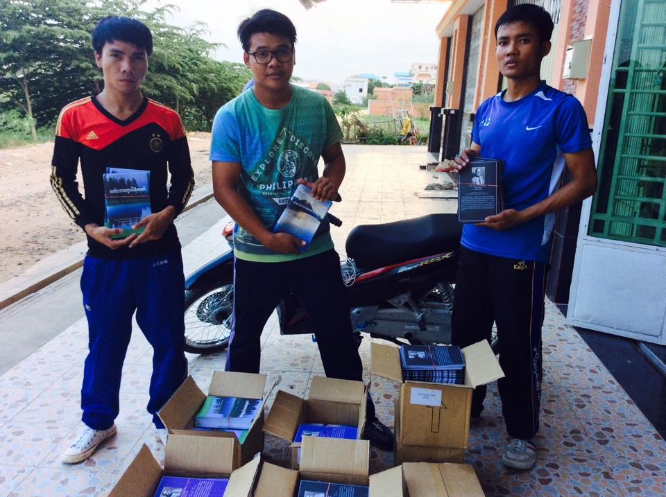

Slide 18
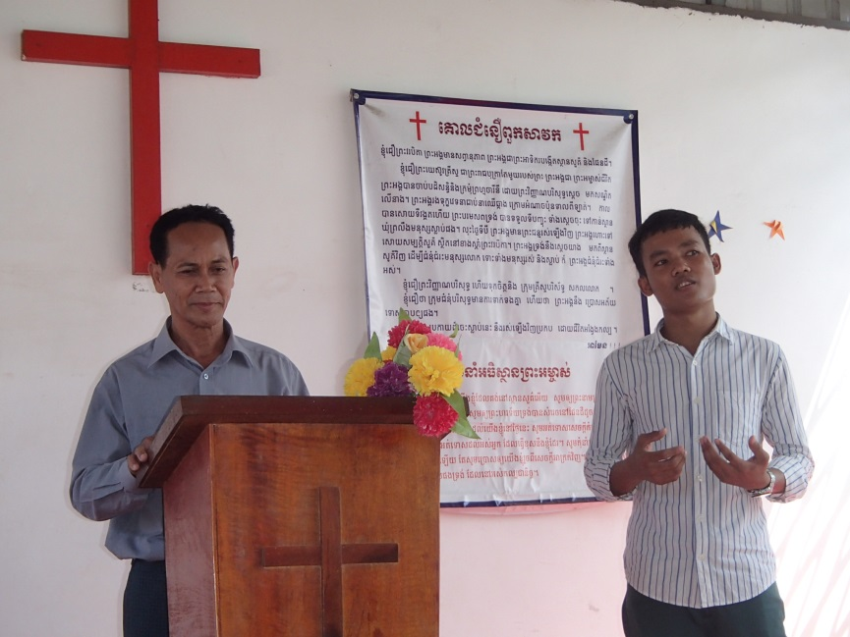
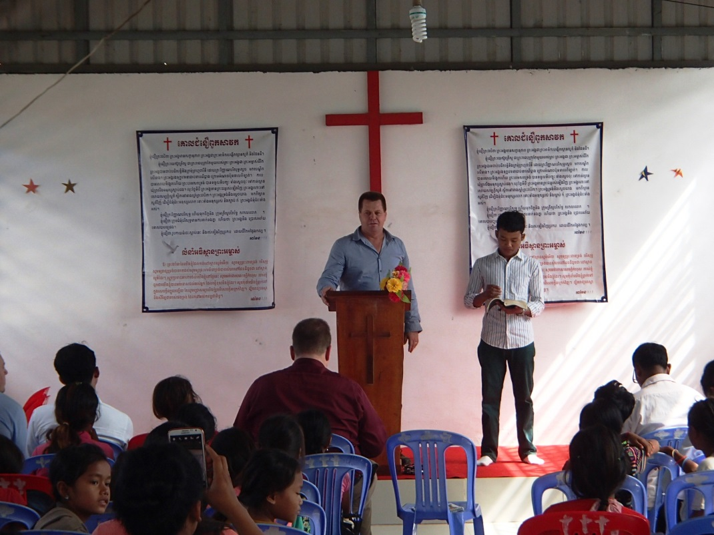

Slide 19
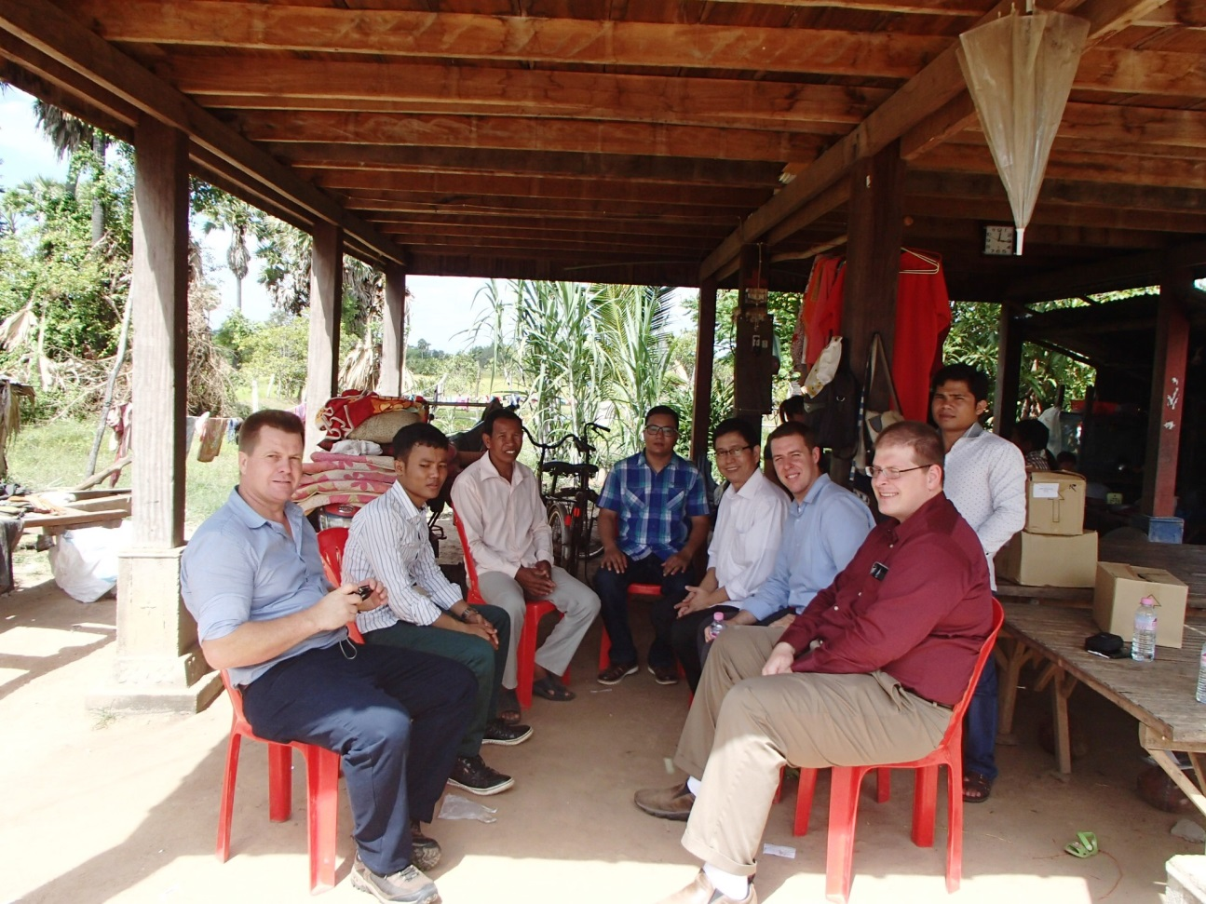
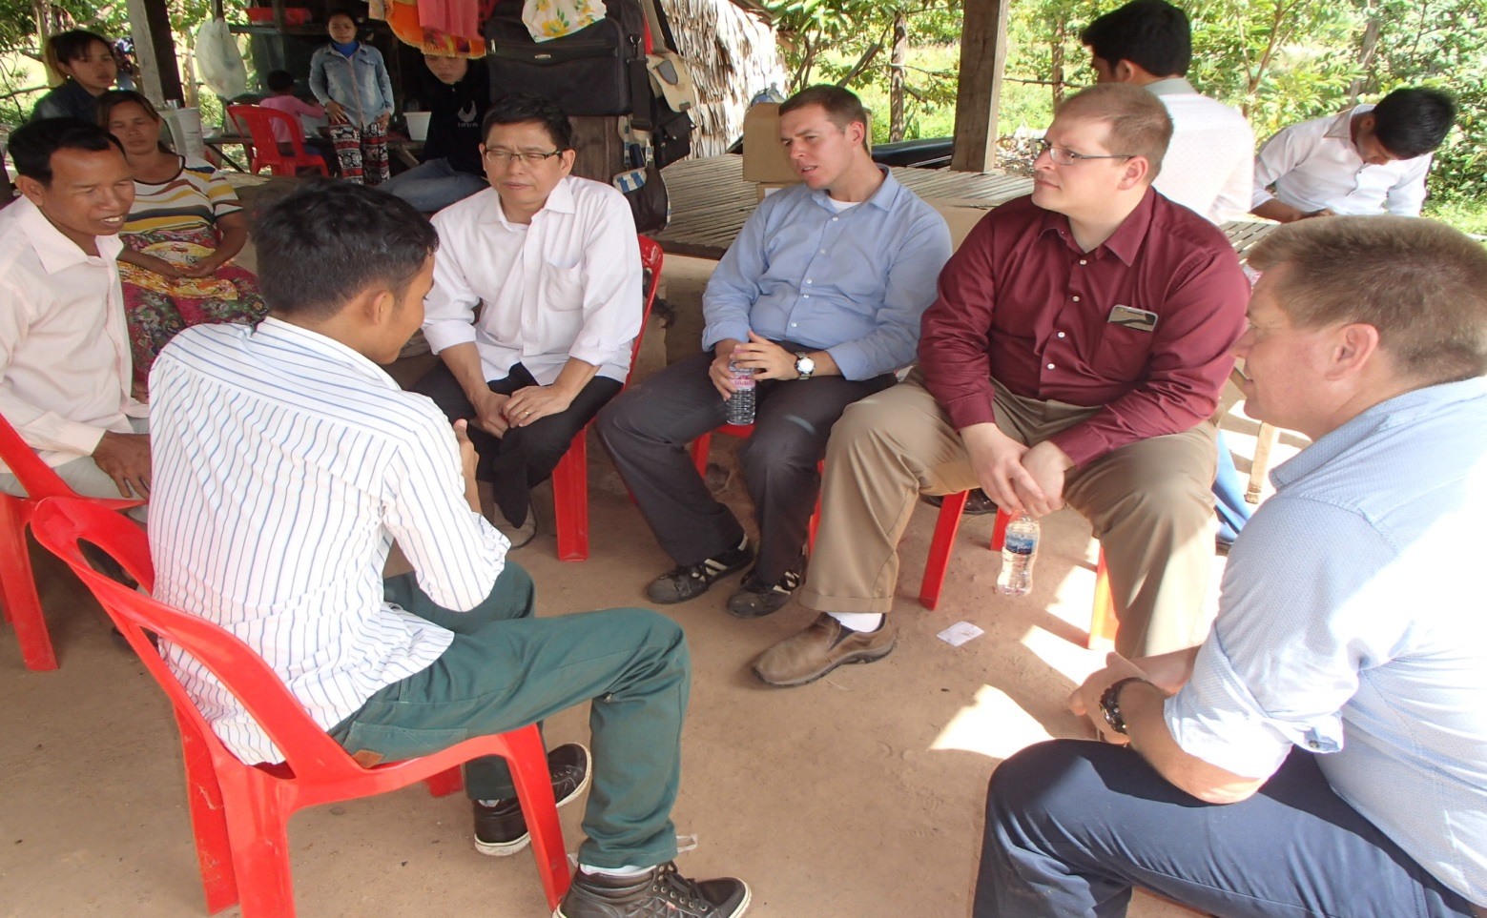

Slide 20
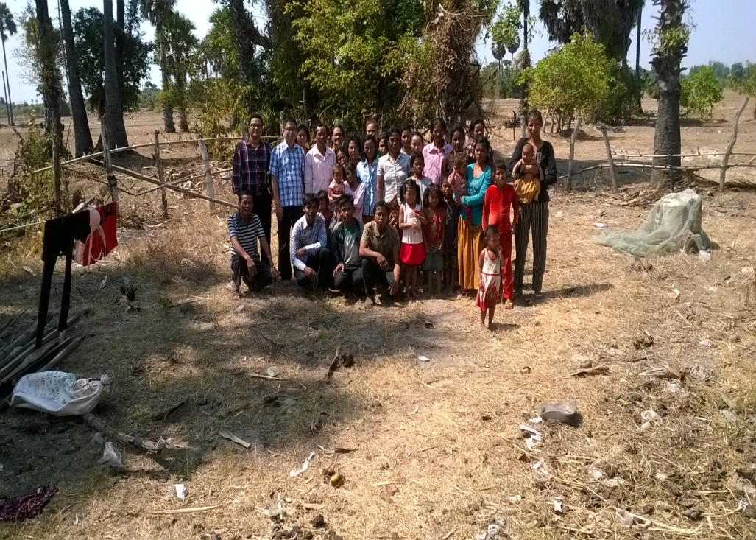
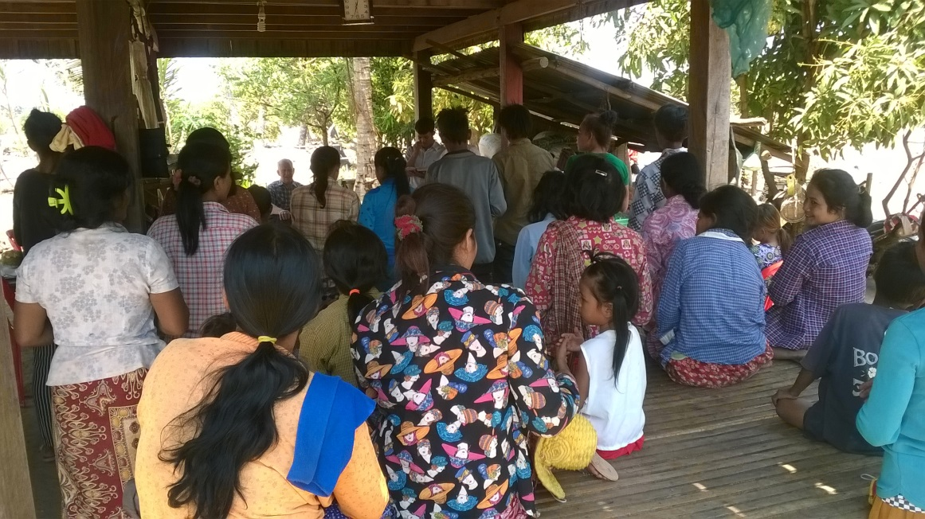

Slide 21
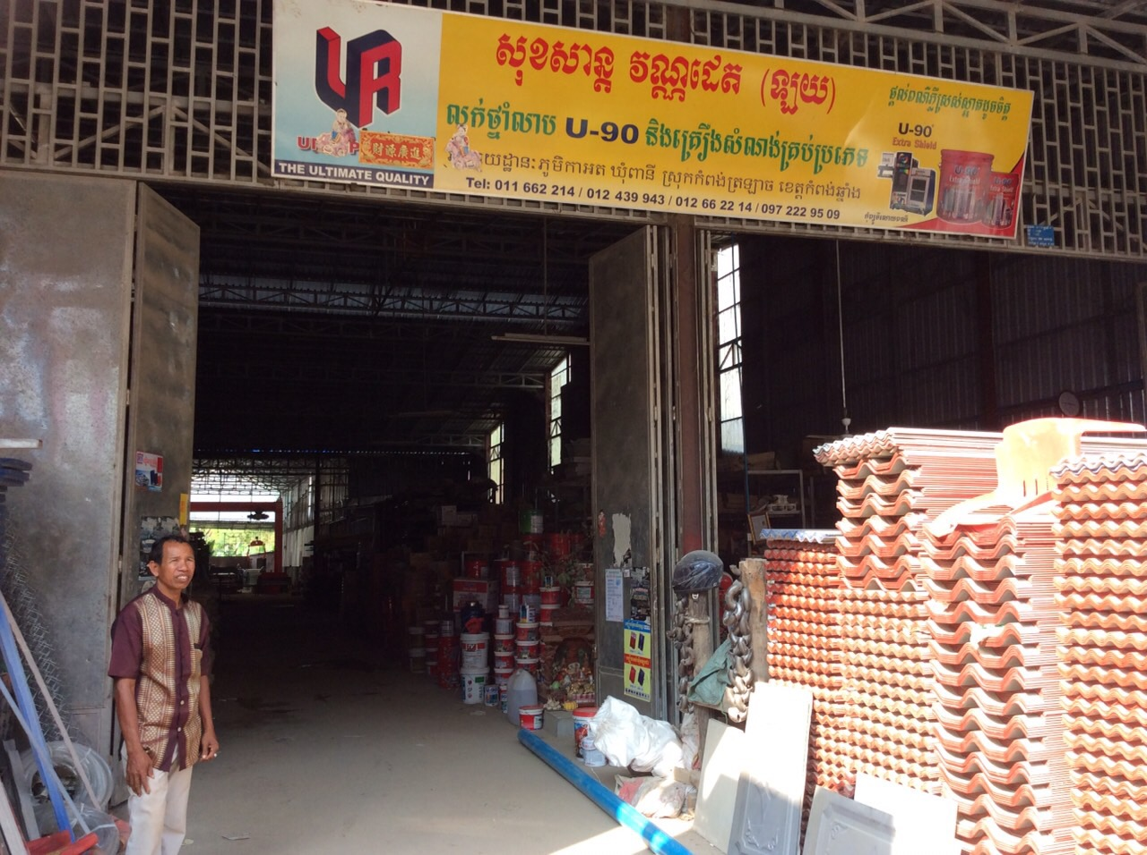
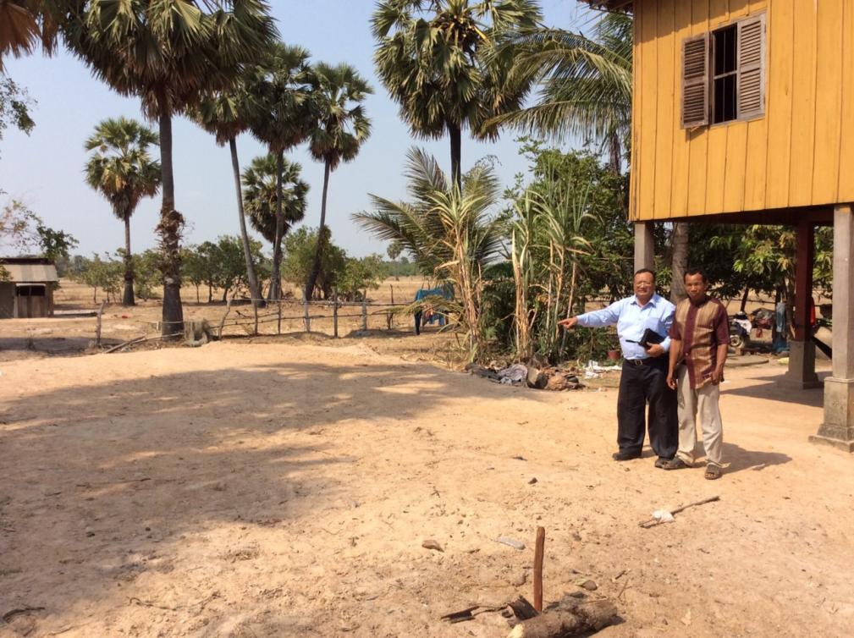

Slide 22
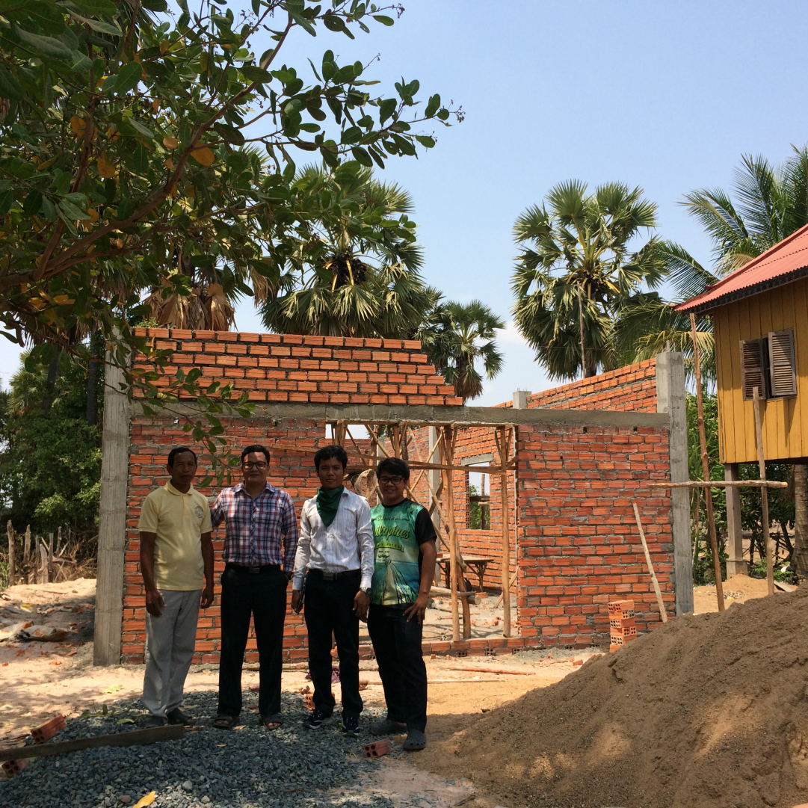
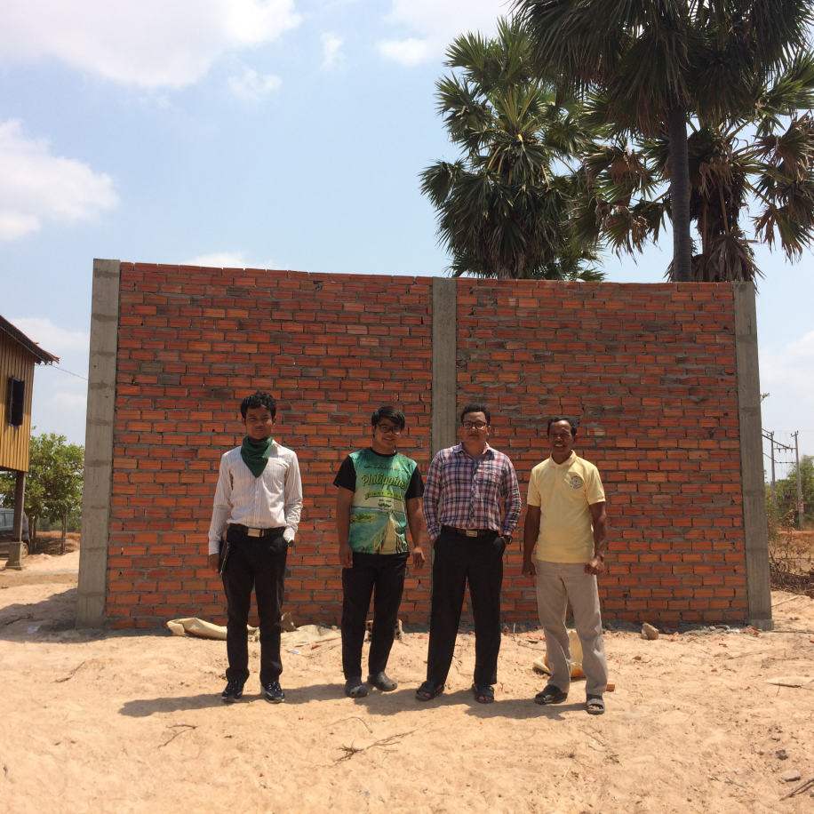

Slide 24
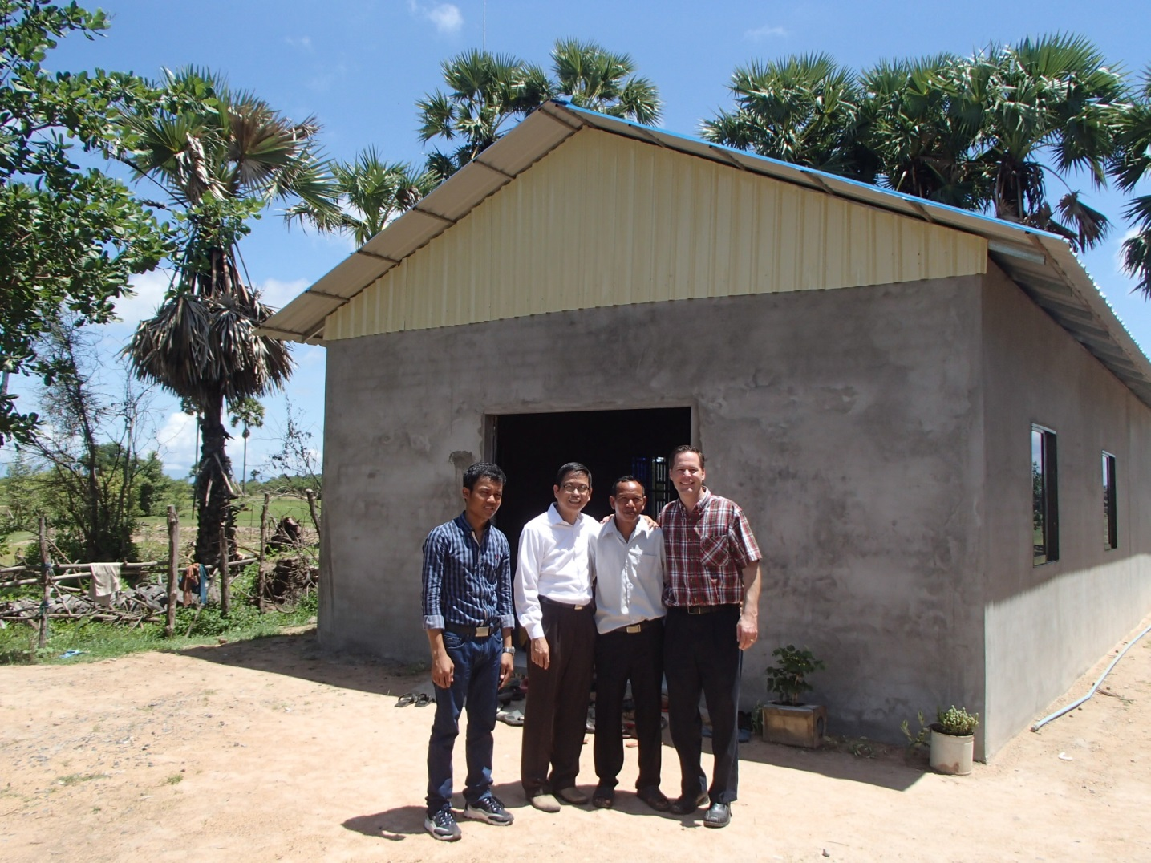
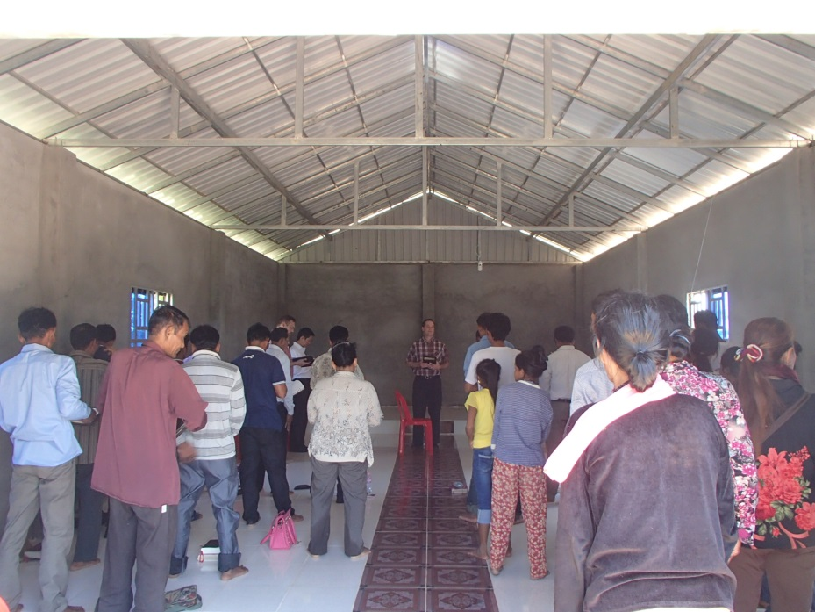
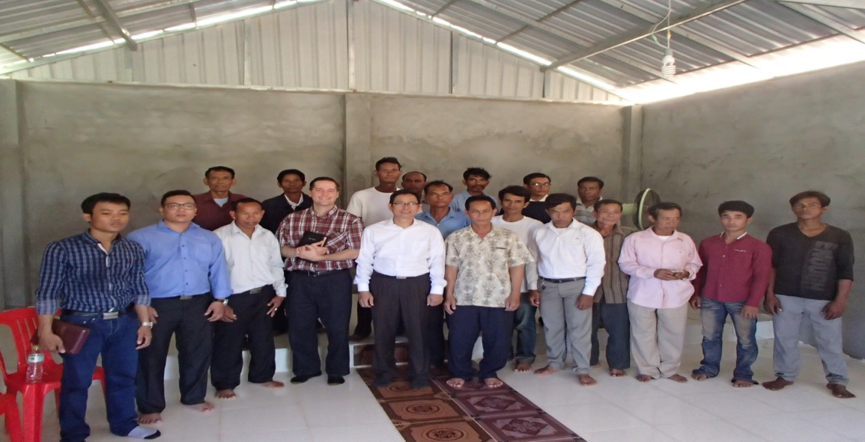

Slide 26
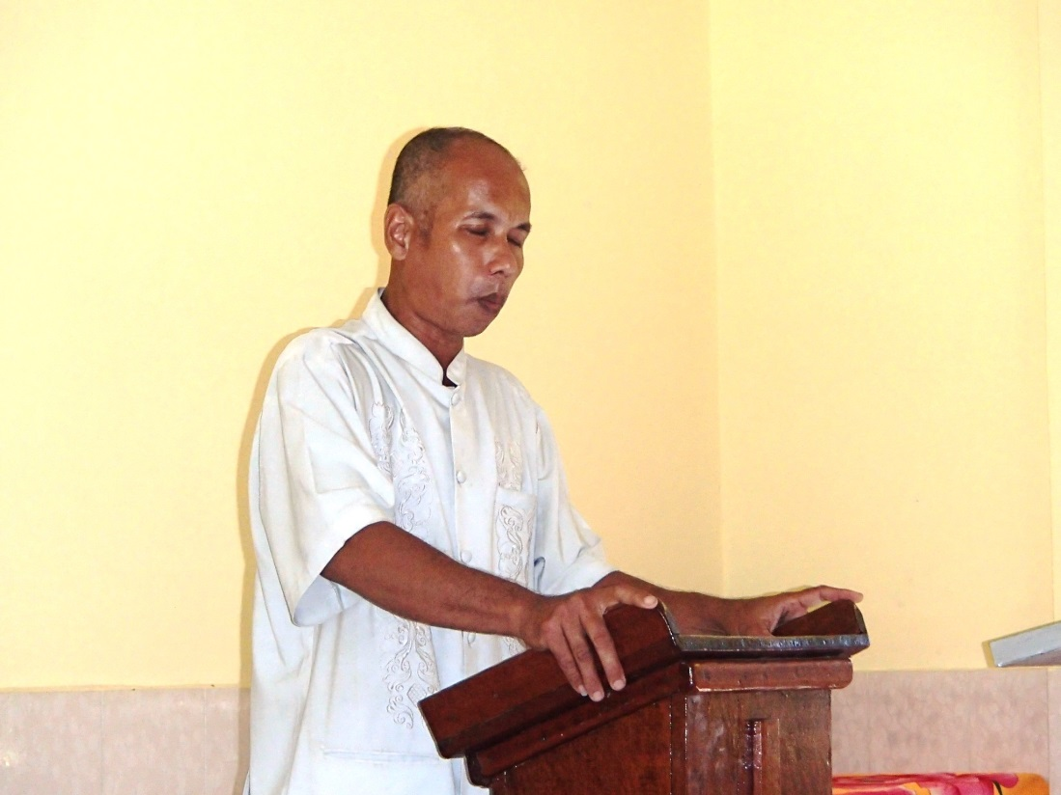
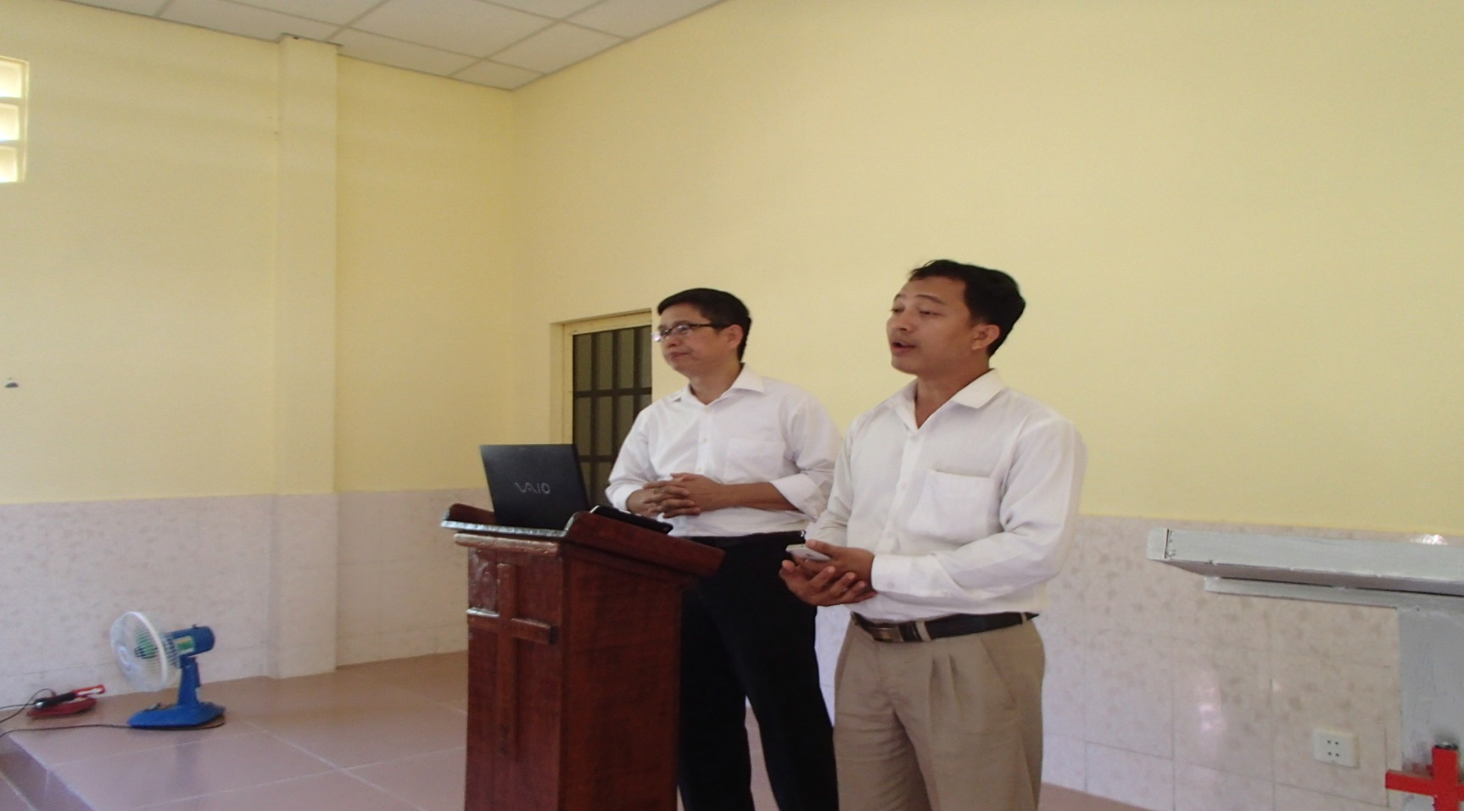

Slide 29
54-0307A THE.END.TIME_ PHOENIX.AZ SUNDAY_
« E-4 † … But you know, the soul is the most important thing of anything in the mortal. 'Cause that's the thing that lasts forever. And I...
And you know, when... I believe that every Christian is obligated to be a missionary. I believe every Christian is obligated. Now, not so much as you have to go over in the old countries and preach or something. But if you can't go, you can help send somebody else. You see? See? What you do to send somebody else...

Slide 30
56-0726 LOVE_ SHREVEPORT.LA THURSDAY_
« E-16 † … Nothing but lost souls, is the only thing that's got any value in it. Money passes away. Homes decay and go away. Everything in the earth moves away. The only value, lasting value, I'd rather have one soul in glory, that I won to Christ, to know and see that that Light of God circles around that soul, through all eternity, my name to be associated with that, than to have every penny of money in the whole earth, 'cause I'd have to lose--lose it all. But what you send up there, is Eternal. And that's the reason we're trying.

Slide 31
MATTHEW 6:19
» 19 † ¶ Lay not up for yourselves treasures upon earth, where moth and rust doth corrupt, and where thieves break through and steal:
MATTHEW 6:20
» 20 † But lay up for yourselves treasures in heaven, where neither moth nor rust doth corrupt, and where thieves do not break through nor steal:
MATTHEW 6:21
» 21 † For where your treasure is, there will your heart be also.

Slide 32
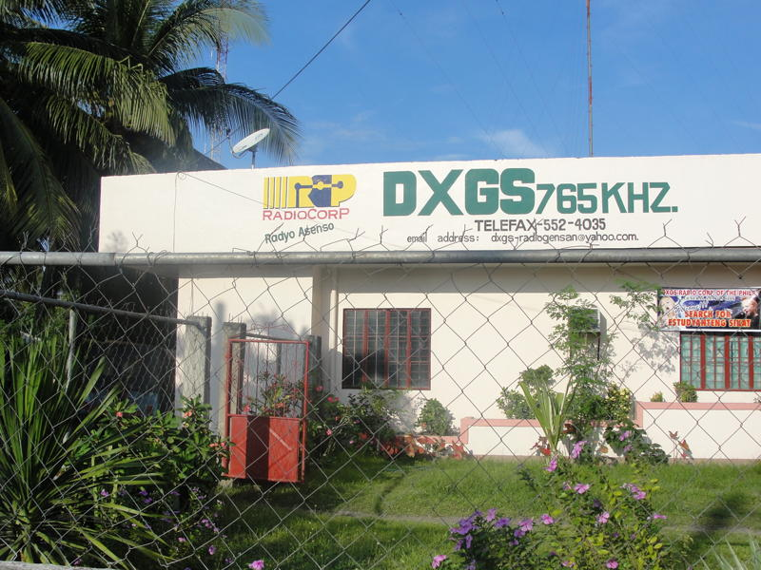
RADIO BROADCAST MINISTRY

Slide 33
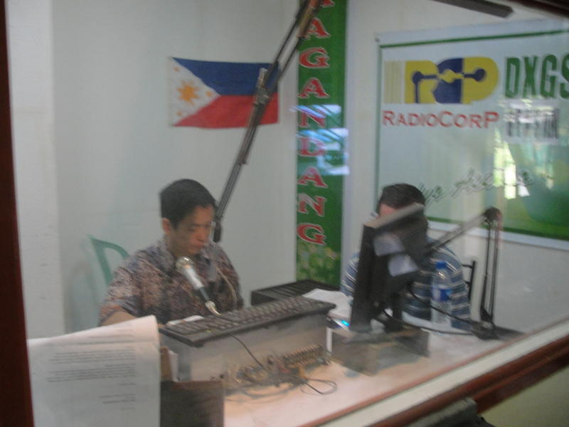
RADIO BROADCAST MINISTRY

Slide 34
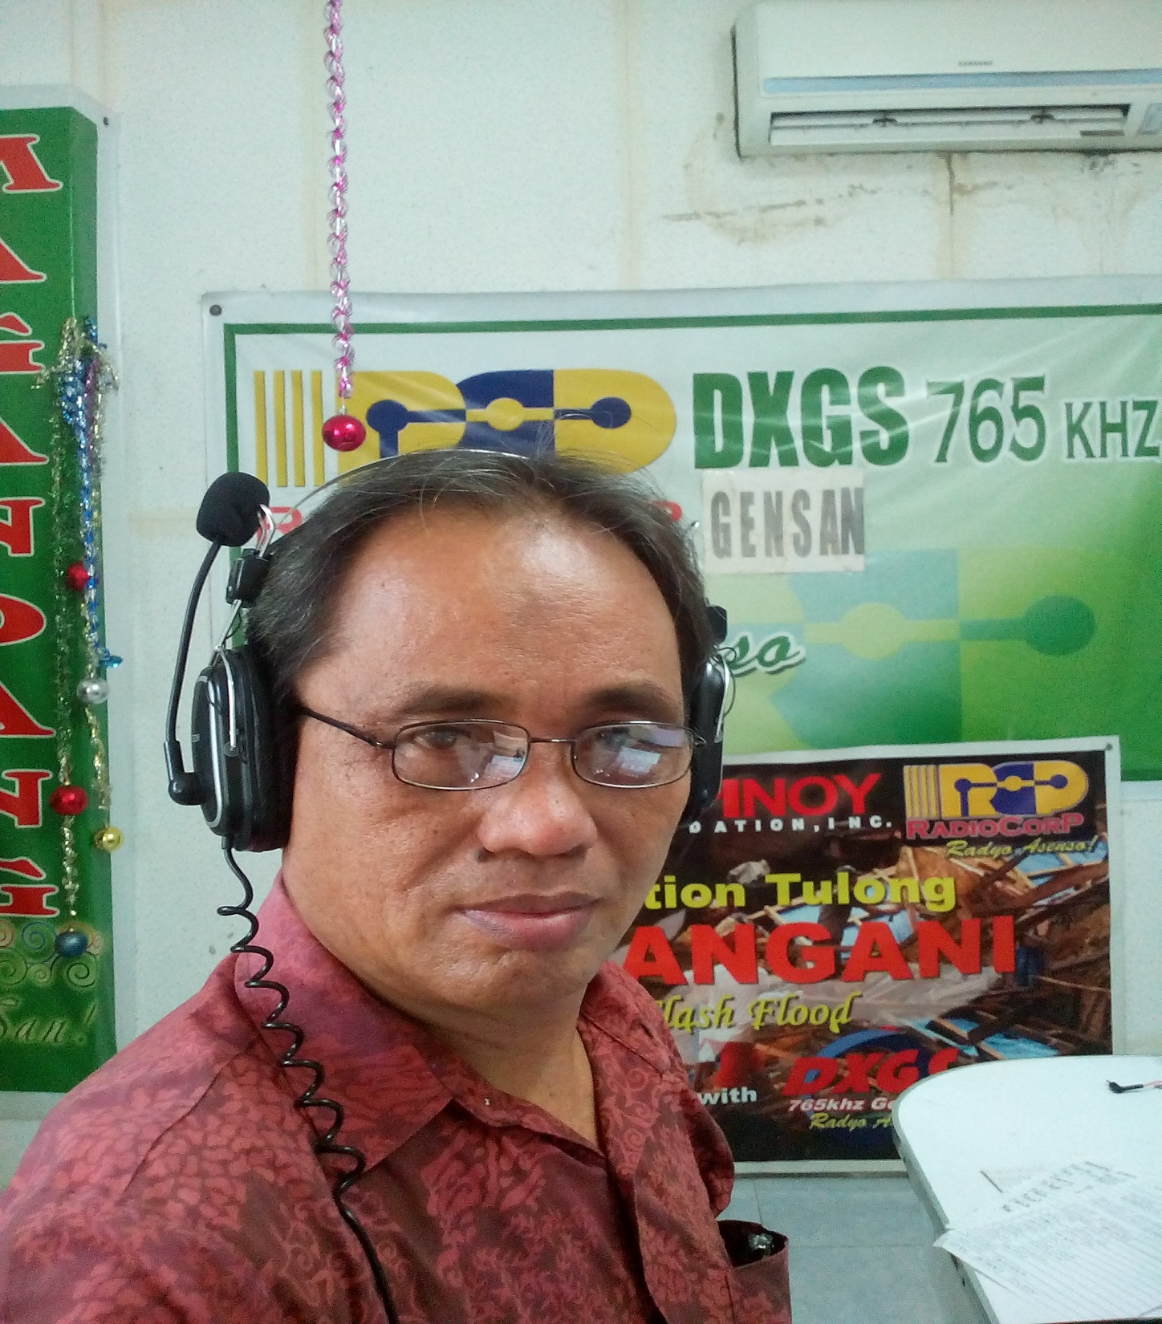
RADIO BROADCAST MINISTRY

Slide 35
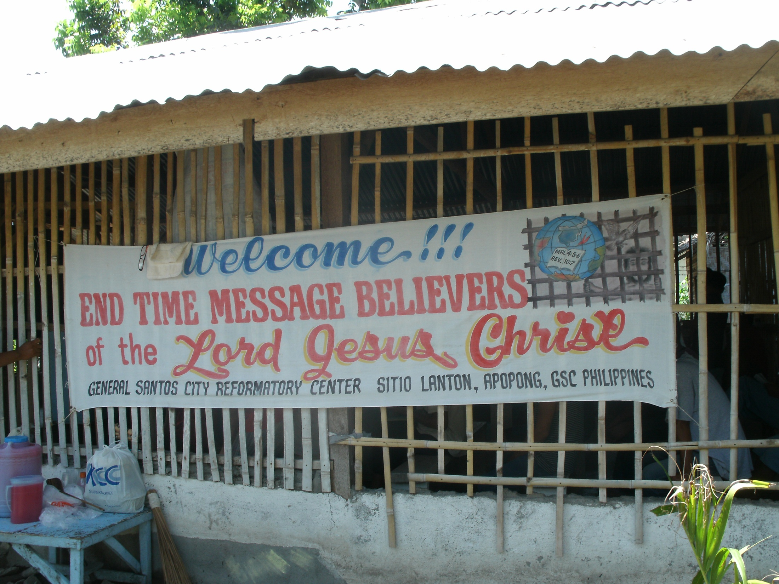
PRISON MINISTRY: GENERAL SANTOS CITY JAIL

Slide 36
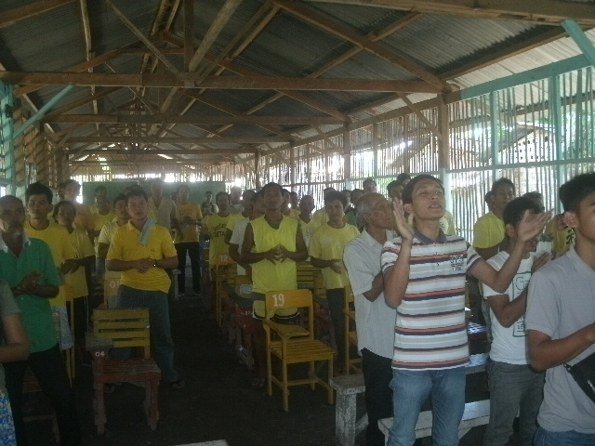
PRISON MINISTRY: GENERAL SANTOS CITY JAIL

Slide 37
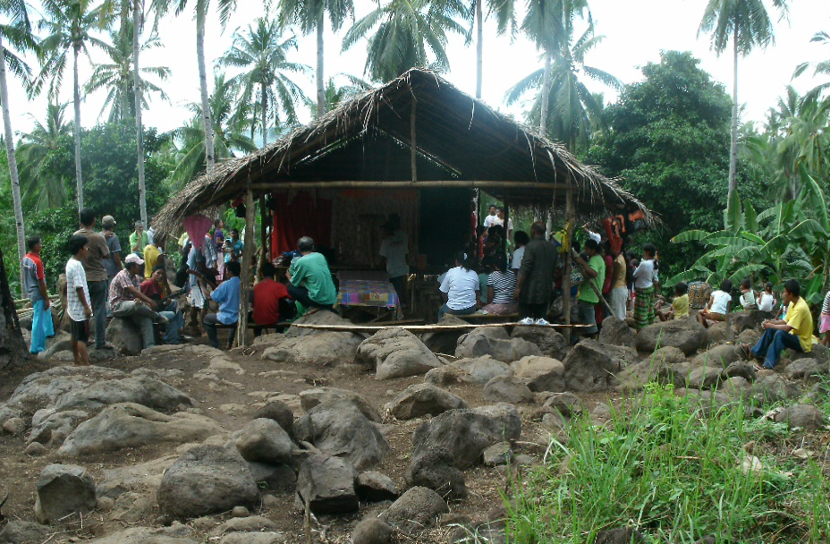
THE CHURCH IN BALUT ISLAND: BROTHER EMELITO KIANDE, PASTOR

Slide 38
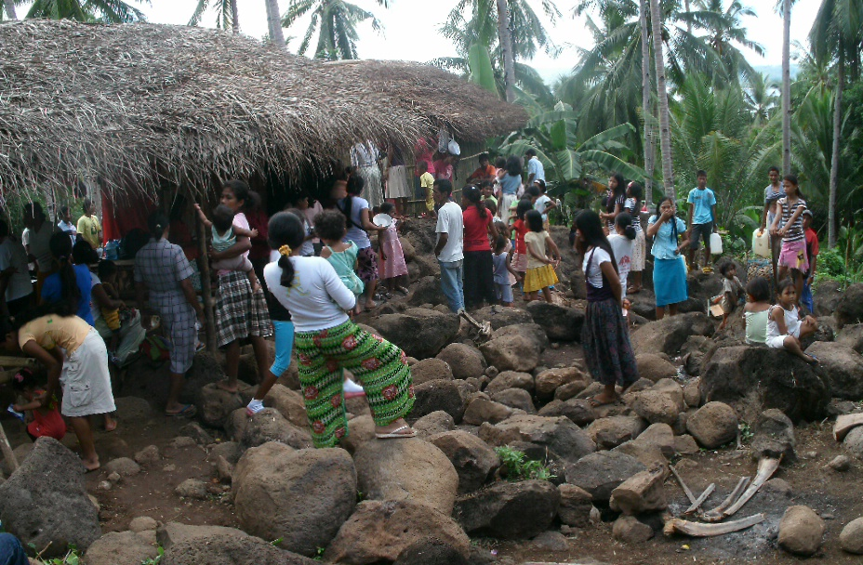
THE CHURCH IN BALUT ISLAND: BROTHER EMELITO KIANDE, PASTOR

Slide 39
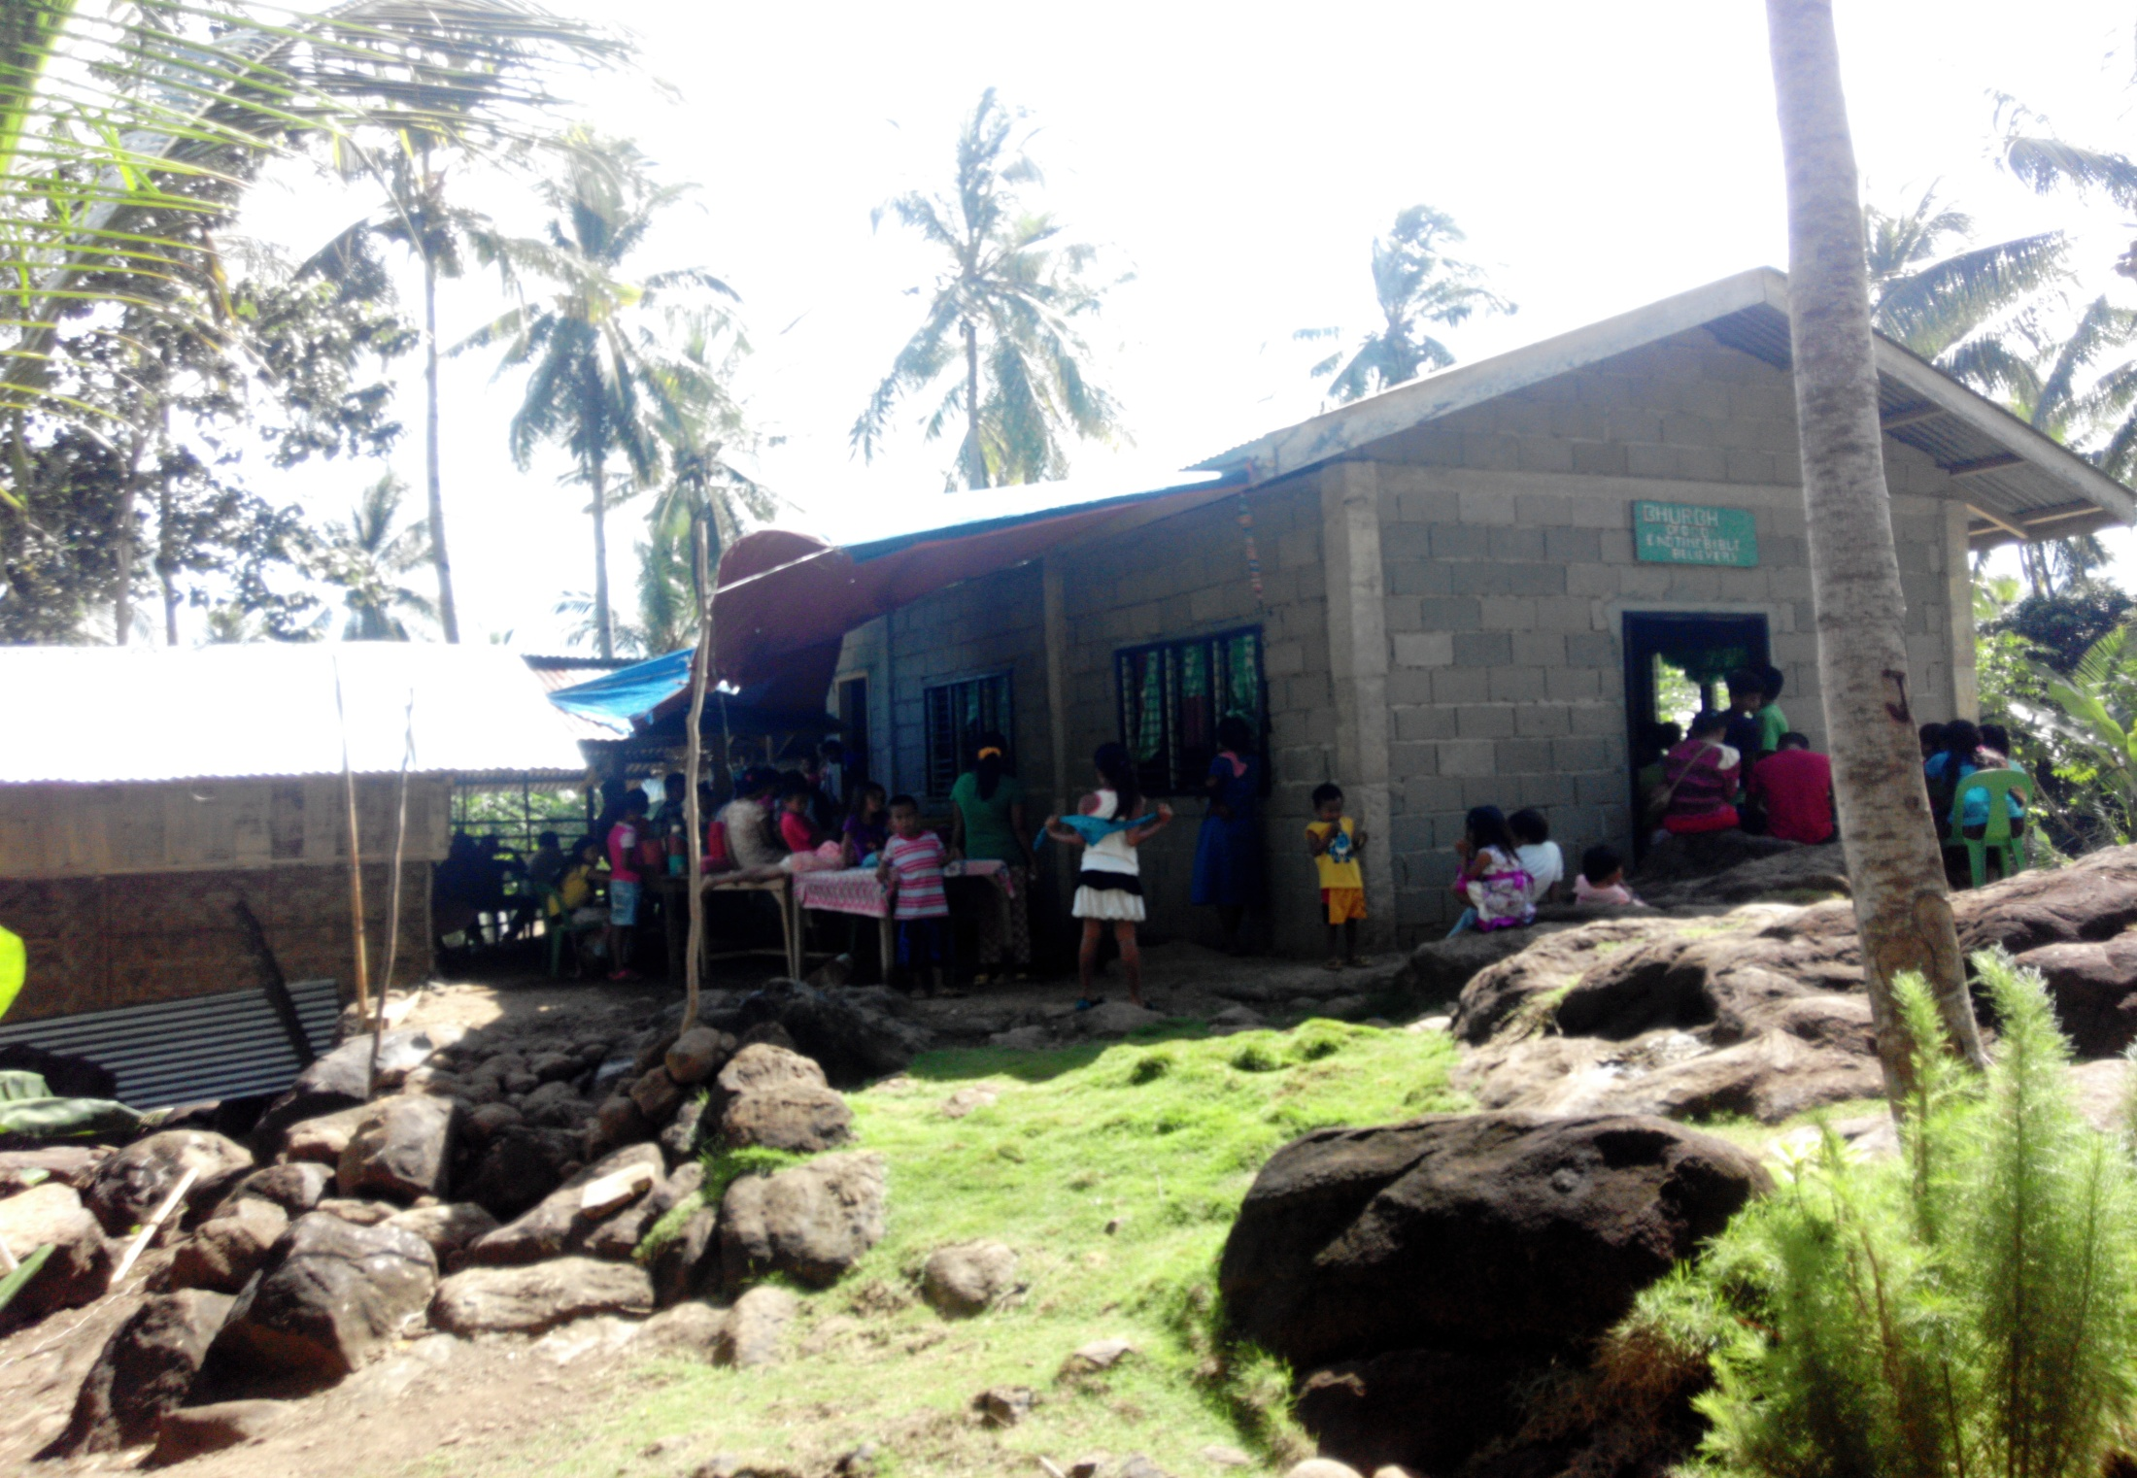
THE CHURCH IN BALUT ISLAND: BROTHER EMELITO KIANDE, PASTOR

Slide 40
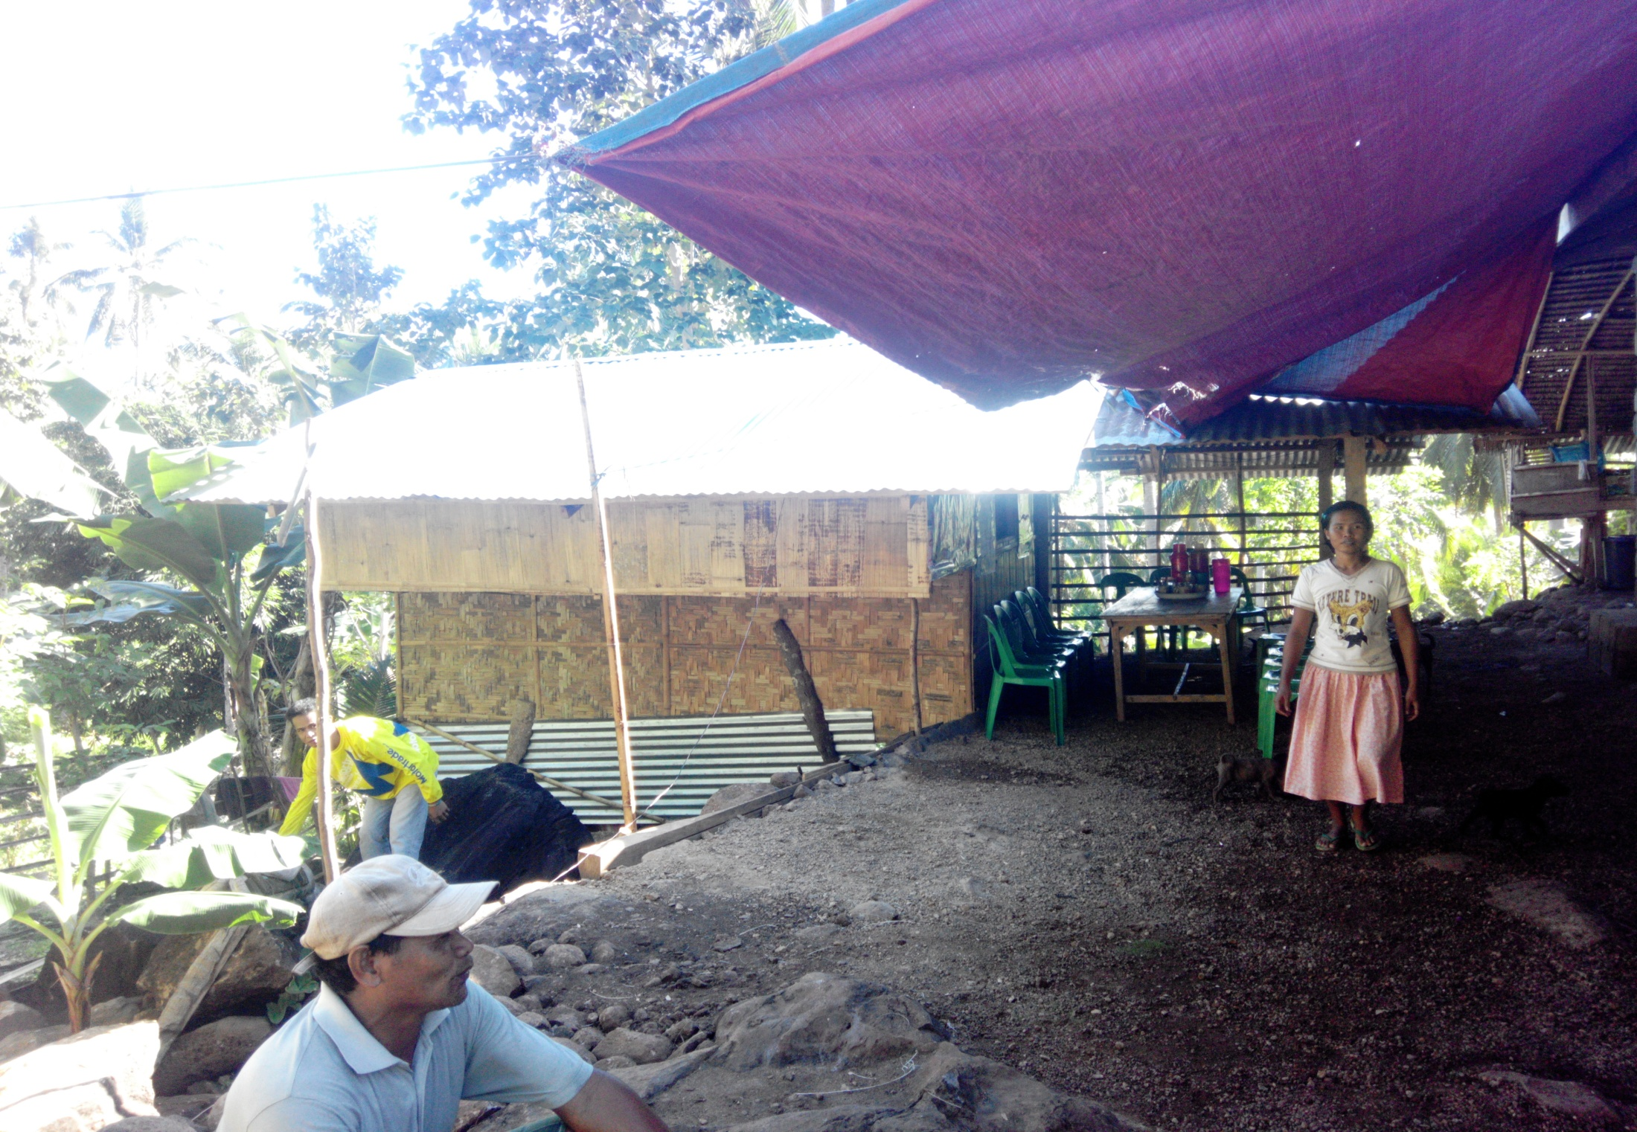
THE PARSONAGE OF THE CHURCH IN BALUT ISLAND: BROTHER EMELITO KIANDE, PASTOR

Slide 41
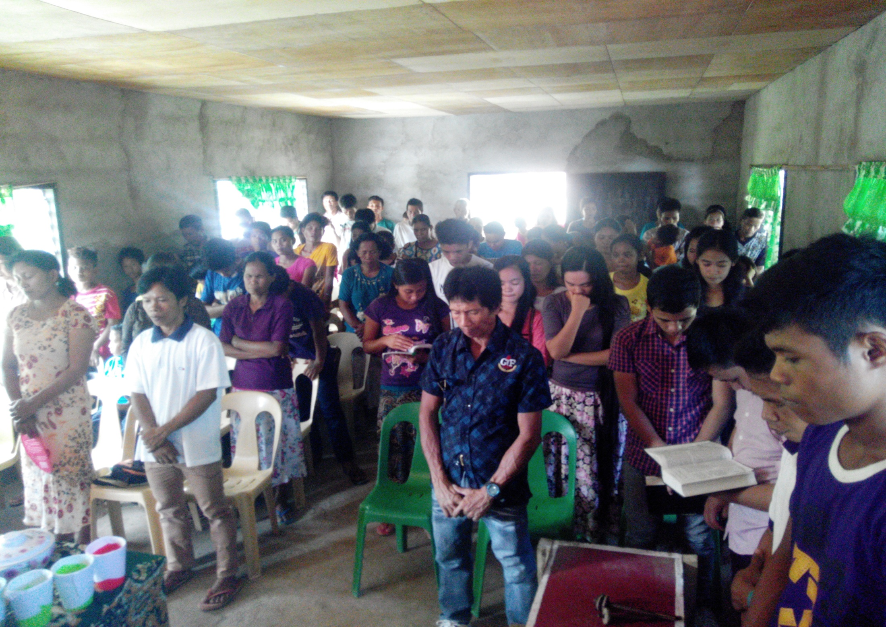
THE CONGREGATION OF THE CHURCH IN BALUT ISLAND

Slide 42
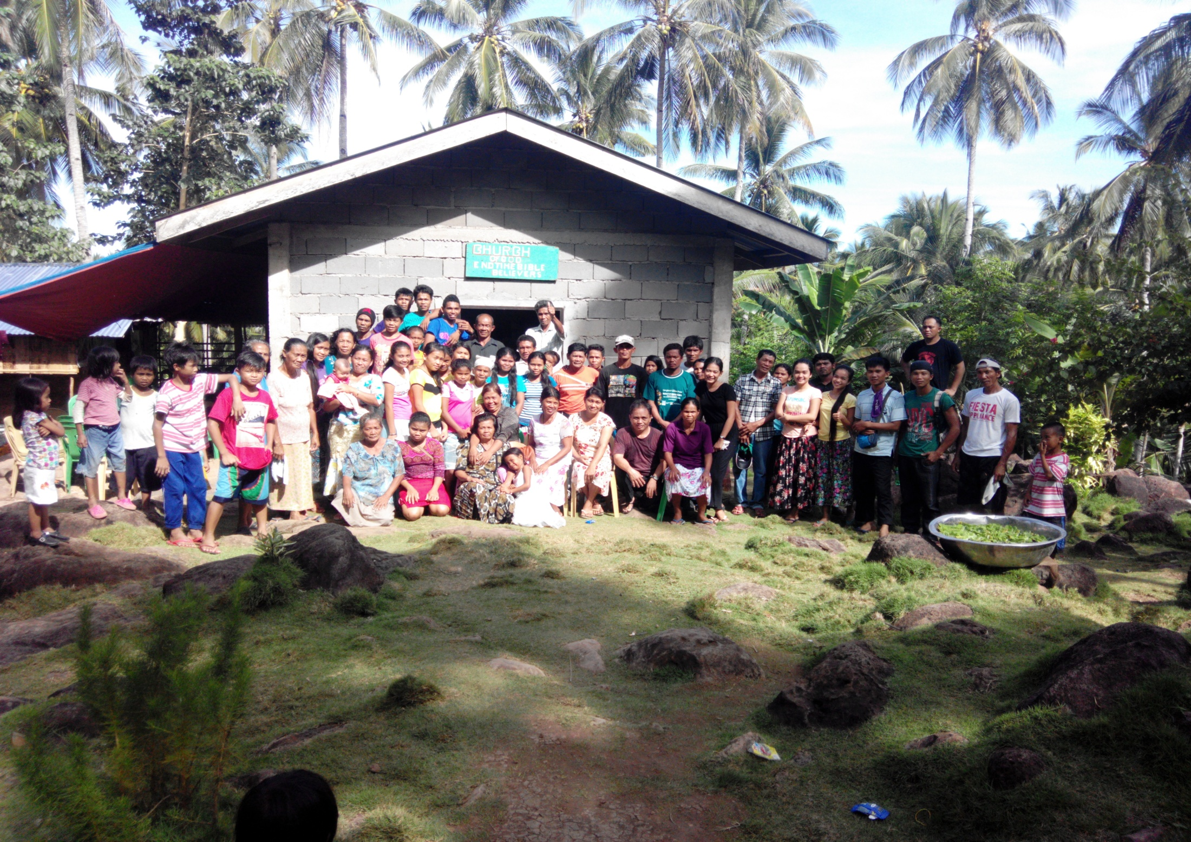
THE CONGREGATION OF THE CHURCH IN BALUT ISLAND

Slide 43
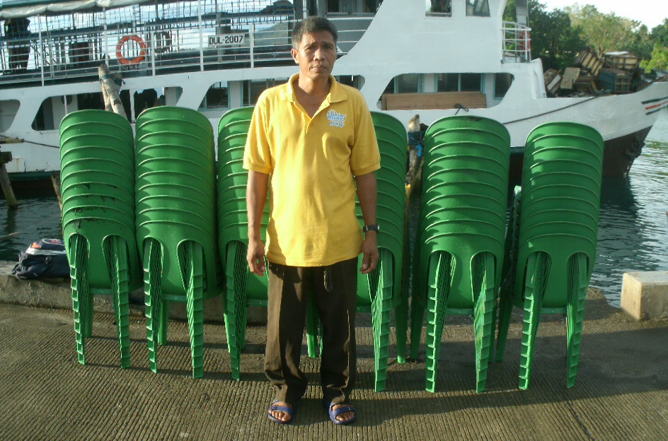
BROTHER EMELITO KIANDE

Slide 44
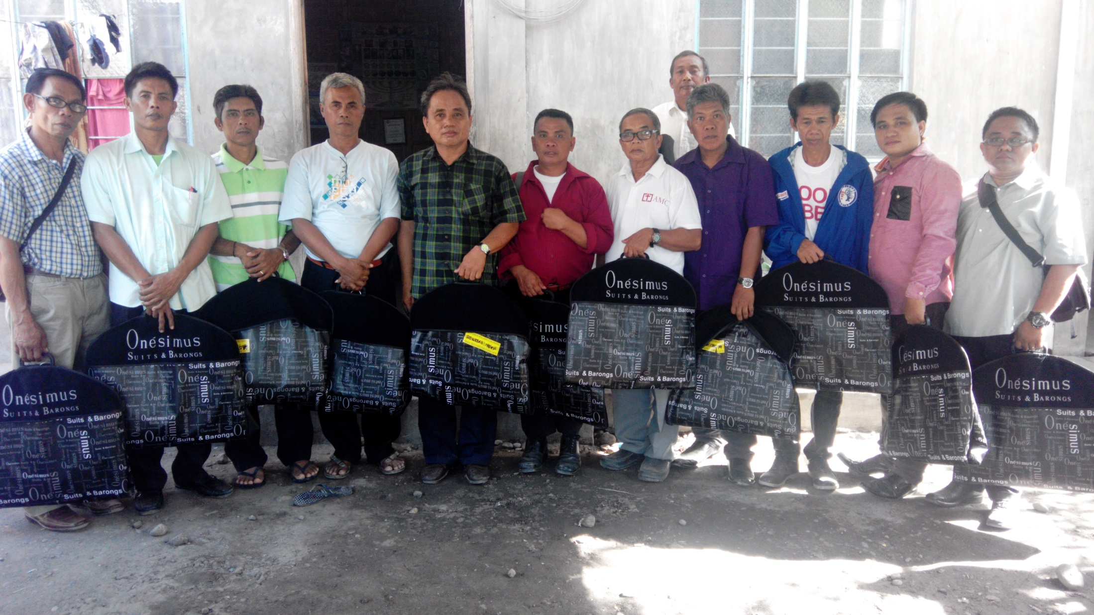

Slide 45
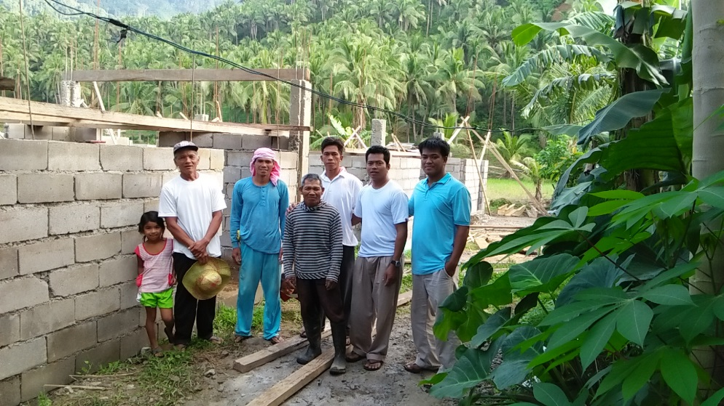
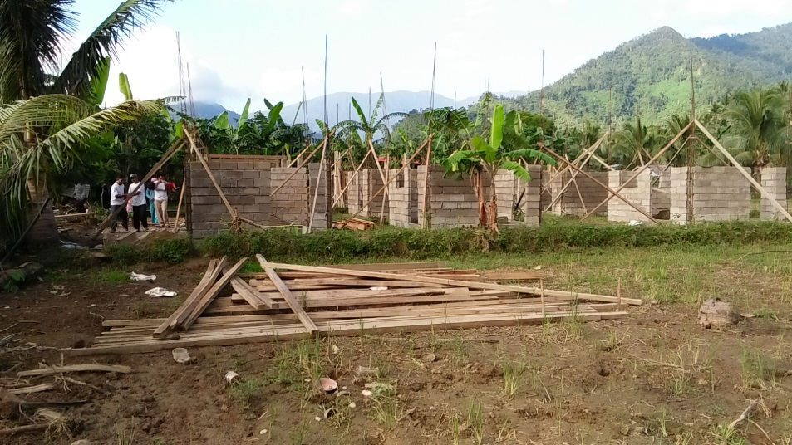
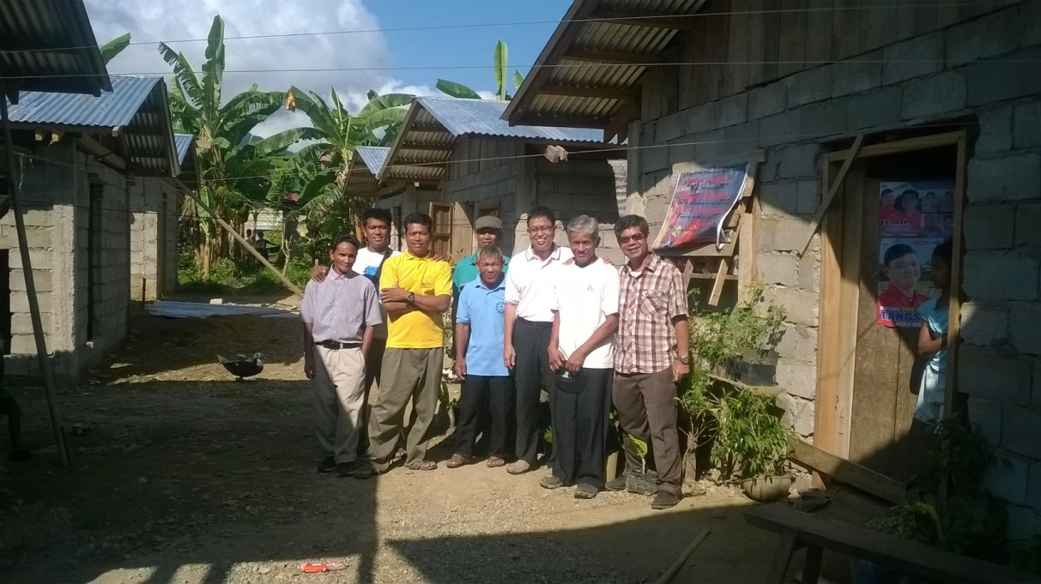

Slide 46
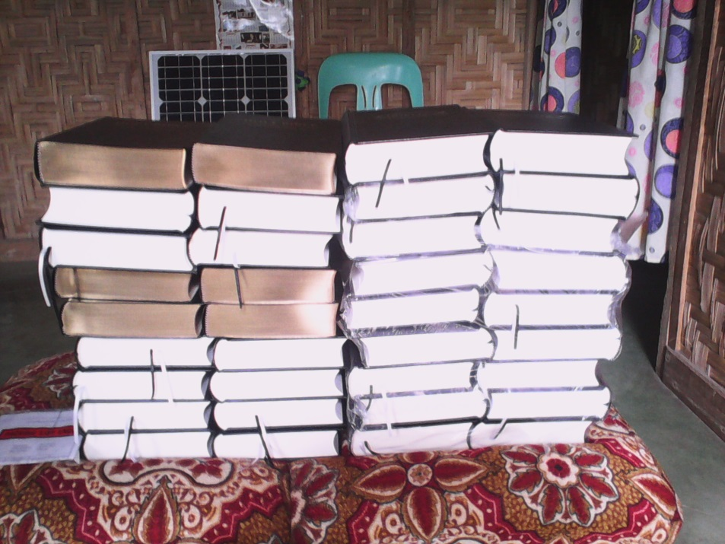
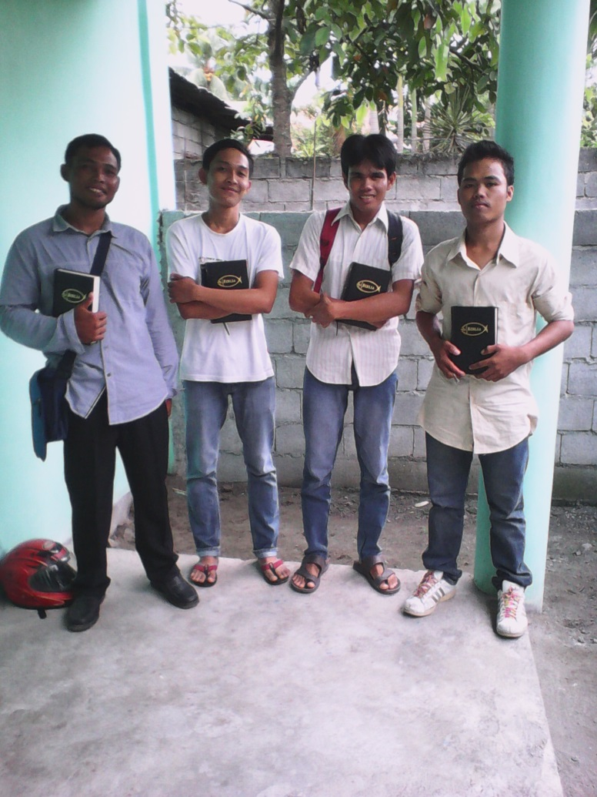
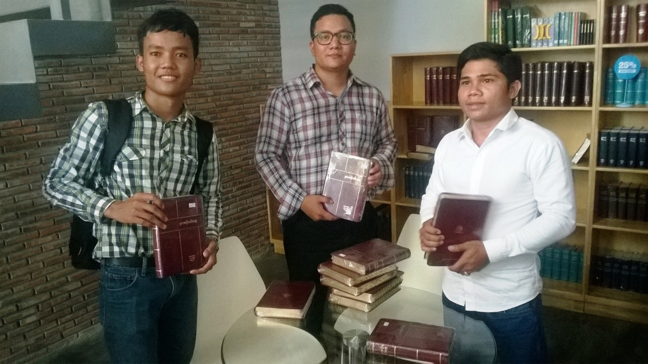

Slide 47
