Slide 1
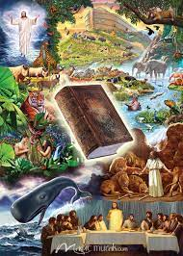

Slide 2
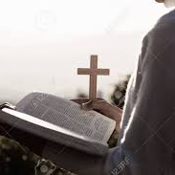
Divine Healing is a process. It takes time and faith to keep believing God. The New Birth is a process. It takes time and faith to keep believing God.

Slide 3
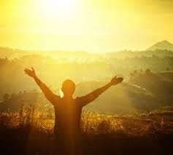
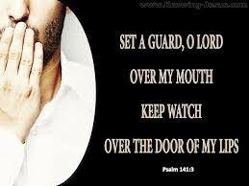
Maintain a positive confession at all times. Refrain from a negative confession at all times. This applies to healing and salvation.

Slide 4
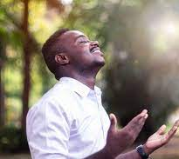
Act like you're healed even when symptoms persist. Act like you're saved even when temptations abound.

Slide 5
54-0813 - Jesus Christ The Same Yesterday, Today, And Forever And the doctor said, “If he eats one mouthful of solid food, he’ll have acute indigestion: die in five minutes.” He said, “I’m the Lord that healeth thee.”
28 I had to believe either the doctor, or what God said. They had doctored me for two years, and done nothing for me.
29 And we had—we had corn bread and beans and onions. I don’t know whether you ever had any of that or not, but it’s good. And when I asked the blessing, I said, “Lord I—I believe You, and I have accepted my healing, I…” Mama had my prune juice poured out there, and barley water mixed together, you know, and my two, little, salty crackers; and that’s all I’d get. I said, “Pass me some beans.”
And she said, “Oh, Honey, you can’t eat that.”
I said, “The Lord said I could.”
“Oh, the doctor said…”
I said, “But I believe the Lord’s Word.”
30 So, they give me a plate full of beans and I took a great…I hadn’t eat for two years, of nothing like that. I got a big mouthful of beans, and a piece of onion, a chunk of corn bread. I started chewing away, it tasted good. When I swallowed it, it hit that raw stomach, it come right back up. I held my hand over my mouth. I said, “Oh no, huh-um, no, sir. You don’t come out of there. No, sir.” And I held my hand over my mouth, till I got another mouthful chewed and swallowed. I put it right on top of it, and I packed it so full, it couldn’t come up. That’s right. I just held it there, going on. I started out, the room, and I went out, and the hot water running out of my mouth.
Mother said, “How you feel?”
I said, “Wonderful.”
I went down the street, and I—I was going down the street, singing:
I can, I will, I do believe;
I can, I will, I do believe;
Some of them say, “How you feeling, Reverend Branham?”
I said, “Wonderful.”
I can, I will, I do believe
That Jesus heals me now.
Are you—you feeling better, Reverend Branham?
“Wonderful, feel good. Jesus healed me.”

Slide 6
54-0813 - Jesus Christ The Same Yesterday, Today, And Forever 31 Week after week passed, just the same. That night, every bit of it was laying right there. I went to the table, you know how poor people are, I said, “Pass me some more beans and corn bread.” That’s right. And I eat it.
And I tell you, brother, the…Mama called the doctor. She said, “Well, that’s…”
He—he said, “Why, it’ll kill him, as sure as the world.”
32 I did, to my unbelief. Now I got alive, and faith now, with Christ Jesus. That’s right. Now, he said…I weigh a hundred and sixty-five pounds; I weighed a hundred and eighteen then.
33 So, you see what the Lord will do? Take Him at His Word, believe it, confess it, no matter how you feel, believe it anyhow. He said so.
34 Abraham believed God, and it was imputed to him for righteousness. The baby never come till twenty-five years later. But he still give God praise for it, before it come. He was strong in faith, giving praise to God. Yes, that’s it.
35 But you look at your symptom. Just a minute. You look at your symptom. You say, “Well, look here, I was prayed for, for a crippled hand, my hand is no better.” That’s no sign you’re not healed. God said so. That’s it. No matter what, that hand takes place, it’s what God said, it ain’t from my hand. See? It’s what God said. I accepted it, and I’ll stay with it, that’s all. Now, He could open it up, or He, today, tomorrow, He, might be twenty-five years, but I…you—you—you let your testimony be positive.
36 Every time you get sick, and you were prayed for, and you go out and get a little sick, you say, “Well, I guess I lost my healing.” Then your testimony becomes negative. And Jesus can’t say no more for you.
37 He’s the High Priest of your confession, setting there, making intercessions on your confession, what you believe.
38 All of you in here that’s saved tonight, you just get in your head that you’re not saved, and go around saying, “No, I—I’m not saved no more.” You’re not saved. That’s a big word for a Baptist, isn’t it? But that’s true. You’re backslid whenever you do that. That’s right, that’s right. I believe you can backslide. Sure. All right.
39 But, you see, you’ve got to have your testimony and your—your confession positive, “Not according to my feelings, but according to what He said.” That’s it.

Slide 7
53-0219 - Accept God's Gift 9 Now, healing is not something that you just say, “Well, I…yeah, I believe it. I believe it.” Now, that’s all right. If that’s the best you can do, just mentally, or just say, “Well, I…Yes, I—I see it. I believe that; I accept it.” Then if you accept it on those basis, keep saying it over and over. Say it out loud. Say it over and over; just keep saying, “I’m healed. I’m healed.” Say it until actually you believe it. And when you believe it, then it’s going to take place.
Don’t have a negative testimony. Every time when you confess, “Well, I still feel bad today. I guess I…” you go right straight back in the same rut that you was in the beginning. There’s not a man or woman in here that is baptized with Holy Spirit but what would start your confession, “I believe I’ve lost the Holy Spirit. I believe It’s gone from me. I believe I…” you’ll go right down; you’ll never…Can you…
10 Listen close. You’ll never live above your confession. Jesus is the High Priest of our confession (Is that right? Now, Hebrews 3:1, now any scholar knows that same word “profession” is “confession” too, same translated.), now setting at the right hand of the Father to make intercessions upon what? Our confession. He can’t do nothing for you until first you confess He’s done it. See?

Slide 8
53-0219 - Accept God's Gift When you accepted…Now, I wasn’t saved…I’m not saved tonight because I get happy and shout. That isn’t it. I’m not saved because the gift of God works through me. I’m saved because I have met the conditions that Jesus Christ required from me. I’m saved according to the Bible. See? Is that right? See? On…And not because I feel like I’m saved. Satan can whip you around the stump on your feelings, but he can’t when it’s THUS SAITH THE LORD. See? He can’t do—go that. He can’t wade across that; that’ll defeat him.
11 Now, when you believed you were saved, setting in your seat, out in the—wherever you was, you accepted it and begin to confess and tell people you were saved. Well, you kept on saying, “I’m saved.”
The people said, “They ain’t no difference in you,” but you believed there was. Is that right? And you kept with your confession and after while it worked righteousness. All your neighbors and everybody knows you’re saved now, because you believed it, you confessed it. Why, what happened? What changed you? He’s the High Priest of your confession, setting at the right hand of the Father, making good what you’re confessing.

Slide 9
53-0219 - Accept God's Gift Now, that’s the same thing it is by healing. You accept Him as your Healer, renounce your feelings. It’s not by feelings; it’s by faith. Say you’re healed; believe you’re healed; act like you’re healed; associate with those who believe in healing; and God will bring you right out to a perfect soundness of health: will not fail.
12 Just an illustration. I’m trying to get faith moving (You see?), so I can see what the Holy Spirit will do here for us in a few minutes. Don’t never look at symptoms. Lady, don’t you look ’cause you’re setting in a wheelchair, or this young fellow here, that’s no more to God than to heal a toothache (See?), not make a bit of difference.
But now, look. He’s the High Priest of—of your confession. Now, if there’s any fellow that ought to had a—a bad case of symptoms, would’ve been Jonah when he was going down to Nineveh. He was backslid, going to Nineveh, or to Tarshish, instead of Nineveh, on the wrong ship, going the wrong way, backslid, running from God in a stormy sea. They tied his hands and feet, throwed him out of the ship. He went down into the sea. A whale swallowed him and went plumb to the bottom of the sea to rest his swimmers as all fish does. There he was, tied hands and feet, backslid, a stormy sea, many fathoms deep in the sea in the belly of a whale.

Slide 10
"Temporary Hypocrite" Hypocrisy: the practice of claiming to have moral standards or beliefs to which one's own behavior does not conform; pretense. I Corinthians 6 9Know ye not that the unrighteous shall not inherit the kingdom of God? Be not deceived: neither fornicators, nor idolaters, nor adulterers, nor effeminate, nor abusers of themselves with mankind, 10Nor thieves, nor covetous, nor drunkards, nor revilers, nor extortioners, shall inherit the kingdom of God. 11And such were some of you: but ye are washed, but ye are sanctified, but ye are justified in the name of the Lord Jesus, and by the Spirit of our God.

Slide 11
Benefits of reading the Bible Every Day: 64-0830E - Questions And Answers #4 36 Somebody told me he had, one, [Indian Chief] one time, was converted, received the Holy Ghost, and he said to him, “How you getting along?”
And he said, “Pretty good and pretty bad.” He said, “Well, how do you mean pretty bad and pretty good?”
He said, “Well, since me receive the Holy Ghost,” he said, “there’s been two dogs in me, and one of them a black dog and one of them a white dog.” And said, “They argue all the time.” Said, “They growl and fight at one another.” And said, “The white dog wants me to do good; the black dog wants me to do bad.”
Said, “Well, Chief, which one of them wins the fight?”
37 Said, “That depends on which one Chief feeds the most.” So I think that’s a good answer here. See? There just depends on the warring of the body that’s in you; it depends on which one you cater to, which nature you cater to, the carnal nature after the things of the world, or the spiritual nature after the things of God. That does it.

Slide 12
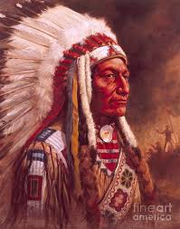
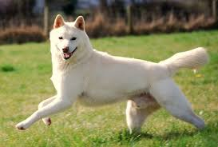
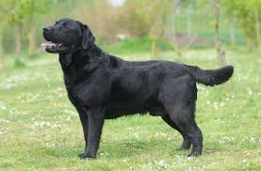
Benefits of reading the Bible Every Day:
Feed the White Dog
Starve the Black Dog to Death

Slide 13
Romans 6 1What shall we say then? Shall we continue in sin, that grace may abound? 2God forbid. How shall we, that are dead to sin, live any longer therein? 3Know ye not, that so many of us as were baptized into Jesus Christ were baptized into his death? 4Therefore we are buried with him by baptism into death: that like as Christ was raised up from the dead by the glory of the Father, even so we also should walk in newness of life. 5For if we have been planted together in the likeness of his death, we shall be also in the likeness of his resurrection: 6Knowing this, that our old man is crucified with him, that the body of sin might be destroyed, that henceforth we should not serve sin. 7For he that is dead is freed from sin.

Slide 14
Romans 10 9That if thou shalt confess with thy mouth the Lord Jesus, and shalt believe in thine heart that God hath raised him from the dead, thou shalt be saved. 10For with the heart man believeth unto righteousness; and with the mouth confession is made unto salvation. I Corinthians 10 13There hath no temptation taken you but such as is common to man: but God is faithful, who will not suffer you to be tempted above that ye are able; but will with the temptation also make a way to escape, that ye may be able to bear it.

Slide 15
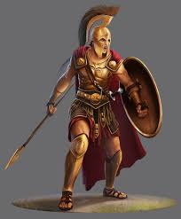
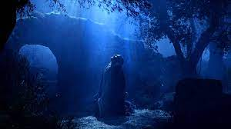
Ephesians 6 10Finally, my brethren, be strong in the Lord, and in the power of his might. 11Put on the whole armour of God, that ye may be able to stand against the wiles of the devil. 12For we wrestle not against flesh and blood, but against principalities, against powers, against the rulers of the darkness of this world, against spiritual wickedness in high places. 13Wherefore take unto you the whole armour of God, that ye may be able to withstand in the evil day, and having done all, to stand. 14Stand therefore, having your loins girt about with truth, and having on the breastplate of righteousness; 15And your feet shod with the preparation of the gospel of peace; 16Above all, taking the shield of faith, wherewith ye shall be able to quench all the fiery darts of the wicked. 17And take the helmet of salvation, and the sword of the Spirit, which is the word of God:

Slide 18
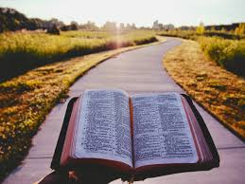
LOVE Part 3 "Really Fall in Love"

Slide 19
57-0407M - God Keeps His Word 58 So, children, back to your God, quickly. Don’t tangle with the world for anything. Stay out of this modern world. Stay out of these modern theologies. Just look to the Lamb of God. Read your Bible and pray, all the time. Don’t be weary. Be rejoicing, happy, for the redemption of the Church is drawing nigh, when we shall see Him Who died for us.

Slide 20
Volume 4 1 DECLENSION FROM FIRST LOVE NO. 217 A SERMON DELIVERED ON SABBATH EVENING, SEPTEMBER 26, 1858 BY THE REV. C. H. SPURGEON AT THE NEW PARK STREET CHAPEL, SOUTHWARK “Nevertheless I have somewhat against thee, because thou hast left thy first love.” Revelation 2:4 We shall never love Christ much except we live near to Him. Love to Christ is dependent on our nearness to Him. It is just like the planets and the sun. Why are some of the planets cold? Why do they move at so slow a rate? Simply because they are so far from the sun. Put them where the planet Mercury is and they will be in a boiling heat and spin round the sun in rapid orbits. So, beloved, if we live near to Christ, we cannot help loving Him—the heart that is near Jesus must be full of His love. But when we live days and weeks and months without personal prayer, without real fellowship—how can we maintain love towards a stranger? He must be a friend and we must stick close to Him, as He sticks close to us—closer than a brother—or else, we shall never have our first love.
There are a thousand reasons that I might have given, but I leave each of you to search your hearts, to find out why thou hast lost, each of you, your first love.

Slide 21
Really fall in Love with the Lord first. 64-0404 - Jehovah-Jireh #3 167 That’s the way it is with God, when not trying to study from some newspaper standpoint, some theological standpoint, but fall in love with Him. Get down and really get Him in your heart, “the love of God shed abroad in their heart by the Holy Ghost,” then go to reading the Bible and you’ll see It coming right out between the lines. See, you know what He is saying. He never said that right out in the Word. Jesus thanked the Father because that He had “hid those things from the eyes of the wise and prudent.” Now, no one else could read my wife’s letters like that, ’cause I love her that way, see, and that’s the way she writes to me. That’s the way God writes to you. It’s between the lines, you read It.

Slide 22
Really fall in Love with the Lord first. 22 Listen, first you’ve got to be borned again of the Spirit of God. If you’re not, you’ll never understand the Word of God. God has said so. God said, “I have hid this Bible from the wise and prudent, and will reveal it to babes such as will believe.” If you want to get anything from God, just be a baby. Open up the Bible. Fall in love with Jesus.
23 Now, when my wife writes me a letter, well, I read it. And she starts off, “Dear Billy, I am setting here tonight. I am thinking much about you.” That’s what she’s saying on the paper, but I can tell what’s between the lines, what she’s reading.
The Bible, you must read between the lines, because God has hid It from those who just read the word alone. I am quoting Scripture that He has hid It from the eyes of the wise and prudent, and will reveal It to babes such as will learn. All that’s ever read that in the Bible say, “Amen.” [Congregation says, “Amen.”—Ed.] Then it’s the baby that’ll humble himself, not be puffed up, but be humble, and say, “Lord, I believe It.”
55-0624 - Abraham

Slide 23
Luke 14 26If any man come to me, and hate not his father, and mother, and wife, and children, and brethren, and sisters, yea, and his own life also, he cannot be my disciple. 27And whosoever doth not bear his cross, and come after me, cannot be my disciple. 28For which of you, intending to build a tower, sitteth not down first, and counteth the cost, whether he have sufficient to finish it? 29Lest haply, after he hath laid the foundation, and is not able to finish it, all that behold it begin to mock him, 30Saying, This man began to build, and was not able to finish. 31Or what king, going to make war against another king, sitteth not down first, and consulteth whether he be able with ten thousand to meet him that cometh against him with twenty thousand? 32Or else, while the other is yet a great way off, he sendeth an ambassage, and desireth conditions of peace. 33So likewise, whosoever he be of you that forsaketh not all that he hath, he cannot be my disciple. Strong's Definition
From a primary word μῖσος misos (hatred); to detest (especially to persecute); by extension to love less: - hate (-ful).
Thayer's Definition
to hate, pursue with hatred, detest.
2) to be hated, detested.

Slide 24
Ephesians 5 22Wives, submit yourselves unto your own husbands, as unto the Lord. 23For the husband is the head of the wife, even as Christ is the head of the church: and he is the saviour of the body. 24Therefore as the church is subject unto Christ, so let the wives be to their own husbands in every thing.
25Husbands, love your wives, even as Christ also loved the church, and gave himself for it; 26That he might sanctify and cleanse it with the washing of water by the word, 27That he might present it to himself a glorious church, not having spot, or wrinkle, or any such thing; but that it should be holy and without blemish. 28So ought men to love their wives as their own bodies. He that loveth his wife loveth himself. 29For no man ever yet hated his own flesh; but nourisheth and cherisheth it, even as the Lord the church: 30For we are members of his body, of his flesh, and of his bones. 31For this cause shall a man leave his father and mother, and shall be joined unto his wife, and they two shall be one flesh. 32This is a great mystery: but I speak concerning Christ and the church. 33Nevertheless let every one of you in particular so love his wife even as himself; and the wife see that she reverence her husband.

Slide 25
Really fall in Love with the Lord first. Keep your mind on the Lord constantly; this helps you fall more in Love with Him. Psalm 94 19In the multitude of my thoughts within me thy comforts delight my soul.
Phillipians 4 8Finally, brethren, whatsoever things are true, whatsoever things are honest, whatsoever things are just, whatsoever things are pure, whatsoever things are lovely, whatsoever things are of good report; if there be any virtue, and if there be any praise, think on these things. 9Those things, which ye have both learned, and received, and heard, and seen in me, do: and the God of peace shall be with you.

Slide 26
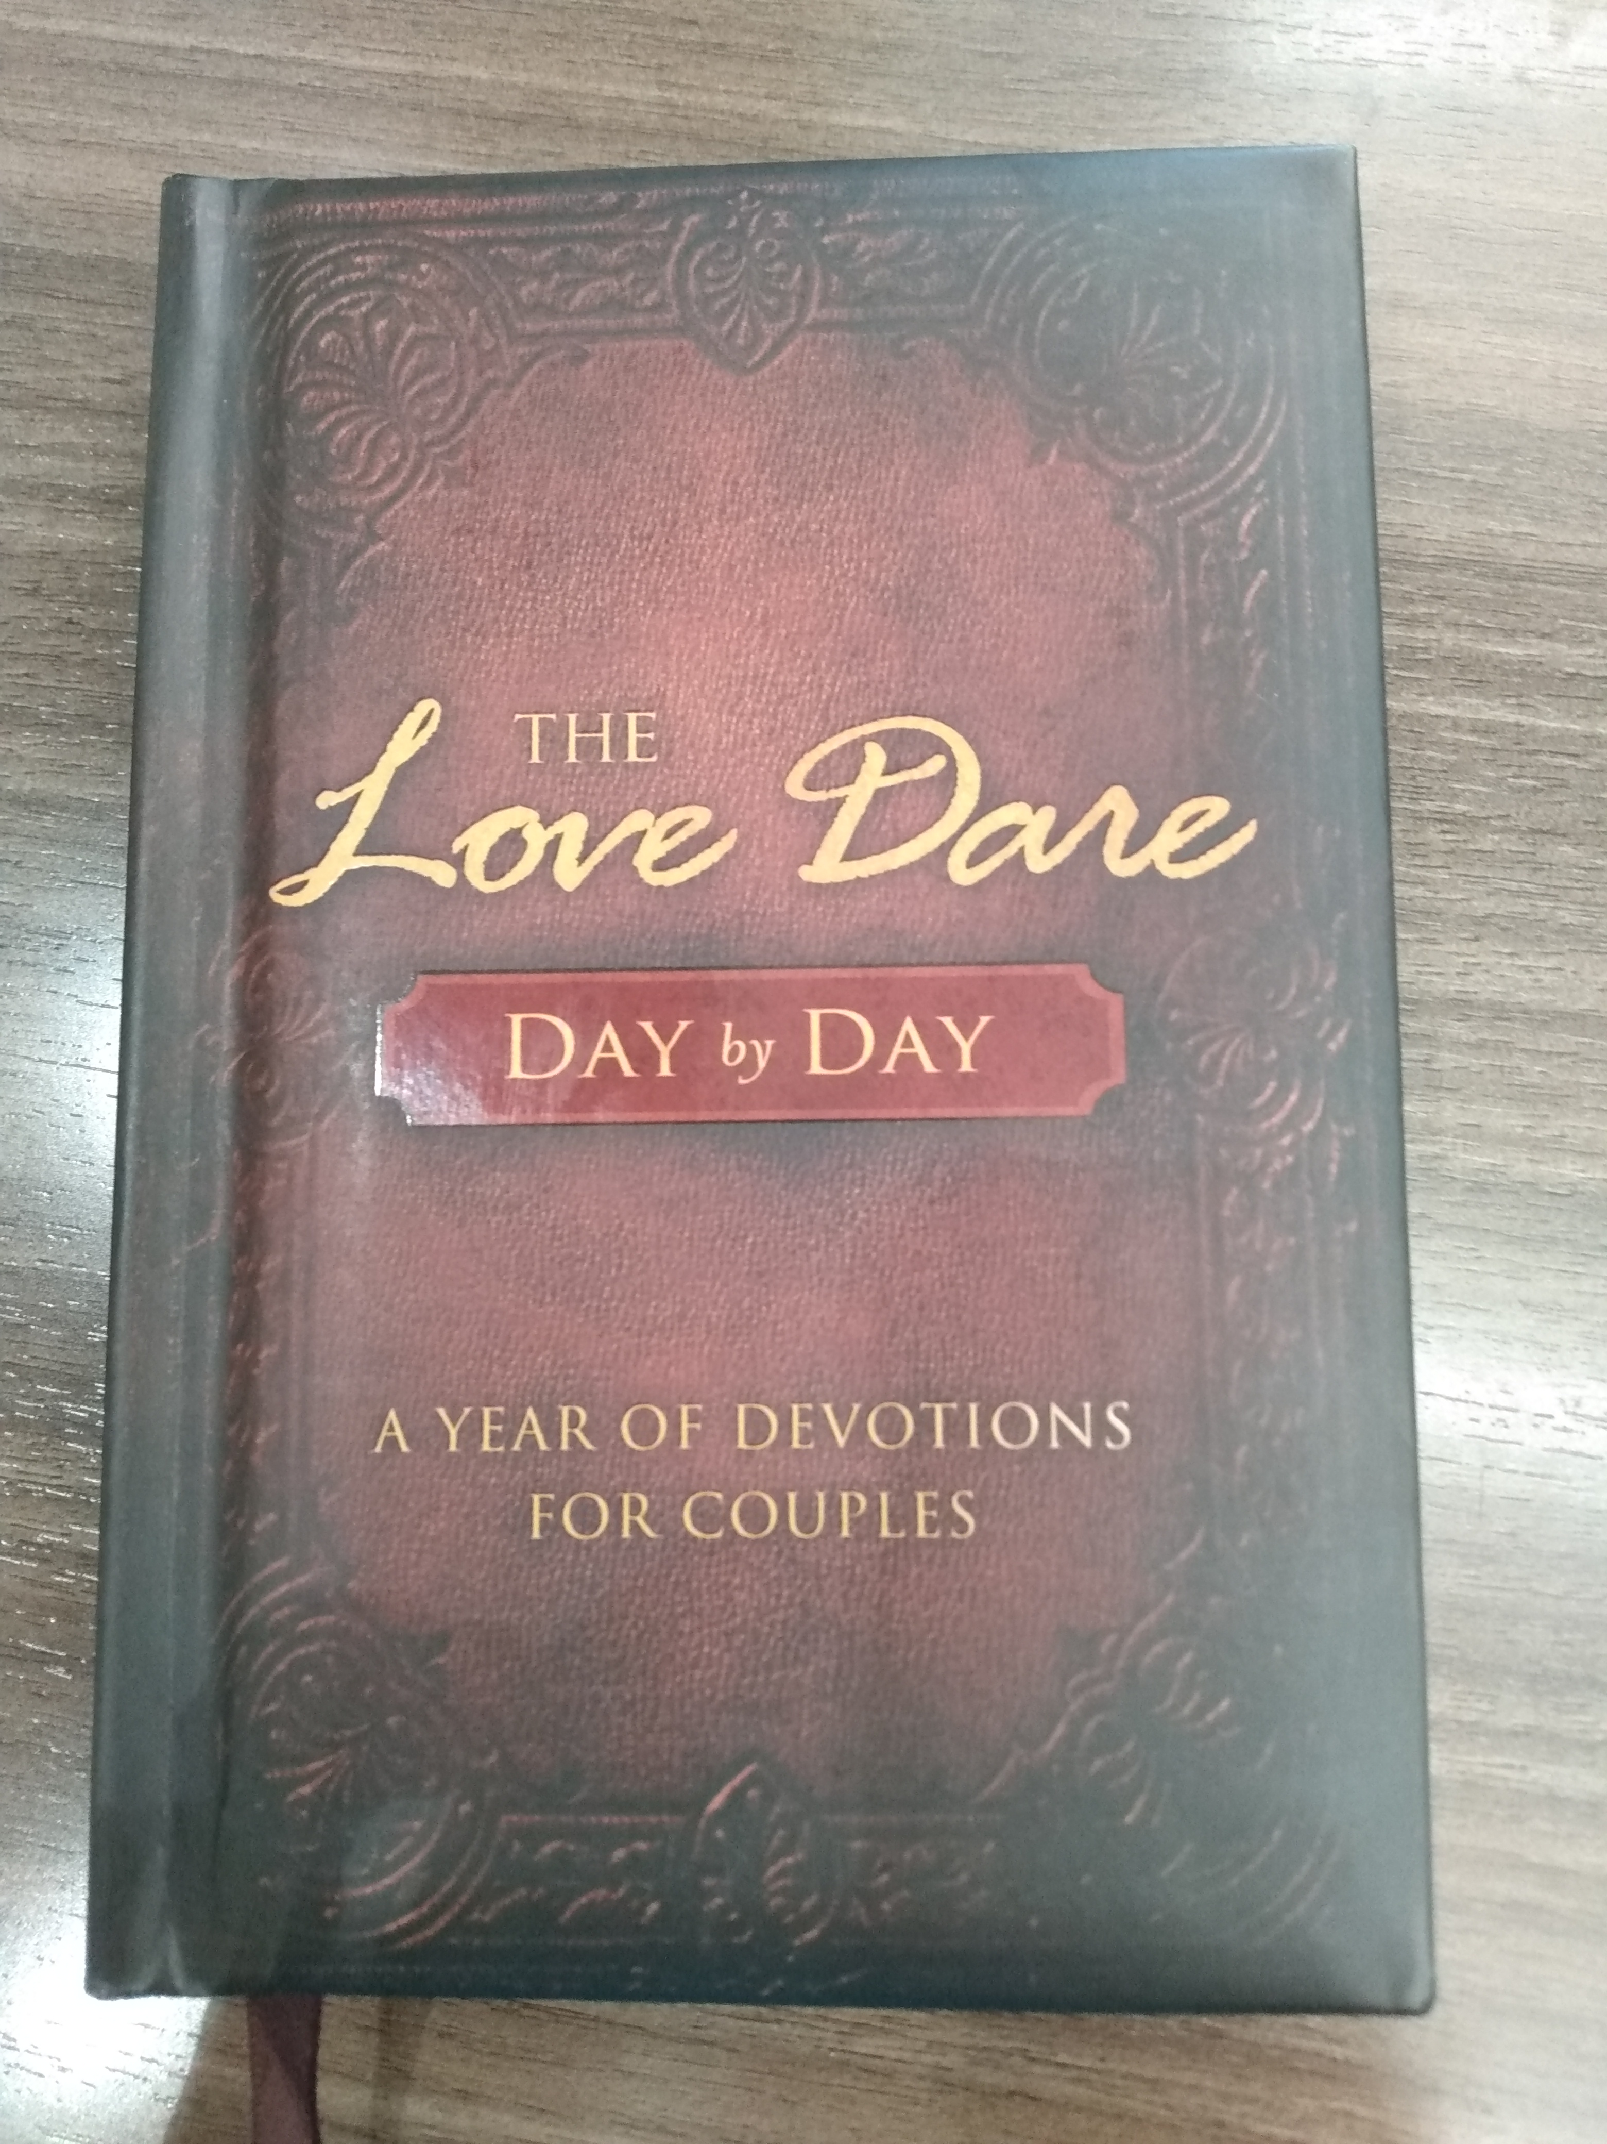

Slide 27
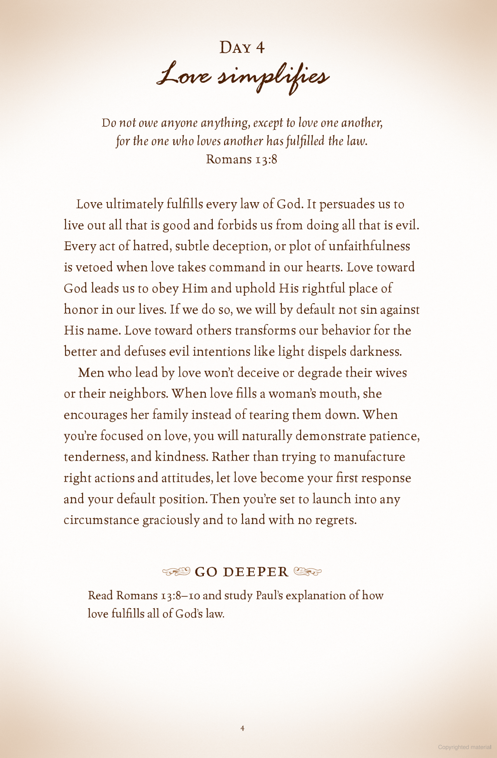

Slide 29
Romans 13 8Owe no man any thing, but to love one another: for he that loveth another hath fulfilled the law. 9For this, Thou shalt not commit adultery, Thou shalt not kill, Thou shalt not steal, Thou shalt not bear false witness, Thou shalt not covet; and if there be any other commandment, it is briefly comprehended in this saying, namely, Thou shalt love thy neighbour as thyself. 10Love worketh no ill to his neighbour: therefore love is the fulfilling of the law.

Slide 30
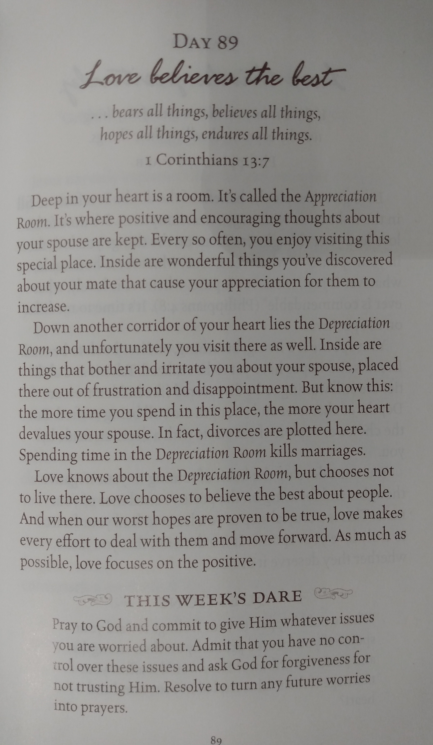

Slide 32
Really fall in Love with the Lord first. Daily Bible reading is enormously important to a child of God. It is ABSOLUTELY necessary for Spiritual growth. Just like a new-born baby must eat to grow, we MUST eat Spiritually to grow, and a sufficient amount of Spiritual Food is necessary.

Slide 33
Really fall in Love with the Lord first. 22 Listen, first you’ve got to be borned again of the Spirit of God. If you’re not, you’ll never understand the Word of God. God has said so. God said, “I have hid this Bible from the wise and prudent, and will reveal it to babes such as will believe.” If you want to get anything from God, just be a baby. Open up the Bible. Fall in love with Jesus.
23 Now, when my wife writes me a letter, well, I read it. And she starts off, “Dear Billy, I am setting here tonight. I am thinking much about you.” That’s what she’s saying on the paper, but I can tell what’s between the lines, what she’s reading.
The Bible, you must read between the lines, because God has hid It from those who just read the word alone. I am quoting Scripture that He has hid It from the eyes of the wise and prudent, and will reveal It to babes such as will learn. All that’s ever read that in the Bible say, “Amen.” [Congregation says, “Amen.”—Ed.] Then it’s the baby that’ll humble himself, not be puffed up, but be humble, and say, “Lord, I believe It.”
55-0624 - Abraham

Slide 34
Left off here September 2023.

Slide 35
What kind of love does God expect husbands and wives to show to each other?
Song of Songs 8:6
Place me like a seal over your heart . . . For love is as strong as death.
Song of Songs is a book about the romantic and sensuous love husbands and wives should have for each other. True sensuous love is a giving love, not a taking love, an offering of self rather than a claim to the spouse’s self.
Ephesians 5:24-25
As the church submits to Christ, so you wives should submit to your husbands in everything. For husbands, this means love your wives, just as Christ loved the church. He gave up his life for her.

Slide 36
After our love for God, nothing should take greater priority than the giving, sacrificial love we have for our spouse. This love helps us learn more about how we are to love God, and it is an example to those who are learning about love.
Hebrews 13:4
Give honor to marriage, and remain faithful to one another in marriage.
Before you are married, it is essential that you make a lifetime, irrevocable commitment to stay married. Then when problems come, you won’t be looking for a way out; instead, you will look for a way through.

Slide 37
Why people don't read the Bible: - I don't have time. - I've read It before. - I don't understand It. - It's too simple to be of value. - I feel unworthy. - I don't want it to become "routine."

Slide 38
So in the spiritual children, you’ve got to eat the Word of God, study the Word of God, you know. Pray and seek God and ask Him to reveal these Things to you instead of just saying, “Oh, I believe That.”
Let It be a part of you. And if you have the New Birth, you will desire... right? Is that what we read? You’ll desire the sincere milk of the Word that we may grow thereby because, see, that will be a part of your life. Why wouldn’t you want to grow in Christ? Why would that not be your desire to want to know more about God?
18-0919 – Being Born Again Pt. 36 (Brotherly Kindness) - Samuel Dale (10:15)

Slide 39
Really fall in Love with the Lord first. Don't just say, "I believe." But live, "I believe." Actions speak louder than words. You can say you believe but missing Church, neglecting Bible reading and prayer proves you don't really believe. We prove what we believe by our actions.

Slide 40
Really fall in Love with the Lord first. In other words, if you don't read the Bible and the Message, you prove you don't believe it's necessary. Perhaps you believe you're alright just being "in the Message," or, "in Spoken Word Church." Take heed to Brother Dale's statement: "I'd rather seek the Holy Ghost every day of my life and find out I had It all along than to not seek It and die lost."

Slide 41
Really fall in Love with the Lord first. Revelation 3 117Because thou sayest, I am rich, and increased with goods, and have need of nothing; and knowest not that thou art wretched, and miserable, and poor, and blind, and naked: 18I counsel thee to buy of me gold tried in the fire, that thou mayest be rich; and white raiment, that thou mayest be clothed, and that the shame of thy nakedness do not appear; and anoint thine eyes with eyesalve, that thou mayest see. 19As many as I love, I rebuke and chasten: be zealous therefore, and repent. 20Behold, I stand at the door, and knock: if any man hear my voice, and open the door, I will come in to him, and will sup with him, and he with me.

Slide 42
Really fall in Love with the Lord first. Some people spend their life trying to figure out what love is; other people spend their life trying to express their love. Humans are created to love, driven by love, by the God of Love. When you possess it, you want to express it.

Slide 43
Really fall in Love with the Lord first. 63-0728 - Christ Is The Mystery Of God Revealed 233 Look, Christ in you makes Him the center of Life of the revelation. See? Christ’s Life in you makes Him the center of the revelation. Christ, in the Bible, makes the Bible the complete revelation of Christ. Christ in you makes you the complete revelation of the whole thing, see, what God is trying to do.

Slide 44
Really fall in Love with the Lord first. 63-0728 - Christ Is The Mystery Of God Revealed 234 What is the new Birth then? You’d say, “Well, Brother Branham, what is the new Birth?” It is the revelation of Jesus Christ personally to you. Amen! See? Not you joined a church, you shook a hand, you done something different, you said a creed, you promised to live by a—a code of rules. But Christ, the Bible, He is the Word that was revealed to you. And no matter what anybody says, what takes place, it’s Christ; pastor, priest, whatever it might be. It’s Christ in you, that is the revelation that the Church was built upon. How will this happen if you don't read the Bible/Message and pray?

Slide 45
Really fall in Love with the Lord first. "Wherefore the rather, brethren, give diligence to make your calling," not your pastor, not your brother, not your sister, not your neighbor, you're calling.
Find out who you are and what you're doing here. "...calling and election sure. For if ye do these things, you shall never fall." What a promise! If you do these things, this formula, Brother Branham said, "this prescription," you shall never fall.
23-0903pm - Son of Man Pt.129 - Wade Dale (1:20:00)

Slide 46
Really fall in Love with the Lord first. Now look, It gave us the promises, it didn't say we were going to automatically get them. Come on somebody! They're there, they're there to get but you got to want them. You got to get them. Make yourself ready. Whereby are given unto us exceeding great and precious promises, that by these, Brother Branham said, "these promises," you might be partakers of the divine nature.
23-0903pm - Son of Man Pt.129 - Wade Dale (1:16:30)

