Slide 1
HEBREWS 1:7-13
…
» 7 † And of the angels he saith, Who maketh his angels spirits, and his ministers a flame of fire.
» 8 † But unto the Son he saith, Thy throne, O God, is for ever and ever: a sceptre of righteousness is the sceptre of thy kingdom.
» 9 † Thou hast loved righteousness, and hated iniquity; therefore God, even thy God, hath anointed thee with the oil of gladness above thy fellows.
» 10 † And, Thou, Lord, in the beginning hast laid the foundation of the earth; and the heavens are the works of thine hands:
» 11 † They shall perish; but thou remainest; and they all shall wax old as doth a garment;
» 12 † And as a vesture shalt thou fold them up, and they shall be changed: but thou art the same, and thy years shall not fail.
» 13 † But to which of the angels said he at any time, Sit on my right hand, until I make thine enemies thy footstool?

Slide 2
Hebrews 1:13 But to which of the angels said he at any time, Sit on my right hand, until I make thine enemies thy footstool?
Hebrews 1:3 Who being the brightness of his glory, and the express image of his person, and upholding all things by the word of his power, when he had by himself purged our sins, sat down on the right hand of the Majesty on high;
Where Did He Sit?

Slide 3
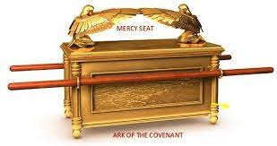
Old Testament – The Mercy Seat
PSALM 99:1
The LORD reigneth; let the people tremble: he sitteth between the cherubims; let the earth be moved.
In the Center of the “Three Room House”

Slide 4
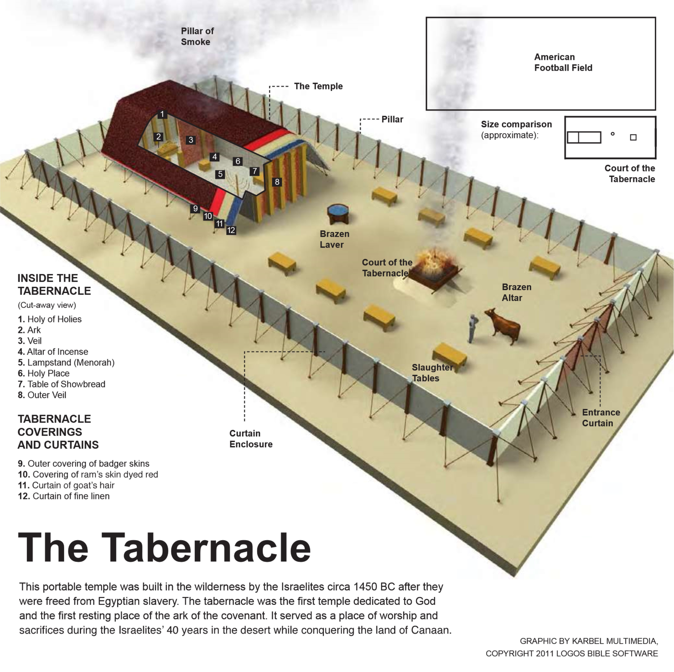
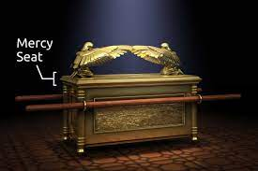
Hebrews 1:13 But to which of the angels said he at any time, Sit on my right hand, until I make thine enemies thy footstool?
61-0108 REVELATION.CHAPTER.FOUR.3_ JEFFERSONVILLE.IN ROJC 645-716 SUNDAY_
« 308 † Now, "the mercy seat." Now, the mercy seat's in the heart, seat where the shining forth of His--His Glory in all of His children, the Shekinah Glory in the human heart. Here is the human heart. Is that right? Is that the mercy seat? How do you come through it into That through these different systems? Through self-will, self-will. Comes into here, and through there, comes out what? Shekinah Glory. What--what is the Shekinah Glory? Is God's Presence. And when a man's walking, or a woman, he's reflecting the Shekinah Glory. He don't go into gambling dens and--and carry on, and go out here and deny the Word. No matter what the people says, he's got his heart set on one thing: God. And if he's truly called of God then Jesus Christ reflects Himself through him with the Shekinah Glory, doing the same things He did back there; manifest the same Gospel, preaching the same Word, same Word being made manifest in the same measure it was then, just like it was truly at Pentecost it's measured back again. Oh, my!

Slide 5
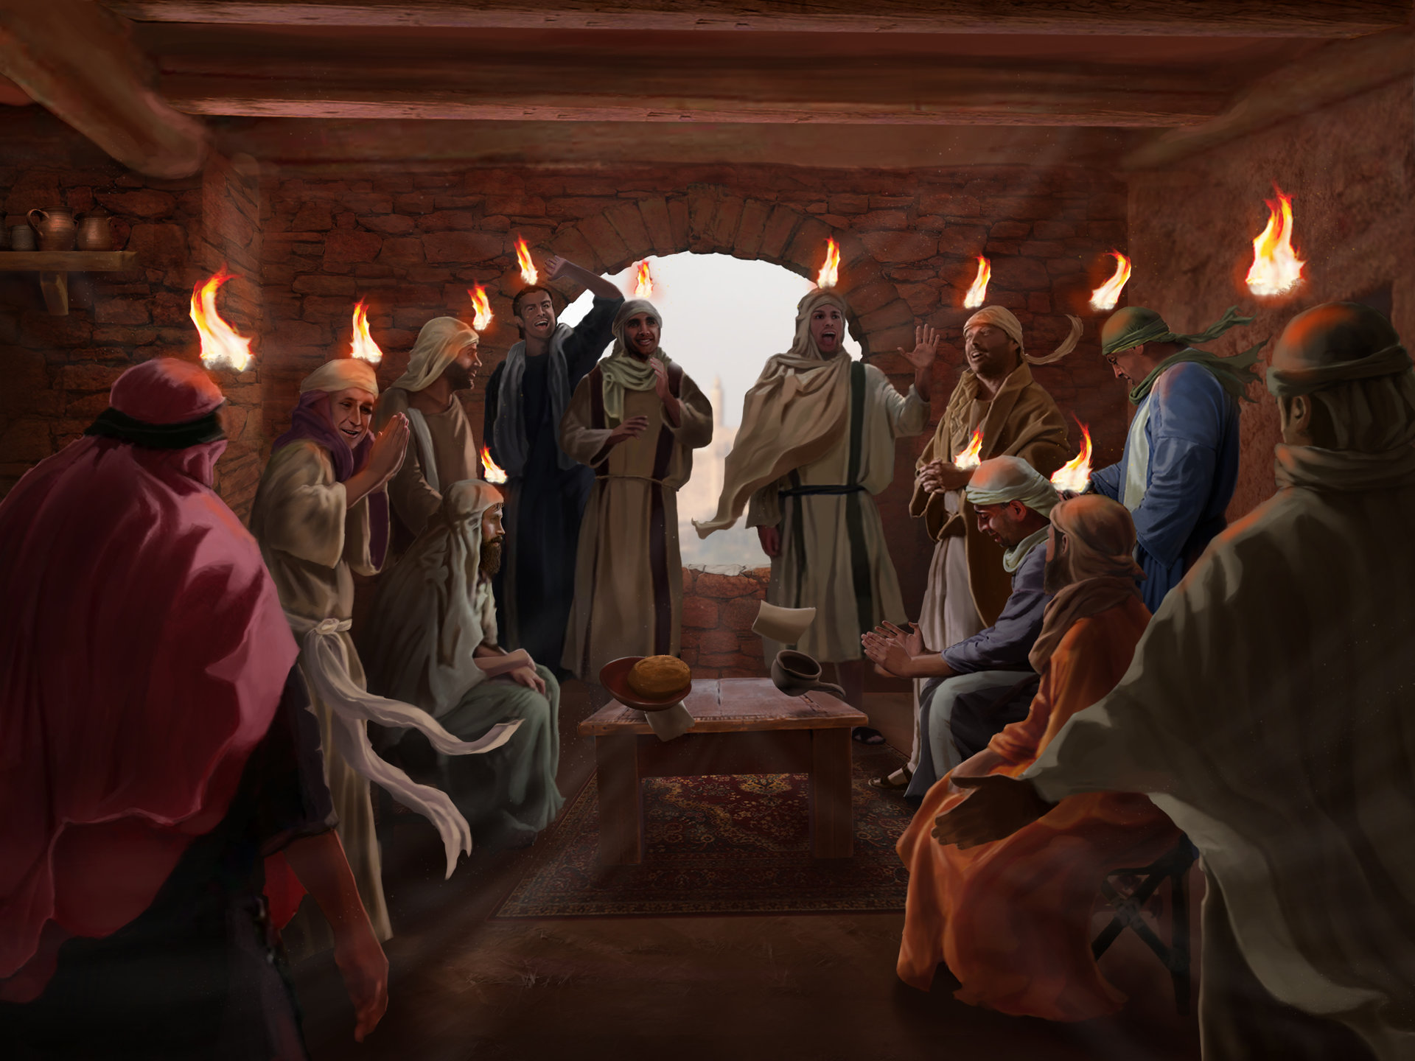
Hebrews 1:13 But to which of the angels said he at any time, Sit on my right hand, until I make thine enemies thy footstool?
Acts 2:32-37
32. This Jesus hath God raised up, whereof we all are witnesses.
33. Therefore being by the right hand of God exalted, and having received of the Father the promise of the Holy Ghost, he hath shed forth this, which ye now see and hear.
34. For David is not ascended into the heavens: but he saith himself, The LORD said unto my Lord, Sit thou on my right hand,
35. Until I make thy foes thy footstool.
36. Therefore let all the house of Israel know assuredly, that God hath made that same Jesus, whom ye have crucified, both Lord and Christ.
37. Now when they heard this, they were pricked in their heart, and said unto Peter and to the rest of the apostles, Men and brethren, what shall we do ?

Slide 6
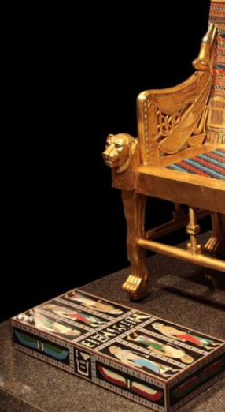
Hebrews 1:13 But to which of the angels said he at any time, Sit on my right hand, until I make thine enemies thy footstool?
DEATH is the LAST ENEMY I CORINTHIANS 15:24-25
» 24 † Then cometh the end, when he shall have delivered up the kingdom to God, even the Father; when he shall have put down all rule and all authority and power.
» 25 † For he must reign, till he hath put all enemies under his feet.
» 26 † The last enemy that shall be destroyed is death.

Slide 7
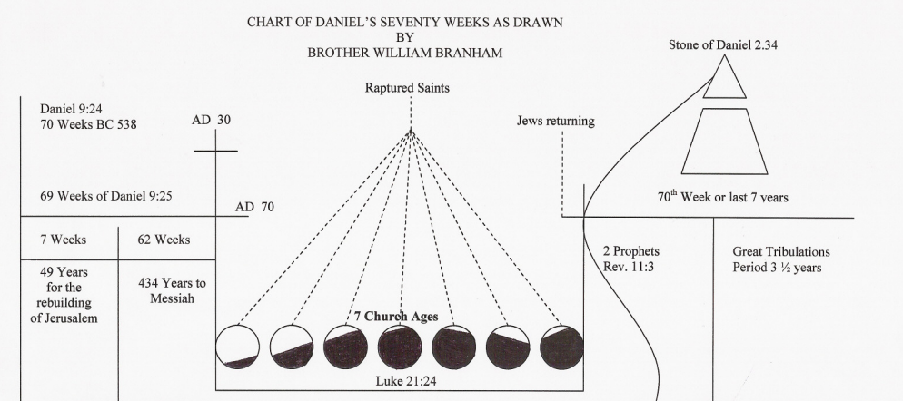
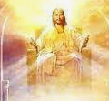
Hebrews 1:13 But to which of the angels said he at any time, Sit on my right hand, until I make thine enemies thy footstool?
Son of Man -> Son of God -> Son of David
Christ as High Priest
SIT… UNTIL

Slide 8
Hebrews 1:13 But to which of the angels said he at any time, Sit on my right hand, until I make thine enemies thy footstool?
63-0321_The Fourth Seal_Jeffersonville, Indiana, USA #14 14. And then we find out that in the revealing of the seals that the Lamb had left his mediatorial work as an intercessor, and had come forth now to claim his rights—all that He had redeemed by his death. And then no one could open the book; no one understood it. It was a book of redemption. And God, the Father, Spirit, had it in his hand, because Christ was at the throne as a mediator, the only mediator. Therefore, there could be no saint, no Mary, no Joseph, no nothing else on that altar, because it was blood; and only the blood of Jesus could make the atonement. So nothing else could be standing as a mediator. That's right. There was nothing else.
63-0318_The First Seal_Jeffersonville, Indiana, USA #109 109. And notice, every time Joseph left... when Joseph rose up from that right hand of that throne... Watch! Glory! There sat Joseph by the right hand of Pharaoh. And when Joseph raised up to leave that throne, the trumpet sounded. “Bow the knee, everybody! Joseph is coming!” When that Lamb leaves the throne yonder on His days of mediatorial work, when He leaves the throne up there and takes that Book of Redemption and walks forth, every knee will bow and every tongue confess! There He is!

Slide 9
Hebrews 1:13 But to which of the angels said he at any time, Sit on my right hand, until I make thine enemies thy footstool?
63-1110M SOULS.THAT.ARE.IN.PRISON.NOW_ JEFFERSONVILLE.IN V-2 N-22 SUNDAY_
« 138 † But under the Sixth Seal, where these Trumpets opened. Remember, under there, we find out that the Lamb came forth, appeared on the scene. He had left the Mercy Seat. His work of redemption was finished. And He came forth and took the Book out of the right hand of Him that sat upon the Throne, and "time was no more." And immediately an angel appeared in the seventh chapter, or the 10th chapter and the 7th verse, saying... This Angel come down and swore, that, "time was no longer.“
« 24-1 † THE.REVELATION.OF.JESUS.CHRIST - CHURCH.AGE.BOOK CPT.1
Do you see it? The LAMB, the High Priest holding His blood as an atonement on the mercy seat for our sins is the Lord God Almighty. That is His present office. That is what He is doing now, pleading His blood for our sins. But one day that Lamb will become the Lion of the Tribe of Juda. He will come forth in power and glory and take His authority to reign as King.

Slide 10
Hebrews 1:13 But to which of the angels said he at any time, Sit on my right hand, until I make thine enemies thy footstool?
Hebrews 1:3 Who being the brightness of his glory, and the express image of his person, and upholding all things by the word of his power, when he had by himself purged our sins, sat down on the right hand of the Majesty on high;
Where Did He Sit?

Slide 11
Hebrews 1:13 But to which of the angels said he at any time, Sit on my right hand, until I make thine enemies thy footstool?
63-0318 THE.FIRST.SEAL_ JEFFERSONVILLE.IN MONDAY_
« 152 † The voice is a thunder. The voice came from where? From the throne where the Lamb had just left as Intercessor. Now, He's standing here to take His position and His claims. But the thunder came from the inside of the throne, thundered out. And the Lamb was standing out here. The thunder, where the Lamb had left, left the Father's throne to go to take His own throne... Glory. Now, now, don't miss it, friends.
We all know as Christians that God swore to David that He would raise up Christ to set on His throne and give Him an everlasting Kingdom here on the earth. He did it. And Jesus said, "He that overcomes the antichrist and all the things of the world shall set with Me on My throne as I have overcome and have set down on My Father's throne." See?
« 155 † Now, someday He rises from the Father's throne, and goes to take His own throne. Now He comes forth to call His subjects. How's He going to claim them? He's already got the Book of Redemption in His hand. Glory. Oh, I feel like singing a hymn.

Slide 12
Hebrews 1:13-14 But to which of the angels said he at any time, Sit on my right hand, until I make thine enemies thy footstool? Are they not all ministering spirits, sent forth to minister for them who shall be heirs of salvation?
Are they not all ministering spirits, sent forth to minister for them who shall be heirs of salvation?
You are the heirs of salvation

Slide 13
Hebrews 2:1-8
» 1 † Therefore we ought to give the more earnest heed to the things which we have heard, lest at any time we should let them slip.
» 2 † For if the word spoken by angels was stedfast, and every transgression and disobedience received a just recompence of reward;
» 3 † How shall we escape, if we neglect so great salvation; which at the first began to be spoken by the Lord, and was confirmed unto us by them that heard him;
» 4 † God also bearing them witness, both with signs and wonders, and with divers miracles, and gifts of the Holy Ghost, according to his own will?
» 5 † For unto the angels hath he not put in subjection the world to come, whereof we speak.
» 6 † But one in a certain place testified, saying, What is man, that thou art mindful of him? or the son of man, that thou visitest him?
» 7 † Thou madest him a little lower than the angels; thou crownedst him with glory and honour, and didst set him over the works of thy hands:
» 8 † Thou hast put all things in subjection under his feet. For in that he put all in subjection under him, he left nothing that is not put under him. But now we see not yet all things put under him.

Slide 14
Hebrews 2:9-14
» 9 † But we see Jesus, who was made a little lower than the angels for the suffering of death, crowned with glory and honour; that he by the grace of God should taste death for every man.
» 10 † For it became him, for whom are all things, and by whom are all things, in bringing many sons unto glory, to make the captain of their salvation perfect through sufferings.
» 11 † For both he that sanctifieth and they who are sanctified are all of one: for which cause he is not ashamed to call them brethren,
» 12 † Saying, I will declare thy name unto my brethren, in the midst of the church will I sing praise unto thee.
» 13 † And again, I will put my trust in him. And again, Behold I and the children which God hath given me.
» 14 † Forasmuch then as the children are partakers of flesh and blood, he also himself likewise took part of the same; that through death he might destroy him that had the power of death, that is, the devil;

Slide 15
Hebrews 2:15-18
» 15 † And deliver them who through fear of death were all their lifetime subject to bondage.
» 16 † For verily he took not on him the nature of angels; but he took on him the seed of Abraham.
» 17 † Wherefore in all things it behoved him to be made like unto his brethren, that he might be a merciful and faithful high priest in things pertaining to God, to make reconciliation for the sins of the people.
» 18 † For in that he himself hath suffered being tempted, he is able to succour them that are tempted.

Slide 16
Hebrews 2:1 Therefore we ought to give the more earnest heed to the things which we have heard, lest at any time we should let them slip.
What type of people ought we to be, when we see the great Jehovah come down and do the things that He does, and see them compared, Scripture by Scripture, that they're the Truth?
And we sit around sometimes like a warts on a log, and just so unconcerned.
We ought to be busy, every minute, trying to get people to Christ.
We ought to be lively stones.
We should never be slothful like we are.
We'll go up to church, and we'll see the Lord Jesus do something, or bless us in such a way, and then we'll go back out and say, "Very nice meeting."

Slide 17
Hebrews 2:1 Therefore we ought to give the more earnest heed to the things which we have heard, lest at any time we should let them slip.
And then when we see those things take place, that we do see take place enough, we should never let these things slip. We just let it go through our fingers. That's what's the matter with the great Pentecostal church today. They've let the very cream of the crop slip through their fingers, when they had it in their hands. But, look what they done, they done like the rest the churches. "They've run in the gain, in the way of Korah, and perished; and the way of Cain, and perished in the gainsaying of Korah."

Slide 18
Hebrews 2:1 Therefore we ought to give the more earnest heed to the things which we have heard, lest at any time we should let them slip.
LET IT SLIP by FIGHTING/DIVISIONS How did the Indians lose this country to the white man? Is because they were disunified. If they had made one big forefront... But they were fighting one among each other. They would have held their grounds if they'd have all come together. 35 How are we going to lose it? - Because we're disunified. - How we lose our experience with God, is because we disunify. We set up one, and call this the--the Methodist, and this the Baptist, and this the Assemblies, and this the Oneness, and this the something-else, and the church of God, and the Nazarene, the Pilgrim Holiness. We disunify the Body of Christ. We should never be divided. We might differ in ideas, but let's be heart-in-heart brothers. God wants us to be. He died for the entire Church of God. And we do not want to be disunified.

Slide 19
Hebrews 2:2-3 » 2 † For if the word spoken by angels was stedfast, and every transgression and disobedience received a just recompence of reward; » 3 † How shall we escape, if we neglect so great salvation; which at the first began to be spoken by the Lord, and was confirmed unto us by them that heard him;
"If the word spoken by the angels was steadfast..." Now, angel is the "messenger." The word angel means the "messenger." And just got through, in the 1st book here, "God, in sundry times and divers manner, spoke to the fathers by the prophets." That was God's messengers.
They were God's angels. A messenger is an angel; or an angel is the messenger, rather.

Slide 20
Hebrews 2:2-3 » 2 † For if the word spoken by angels was stedfast, and every transgression and disobedience received a just recompence of reward; » 3 † How shall we escape, if we neglect so great salvation; which at the first began to be spoken by the Lord, and was confirmed unto us by them that heard him;
A messenger!
You are a messenger, this morning. You're...
You are a messenger of good news or a messenger of bad news.
Oh, isn't it beautiful, to know that we are ambassadors, that we are angels, the messengers of the resurrection?
And we are God's messengers to the sinful world, that Christ lives. In our hearts, He lives. In our spirits, He lives. And He brings us from the low debauched life of sin, and exalts us up, and gives us a "hallelujah" in our soul, and makes us new creatures.

Slide 21
Hebrews 2:2-3 » 2 † For if the word spoken by angels was stedfast, and every transgression and disobedience received a just recompence of reward; » 3 † How shall we escape, if we neglect so great salvation; which at the first began to be spoken by the Lord, and was confirmed unto us by them that heard him;
THEIR WORD was STEADFAST And now, in the Old Testament, "if the word spoken by angels were steadfast," that way it had to be right.
In the Old Testament, before a prophet's word could be made manifest, it had to be examined and proved. They wasn't loose with it, like we are today.
Just go out and have any kind of a sensation, or anything else, "Oh, glory to God, that's it!" You're mistaken.
The Bible said, that, "In the last days, the Devil will impersonate Christianity, so close, till it'll deceive the very Elected if possible." That's right. So, we must test it.

Slide 22
Hebrews 2:3 » 3 † How shall we escape, if we neglect so great salvation; which at the first began to be spoken by the Lord, and was confirmed unto us by them that heard him;
How shall we escape?
If Elijah's voice brought destruction, because he was an angel of the Lord, how will we escape when the Voice of Christ speaking through?
Or, how can we fail when you're prayed for, if It's the Voice of Christ?
Where is your escape?
Oh, you say, "Bless God, I belong to the Methodist church. I'm a Presbyterian. I'm a Pentecostal." That doesn't have one thing to do with It. And you get on a side-line and want to call It "spiritualism, or some mental telepathy, or some devil," or something. Shame on them!
And when we see Him come down, to continue to confirm His Word, how shall we escape if we sucker to some church, or some organization, or denomination, or some little pet theory of our own? You better turn loose. "For every sin received a just recompense under the angels, how much more when the Son of God is speaking from the Heavens, to make manifest His Word! How shall we escape, if we neglect so great a salvation?"

Slide 23
Hebrews 2:3 » 3 † How shall we escape, if we neglect so great salvation; which at the first began to be spoken by the Lord, and was confirmed unto us by them that heard him;
54-0404E GOD.HAS.A.PROVIDED.WAY_ LOUISVILLE.KY V-25 N-9 SUNDAY_
And there's where all the types and the shadows of the Old Testament, all come and met in Jesus Christ. He paid the supreme price, ascended on high, and sent back the Holy Ghost tonight, which is God's provided Way of your escape.

Slide 24
** Hebrews 2:4 » 4 † God also bearing them witness, both with signs and wonders, and with divers miracles, and gifts of the Holy Ghost, according to his own will?
God always bears witness.
Your life will bear witness.
I don't know what your testimony is, but your life speaks so loud, your voice can't be heard.
But, your living, your every-day life will testify what you are. God bears witness. Yes.
The Holy Spirit is a seal, and a seal takes both sides of the paper.
They see you standing here and see you when you go away. Not only in church but at every-day work. You're sealed on both sides, inside and outside. By the joy that you have, and by the life that you live, you're sealed, in and outside, that you know you're saved and the world knows you're saved, by the life that you live, for God bears witness.

Slide 25
** Hebrews 2:4 » 4 † God also bearing them witness, both with signs and wonders, and with divers miracles, and gifts of the Holy Ghost, according to his own will?
both with signs and wonders, and with divers miracles, and gifts of the Holy Ghost, according to his own will?
Acts 3:4
And Peter, fastening his eyes upon him with John, said, Look on us. Brother, when the world knows that you've been with Jesus, when you can live such an unadulterated life in this present world and in this darkness, that the world knows and can see that you've been with Jesus; when a rugged, old vulgar prostitute of the street can become a lady, washed in the Blood of the Lamb; God is bearing witness that He lives.
81 Take a drunkard, who is so low-down that he would run around on his wife, that he would mistreat his children, and take the food from the table, to spend on a prostitute. Let him get with Jesus once. You'll see him returning, like Legion, who was in his right mind and clothed, to his babies and to his wife and to his loved ones.

Slide 26
** Hebrews 2:4 » 4 † God also bearing them witness, both with signs and wonders, and with divers miracles, and gifts of the Holy Ghost, according to his own will?
Lady Maccabee in Oklahoma And when this little preacher give her story, in such a way, till he had the people setting on the end of their seats, listening what would be next.
When he got down to that: very vile, dirty, low-down, till the laws wouldn't even want to fool with her, she was so low.
The very Devil in hell would reject such a person, nearly, the way he told the story.
Then he said, "Gentlemen, of the religions of the world, has your religion got anything that would clean the hands of Lady Maccabee?“
Everybody set still. Then he clapped his hands together, and jumped up in the air.
He said, "Glory be to God! The Blood of Jesus Christ won't only clean her hands, but It'll clean her heart and make her His Bride."

Slide 27
** Hebrews 2:5 For unto the angels hath he not put in subjection the world to come, whereof we speak.
…the great Angels that ministers in the Heavens, Gabriel, Michael, Woodworm, and the tens of thousands times tens of thousands of Angels of Heaven; or the tens of hundreds of prophets that's been on the earth, every one of them;
He's never put any of them to have control over the world to come, that we speak of. Not a one!
He never said, "Isaiah, you'll control the world."
He never put the world in subjection to Elijah. Neither did He put it to Gabriel, or any angel, any ministering spirit.

Slide 28
Hebrews 2:6 But one in a certain place [David] testified, saying, What is man, that thou art mindful of him? or the son of man, that thou visitest him?
What is man, that thou art mindful of him?
Who are you, anyhow? What does that job you got mean? Or what does that little house we own mean? What does the car we own mean?
Pretty little girl, you little sassy thing, what does that little look that you have now? You young men with a shiny, slick hair, straight shoulders; you'll bend down someday, when stooped with age.
But, blessed be the Lord! You've got a soul that's born again. You'll live forever and ever, because He become you, that you through His grace might become Him, and make a place for you.
Oh, we who think that we got a change of clothes, and a few groceries in the house, what are we? God could take it in a second. Your very breath holds in His hand.
And here in our midst to heal the sick, to proclaim and profess, and to foretell, and every time perfect. And even concerned enough to bring a little, dead fish back to its life again, in the midst of us. Jehovah around us, Jehovah in us, the great and mighty I AM.

