Slide 1
Review of Hebrews 1:1-6
Hebrews 1:1-6
1. God, who at sundry times and in divers manners spake in time past unto the fathers by the prophets,
2. Hath in these last days spoken unto us by his Son, whom he hath appointed heir of all things, by whom also he made the worlds;
3. Who being the brightness of his glory, and the express image of his person, and upholding all things by the word of his power, when he had by himself purged our sins, sat down on the right hand of the Majesty on high;
4. Being made so much better than the angels, as he hath by inheritance obtained a more excellent name than they.
5. For unto which of the angels said he at any time, Thou art my Son, this day have I begotten thee? And again, I will be to him a Father, and he shall be to me a Son?
6. And again, when he bringeth in the firstbegotten into the world, he saith, And let all the angels of God worship him.

Slide 2
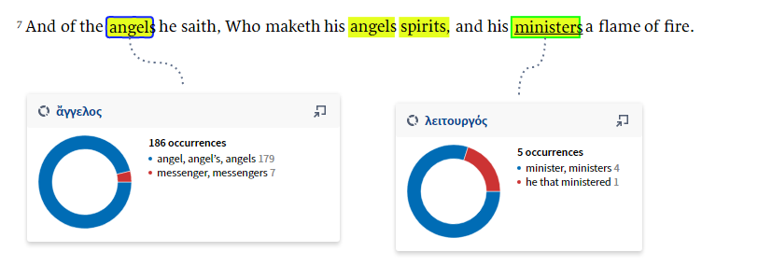
Hebrews 1:7

Slide 3
1:7 And of the angels he saith, Who maketh his angels spirits, and his ministers a flame of fire.
The Greatest Battle Ever Fought
Now, here the Bible comes right back and tells us here, that God sends forth angels. Glory! What are they? "Ministering spirits." Glory! Ministering spirits, sent (where?) from the Presence of God. What to do? Minister His Word. Amen! They're not to minister some theology of some denominational group, but to minister His Word. That's it. "Ministering spirits, sent forth."
164 How do we know they are? The Bible said, that, "The Word of the Lord came to the prophets." Is that right? These angels minister His Word, through His Spirit; minister the Word, through the Holy Spirit. And the Spirit and the Word came to the prophets, and the prophets had the Word of God. That's the reason they could do the miracles that they did. It wasn't the man; it was the Spirit of God in the man. The Spirit of Christ in the man, for the Word of God. What had he done? Cleaned out every channel. God had chose him, and he was anointed with the Holy Ghost. And it wasn't him. He never did anything till he saw it in a vision. Elijah said, on Mount Carmel, "All this I've done at Your command. Now, Lord, let it be known that Thou art God." Oh, glory to God!

Slide 4
1:7 And of the angels he saith, Who maketh his angels spirits, and his ministers a flame of fire.
57-0825E HEBREWS.CHAPTER.TWO.2_ JEFFERSONVILLE.IN HEB SUNDAY_
99 What do we find the angels to be? Prophets. "God spoke in sundry time..." Now, you have to make, not our own idea, but the Bible. Now the 1st chapter, of 1st chapter, the 1st verse.
God, who at sundry times... in divers manners spake... to the fathers by the prophets,
Now he goes over here, and say again.
For if the word spoken by angels were steadfast,...
And what does an angel mean? "Messenger." If God anointed messenger..." And then if we be anointed, we are God's messengers.

Slide 5
Hebrews 1:7
Hebrews 1:7
And of the angels he saith, Who maketh his angels spirits, and his ministers a flame of fire.
Hebrews 1:13-14
But to which of the angels said he at any time, Sit on my right hand, until I make thine enemies thy footstool?
Are they not all ministering spirits, sent forth to minister for them who shall be heirs of salvation?
Hebrews 2:5-6
For unto the angels hath he not put in subjection the world to come, whereof we speak.
But one in a certain place testified, saying, What is man, that thou art mindful of him? or the son of man, that thou visitest him?

Slide 6
1:7 And of the angels he saith, Who maketh his angels spirits, and his ministers a flame of fire.
62-0311 THE.GREATEST.BATTLE.EVER.FOUGHT_ JEFFERSONVILLE.IN V-3 N-11 SUNDAY_
"Ministering spirits, sent forth."
164 How do we know they are? The Bible said, that, "The Word of the Lord came to the prophets." Is that right? These angels minister His Word, through His Spirit; minister the Word, through the Holy Spirit. And the Spirit and the Word came to the prophets, and the prophets had the Word of God.
That's the reason they could do the miracles that they did. It wasn't the man; it was the Spirit of God in the man.
The Spirit of Christ in the man, for the Word of God. What had he done? Cleaned out every channel. God had chose him, and he was anointed with the Holy Ghost. And it wasn't him. He never did anything till he saw it in a vision. Elijah said, on Mount Carmel, "All this I've done at Your command. Now, Lord, let it be known that Thou art God." Oh, glory to God!

Slide 7
1:7 And of the angels he saith, Who maketh his angels spirits, and his ministers a flame of fire.
60-0308 DISCERNMENT.OF.SPIRIT_ PHOENIX.AZ V-9 N-3 TUESDAY_
« 18 † A New Testament prophet is a preacher. We all know that. Just any minister that's a preacher is a prophet, a New Testament prophet, if he's prophesying, preaching, not to try to edify himself to make a big name, or to edify his organization. Which, he should be in an organization. Here I am without one, but yet preaching you should be. That's right. Every man ought to have a church home. You ought to have a place, not just to float about from pillar to post, but have somewhere that you go to church and you call it your church, somewhere you pay your tithe, and somewhere that you help support the cause. Take your choice, but then don't never disfellowship the other man because he don't belong with your group. See? Discern his spirit and see if he's got the same purpose in heart, then you got fellowship one with another. You're working for one great cause. That's the cause of Christ. I think that that is absolutely true.
« 19 † Now, if we will notice the motives and objectives of the Old Testament prophets, them men had one objective, and that was Jesus Christ. They had one thing that their whole theme of the Old Testament was built around the coming Messiah. They--they did not go out and do things just for money or for fame. They had one thing, they were anointed with the Spirit of God, and they predicted the coming Messiah. And those men were so anointed with the Spirit until they sometimes acted like the Spirit that was within them, they spoke seemingly of themselves. Watch how the Spirit of God made them men act.

Slide 8
Hebrews 1:7
Hebrews 1:7
And of the angels he saith, Who maketh his angels spirits, and his ministers a flame of fire.
Hebrews 1:13-14
But to which of the angels said he at any time, Sit on my right hand, until I make thine enemies thy footstool?
Are they not all ministering spirits, sent forth to minister for them who shall be heirs of salvation?
Hebrews 2:5-6
For unto the angels hath he not put in subjection the world to come, whereof we speak.
But one in a certain place testified, saying, What is man, that thou art mindful of him? or the son of man, that thou visitest him?

Slide 9
Hebrews 1:7
59-0422 WE.WOULD.SEE.JESUS_ SAN.JOSE.CA WEDNESDAY_
« E-48 …I pray, Father, that Your great mercy and love will be manifested to each and every one. Just a few moments, Lord, here I'll be before these people in this... the... The clergyman, the ministers of the Gospel setting here on the platform, angels ordained to preach Life.
62-1123 THE.WAY.BACK_ SHREVEPORT.LA FRIDAY_
Look at Stephen that morning, our little Holy Ghost brother, standing before the Sanhedrin cancel--Council. The 7th chapter of Acts, said, "You men of Israel, you that dwell in Judaea," and so forth, how "our fathers come up out of Mesopotamia," and so forth: begin to tell them. Then he got wound up, got started. The Holy Ghost come upon him. He said, he shined.
His face shined like an Angel. He said, "You stiffnecks, uncircumcised in heart and ears, you always do resist the Holy Ghost. Like your fathers did, so do you." Whew. Hm. He knowed where he was standing. He knowed his position.
His face might not have shined like a light up there, but an Angel knows what He's doing. An Angel is a Messenger that's commissioned from God. He don't have to take down. He knows exactly. And them half a million howling wolves of clergy out there condemning that man for the way he was doing, and the sermons he was preaching, and Stephen stood there, and said, "You're uncircumcised of the heart and ears, and you resist the Holy Ghost like your fathers did. So are you doing the same thing." He was telling them the way back to the God that opened up the Red Sea, or tell them--to the God who rained the plagues down in Egypt.

Slide 10
Hebrews 1:7
I Corinthians 11:10
10 For this cause ought the woman to have power on her head because of the angels.
...
15 But if a woman have long hair, it is a glory to her: for her hair is given her for a covering.
power: a sign of the husband's authority over his wife, i.e. the veil with which propriety required a women to cover herself

Slide 11
Hebrews 1:7
62-0630E THE.MEANEST.MAN.IN.SANTA.MARIA_ SANTA.MARIA.CA SATURDAY_
« E-26 † That's the way... the women is supposed to wear long hair because of the--of her head, which is her husband. He's to have short hair because of Christ. The woman wears long hair because of the angels.
What is the angels? The messenger, a true messenger to the church. That's right. He will always call it down and say it's wrong (See?), and so forth. And the church, to be so yielded to Jesus that it don't claim its own head, its own headship. Christ is the Headship of the church: veiled, we're not our own, but we're His, yielded to Him and Him alone. How beautiful.

Slide 12
1:7 And of the angels he saith, Who maketh his angels spirits, and his ministers a flame of fire.
A New Testament “Prophet”
filled with the Holy Spirit
Anointed to Bring the Word
“Ministering Spirits”
To minister His Word. “They're not to minister some theology of some denominational group, but to minister His Word.”
Reflecting the Light of Jesus Christ
Apostles, Pastors, Teachers, Evangelists, Prophets
Under their Messenger
The Seven (Ministering) Spirits

Slide 13
1:7 And of the angels he saith, Who maketh his angels spirits, and his ministers a flame of fire.
60-1204E THE.PATMOS.VISION_ JEFFERSONVILLE.IN ROJC 69-130 SUNDAY_
« 51 † You see, each message waits for its time.If there be one who speaks with tongues, there be no interpreter, let him hold his peace until there be an interpreter. See? And these messages are given usually just before the meeting. Then the prophet... or the preacher, which is a New Testament prophet, a preacher, when he comes forth, God begins to move through him, see. Then when he's finished, then messages begin, another; then, just before. It's always in order, always.

Slide 14
1:7 And of the angels he saith, Who maketh his angels spirits, and his ministers a flame of fire.
62-0725 A.GREATER.THAN.SOLOMON.IS.HERE_ PORT.ALBERNI.BC WEDNESDAY_
« E-5 † A prophet is a seer who sees the people's hearts and foretells the things that's coming to pass. And--and now, there's a gift of prophecy. That's in the church with the local members. It falls upon any of them. They give a prophecy. Then it cannot be received to the church until it's been judged by two or three witnesses. And then, they have to put their seal on that, to say it's of God. Then they have to watch to see if it happens. Then it may never fall on that brother or sister again. It may be on another one the next... That's a gift of prophecy.
But a prophet, p-r-o-p-h-e-t, is borned a prophet, always from bef--was ordained that before the world ever even begin. See? Now, you take like Jesus Christ, the King of prophets. He was, from the garden of Eden, the Seed of the woman, prophet. And Moses was borned a proper child, a prophet. John the Baptist, why, Isaiah saw him seven hundred and twelve years before he was born, and said he's the "voice of one crying in the wilderness," seven hundred and twelve years before he was born. Jeremiah--God said before he was even formed in his mother's womb that He knew him, and sanctified him, and ordained him a prophet to the nations. See?

Slide 15
1:7 And of the angels he saith, Who maketh his angels spirits, and his ministers a flame of fire.
LAODICEAN.CHURCH.AGE - CHURCH.AGE.BOOK CPT.9
In the Dark Ages the Word was almost entirely lost to the people. But God sent Luther with the WORD. The Lutherans spoke for God at that time. But they organized, and again the pure Word was lost for organization tends toward dogma and creeds, and not simple Word. They could no longer speak for God. Then God sent Wesley, and he was the voice with the Word in his day. The people who took his revelation from God became the living epistles read and known of all men for their generation. When the Methodists failed, God raised up others and so it has gone on through the years until in this last day there is again another people in the land, who under their messenger will be the final voice to the final age.

Slide 16
1:7 And of the angels he saith, Who maketh his angels spirits, and his ministers a flame of fire.
Seven Ministering Spirits in the Book of Revelation
Revelation 1:4
John to the seven churches which are in Asia: Grace be unto you, and peace, from him which is, and which was, and which is to come; and from the seven Spirits which are before his throne;
Revelation 3:1
And unto the angel of the church in Sardis write; These things saith he that hath the seven Spirits of God, and the seven stars; I know thy works, that thou hast a name that thou livest, and art dead.
Revelation 6:1
And I beheld, and, lo, in the midst of the throne and of the four beasts, and in the midst of the elders, stood a Lamb as it had been slain, having seven horns and seven eyes, which are the seven Spirits of God sent forth into all the earth.

Slide 17
1:7 And of the angels he saith, Who maketh his angels spirits, and his ministers a flame of fire.
60-1209 THE.SARDISEAN.CHURCH.AGE_ JEFFERSONVILLE.IN ROJC 329-372 FRIDAY_
« 73 † Now let's take the 1st verse:.
..unto the angel of the church of Sardis write; These things saith he that has... seven Spirits of God, and the seven stars; I know thy work, that thou has a name that thou livest, and art dead.
Now the salute. Now, the seven Spirits are... "The seven Spirits and the seven stars." The Spirits was the angels that went to the stars which were messengers. "Seven Spirits," seven different times the Holy Spirit would anoint a messenger, which was a star in his day. A--a Spirit is Eternal, and the star that was made for a purpose to reflect Light in the dark of these church ages where candles and stars are representing. The angel, the Spirit, was the one that went to the star and reflected the Light of the Holy Spirit through this star to that church age. That, you might know... wonder who the seven Spirits are. It's the seven messengers of the seven church ages. See?
Now, and each time that the star came in on the scene, the Holy Spirit came down and anointed that star and kept it just exactly like the first one was.

Slide 18
1:7 And of the angels he saith, Who maketh his angels spirits, and his ministers a flame of fire.
61-0618 REVELATION.CHAPTER.FIVE.2_ JEFFERSONVILLE.IN ROJC 747-793 SUNDAY_
« 201 † Now, one thing here, I got here five things I'd like to speak of, just a second, just as quick as I can. Look. The seven... There's seven seals, and there's five sevens in God's plan of redemption. Five is the number of "grace." How many knows that? J-e-s-u-s, f-a-i-t-h, five is the number of grace. Six is the man's day, and seven is his--his day of redemption.
Now, watch. Now, there's seven seals in this, or--or seven stages in this great plan of redemption. There is seven what? Seven seals of redemption, seven Spirits of God... We find that (if you want to see if it says "Seven Spirits," let me see here just a minute), the 5th chapter, beginning at the 6th verse (I believe, we see here), the 6th verse:
And... behold, and, lo, in the midst of the throne and of the four beasts, and in the midst of the elders, stood a Lamb as it had been slain, having seven heads and seven eyes, which are the seven Spirits of God sent forth into all the earth.
What is those seven Spirits? Them seven messengers. There's Saint Columba, and Irenaeus, and--and John Wesley, and Martin Luther, and so forth. See, "the seven Spirits," which are seven men (seven angels), which are seven messages.

Slide 19
1:7 And of the angels he saith, Who maketh his angels spirits, and his ministers a flame of fire.
60-1205 THE.EPHESIAN.CHURCH.AGE_ JEFFERSONVILLE.IN ROJC 131-183 MONDAY_
« 50 † Now--now, each one of these churches, according to the Scripture there, had an angel. And the angel was a... How many knows what an angel means? It's a "messenger," a messenger. And there--there was seven angels to the seven churches, meant "seven messengers." Now, and they was stars in His hand. And in His hand these--these twelve... these seven stars that was to reflect the Light of His presence in the day of night that we were living in. As the stars reflects the sun to the earth, makes it light so we can walk, and get around at nighttime.
Now we find out then, that during this time, that each one of those angels had a position and place. And, brethren, tonight we don't get to it, because we know this angel of the first church, but it's going to be a mysterious and glorious thing to find and pull out of history, before you, the angels of these other churches. The angel of the first church was Saint Paul, he founded it, God's messenger. The angel of the church of Ephesus was Saint Paul. The church... Now, the reason I...

Slide 20
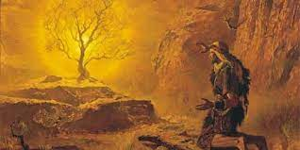
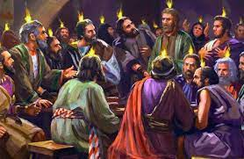
1:7 And of the angels he saith, Who maketh his angels spirits, and his ministers a flame of fire.
Psalm 104:4 Who maketh his angels spirits; his ministers a flaming fire:
Jeremiah 20:9
Then I said, I will not make mention of him, nor speak any more in his name. But his word was in mine heart as a burning fire shut up in my bones, and I was weary with forbearing, and I could not stay.
Job 32:18
For I am full of matter, the spirit within me constraineth me.
Psalm 39:3
My heart was hot within me, while I was musing the fire burned: then spake I with my tongue,
Acts 4:20 For we cannot but speak the things which we have seen and heard.

Slide 21
Review Hebrews 1:7
Hebrews 1:7
And of the angels he saith, Who maketh his angels spirits, and his ministers a flame of fire.
Hebrews 1:13-14
But to which of the angels said he at any time, Sit on my right hand, until I make thine enemies thy footstool?
Are they not all ministering spirits, sent forth to minister for them who shall be heirs of salvation?
Hebrews 2:5-6
For unto the angels hath he not put in subjection the world to come, whereof we speak.
But one in a certain place testified, saying, What is man, that thou art mindful of him? or the son of man, that thou visitest him?

Slide 22
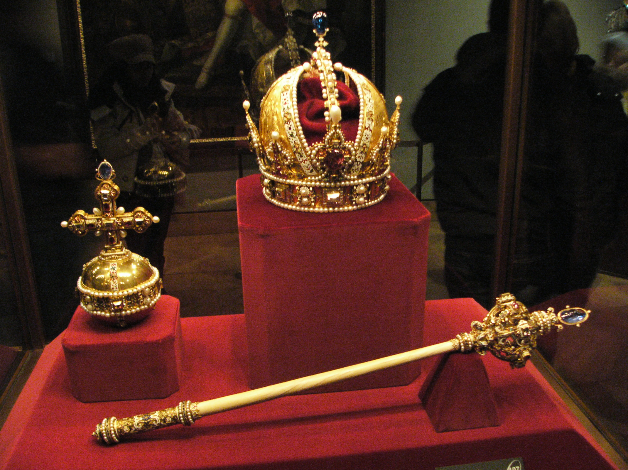
Hebrews 1:8 But unto the Son he saith, Thy throne, O God, is for ever and ever: a sceptre of righteousness is the sceptre of thy kingdom.
Quoting David
Psalm_45:6-7 6. Thy throne, O God, is for ever and ever: the sceptre of thy kingdom is a right sceptre. 7. Thou lovest righteousness, and hatest wickedness: therefore God, thy God, hath anointed thee with the oil of gladness above thy fellows.
Symbol of Authority, Divine Power, Dominion

Slide 23
Hebrews 1:8 But unto the Son he saith, Thy throne, O God, is for ever and ever: a sceptre of righteousness is the sceptre of thy kingdom.
Scepter. Long staff with an ornamental head and other decorations used to represent royal authority;
a shorter staff was used as a battle mace to symbolize royal military power.
It is of more than passing interest that those two ideas are also conveyed by the Bible when the word scepter appears in a passage.
The scepter of royal authority is referred to in Genesis 49:10, indicating that Judah’s descendants would exercise royal authority (so also in Ps 45:6, two times, and quoted in Heb 1:8). Amos (1:5, 8) refers to the royal authority of the kings of Syria and Philistia and Zechariah (10:11) to that of Egypt. King Ahasuerus held out this type of scepter to Esther (Est 4:11; 5:2; 8; 4).
The scepter of royal military power is referred to in Numbers 24:17 in reference to the coming messianic king. In Isaiah 14:5 it refers to the means by which Babylon exercised its oppressive military power that was to be destroyed by God. Ezekiel 19:11, 14 uses scepter to refer to the authority, power, and dominion which Israel lost and was not able to regain. In Psalm 2:9 and Isaiah 30:31 some recent translations (e.g., niv) have scepter, not rod of iron, to indicate divine power.

Slide 24
** Hebrews 1:9
Thou hast loved righteousness, and hated iniquity; therefore God, even thy God, hath anointed thee with the oil of gladness above thy fellows.
RIGHTEOUSNESS (Hebrew צדק, tsdq;, צְדָקָה, tsedaqah;, צַדִּיק, tsaddiq; Greek δικαιοσύνη, dikaiosynē, δίκαιος, dikaios). The quality, state, and characteristic of being in the right.
The English word “righteousness” refers to the quality of being righteous or in the right and is cognate to “just,” “justness,” and “justice.”
INIQUITY - to know not to do something and to do it anyway, and vice versa - …the crooked (AVON) BEHAVIOR and its CONSEQUENCES - …the crooked (AVON) CHARACTER of your ACTIONS
Psalm 32:5 I acknowledge my sin unto thee, and mine iniquity have I not hid. I said, I will confess my transgressions unto the Lord; and thou forgavest the iniquity of my sin. Selah.

Slide 25
Hebrews 1:9
Thou hast loved righteousness, and hated iniquity; therefore God, even thy God, hath anointed thee with the oil of gladness above thy fellows.
57-0307 GOD.KEEPS.HIS.WORD.2_ PHOENIX.AZ THURSDAY_
« E-57 † I have no prejudice against anybody. Any of these teachers from California, and all around, that's passing through the land with all these fantastics, God knows, that nearly every one of them that I know, I've set down with pleading tears and saying, "Brother, look here, that's not..."
"Oh, we're anointed with the oil of gladness."
I said, "Not oil out of your body, nothing can come out of your body that can do you any good." And the whole armor of God is supernatural. What is the armor of God? Love, joy, peace, long suffering, goodness, meekness, gentleness, patience, faith. Nothing... So all the natural work is done as the sacrifice of Christ. We just believe it. It's by faith. Nothing you have to see, nothing you have to feel; you got to believe it. Jesus never did say, "Did you see it? Did you feel it?" He said,"Did you believe it?" Did you believe it?
65-0217 A.MAN.RUNNING.FROM.THE.PRESENCE.OF.THE.LORD_ JEFFERSONVILLE.IN V-5 N-8 WEDNESDAY_
We love You, Lord Jesus. Make that so real in our hearts, Lord. Pour in the oil of gladness, this week, Lord, in our souls. Give us a bathing, a washing of the Word, by the water of the Word, dividing unto us Truth.

Slide 26
** Hebrews 1:9
» 9 † Thou hast loved righteousness, and hated iniquity; therefore God, even thy God, hath anointed thee with the oil of gladness above thy fellows.
John 3:34 For he whom God hath sent speaketh the words of God: for God giveth not the Spirit by measure unto him.
Colossians 2:9 For in him dwelleth all the fulness of the Godhead bodily.
Isaiah 61:1 The Spirit of the Lord GOD is upon me; because the LORD hath anointed me to preach good tidings unto the meek; he hath sent me to bind up the brokenhearted, to proclaim liberty to the captives, and the opening of the prison to them that are bound;

Slide 27
Hebrews 1:9
Thou hast loved righteousness, and hated iniquity; therefore God, even thy God, hath anointed thee with the oil of gladness above thy fellows.
Anointed by the Word
64-0418B A.PARADOX_ TAMPA.FL SATURDAY_
Now, what is it? Christ coming to His Body. Christ is the Word. We all know the anointing is Christ, that comes on the Word, that makes the Word live. Is that right? [Congregation says, "Amen."--Ed.] That is the anointing. Christ is the anointing, the Spirit that comes upon the Word, that quickens the Word, to make it live. Now, the Word is in your heart. You believe in Divine healing, whatevermore. See? And Christ, the anointing, coming to His Body. See the--the connection there? Just like husband and wife to become one. Now, the church has got to get to the ministry, until the church and Christ become one. He can anoint you for every blessing that's in the Bible. All of it is yours. Everything is promised at this age is yours. When we leave anything out... See? Then, if anointing strikes that, it will--it will anoint it. It's just here.

Slide 28
** Hebrews 1:9
Thou hast loved righteousness, and hated iniquity; therefore God, even thy God, hath anointed thee with the oil of gladness above thy fellows.
Anointed for a Purpose
The gladness of our Lord Jesus may be viewed, first, as the gladness which he had IN his work. – SPURGEON
Luke 2:49
And he said unto them, How is it that ye sought me? wist ye not that I must be about my Father's business?
John 4:32
But he said unto them, I have meat to eat that ye know not of.
PSALM 40:7-8
7 † Then said I, Lo, I come: in the volume of the book it is written of me,
8 † I delight to do thy will, O my God: yea, thy law is within my heart.

Slide 29
Hebrews 1:10-11 And, Thou, Lord, in the beginning hast laid the foundation of the earth; and the heavens are the works of thine hands: They shall perish; but thou remainest; and they all shall wax old as doth a garment;
Hebrews 13:8
Jesus Christ the same yesterday, and to day, and for ever.

Slide 30
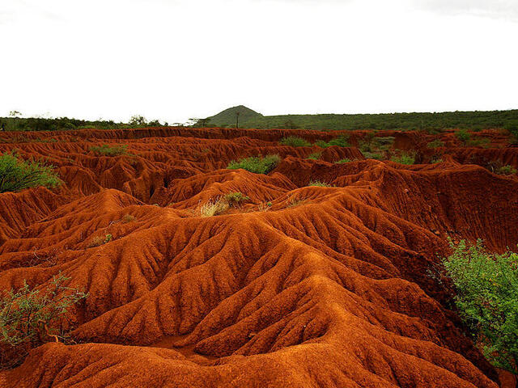
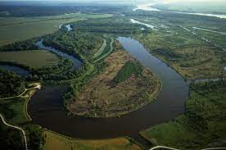
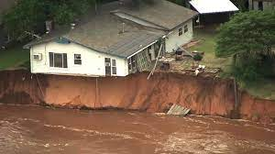
Hebrews 1:12 And as a vesture shalt thou fold them up, and they shall be changed: but thou art the same, and thy years shall not fail.

Slide 31
HEBREWS 1:1
» 1 † God, who at sundry times and in divers manners spake in time past unto the fathers by the prophets,
» 2 † Hath in these last days spoken unto us by his Son, whom he hath appointed heir of all things, by whom also he made the worlds;
» 3 † Who being the brightness of his glory, and the express image of his person, and upholding all things by the word of his power, when he had by himself purged our sins, sat down on the right hand of the Majesty on high;
» 4 † Being made so much better than the angels, as he hath by inheritance obtained a more excellent name than they.
» 5 † For unto which of the angels said he at any time, Thou art my Son, this day have I begotten thee? And again, I will be to him a Father, and he shall be to me a Son?
» 6 † And again, when he bringeth in the firstbegotten into the world, he saith, And let all the angels of God worship him.
» 7 † And of the angels he saith, Who maketh his angels spirits, and his ministers a flame of fire.
» 8 † But unto the Son he saith, Thy throne, O God, is for ever and ever: a sceptre of righteousness is the sceptre of thy kingdom.
» 9 † Thou hast loved righteousness, and hated iniquity; therefore God, even thy God, hath anointed thee with the oil of gladness above thy fellows.
» 10 † And, Thou, Lord, in the beginning hast laid the foundation of the earth; and the heavens are the works of thine hands:
» 11 † They shall perish; but thou remainest; and they all shall wax old as doth a garment;
» 12 † And as a vesture shalt thou fold them up, and they shall be changed: but thou art the same, and thy years shall not fail.

Slide 32
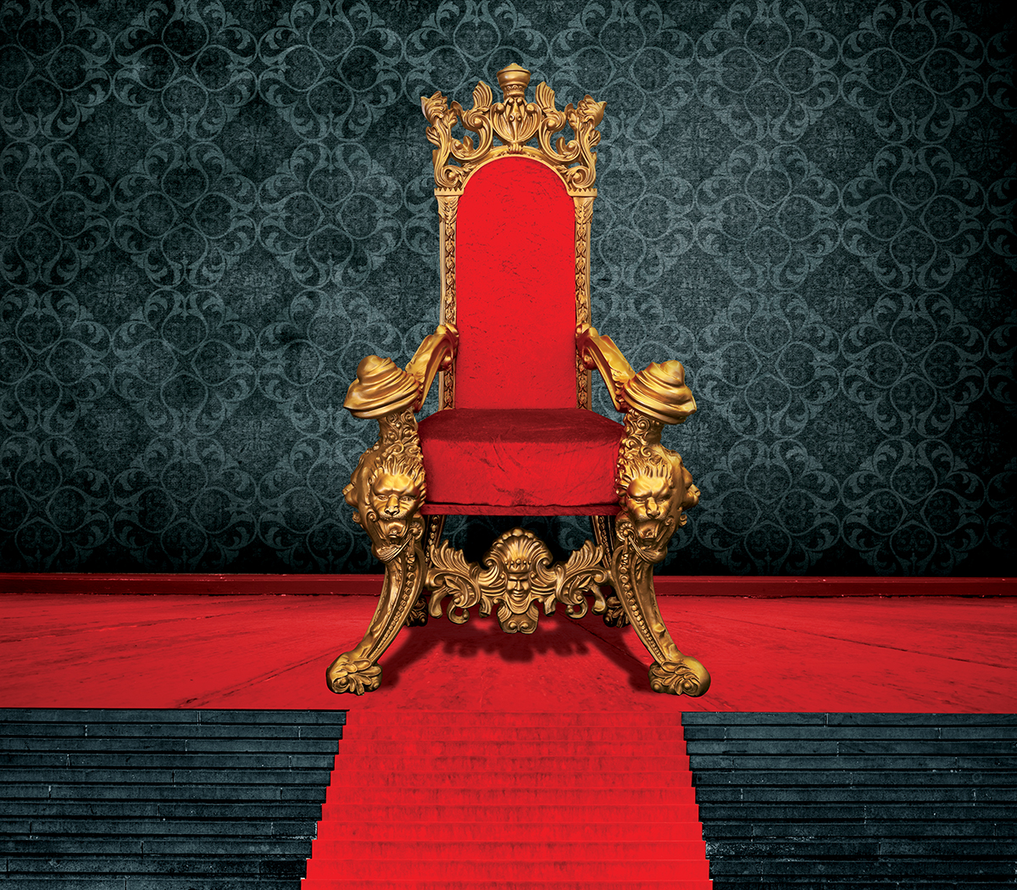
Hebrews 1:13 But to which of the angels said he at any time, Sit on my right hand, until I make thine enemies thy footstool?
Hebrews 1:3 Who being the brightness of his glory, and the express image of his person, and upholding all things by the word of his power, when he had by himself purged our sins, sat down on the right hand of the Majesty on high;
Where Did He Sit?

Slide 33
Seated on His Throne
54-0516 QUESTIONS.AND.ANSWERS.LAW.HAVING.A.SHADOW_ JEFFERSONVILLE.IN SUNDAY_
« E-64 † What did the prophets all say Jesus would do, when He come? Rule the nations with a rod of iron. Is that right? They failed to see His first coming to the Gentiles; when He returns, then, He does rule all nations. He will come. He isn't up on His throne now. He's setting on God's throne. "He that overcomes shall sit with Me on My throne, as I have overcome, and set on My Father's throne." Now, He's wanting to come back. And who... Where is His earthly throne? The throne of David. God said He'd give Him the throne of David, in the Millennium. He'll sit on David's throne, and we'll see Him, the great King of kings, setting there. There He is. Now, He's setting on His Father's throne, in other words, He's setting in God's power, in Spirit, now. But when He comes back, He'll set in a earthly body (Hallelujah!) on David's throne. Now, He's setting in the majesty of Father now. When we say, "Father": it's Jesus, It's the Spirit of God, by the Holy Spirit, in us. Now, He's on His Father's throne, right hand of majesty. We use the body name, "Jesus Christ," Who appeared, the Holy Spirit, which is God. "Whatever you ask the Father in My name, that will I do; for I and My Father are one."

Slide 34
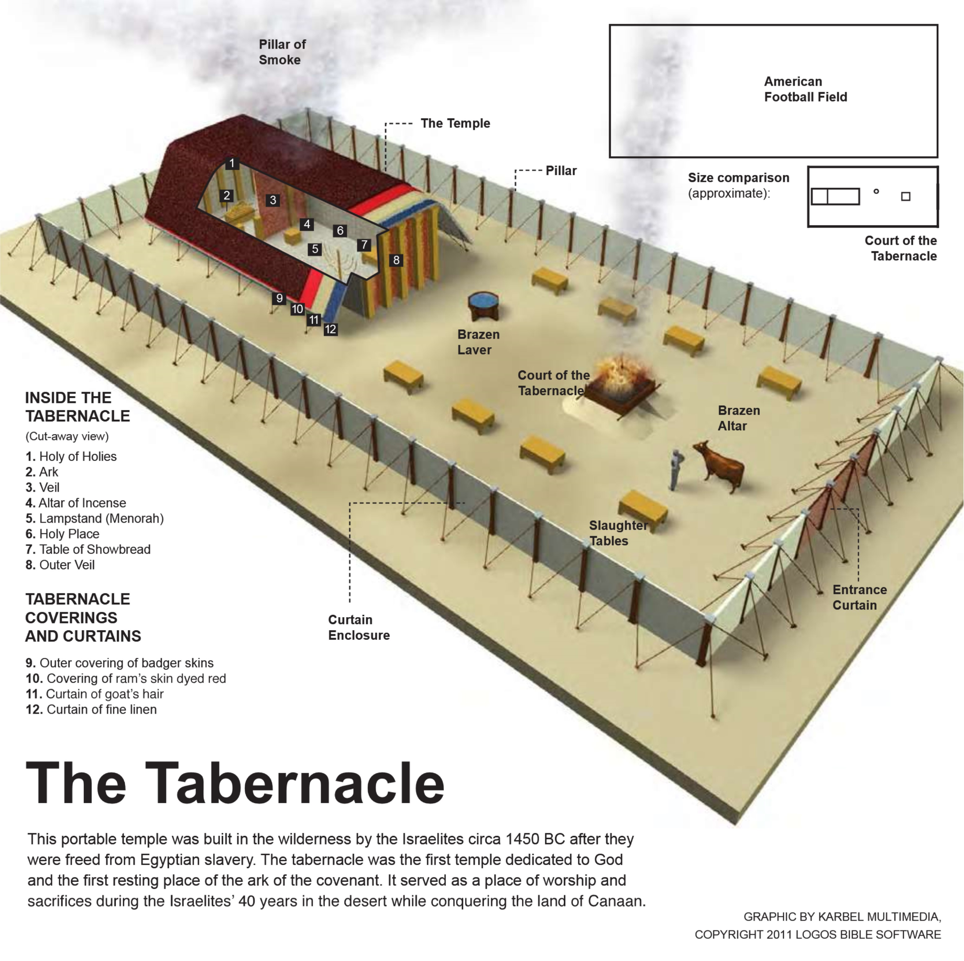
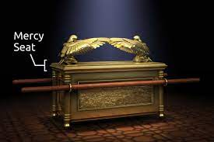
Hebrews 1:13 But to which of the angels said he at any time, Sit on my right hand, until I make thine enemies thy footstool?
61-0108 REVELATION.CHAPTER.FOUR.3_ JEFFERSONVILLE.IN ROJC 645-716 SUNDAY_
« 308 † Now, "the mercy seat." Now, the mercy seat's in the heart, seat where the shining forth of His--His Glory in all of His children, the Shekinah Glory in the human heart. Here is the human heart. Is that right? Is that the mercy seat? How do you come through it into That through these different systems? Through self-will, self-will. Comes into here, and through there, comes out what? Shekinah Glory. What--what is the Shekinah Glory? Is God's Presence. And when a man's walking, or a woman, he's reflecting the Shekinah Glory. He don't go into gambling dens and--and carry on, and go out here and deny the Word. No matter what the people says, he's got his heart set on one thing: God. And if he's truly called of God then Jesus Christ reflects Himself through him with the Shekinah Glory, doing the same things He did back there; manifest the same Gospel, preaching the same Word, same Word being made manifest in the same measure it was then, just like it was truly at Pentecost it's measured back again. Oh, my!

Slide 35
Hebrews 1:13 But to which of the angels said he at any time, Sit on my right hand, until I make thine enemies thy footstool?
61-0101_Revelation, Chapter Four #2_Jeffersonville, Indiana, USA #114
114. You say, “I got to ... all right. I can tell dirty jokes, it don't condemn me.” Why? You ain't got nothing it can condemn. No one's there to take it out. No one's there to condemn you. “Well, I'll tell you,” the women say, “I can have short hair. It don't condemn me.” It's no wonder! See? “No, I can wear shorts, I can do this.” A man said, “It don't hurt me to smoke cigars. And it don't hurt me to play some cards and shoot some dice (and whatever they do). It don't hurt me.” They still belong to the church, see, “Don't hurt me to do this.” Why? Why? There's nothing there to judge you. But when Christ comes in, you've created an altar on your heart, and your sins are taken daily! The great St. Paul said, “I die daily. Nevertheless I live; not me but Christ liveth in me.” There's the inner veil. Oh, brother, sister!

Slide 36
Hebrews 1:13 But to which of the angels said he at any time, Sit on my right hand, until I make thine enemies thy footstool?
Acts_2:32-37
32. This Jesus hath God raised up, whereof we all are witnesses.
33. Therefore being by the right hand of God exalted, and having received of the Father the promise of the Holy Ghost, he hath shed forth this, which ye now see and hear.
34. For David is not ascended into the heavens: but he saith himself, The LORD said unto my Lord, Sit thou on my right hand,
35. Until I make thy foes thy footstool.
36. Therefore let all the house of Israel know assuredly, that God hath made that same Jesus, whom ye have crucified, both Lord and Christ.
37. Now when they heard this, they were pricked in their heart, and said unto Peter and to the rest of the apostles, Men and brethren, what shall we do ?

Slide 37
Hebrews 1:13 But to which of the angels said he at any time, Sit on my right hand, until I make thine enemies thy footstool?
Revelation 3:21 To him that overcometh will I grant to sit with me in my throne, even as I also overcame, and am set down with my Father in his throne.
64-0617_The Identified Christ Of All Ages_Topeka, Kansas USA #25
25. Then when He died, rose, ascended, and sent back the Holy Spirit, that was the Son of God. God is a spirit, and through the church age it's been Son of God. And then in the millennium it's Son of David, sitting on the throne, ruling. He has ascended up. “He that overcomes shall sit with me on my throne, as I have overcome and sit down on my Father's throne.” He's sitting on the Father's throne now. But in the millennium He sits upon his own throne because He is the Son of David. Son of man, Son of God, Son of David, see—it's just perfectly.

Slide 38
Hebrews 1:13 But to which of the angels said he at any time, Sit on my right hand, until I make thine enemies thy footstool?
Son of Man Son of God
Son of Man Son of David

Slide 39
Hebrews 1:13 But to which of the angels said he at any time, Sit on my right hand, until I make thine enemies thy footstool?
61-0101_Revelation, Chapter Four #2_Jeffersonville, Indiana, USA #115
115. Hurry, I know.... Oh, no, I just can't finish it, I'm past time. Let's see. Let me.... No, I better not. See, I want to take the twenty-four elders, and I know I'm holding you all off from your dinner. We'll just.... Let's see, that.... How many says take the twenty-four elders? All right, just a minute. “Twenty-four elders (then let's get them right quick now), around about the throne,” and were twenty... around the throne. Now you see.... Where's the throne at now? In the heart. In the heart of who? The members of the seven church ages. Christ! Speak a word against their action, you're condemned. You'll answer for it in the day of judgement. And who will judge the earth? Saints shall judge the earth. Who did Daniel see coming with tens of thousand times ten thousands? The Saints. The books were opened... sinners. Another book was opened which was the book of life, the sleeping virgin. Oh, my, can't they see that? The sleeping church, them that went out to meet the Bridegroom, they let the oil go out of the lamp; never entered into this, never let Christ take control so He could work miracles, and speak with tongues, and do wonders and things to prove that He lived in His church.

Slide 40
Hebrews 1:13 But to which of the angels said he at any time, Sit on my right hand, until I make thine enemies thy footstool?
61-0101_Revelation, Chapter Four #2_Jeffersonville, Indiana, USA #107
106. Now, now, what is the outer courts? That's the flesh, see. That's the first thing you come to, the flesh. You've got to consume that first. You've got to pass beyond the flesh. “I don't feel like getting up and going to church. The roads are too slick. It's too hot. Oh, church, I don't know.” That's the flesh. All right. Now, you got to consume and walk through that. God has to get through that. The next time He comes, He has to come into the soul, that's the nature. “Oh, what will the Joneses say about me? Oh, my! You know, my church will kick me out if I do something like that, see.” But you got to walk through that.
107. And when you walk through that, then He goes into the heart and there's where He's throned. That's the Holy Spirit in you.

Slide 41
Hebrews 1:13 But to which of the angels said he at any time, Sit on my right hand, until I make thine enemies thy footstool?
60-1127E_The Queen Of The South_Shreveport, Louisiana, USA #56
56. That isn't life, that's death. What makes a.... What would a beautiful young woman want to do a thing like that? What would a man, maybe with his wife home baby sitting, too, and him up there pulling after her, another man's wife. Why do they drink? What causes people to sin? Is because they're thirsty. That's right. When God made a human heart, He made a little place in there for Himself. He made you so you'd thirst. Not thirst for that, but thirst for Him. How dare a man or a woman, citizen of any country, to try to quench that holy thirst with the things of the world. That's the reason they do it because ... you don't need another drink, you don't need a cigarette, you smokers, you don't need another drink, you people who drink, you don't need another party, you need God is what you need, to thirst for righteousness. God made that place and made you to thirst. That's part of you. He made that little place in your heart to throne Himself and to satisfy your thirsting.

Slide 42
Hebrews 1:13 But to which of the angels said he at any time, Sit on my right hand, until I make thine enemies thy footstool?
63-0321_The Fourth Seal_Jeffersonville, Indiana, USA #14 14. And then we find out that in the revealing of the seals that the Lamb had left his mediatorial work as an intercessor, and had come forth now to claim his rights—all that He had redeemed by his death. And then no one could open the book; no one understood it. It was a book of redemption. And God, the Father, Spirit, had it in his hand, because Christ was at the throne as a mediator, the only mediator. Therefore, there could be no saint, no Mary, no Joseph, no nothing else on that altar, because it was blood; and only the blood of Jesus could make the atonement. So nothing else could be standing as a mediator. That's right. There was nothing else.
63-0318_The First Seal_Jeffersonville, Indiana, USA #109 109. And notice, every time Joseph left... when Joseph rose up from that right hand of that throne... Watch! Glory! There sat Joseph by the right hand of Pharaoh. And when Joseph raised up to leave that throne, the trumpet sounded. “Bow the knee, everybody! Joseph is coming!” When that Lamb leaves the throne yonder on His days of mediatorial work, when He leaves the throne up there and takes that Book of Redemption and walks forth, every knee will bow and every tongue confess! There He is!

Slide 43
Hebrews 1:13-14 But to which of the angels said he at any time, Sit on my right hand, until I make thine enemies thy footstool? Are they not all ministering spirits, sent forth to minister for them who shall be heirs of salvation?
You are the heirs of salvation

