Slide 1
Perfect Love Casteth Out Fear
There Is No Place For Fear In a Believer’s Life
I John 4:16-21

Slide 2
God Is Love
I John 4:16
And we have known and believed the love that God hath to us. God is love; and he that dwelleth in love dwelleth in God, and God in him.
I John 4:7
Beloved, let us love one another: for love is of God; and every one that loveth is born of God, and knoweth God.

Slide 3
What Is Agape Love?
The word love in verse 16 is Agape love which is the love that God loves us with:
Charity
Dear
Charitibly
Feast of Charity
Brotherly love, affection, good will, love, benevolence
Love Feasts
I John 4:16 - And we have known and believed the love that God hath to us.

Slide 4
What Is Phileo Love?
There is also Phileo love which is the physical human love we have for one another or an animal:
To Love
To Approve Of
To Kiss
To Show Signs Of Love
to treat affectionately or kindly
to be fond of doing
Matt: 10:37 - He that loveth father or mother more than me is not worthy of me:

Slide 5
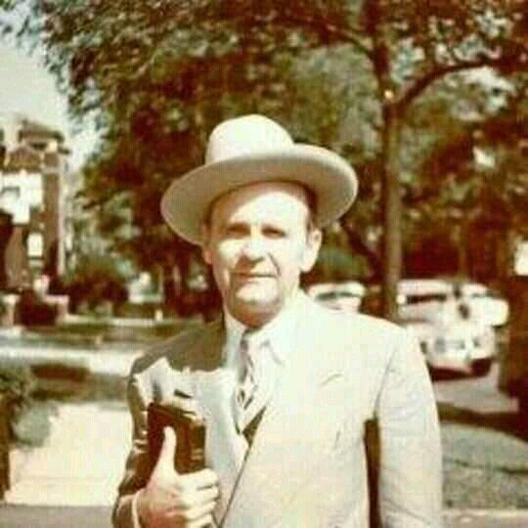
“Now, love one another. Above everything that you do, love one another. And as you love one another, you’ll love God. See? You love each other and you’ll love God. For God is love. And a man that walks in love, walks in life.”

Slide 6
“ And perfect love casteth out all fear. Then if you can take Him at His Word, and not fear a bit about it. Say, “Lord, I love You; I know You’re going to answer because You promised me You would, and I just know You’re going to do it.” See? And it takes away all fear.”

Slide 7
“How can you have faith in your wife if you don't love her? That's in Phileo. Now, how about Agapao to God? How can it be if you don't love God? If you said you love your wife and never tell her about it, and never set down and make love to her, expressing it to her, kiss her, hug her, and tell her she's the best cook in the country,

Slide 8
“all the things that you know, and how pretty she is, and how much you love her; if you don't do that she'll never know it. That's the way. If you do love her, you express it.
That's the way we do to God. When we love Him, we tell Him about it. We set down and we adore Him, and worship Him, and... See, love drives us to that.”

Slide 9
God doesn’t want us to just abide in PHILEO LOVE because that love can easily FAIL
God’s AGAPE LOVE can never fail because it’s an ETERNAL, PURE, LIFE-GIVING love

Slide 10
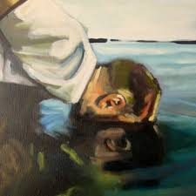
What Is Narcissim?
Comes from Greek mythology - Narcissus fell in love with his reflection in the water and fell in and drowned:
Excessive interest in or admiration of oneself and one's physical appearance.
Selfishness, involving a sense of entitlement.
A lack of empathy, and a need for admiration.
Technology and Society has made us narcissistic
2 Tim 3:1-2 - This know also, that in the last days perilous times shall come. For men shall be lovers of their own selves...

Slide 11
Two Types Of Fear In The Bible
Ecclesiastes 12:13 - Let us hear the conclusion of the whole matter: Fear God, (Respect, Reverence) and keep his commandments: for this is the whole duty of man.
II Timothy 1:7 - For God hath not given us the spirit of fear; (cowardice, timidity) but of power, and of love, and of a sound mind.

Slide 12
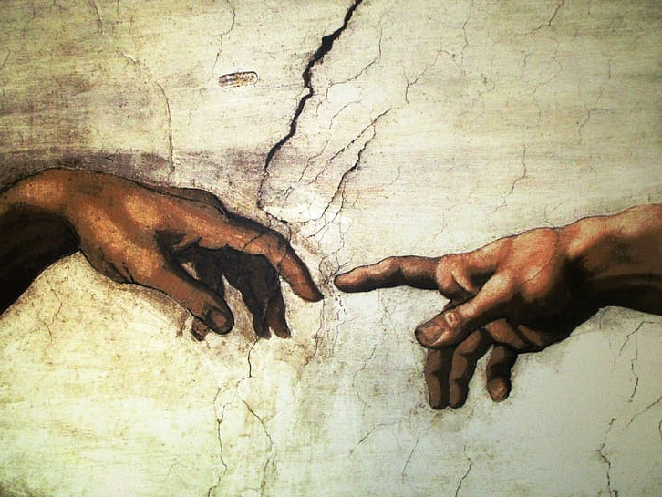
Where Does Perfect Love Originate From?
I John 4:18 - There is no fear in love; but perfect love casteth out fear: because fear hath torment. He that feareth is not made perfect in love.
Adam and Eve were created in the image of God.
Adam and Eve had Eternal Life in their Soul
Therefore Adam and Eve had perfect love.
Dominion over nature-full faith Not afraid of anything.
There is only once source of eternal life and once source of perfect love - GOD

Slide 13
“And he must’ve took her by the hand, and we’d say this, said, “Let’s take a little stroll, darling.” That was Mr. and Mrs. you years ago. And we took a little stroll, and they went down through the—the garden. And the first thing you know, there come a ferocious roar out the jungle. Who was it? It was Leo the lion. She couldn’t get

Slide 14
“scared; wasn’t nothing about her to scare, she had perfect love; and love casteth out fear. And he… Adam said, “Come here, Leo. Eve, you’ve never met it. This, I have called him, the lion; I’ve named everything here.” And he scratched him on the back of the neck, and he meowed like a kitty and followed them.”

Slide 15
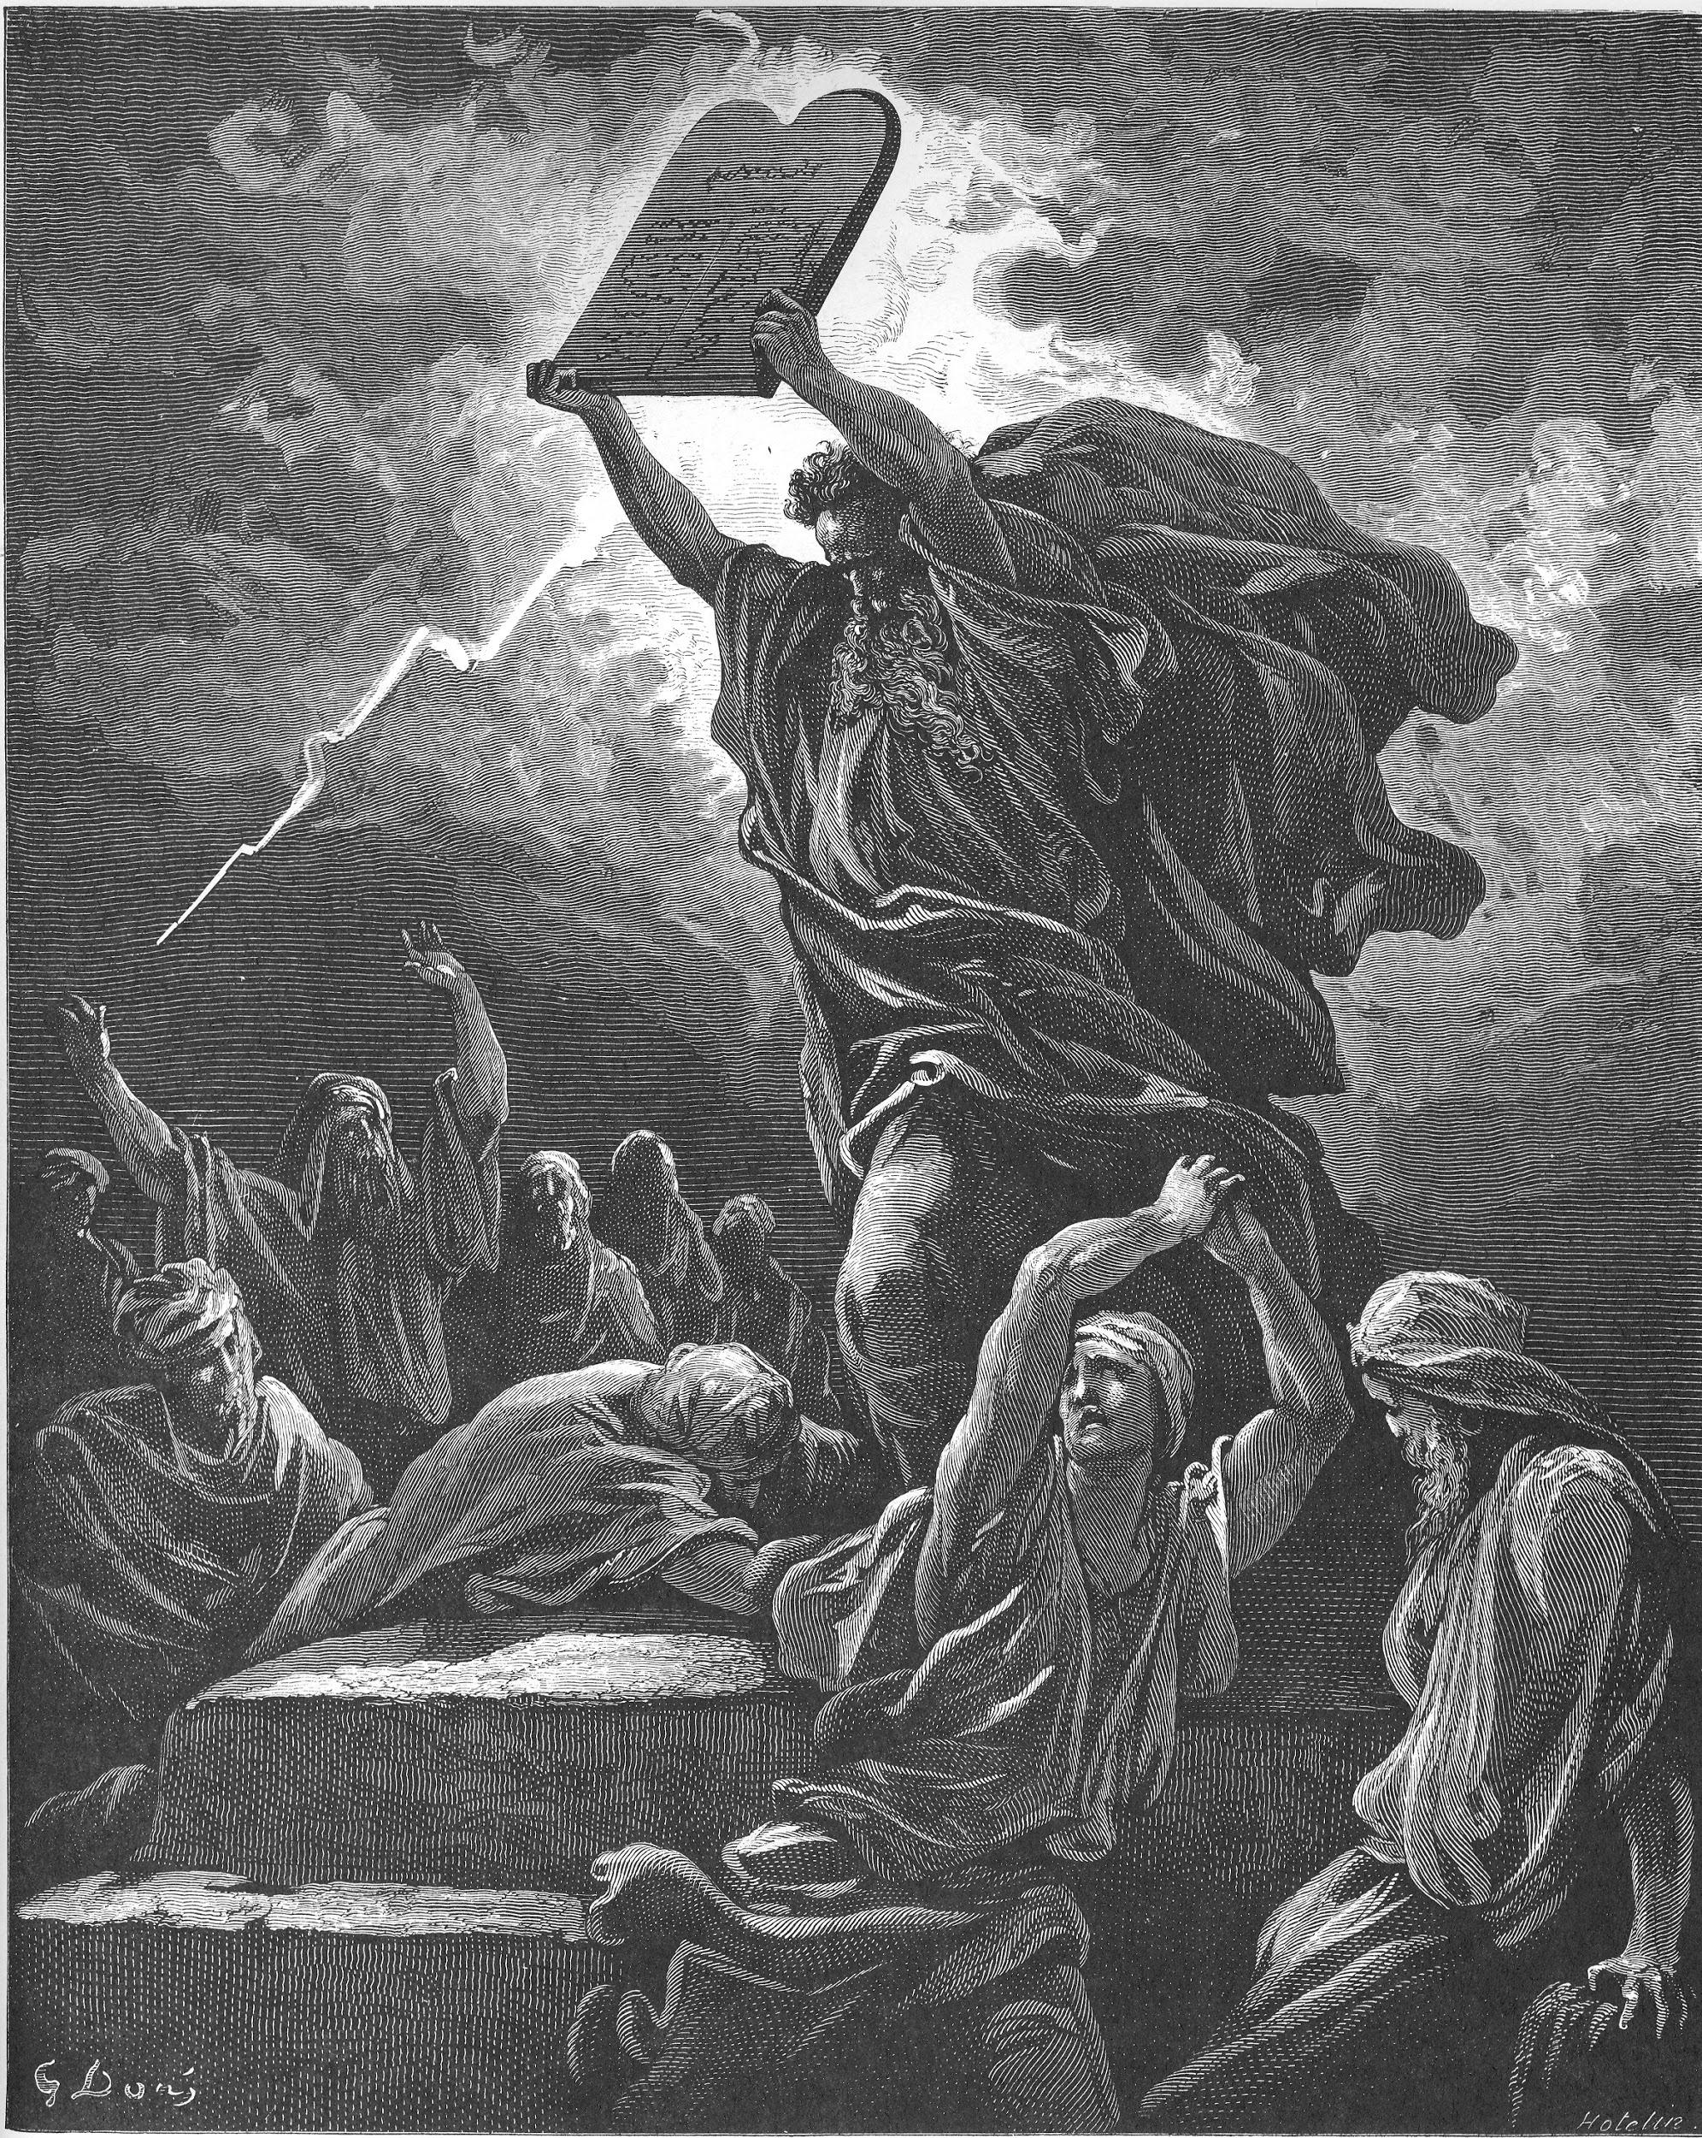
The Law Could Not Produce Perfect Love
Hebrews 7:19 - For the law made nothing perfect, but the bringing in of a better hope [did]; by the which we draw nigh unto God.
God’s will was not to give his children the law
With the law came worries, frustrations, fear, torment
A child willingly obeying and respecting parents is showing them love
A fearful child will obey and respect, but not out of love, but out of fear of getting in trouble.
Some people still live by the law thinking that their own works will bring approval or disapproval from God.

Slide 16
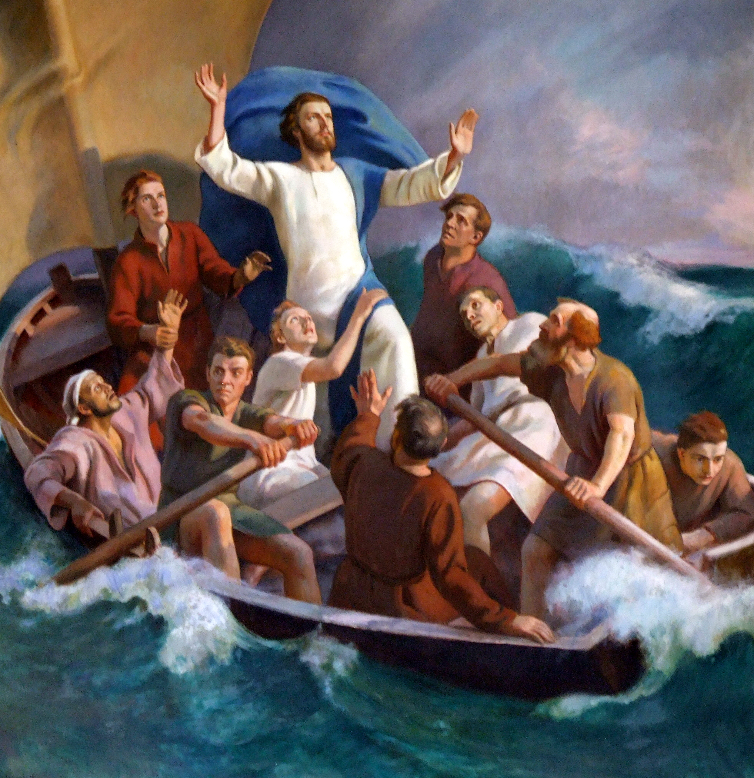
Jesus Calms The Storm - Mark 4:35-41
Jesus sleeping in the boat during a storm - Best example of the peace of God
Jesus said let’s go to the other side. Disciples just had to believe that.
Jesus asked them why were they so fearful? Why didn't they have faith?

Slide 17
“This loving Him… Oh, we say, “We have faith. We have love.” But if we had love, we’d have faith, for that is… “Perfect love casteth out all fear.” And when fear is gone, faith is perfect. You’re scared He won’t keep His Word, but I believe that He does. And now, we’ll find what He did.”

Slide 18
FAITH IS LOVE’S INCENTIVE
“Now, the Word plainly states (if you want to put this down) in Galatians 5 and 6, that faith worketh by love. See? Faith worketh by love. And the only way that you can have faith, is have love first. Because after all, faith is love's incentive. Incentive, that's exactly what--what faith is, is an incentive to love. Now, you--if you don't have love you can't have faith. See?”

Slide 19
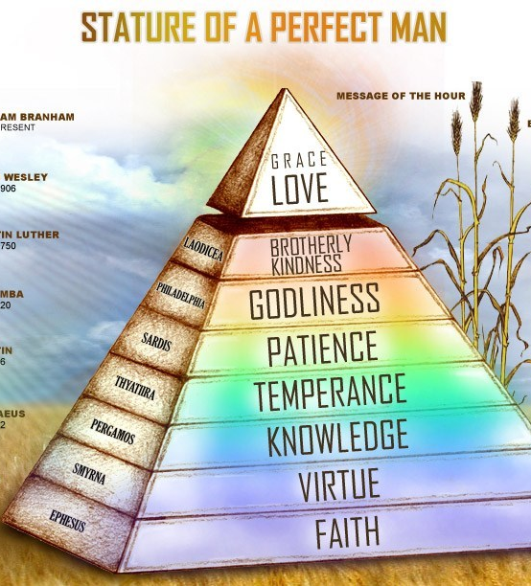
You are born again at Faith (Christ the foundation) which gives you Eternal Life in your soul.
That Eternal Life Is Perfect Love in your soul.
Having access to this perfect love allows you to access faith in the time of need.

Slide 20
It’s all Jesus Christ from Faith to Love/Grace and back.
Jesus is the corner stone as much as he is the headstone
It’s all one unit. Christ in you the hope of glory. We are striving to manifest all of those virtues on this outside man.

Slide 21
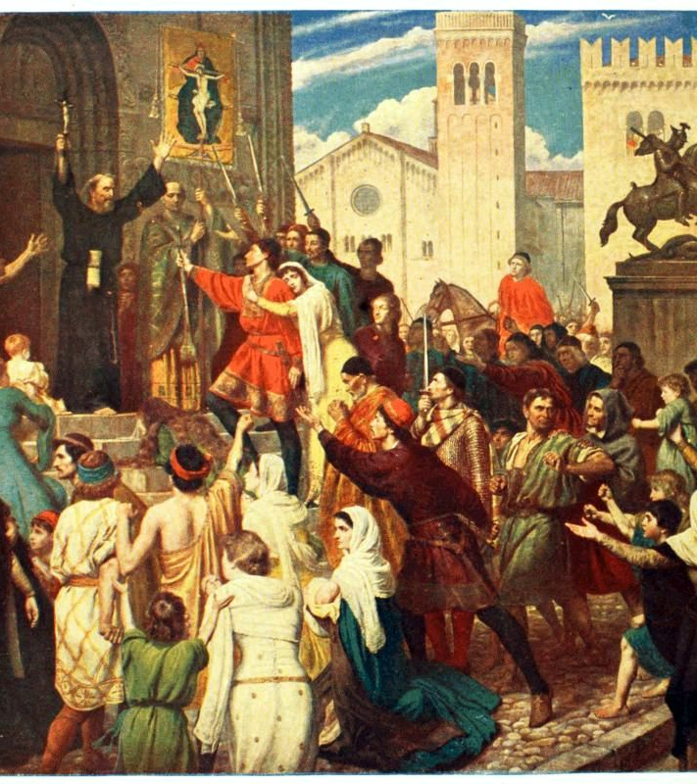
Examples Of Perfect Love In Action
Bro. Branham stops a charging bull
Bro. Branham stops a maniac from charging towards him
Peter and the disciples were not afraid anymore after receiving the Holy Ghost

Slide 22
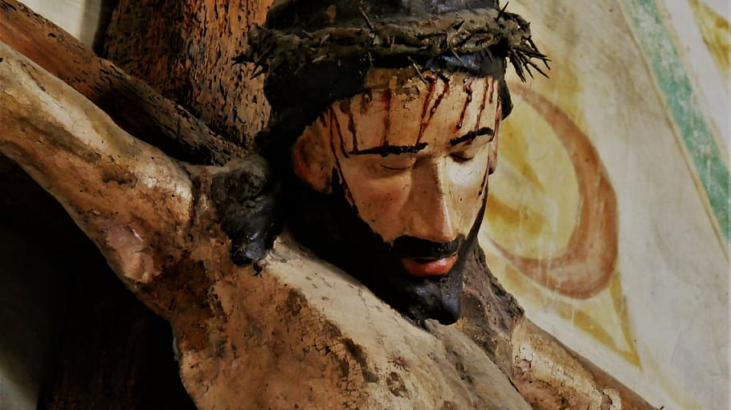
Perfect Love Usually Shines Brighter During Trials & Tribulations
Jesus on the cross could say Father forgive them for they not not what they do - NO FEAR
Stephen and others later did the same as they were dying for their faith. - NO FEAR
It’s easy to love those that love you back. But can you STILL LOVE IN THE MIDST OF WOLVES?

Slide 23
How Do We Obtain This Perfect Love?
GET BORN AGAIN
RECEIVE THE WORD OF GOD
AS YOU RECEIVE THE WORD AND BELIEVE IT AND IT’S REVEALED TO YOU THAT MAKES YOU A CANDIDATE FOR THE HOLY GHOST

Slide 24
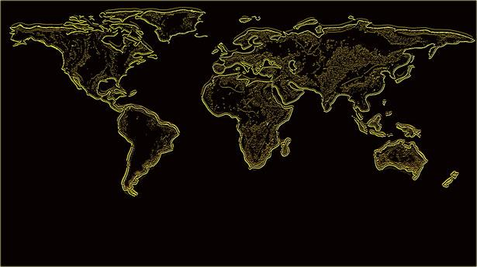
Have Boldness In The Day Of Judgement
I John 4:17
Herein is our love made perfect, that we may have boldness in the day of judgment: because as he is, so are we in this world.
THIS IS YOUR TIME TO PUT IN ACTION WHAT GOD HAS PLACED IN YOU!!!

Slide 25
“I believe that the reason we don't have desperation is because it's a lack of love, the love of God. I think that the love of God causes desperation. If God is in you, the Token inside of you, and you see the conditions of times and people wading in sin the way they are, it'll throw you into desperation. I believe it will.”

Slide 26
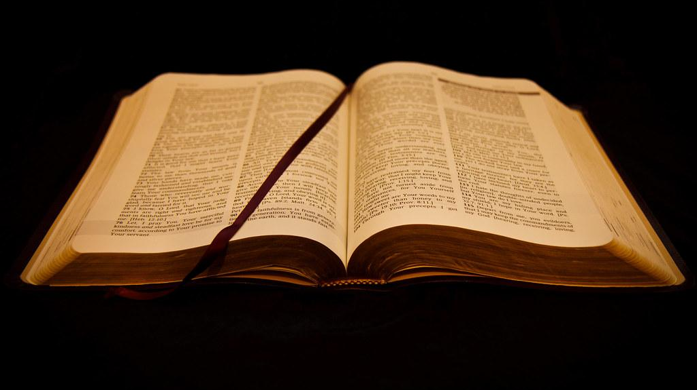
Romans 8:31, 35-39
31 What shall we then say to these things? If God be for us, who can be against us?
35 Who shall separate us from the love of Christ? shall tribulation, or distress, or persecution, or famine, or nakedness, or peril, or sword?
36As it is written, For thy sake we are killed all the day long; we are accounted as sheep for the slaughter.
37Nay, in all these things we are more than conquerors through him that loved us.
38For I am persuaded, that neither death, nor life, nor angels, nor principalities, nor powers, nor things present, nor things to come,
39Nor height, nor depth, nor any other creature, shall be able to separate us from the love of God, which is in Christ Jesus our Lord.

Slide 27
Romans 8:31, 35-39
36 As it is written, For thy sake we are killed all the day long; we are accounted as sheep for the slaughter.
37 Nay, in all these things we are more than conquerors through him that loved us.
38For I am persuaded, that neither death, nor life, nor angels, nor principalities, nor powers, nor things present, nor things to come,
39Nor height, nor depth, nor any other creature, shall be able to separate us from the love of God, which is in Christ Jesus our Lord.

Slide 28
Romans 8:31, 35-39
38 For I am persuaded, that neither death, nor life, nor angels, nor principalities, nor powers, nor things present, nor things to come,
39 Nor height, nor depth, nor any other creature, shall be able to separate us from the love of God, which is in Christ Jesus our Lord.

