Slide 1
Ii Samuel 23
8 ¶ These be the names of the mighty men whom David had: The Tachmonite that sat in the seat, chief among the captains; the same was Adino the Eznite: he lift up his spear against eight hundred, whom he slew at one time.
9 And after him was Eleazar the son of Dodo the Ahohite, one of the three mighty men with David, when they defied the Philistines that were there gathered together to battle, and the men of Israel were gone away:
10 He arose, and smote the Philistines until his hand was weary, and his hand clave unto the sword: and the LORD wrought a great victory that day; and the people returned after him only to spoil.

Slide 2
Ii Samuel 23
11 And after him was Shammah the son of Agee the Hararite. And the Philistines were gathered together into a troop, where was a piece of ground full of lentiles: and the people fled from the Philistines.
12 But he stood in the midst of the ground, and defended it, and slew the Philistines: and the LORD wrought a great victory.

Slide 3
Stand your ground

Slide 4
STAND YOUR GROUND is a military order which means to maintain your assigned position in the face of imminent threat, danger or opposition.

Slide 5
2Lt Hiroo Onoda
Imperial Japanese Army intelligence officer who fought in World War II and was a Japanese holdout who did not surrender in August 1945. After the war ended Onoda spent 29 years holding out in the Philippines until his former commander traveled from Japan to informally relieve him from duty in 1974

Slide 6
On 26 December 1944, he was sent to Lubang Island in the Philippines. He was ordered to do all he could to hamper enemy attacks on the island, including destroying the airstrip and the pier at the harbor. Onoda's orders also stated that under no circumstances was he to surrender or take his own life.

Slide 7
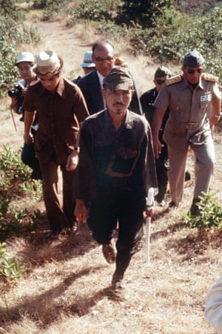
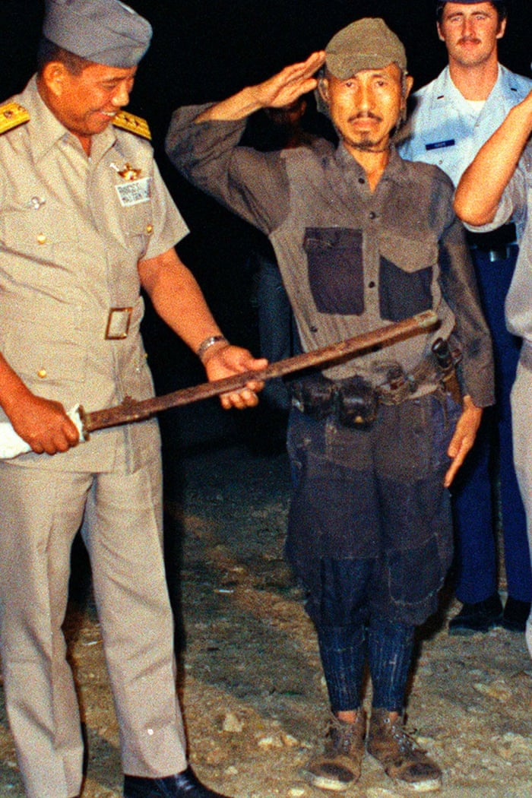

Slide 8
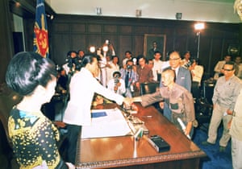

Slide 9
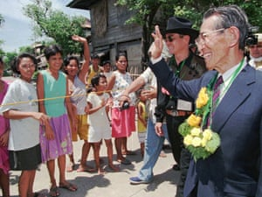

Slide 10
David’s three mighty men
Adino the Eznite – he lifted up his spear against 800 Philistines and slew them at one time in the passage way
Eleazar son of Dodo – he defended a barley field with his sword stuck in his hand from Philistines stealing the crops every year
Shammah son of Agee – he stood in the ground full of lentiles to defend it from the Philistines

Slide 11
Characteristics of these three mighty men
These three mighty men did not run or retreat when the odds were against them
These three mighty men did not quit or surrendered when it seemed like it was the only logical thing to do
These three mighty men did not refuse to defend the seemingly insignificant parcel of ground which might be beneath there abilities and dignity
In each case, God gave victory after He saw the determination of these men to stand there ground

Slide 12
Quote: God’s preparation -1954
So your trials sometime is jewels. Do you realize that? It said that it was more precious than gold, your faith when it's been tried
When you go through temptation, just hold your ground
Stay right where you're at till God says it. Don't shake at every wind
Even if you're a little out of the way, if you'll really, in your heart, be sincere and stand firm on what you believe, God will respect it.

Slide 13
Quote: Stand still and see the salvation of the lord - 1957
“And it's so strange to see that when people take a stand for God, looks like that the devil throws everything in their way that he can throw in their way. But God makes a way through that way.”

Slide 14
The unchangeable god working in an unexpectable way - 1962
“When God makes a promise and opposition rise, that's only the test whether you've really got the Word or not”
“don't give up and go back into the world. That's only a testing time”

Slide 15
quote: fifth seal (1963)
Notice, as the antichrist went forth on his beast of ministry there, God sent forth a beast to combat it. See? Now, watch. Then every time the beast rode on his horse (the antichrist rode on his horse, on his beast) to announce his ministry, God sent His beast also, in his own mask to announce His combat to it.n his beast) to announce his ministry, God sent His beast also, in his own mask to announce His combat to it.

Slide 16
Meaning of combat
Counter
Offense
Movement
Before
Attack
Time

Slide 17
Quote: Three kind of believers - 1963
And as long as we're here on earth, we know that'll be the cry, for we are in a battle. The battle is raging, and You promised and said how the enemy would be like a roaring lion. He is loose among the people, and we can see it everywhere, like a roaring lion devouring what he may, because he knows his time is short. But we have a Father who cares for His little ones

Slide 18
ISAIAH 54:17 † No weapon that is formed against thee shall prosper; and every tongue that shall rise against thee in judgment thou shalt condemn. This is the heritage of the servants of the LORD, and their righteousness is of me, saith the LORD.

