Slide 1
When Jesus Became A Worm
Psalms 22:1-8
Matthew 27:46

Slide 2
Matthew 27:46
46And about the ninth hour Jesus cried with a loud voice, saying, Eli, Eli, lama sabachthani? that is to say, My God, my God, why hast thou forsaken me?
Psalms 22:1-8
1 My God, my God, why hast thou forsaken me? why art thou so far from helping me, and from the words of my roaring? 2 O my God, I cry in the day time, but thou hearest not; and in the night season, and am not silent. 3 But thou art holy, O thou that inhabitest the praises of Israel. 4 Our fathers trusted in thee: they trusted, and thou didst deliver them. 5 They cried unto thee, and were delivered: they trusted in thee, and were not confounded. 6 But I am a worm, and no man; a reproach of men, and despised of the people. 7 All they that see me laugh me to scorn: they shoot out the lip, they shake the head, saying, 8 He trusted on the LORD that he would deliver him: let him deliver him, seeing he delighted in him.

Slide 3
64-0312 WHEN.THEIR.EYES.WERE.OPENED.THEY.KNEW.HIM_ BEAUMONT.TX THURSDAY_ « 92 † And, look, the Scripture had said that was going to happen, exactly word by word the way it was. Even David, hundreds of years before that, about eight hundred years, cried the very same thing that He said on the cross. And no doubt, that in the temple that morning, they might have sang that same song, Psalms 22, "My God, My God, why has Thou forsaken Me?" In the temple singing about it, and, the God that they claimed that they served, they were crucifying.

Slide 4
So This Was Jesus Christ Speaking Through David In Psalm 22
So we know this scripture is talking about Christ, but why does he call himself a worm in verse 6?
We know that Jesus is a Lion because he’s a conqueror and king and nothing can defeat him.
We know He’s a lamb because he is meek and lowly and he was the sacrifice that took our stead on the cross.
But why is He a worm?

Slide 5
Jesus Represented By A Worm?
You might say well that is because he became lower than man, that is true but all animals are lower than man. Man was given dominion over the earth so he could have called himself a chicken and that would have been below man, but he picked a worm.
He picked a worm not because it’s gross either. If he wanted something gross he could have picked a roach or maggot or something like that.

Slide 6
Jesus Represented By A Worm?
The word scarlet is used several times in the Scriptures – For example The scarlet thread that Rahab put out of the window of her house as a token in Joshua 2
In the Hebrew Lexicon the word for Crimson is:
shani {shaw-nee'}
scarlet, crimson
1a) properly, the insect 'coccus ilicis', the dried body of the female yielding colouring matter from which is made the dye used for cloth to colour it scarlet or crimson

Slide 7
Jesus Represented By A Worm?
The meaning of the word scarlet goes hand in hand with the meaning of the word crimson in the Hebrew Lexicon:
Isaiah 1:18
18Come now, and let us reason together, saith the LORD: though your sins be as scarlet, they shall be as white as snow; though they be red like crimson, they shall be as wool.
towla' {to-law'} and (feminine) towle'ah {to-lay-aw'}
1) worm, scarlet stuff, crimson
1a) worm -- the female 'coccus ilicis'
1b) scarlet stuff, crimson, scarlet
1b1) the dye made from the dried body of the female of the worm 'coccus ilicis'
2) worm, maggot
2a) worm, grub
2b) the worm 'coccus ilicis'

Slide 8
Jesus Represented By A Worm?
This word Towla is the same word used for the word worms in:
Exodus 16:20
19And Moses said, Let no man leave of it till the morning.
20Notwithstanding they hearkened not unto Moses; but some of them left of it until the morning, and it bred worms, and stank: and Moses was wroth with them.
The general Hebrew word in the Bible for worm is Rimmah which means a maggot, or a common worm. (Job 25:6, Isaiah 14:11) But the word that was used in Psalms 22 to describe Jesus was Towla or Tola’Ath which is the same word in Hebrew for the word Crimson or Scarlet.

Slide 9
What Is Coccus ilicis – The Crimson Grub or Scarlet Worm?
The dried bodies of the females of a scale insect (Coccus ilicis), allied to the cochineal insect, and found on several species of oak near the Mediterranean and old Israel.
In ancient days the dead bodies of the female Crimson worms were scraped from the tree, dried and then ground into a powder that was used to dye their cloth and garments a scarlet or red color.
They are round about the size of a pea. Because they don’t look like a worm, some people think they are part of a tree or plant.
The crushed worm was also used to make medicine that helps the heart beat smoothly.
The white wax body was used to make shellac, a preservative of wood.

Slide 10
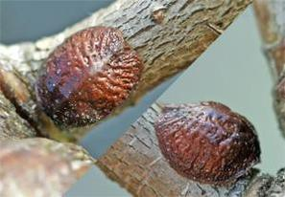
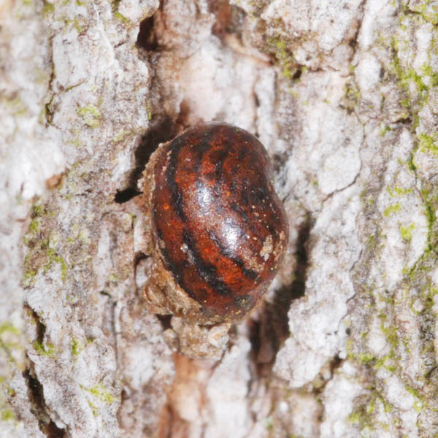
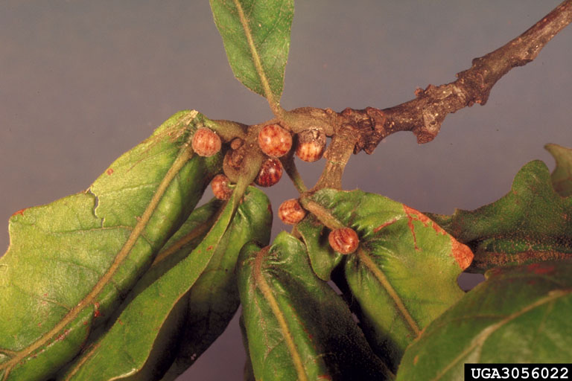

Slide 11
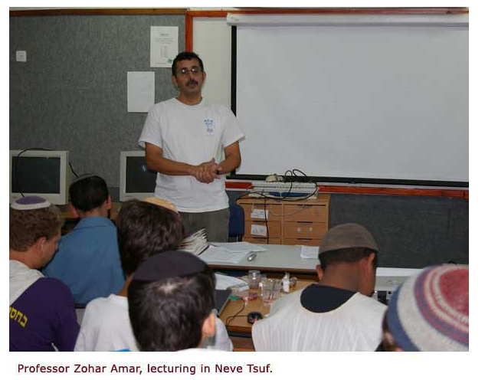
The Following Pictures Are From The Temple Institute

Slide 12
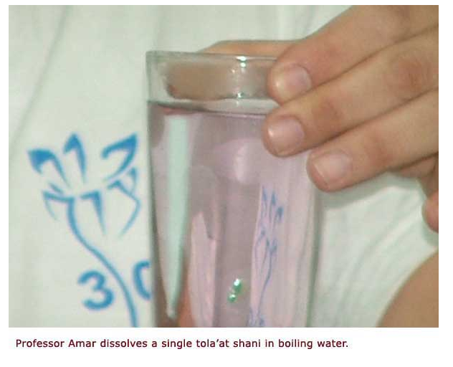

Slide 13
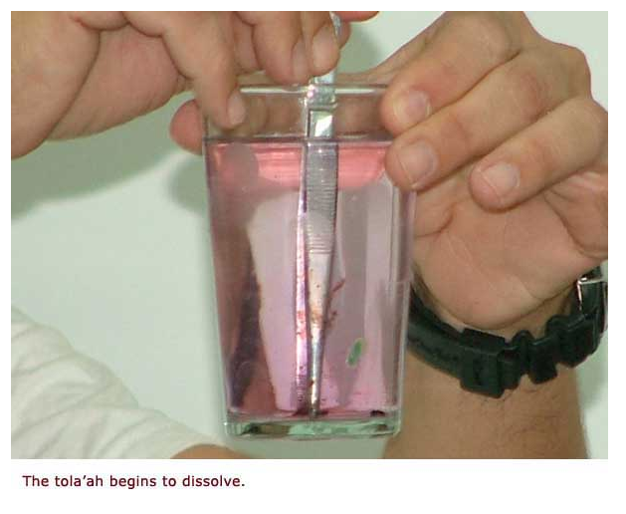

Slide 14
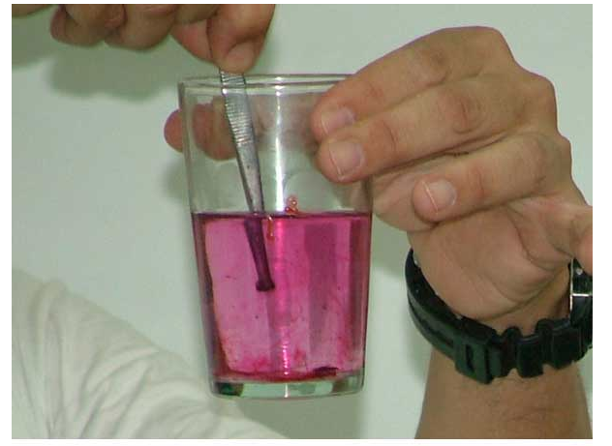

Slide 15
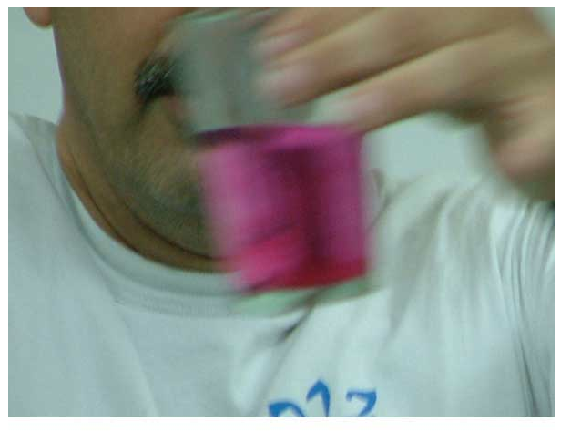

Slide 16
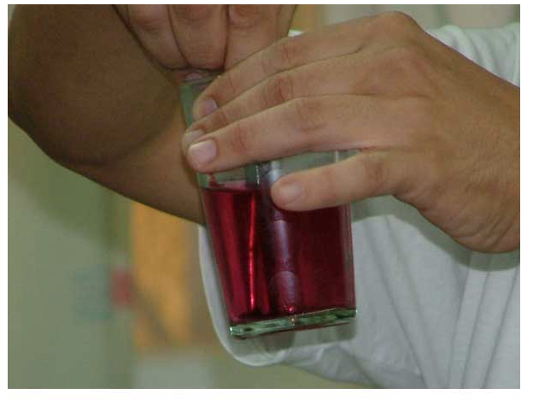

Slide 17
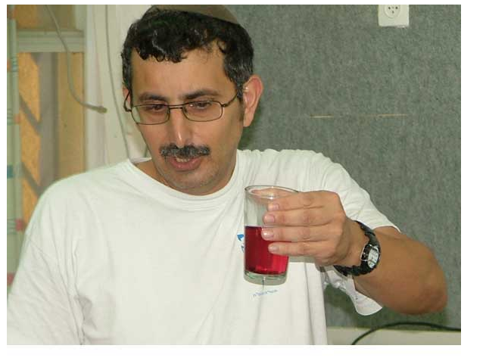

Slide 18
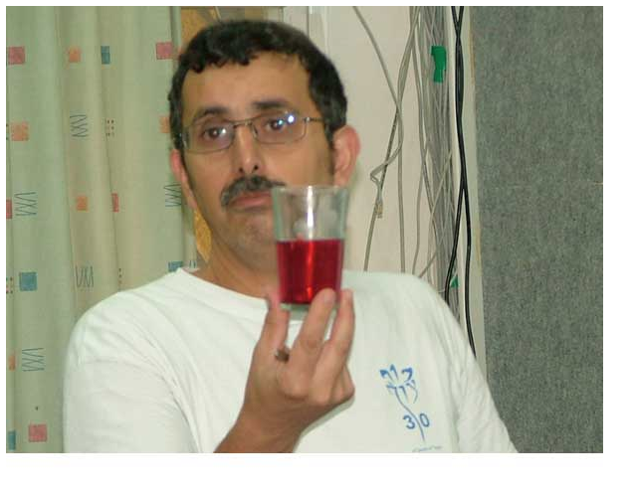

Slide 19
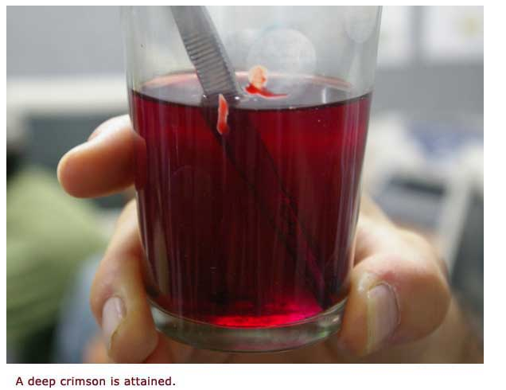

Slide 20
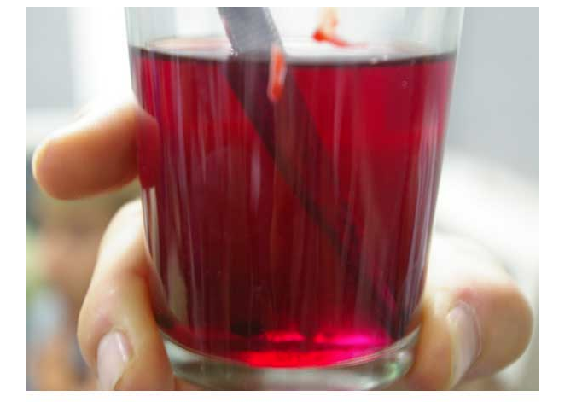

Slide 21
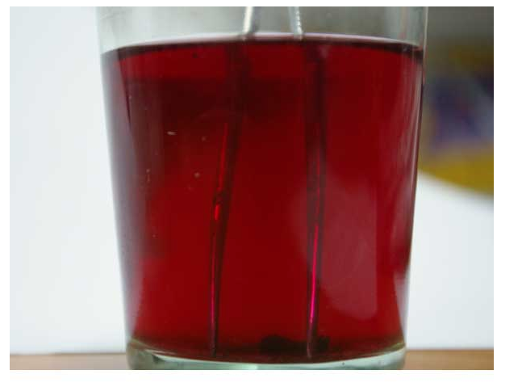

Slide 22
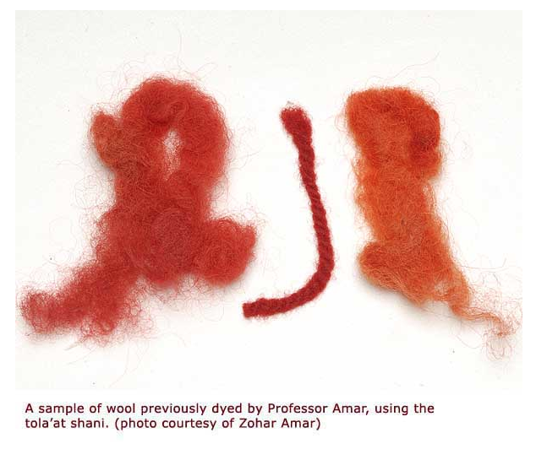

Slide 23
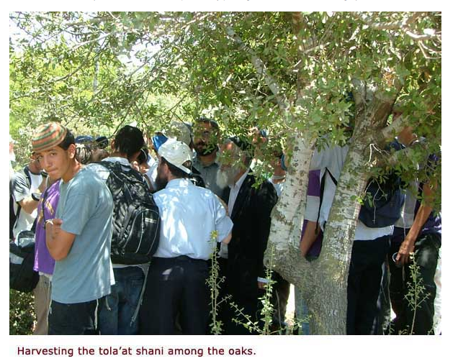

Slide 24
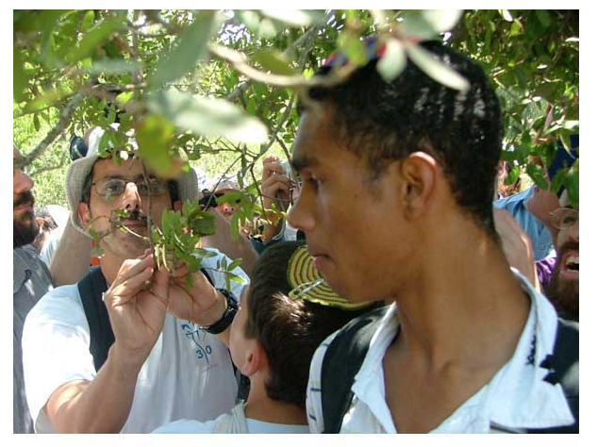

Slide 25
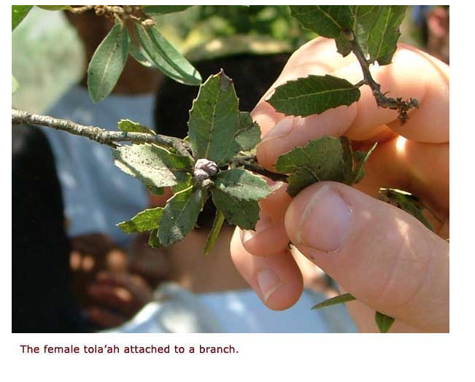

Slide 26
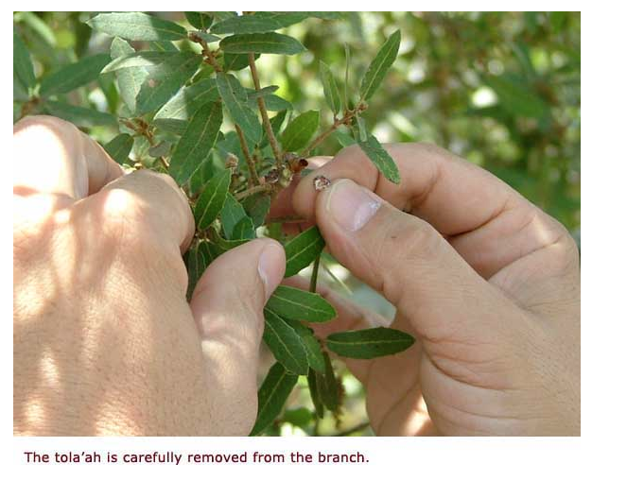

Slide 27
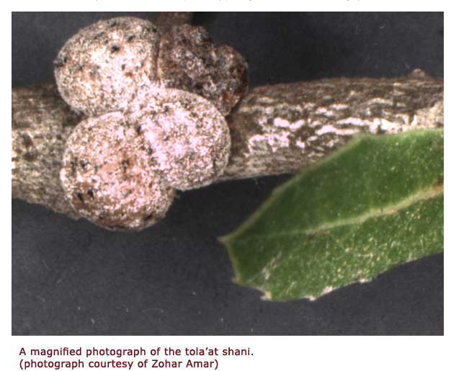

Slide 28
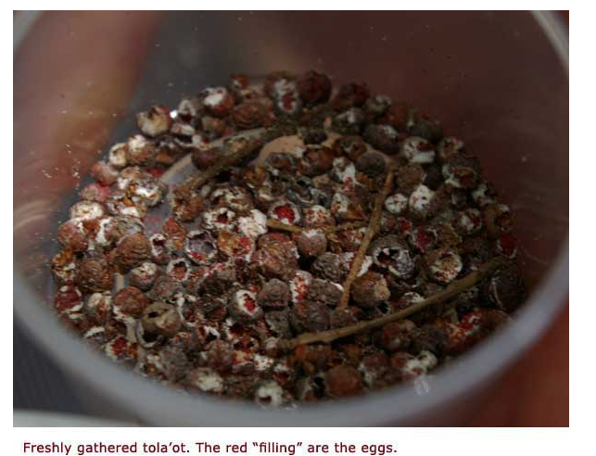

Slide 29
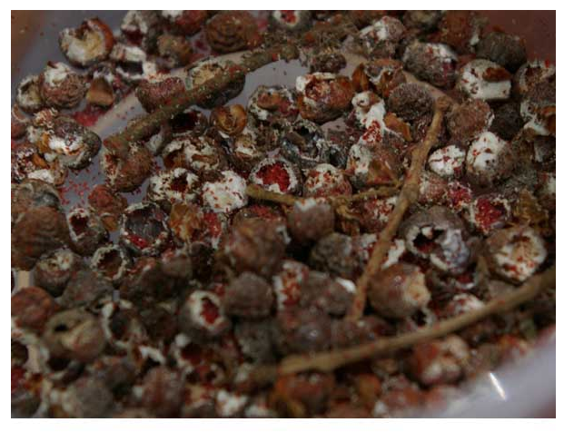

Slide 30
What Does All This Talking About Worms Have To Do With Jesus And Easter???
Psalms 22:6 - But I am a worm, and no man; a reproach of men, and despised of the people.
Many people despised Jesus when he was here on earth. – compared to the Pharisees and Sadducees in the physical he didn’t have it.
To many people, Jesus was irrelevant, insignificant, and unimportant. In other words he was as low as a worm.
“He’s not as powerful like a Lion as people say he is”.” He’s not as lovable as a lamb as people say he is.” HE’S JUST A LOW DOWN INSIGNIFICANT WORM, NOT TO BE PAID ATTENTION TO BUT TO JUST BE TRAMPLED ON.

Slide 31
Correlation Of This Worm To What Jesus Did For Us On The Cross
When it is time for the female or mother Crimson worm to have babies (which she does only one time in her life), she finds the trunk of a tree, a wooden fencepost or a stick
The crimson worm climbs on the tree all by itself. Nobody forces it to get on the tree. Jesus willingly climbed up cross without anyone forcing him. He said “I lay my life down”. He could have called 10,000 angels to set him free, but he didn't.
The crimson worm knows when it climbs on the tree that it will not come back down alive. It is going to the tree to birth a family and to do that it must die. Jesus knowing all things still was willing to die on the cross to birth a family.

Slide 33
Correlation Of This Worm To What Jesus Did For Us On The Cross
Once on the tree, the crimson worm then attaches itself to the tree. It makes sure it is secure because the body of the worm will eventually be the shelter for the young, which are born. It is so strongly and permanently stuck to the wood that the shell cannot be removed without tearing it’s body completely apart and killing it. Her body turns into a shell for protection of her babies. It was not nails that held our Savior to the cross. It was love!
When the baby worms (or larvae) hatch, they stay under the shell. Not only does the mother’s body give protection for her babies, but it also provides them with food – the babies feed on the LIVING body of the mother!

Slide 35
Correlation Of This Worm To What Jesus Did For Us On The Cross
Matthew 26:26-27
26And as they were eating, Jesus took bread, and blessed it, and brake it, and gave it to the disciples, and said, Take, eat; this is my body.
John 6:53-57
53Then Jesus said unto them, Verily, verily, I say unto you, Except ye eat the flesh of the Son of man, and drink his blood, ye have no life in you. 54Whoso eateth my flesh, and drinketh my blood, hath eternal life; and I will raise him up at the last day 55For my flesh is meat indeed, and my blood is drink indeed. 56He that eateth my flesh, and drinketh my blood, dwelleth in me, and I in him. 57As the living Father hath sent me, and I live by the Father: so he that eateth me, even he shall live by me.

Slide 36
Correlation Of This Worm To What Jesus Did For Us On The Cross
After just a few days of feeding on the LIVING body of the mother the young worms grow and the mother dies. It then secretes a crimson/scarlet red dye that stains the wood it’s attached to and also covers the young worms. This scarlet red covering protects them from predators and stains them blood red for the rest of their lives.
Matthew 26:28
28For this is my blood of the new testament, which is shed for many for the remission of sins.
Romans 5:9
9Much more then, being now justified by his blood, we shall be saved from wrath through him.

Slide 37
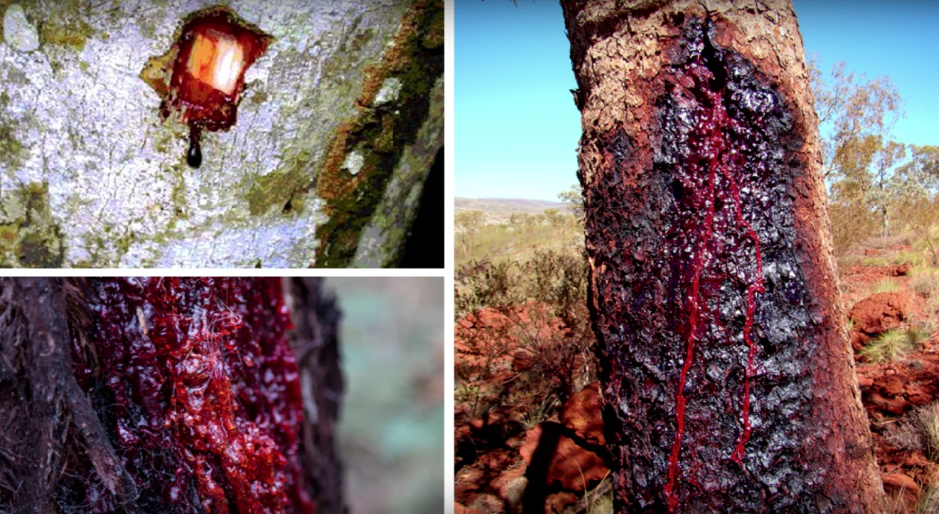

Slide 38
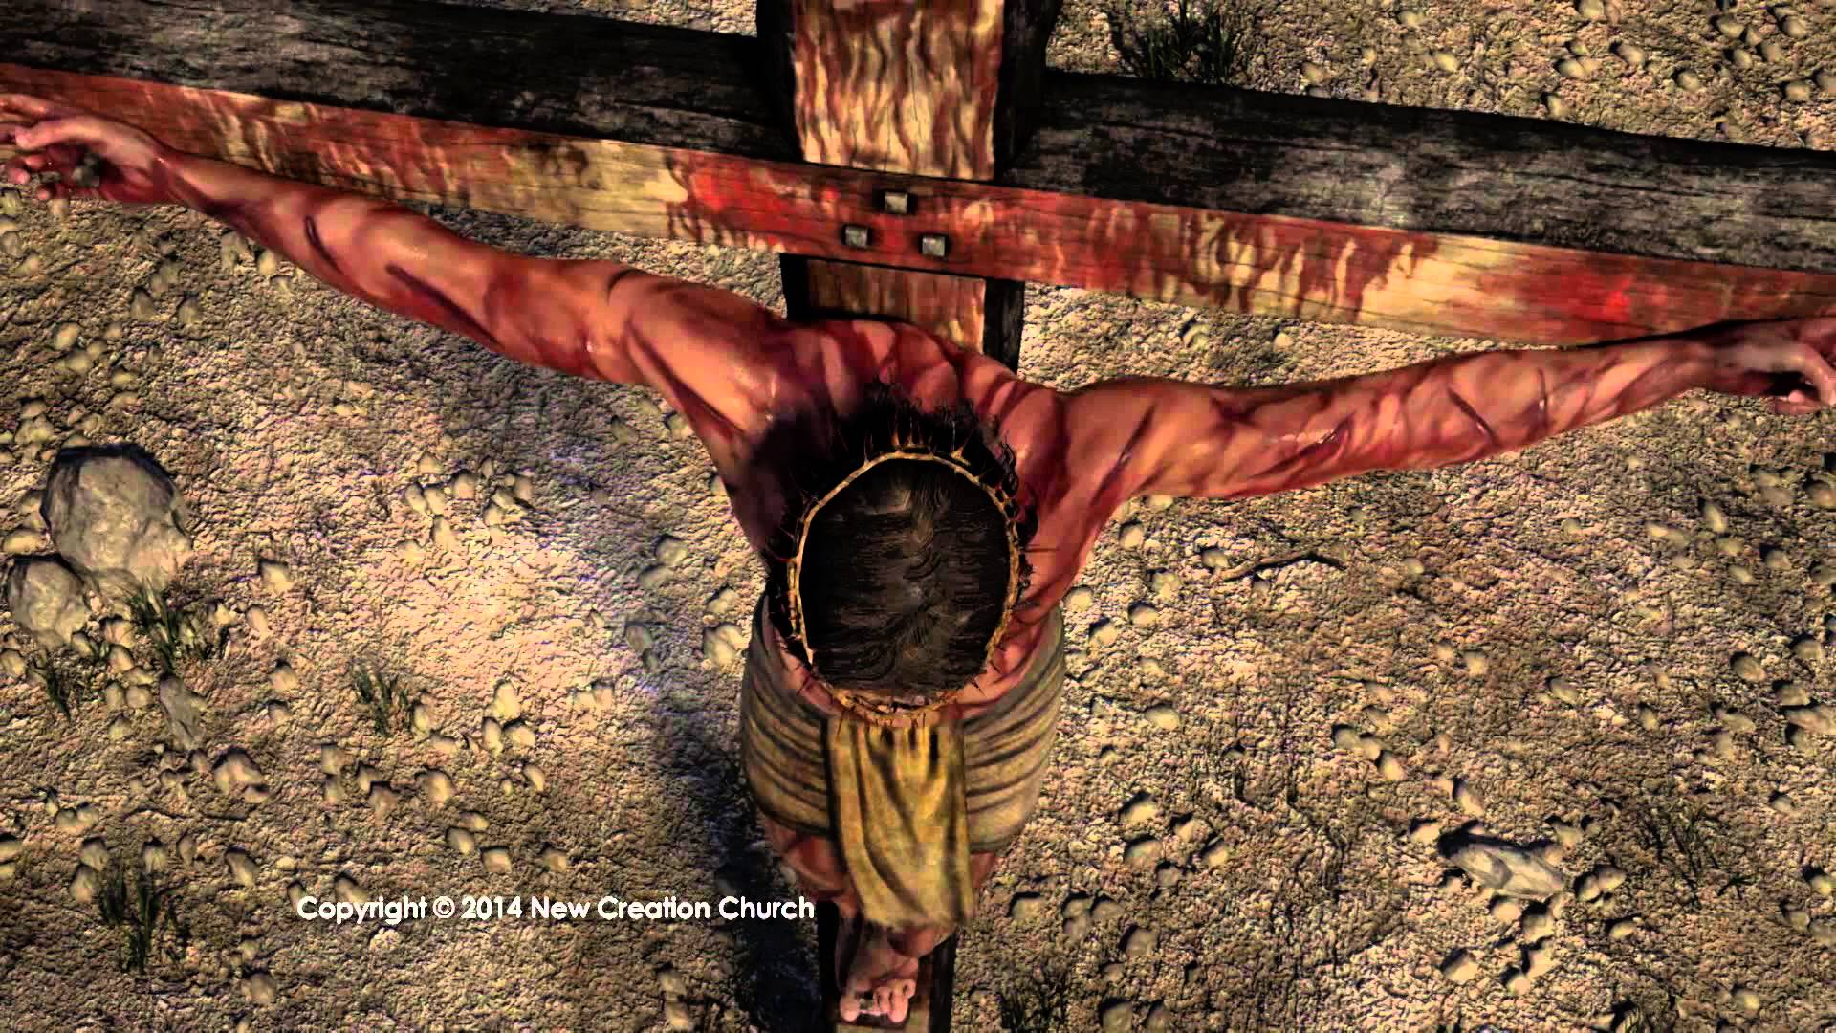

Slide 39
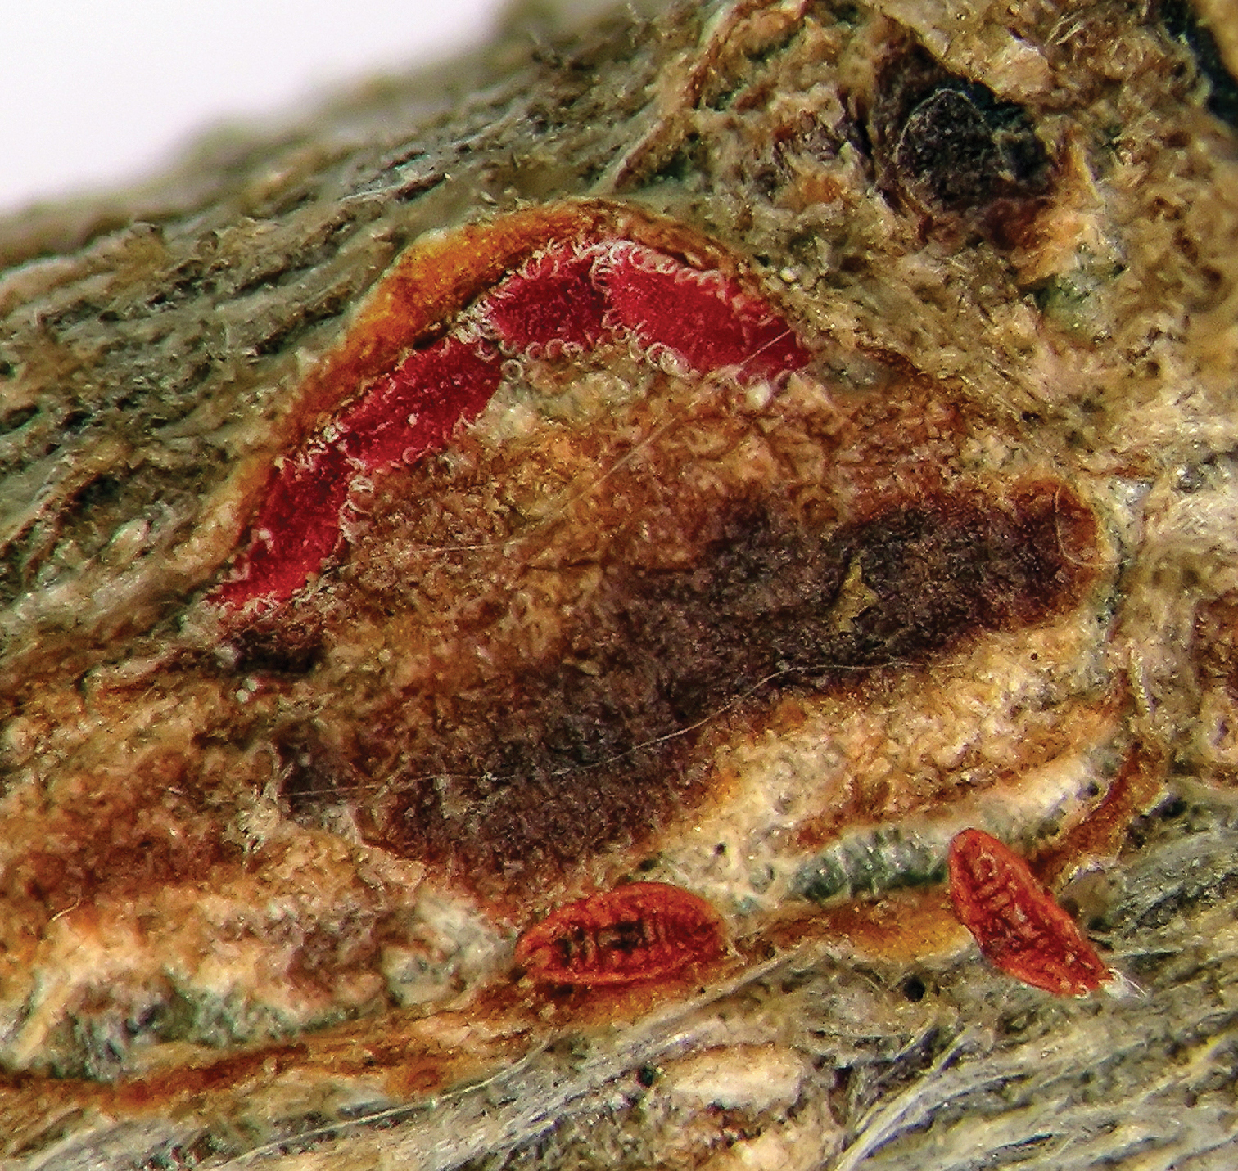
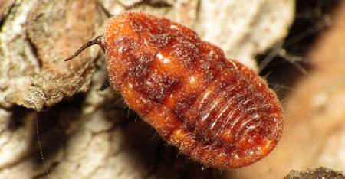

Slide 40
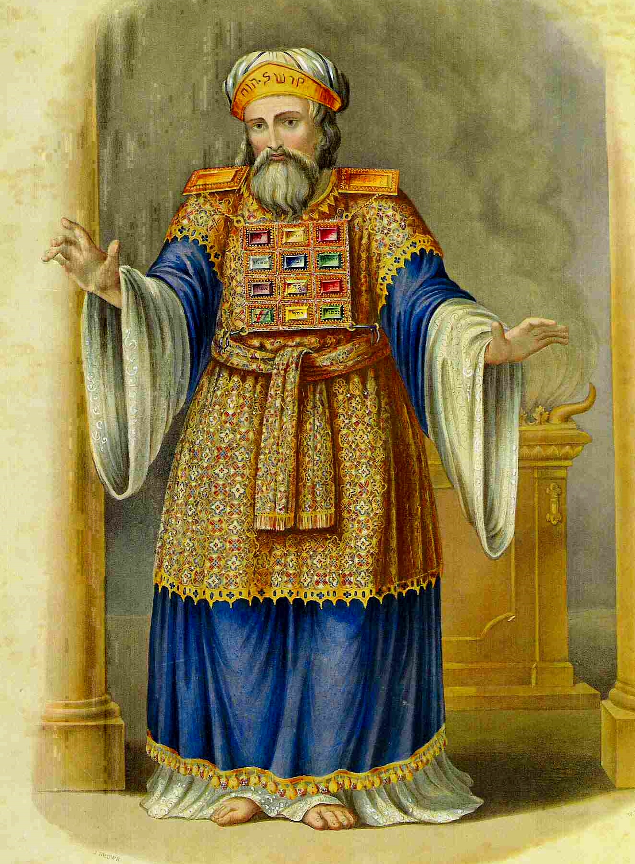
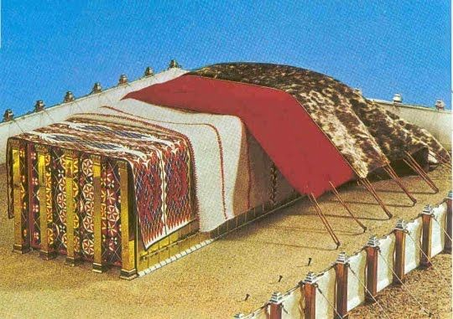
Correlation Of This Worm To What Jesus Did For Us On The Cross
After the mother dying to birth the family, for a period of three days the worm can be scraped from the tree and the crimson gel can be used to make a dye. That dye was the same which was used in the tabernacle and in the garments of the High Priest.

Slide 41
Correlation Of This Worm To What Jesus Did For Us On The Cross
Matthew 12:40
For as Jonas was three days and three nights in the whale's belly; so shall the Son of man be three days and three nights in the heart of the earth.
On the morning of the fourth day, the worm has pulled the head and tail together and is now in the shape of a heart on the tree but it is no longer crimson. It is now a wax, which is white as snow. They can still harvest the wax and use it to make shellac, a preservative of wood. The resurrection of Jesus Christ, which serves as the preservative of the message of the cross.

Slide 42
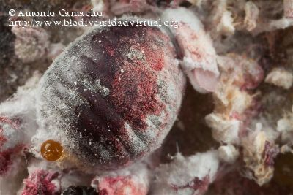

Slide 43
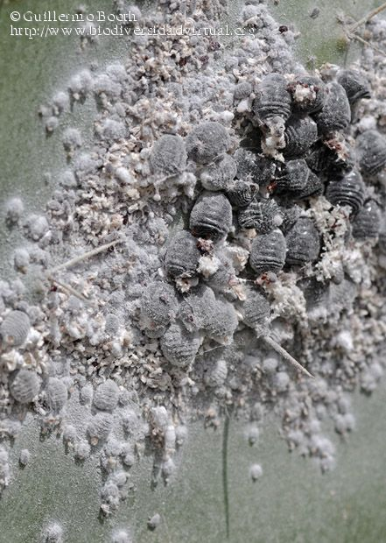

Slide 44
Psalm 22:14
14 I am poured out like water, and all my bones are out of joint: my heart is like wax; it is melted in the midst of my bowels.
Isaiah 1:18
“Come now, let us reason together, says the LORD: though your sins be as scarlet,( shaniy {shaw-nee'}) they shall be as white as snow; though they be red like crimson,( towla' {to-law'}) they shall be as wool.

Slide 45
The crimson worm is also very fragrant when it is crushed.
Ephesians 5:1
1Be ye therefore followers of God, as dear children; 2And walk in love, as Christ also hath loved us, and hath given himself for us an offering and a sacrifice to God for a sweetsmelling savour.
The crushed worm was also used for medicine to help the heart beat smoothly.
Isaiah 53:5
5But he [was] wounded for our transgressions, [he was] bruised for our iniquities: the chastisement of our peace [was] upon him; and with his stripes we are healed.

Slide 46
In a sense, that’s another reason Jesus became a “worm” - to be a kind of bait. God needed to sink His teeth of anger into something - His appetite of holy wrath needed to be fed. But Jesus didn’t want Him to feed on us.
God has a purpose with all Scripture. That’s why 2 Timothy 3:16 says:
16 All scripture is given by inspiration of God, and is profitable for doctrine, for reproof, for correction, for instruction in righteousness:
17 That the man of God may be perfect, thoroughly furnished unto all good works.

