Slide 1
The Mark of the Beast Part 2
Nestor Espanola - Philippines

Slide 2
The Mark of the Beast
Revelation 13:1-10
¹And I stood upon the sand of the sea, and saw a beast rise up out of the sea, having seven heads and ten horns, and upon his horns ten crowns, and upon his heads the name of blasphemy.
²And the beast which I saw was like unto a leopard, and his feet were as [the feet] of a bear, and his mouth as the mouth of a lion: and the dragon gave him his power, and his seat, and great authority.

Slide 3
The Mark of the Beast
Revelation 13:1-10
³And I saw one of his heads as it were wounded to death; and his deadly wound was healed: and all the world wondered after the beast.
⁴And they worshipped the dragon which gave power unto the beast: and they worshipped the beast, saying, Who [is] like unto the beast? who is able to make war with him?

Slide 4
The Mark of the Beast
Revelation 13:1-10
⁵And there was given unto him a mouth speaking great things and blasphemies; and power was given unto him to continue forty [and] two months.
⁶And he opened his mouth in blasphemy against God, to blaspheme his name, and his tabernacle, and them that dwell in heaven.

Slide 5
The Mark of the Beast
Revelation 13:1-10
⁷And it was given unto him to make war with the saints, and to overcome them: and power was given him over all kindreds, and tongues, and nations.
⁸And all that dwell upon the earth shall worship him, whose names are not written in the book of life of the Lamb slain from the foundation of the world.

Slide 6
The Mark of the Beast
Revelation 13:1-10
⁹If any man have an ear, let him hear.
¹⁰He that leadeth into captivity shall go into captivity: he that killeth with the sword must be killed with the sword. Here is the patience and the faith of the saints.

Slide 7
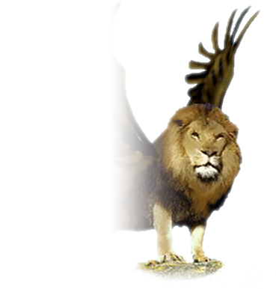
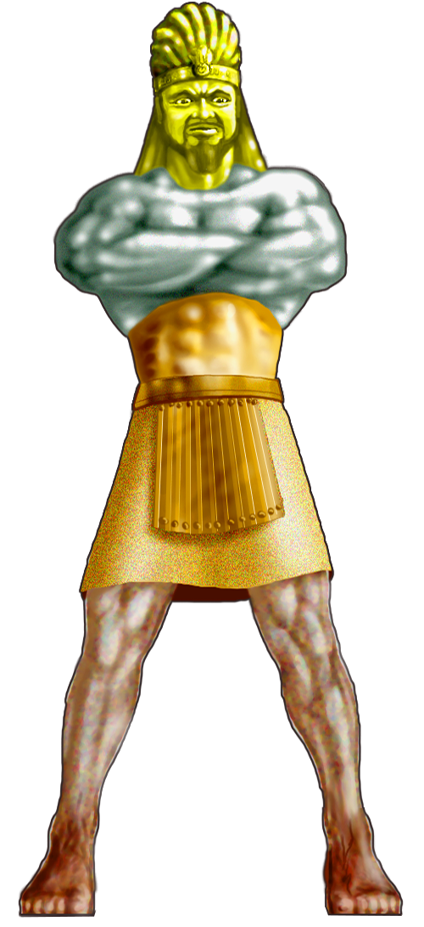
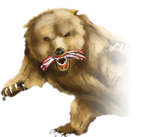
Characteristic
Quality
Lion with Eagle wings
GOLD: Babylonian
(605-539BC)
Bear with 3 ribs in mouth
SILVER: Medo-Persian
(539-331BC)
Leopard with 4 wings and 4 heads
Bronze: Grecian
(331-146BC)
IRON: Roman
(146BC-1453AD)
Mystery Beast
Mystery Babylon
IRON/CLAY: Papal Rome
(1453AD-PRESENT)

Slide 8
Revelation 1:1-6
¹The Revelation of Jesus Christ, which God gave unto him, to shew unto his servants things which must shortly come to pass; and he sent and signified [it] by his angel unto his servant John:
²Who bare record of the word of God, and of the testimony of Jesus Christ, and of all things that he saw.

Slide 9
Revelation 1:1-6
³Blessed [is] he that readeth, and they that hear the words of this prophecy, and keep those things which are written therein: for the time [is] at hand.
⁴John to the seven churches which are in Asia: Grace [be] unto you, and peace, from him which is, and which was, and which is to come; and from the seven Spirits which are before his throne;

Slide 10
Revelation 1:1-6
⁵And from Jesus Christ, [who is] the faithful witness, [and] the first begotten of the dead, and the prince of the kings of the earth. Unto him that loved us, and washed us from our sins in his own blood,
⁶And hath made us kings and priests unto God and his Father; to him [be] glory and dominion for ever and ever. Amen

Slide 11
Revelation 1:19-20
¹⁹Write the things which thou hast seen [PAST], and the things which are [PRESENT], and the things which shall be hereafter [FUTURE];

Slide 12
Revelation 1:19-20
²⁰The mystery of the seven stars which thou sawest in my right hand, and the seven golden candlesticks. The seven stars are the angels of the seven churches: and the seven candlesticks which thou sawest are the seven churches.

Slide 13
Revelation 10:7
⁷But in the days of the voice of the seventh angel, when he shall begin to sound, the mystery of God should be finished, as he hath declared to his servants the prophets.

Slide 14
The Book of Revelation
is a Book of Symbols
No Parking

Slide 15
Revelation 13:1
BEAST WITH SEVEN HEADS
Revelation 17:1-3
¹And I stood upon the sand of the sea, and saw a beast rise up out of the sea, having seven heads and ten horns, and upon his horns ten crowns, and upon his heads the name of blasphemy.
¹And there came one of the seven angels which had the seven vials, and talked with me, saying unto me, Come hither; I will shew unto thee the judgment of the great whore that sitteth upon many waters:
³So he carried me away in the spirit into the wilderness: and I saw a woman sit upon a scarlet coloured beast, full of names of blasphemy, having seven heads and ten horns.
²With whom the kings of the earth have committed fornication, and the inhabitants of the earth have been made drunk with the wine of her fornication.

Slide 16
Revelation 17:1-18
¹And there came one of the seven angels which had the seven vials, and talked with me, saying unto me, Come hither; I will shew unto thee the judgment of the great whore that sitteth upon many waters:
²With whom the kings of the earth have committed fornication, and the inhabitants of the earth have been made drunk with the wine of her fornication.

Slide 17
Revelation 17:1-18
³So he carried me away in the spirit into the wilderness: and I saw a woman sit upon a scarlet coloured beast, full of names of blasphemy, having seven heads and ten horns.
⁴And the woman was arrayed in purple and scarlet colour, and decked with gold and precious stones and pearls, having a golden cup in her hand full of abominations and filthiness of her fornication:

Slide 18
Revelation 17:1-18
⁵And upon her forehead was a name written, MYSTERY, BABYLON THE GREAT, THE MOTHER OF HARLOTS AND ABOMINATIONS OF THE EARTH.
⁶And I saw the woman drunken with the blood of the saints, and with the blood of the martyrs of Jesus: and when I saw her, I wondered with great admiration.

Slide 19
Revelation 17:1-18
⁷And the angel said unto me, Wherefore didst thou marvel? I will tell thee the mystery of the woman, and of the beast that carrieth her, which hath the seven heads and ten horns.

Slide 20
Revelation 17:1-18
⁸The beast that thou sawest was, and is not; and shall ascend out of the bottomless pit, and go into perdition: and they that dwell on the earth shall wonder, whose names were not written in the book of life from the foundation of the world, when they behold the beast that was, and is not, and yet is.

Slide 21
Revelation 17:1-18
⁹And here is the mind which hath wisdom. The seven heads are seven mountains,
on which the woman sitteth.
¹⁰And there are seven kings: five are fallen, and one is, and the other is not yet come; and when he cometh, he must continue a short space.
¹¹And the beast that was, and is not, even he is the eighth, and is of the seven, and goeth into perdition.

Slide 22
Revelation 17:1-18
¹²And the ten horns which thou sawest are ten kings, which have received no kingdom as yet; but receive power as kings one hour with the beast.
¹³These have one mind, and shall give their power and strength unto the beast.
¹⁴These shall make war with the Lamb, and the Lamb shall overcome them: for he is Lord of lords, and King of kings: and they that are with him are called, and chosen, and faithful.

Slide 23
Revelation 17:1-18
¹⁵And he saith unto me, The waters which thou sawest, where the whore sitteth, are peoples, and multitudes, and nations, and tongues.
¹⁶And the ten horns which thou sawest upon the beast, these shall hate the whore, and shall make her desolate and naked, and shall eat her flesh, and burn her
with fire.

Slide 24
Revelation 17:1-18
¹⁷For God hath put in their hearts to fulfil his will, and to agree, and give their kingdom unto the beast, until the words of God shall be fulfilled.
¹⁸And the woman which thou sawest is that great city, which reigneth over the kings of the earth.

Slide 25
Mystery of the Woman and the Beast
Revelation 17:3
³So he carried me away in the spirit into the wilderness: and I saw a woman sit upon a scarlet coloured beast, full of names of blasphemy, having seven heads and ten horns.

Slide 26
Mystery of the Woman and the Beast
Revelation 17:3-4
³…and I saw a woman sit upon a scarlet coloured beast, full of names of blasphemy, having seven heads and ten horns.
⁴And the woman was arrayed in purple and scarlet colour, and decked with gold and precious stones and pearls…

Slide 27
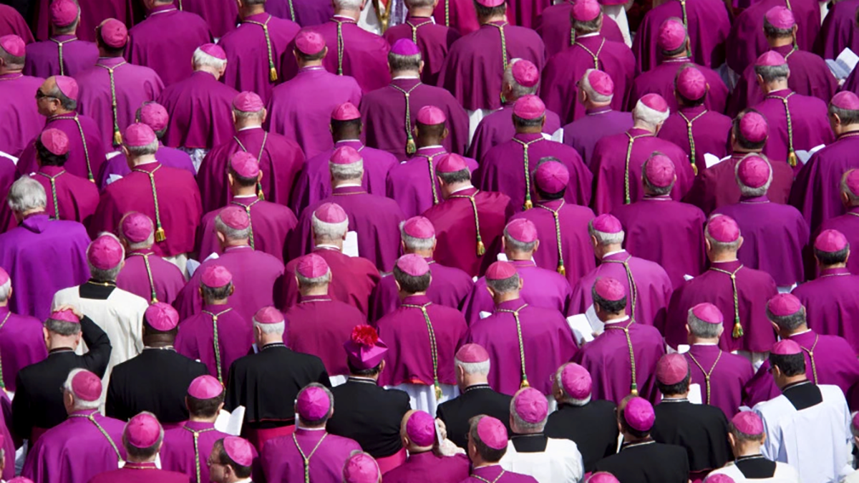

Slide 28
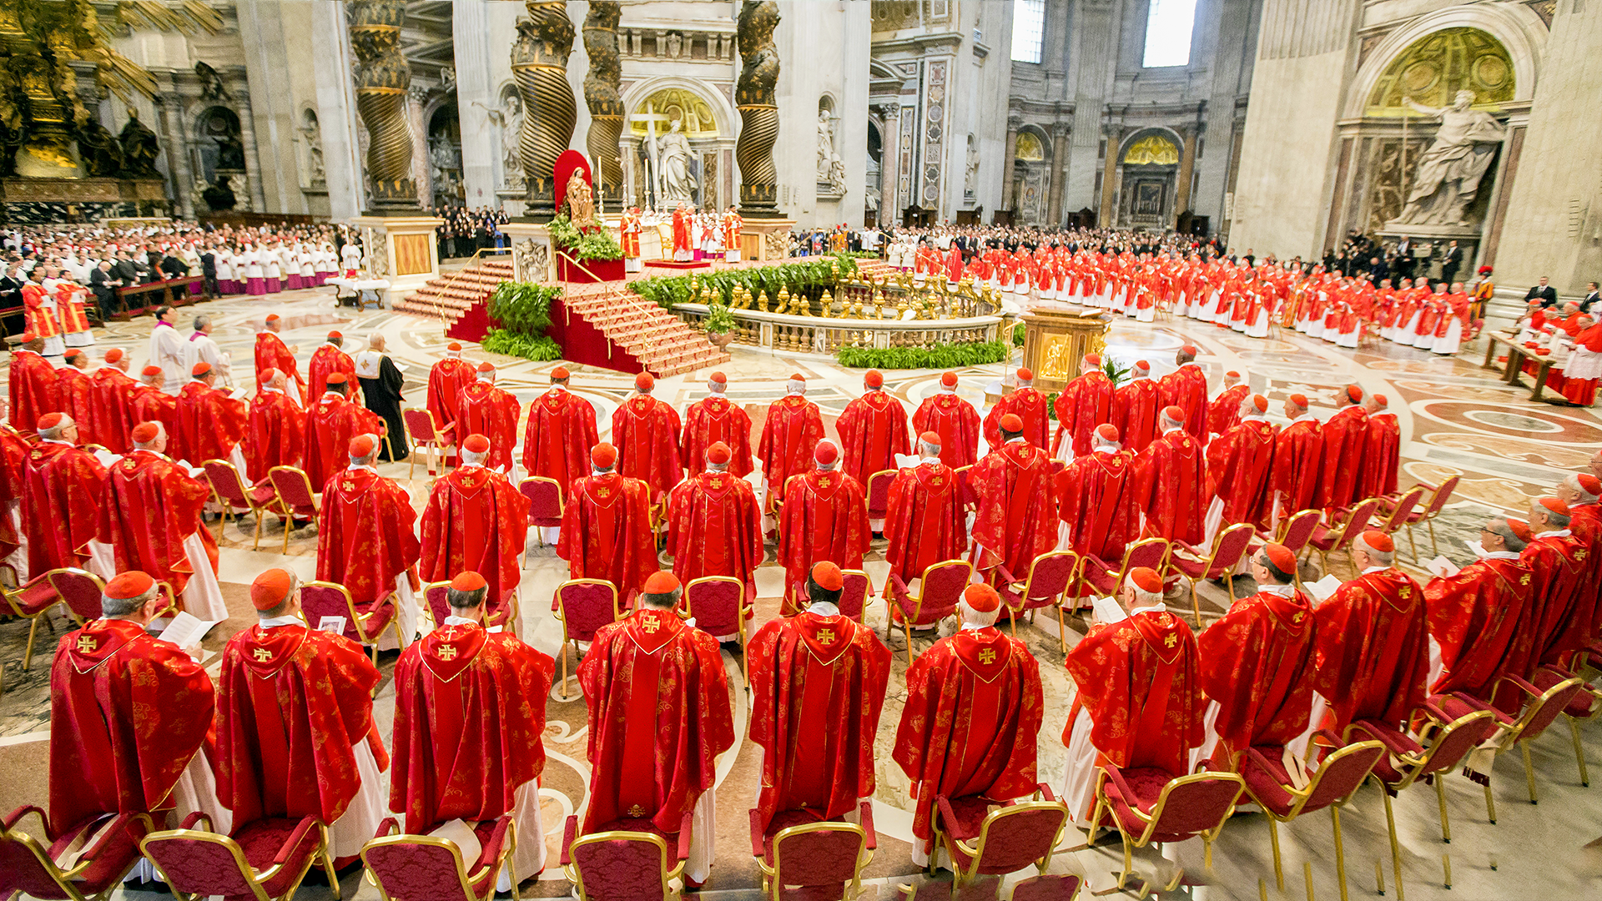

Slide 29
Mystery of the Woman and the Beast
Revelation 17:7
⁷And the angel said unto me, Wherefore didst thou marvel? I will tell thee the mystery of the woman, and of the beast that carrieth her, which hath the seven heads and ten horns.

Slide 30
Mystery of the Woman and the Beast
Revelation 17:18
¹⁸And the woman which thou sawest is that great city, which reigneth over the kings of the earth.

Slide 31
Mystery of the Woman and the Beast
Revelation 17:9
⁹And here is the mind which hath wisdom. The seven heads are seven mountains, on which the woman sitteth.

Slide 32
Mystery of the Woman and the Beast
She’s a city sitting
on seven mountains

Slide 33
Mystery of the Woman and the Beast
List of cities built on seven hills can be found on Wikipedia
Rome is referred to as the,
“City of Seven Hills”

Slide 34
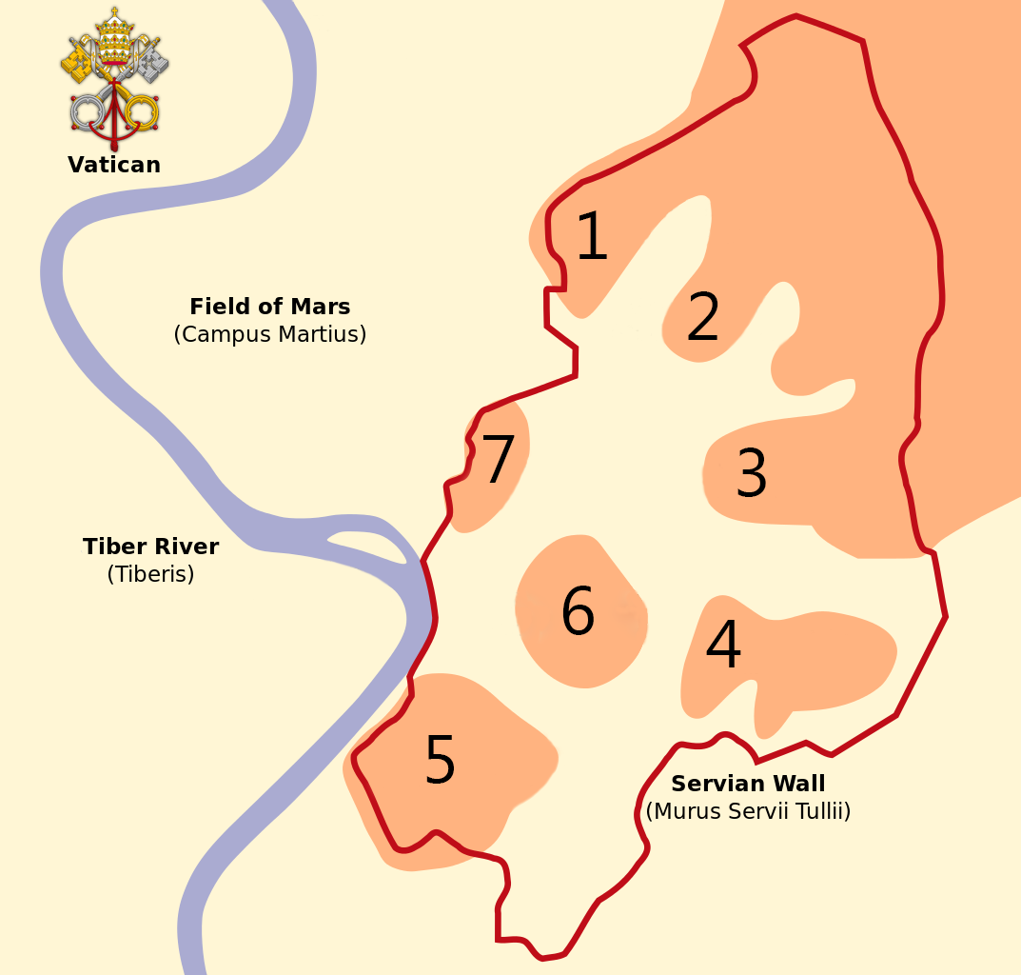
The 7 Hills of Rome
Quirinal
Viminal
Esquiline
Caelian
Aventine
Palatine
Capitoline

Slide 35
Revelation 17:1-6
Revelation 17:18
³…and I saw a woman sit upon a scarlet coloured beast...
⁴And the woman was arrayed in purple and scarlet colour, and decked with gold and precious stones and pearls, having a golden cup in her hand full of abominations and filthiness of her fornication:
⁵And upon her forehead [was] a name written, MYSTERY, BABYLON THE GREAT, THE MOTHER OF HARLOTS AND ABOMINATIONS OF THE EARTH.
⁶And I saw the woman drunken with the blood of the saints, and with the blood of the martyrs of Jesus...
¹⁸And the woman which thou sawest is that great city, which reigneth over the kings of the earth.
She is very,
VERY RICH
scarlet colour, and decked with gold and precious stones and pearls
Revelation 17:9
⁹And here [is] the mind which hath wisdom. The seven heads are seven mountains, on which the woman sitteth.
Roman Catholic Church
KILLED 68 MILLION CHRISTIANS
Both represent:
VATICAN CITY
⁶And I saw the woman drunken with the blood of the saints, and with the blood of the martyrs of Jesus

Slide 36
Revelation 17:1
MANY WATERS
Revelation 17:15
¹And there came one of the seven angels which had the seven vials, and talked with me, saying unto me, Come hither; I will shew unto thee the judgment of the great whore that sitteth upon many waters:
¹⁵And he saith unto me, The waters which thou sawest, where the whore sitteth, are peoples, and multitudes, and nations, and tongues.

Slide 37
World Economy
Revelation 18:11-13
¹¹And the merchants of the earth shall weep and mourn over her; for no man buyeth their merchandise any more:
¹²The merchandise of gold, and silver, and precious stones, and of pearls, and fine linen, and purple, and silk, and scarlet, and all thyine wood, and all manner vessels of ivory, and all manner vessels of most precious wood, and of brass, and iron, and marble,
¹³And cinnamon, and odours, and ointments, and frankincense, and wine, and oil, and fine flour, and wheat, and beasts, and sheep, and horses, and chariots, and slaves, and souls of men.

Slide 38
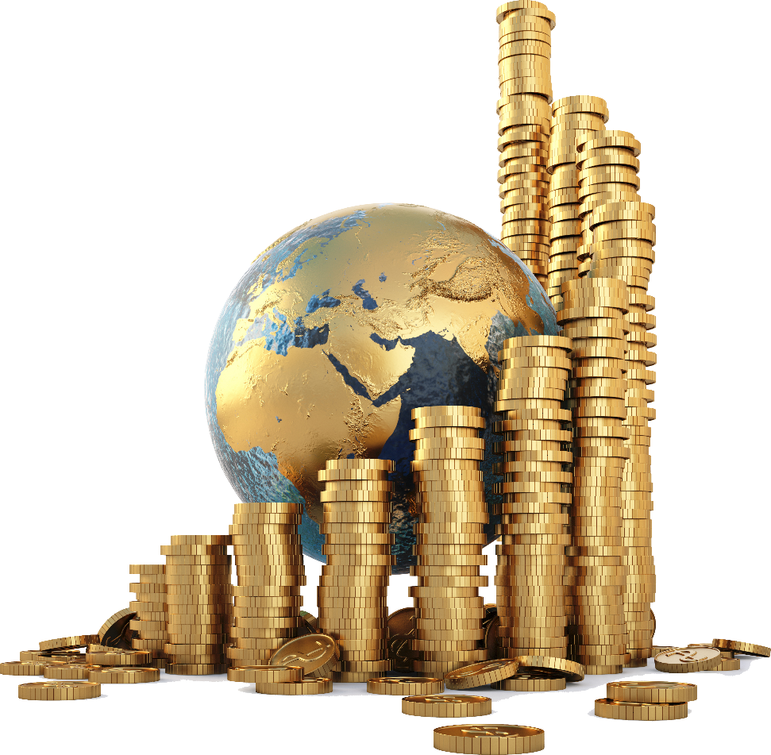
World Economy
Revelation 18:11-13
¹¹And the merchants of the earth shall weep and mourn over her; for no man buyeth their merchandise any more:
¹²The merchandise of gold, and silver, and precious stones, and of pearls, and fine linen, and purple, and silk, and scarlet, and all thyine wood, and all manner vessels of ivory, and all manner vessels of most precious wood, and of brass, and iron, and marble,
¹³And cinnamon, and odours, and ointments, and frankincense, and wine, and oil, and fine flour, and wheat, and beasts, and sheep, and horses, and chariots, and slaves, and souls of men.
She controls the
ECONOMY of the WORLD

Slide 39
Revelation 13:2
²And the beast which I saw was like unto a leopard, and his feet were as [the feet] of a bear, and his mouth as the mouth of a lion: and the dragon gave him his power, and his seat, and great authority.

Slide 40
Revelation 13:4
⁴And they worshipped the dragon which gave power unto the beast: and they worshipped the beast, saying, Who [is] like unto the beast? who is able to make war with him?

Slide 41
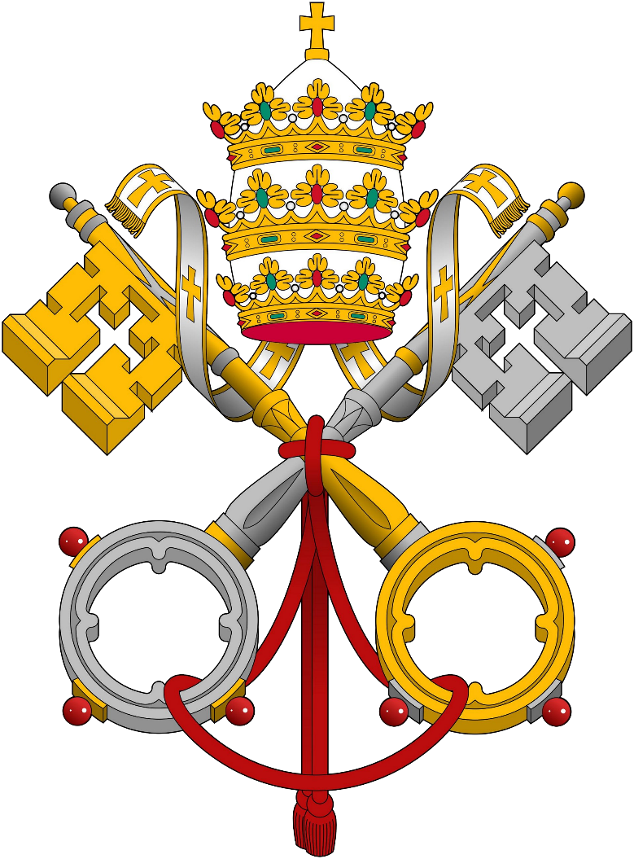
Revelation 17:10-11
¹⁰And there are seven kings: five are fallen, and one is, [and] the other is not yet come; and when he cometh, he must continue a short space.
¹¹And the beast [POWER] that was [PAST], and is not, even he is the eighth [FUTURE], and is of the seven [PRESENT], and goeth into perdition.
Same Power
all the time.
Papal System:
Power of the Pope

Slide 42
1
8
7
2
6
3
5
4

Slide 43
2nd Beast comes out of the Earth
Revelation 18:11-14
¹¹And I beheld another beast coming up out of the earth; and he had two horns like a lamb, and he spake as a dragon.
¹²And he exerciseth all the power of the first beast before him, and causeth the earth and them which dwell therein to worship the first beast, whose deadly wound was healed.

Slide 44
2nd Beast comes out of the Earth
Revelation 18:11-14
¹³And he doeth great wonders, so that he maketh fire come down from heaven on the earth in the sight of men,
¹⁴And deceiveth them that dwell on the earth by [the means of] those miracles which he had power to do in the sight of the beast; saying to them that dwell on the earth, that they should make an image to the beast, which had the wound by a sword, and did live.

Slide 45
2nd Beast comes out of the Earth
Revelation 13:11
¹¹And I beheld another beast coming up out of the earth; and he had two horns like a lamb, and he spake as a dragon.

Slide 46
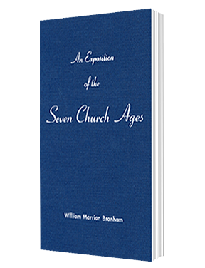
2nd Beast comes out of the Earth
Exposition of the Church Ages
Chapter 4: Smyrnaean Church Age
And if you think this shocking, just wait until the prophecy of Revelation 13 is fulfilled. It is strikingly true that the United States of America is in that chapter. The very number thirteen is a symbol of this nation.
It started with thirteen colonies. Its flag has
thirteen stars and thirteen stripes. And there is
her destiny in the thirteenth chapter.

Slide 47
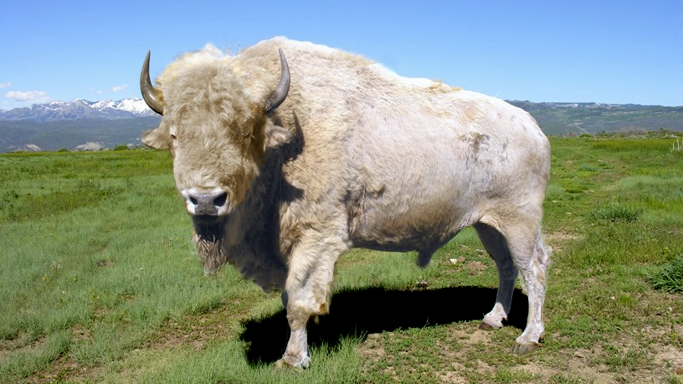
American White Buffalo

Slide 48
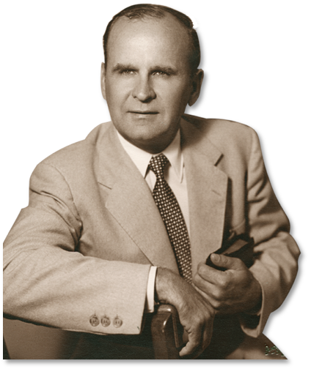
Brother Branham
Mark of the Beast (54-0513)
And I beheld another beast coming up out of the earth... (not out of water, out of the earth).
Then, the thickness and multitudes of people is water, then this is where there was no people, the
United States. And he had two horns like a lamb...
“Two horns like a lamb,” not a lamb. What is it?
It's our American buffalo. Sure.

Slide 49
Brother Branham
Mark of the Beast (54-0513)
See, there he is, "two horns like a lamb." But then what did he do? He had freedom of religion, first; he acted like a lamb; he spoke like a lamb. But remember, he never did become an old ram. He
was a lamb. This country is only a hundred and
fifty years old, you know, just a lamb.
...and then he spake like a dragon.

Slide 50
Brother Branham
Mark of the Beast (54-0513)
And he exercised all the power... the first beast had before him... (the red dragon)... and caused all that was on the earth, that dwelled upon the earth to worship the beast, whose deadly wound was healed. (Look!)

Slide 51
Brother Branham
Questions and Answers: Law Having a Shadow (54-0516)
...What is American? America was established at Plymouth Rock for one purpose: freedom of religion. Is that right?

Slide 52
America in the Bible
Revelation 13:13
¹³And he doeth great wonders, so that he maketh fire come down from heaven on the earth in the sight of men,

Slide 53
Brother Branham
The Mark of the Beast (54-0513)
And he does great wonders, so to make him a fire come down out of heaven... (The atomic bomb, and hydrogen; smart, intelligent nation, and so forth, deceiving the nations by these
things.)

Slide 54
Iraq Faces Massive U.S. Missile Barrage
CBS News, January 24, 2003
They're calling it "A-Day," A as in airstrikes so devastating they would leave Saddam's soldiers unable or unwilling to fight. If the Pentagon sticks to its current war plan, one day in March the Air Force and Navy will launch between 300 and 400 cruise missiles at targets in Iraq. As CBS News Correspondent David Martin reports, this is more than the number that were launched during the entire 40 days of the first Gulf War.
On the second day, the plan calls for launching another 300 to 400 cruise missiles.

Slide 55
Iraq Faces Massive U.S. Missile Barrage
CBS News, January 24, 2003
"There will not be a safe place in Baghdad," said one Pentagon official who has been briefed on the plan.
"The sheer size of this has never been seen before, never been contemplated before," the official said.
The battle plan is based on a concept developed at the National Defense University. It's called "Shock and Awe" (Great wonder!) and it focuses on the psychological destruction of the enemy's will to fight rather than the physical destruction of his military forces.

Slide 56
Amendments to the Constitution of the United States of America
Amendment I
Ratified December 15, 1791
Congress shall make no law respecting an establishment of religion, or prohibiting the free exercise thereof; or abridging the freedom of speech, or of the press; or the right of the people peaceably to assemble, and to petition the Government for a redress of grievances.

Slide 57
Amendments to the Constitution of the United States of America
Amendment II
Ratified December 15, 1791
A well regulated Militia, being necessary to the security of a free State, the right of the people to keep and bear Arms, shall not be infringed.

Slide 58
History of Harvard – the First University in the USA
In 1893, Baedeker's guidebook called Harvard "the oldest, richest, and most famous of American seats of learning." Harvard College, established in 1636 by vote of the Great and General Court of the Massachusetts Bay Colony making it the oldest institution of higher learning in the United States. The college was named for its first benefactor, British-born John Harvard of Charlestown, a young minister who, upon his death in 1638, left his library and half his estate to the new institution. The charter creating the corporation of Harvard College was signed by Massachusetts Governor Thomas Dudley in 1650. The College's original purpose was to train Puritan ministers.

Slide 59
History of Harvard – the First University in the USA
During its early years, the College offered a classic academic course based on the English university model but consistent with the prevailing Puritan philosophy of the first colonists in New England. The College was never affiliated with any particular denomination, but many of its earliest graduates went on to become clergymen in Puritan churches throughout New England. An early brochure, published in 1643, justified the College's existence: "To advance Learning and perpetuate it to Posterity; dreading to leave an illiterate Ministry to the Churches."

Slide 60
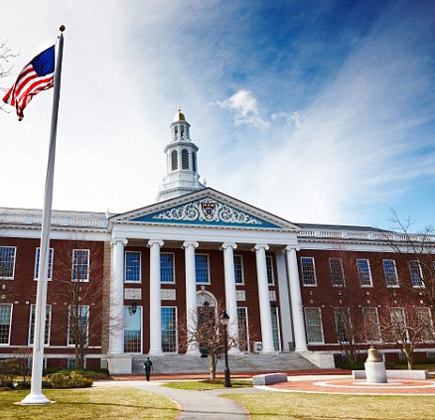
History of Harvard – the First University in the USA
Harvard's early motto was Veritas Christo et Ecclesiae, “Truth for Christ and the Church.” In a directive to its students, it laid out the purpose of all education: “Let every student be plainly instructed and consider well that the main end of his life and studies is to know God and Jesus, which is eternal life. And therefore to lay Christ at the bottom as the only foundation of all sound learning and knowledge.”

Slide 61
History of Yale
Yale traces its beginnings to, "An Act for Liberty to Erect a Collegiate School," passed by the General Court of the Colony of Connecticut on October 9, 1701 in an effort to create an institution to train ministers. Soon thereafter, a group of ten Congregationalist ministers led by James Pierpont, all of whom were alumni of Harvard (the only North American college during their youth), met in the study of Reverend Samuel Russell in Branford, Connecticut, to pool their books to form the school's first library. The group is now known as "The Founders."

Slide 62
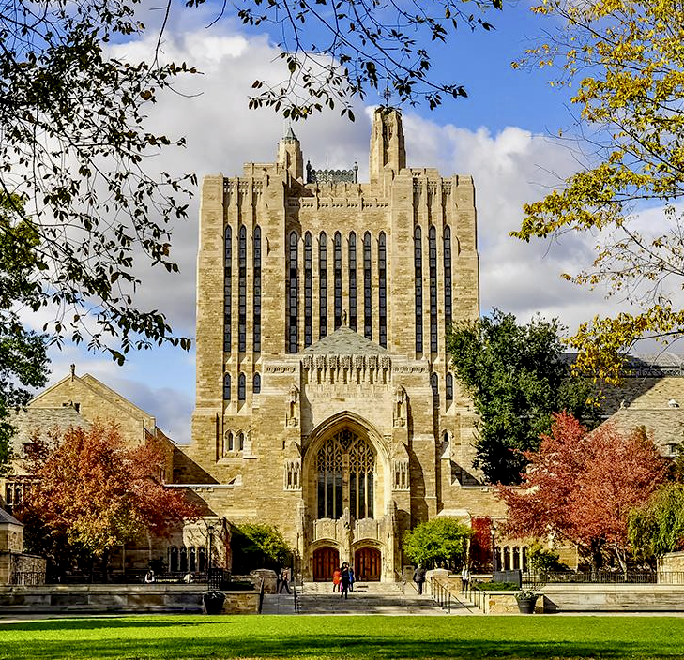
History of Yale
Originally called the Collegiate School, the institution opened in the home of its first rector, Abraham Pierson, in Killingworth (now Clinton). In 1718, the college moved to New Haven, Connecticut, where it remains to this day.

Slide 63
History of Yale
In the meanwhile, a rift formed at Harvard between its sixth president Increase Mather (Harvard A.B., 1656) and the rest of the Harvard clergy, whom Mather viewed as increasingly liberal, ecclesiastically lax, and overly broad in Church polity.
The relationship worsened after Mather resigned, and the administration repeatedly rejected his son and ideological colleague, Cotton Mather, for the position of the Harvard presidency. The feud caused the Mathers to champion the success of the Collegiate School in the hope that it would maintain the Puritan religious orthodoxy in a way that Harvard had not.

Slide 64
The Image of the Beast
Revelation 13:14
¹⁴And deceiveth them that dwell on the earth by [the means of] those miracles which he had power to do in the sight of the beast; saying to them that dwell on the earth, that they should make an image to the beast, which had the wound by a sword, and did live.

Slide 65
The Image of the Beast
Exposition of the Church Ages
Chapter 10 – Resume of the Ages
The false church groups will come together in a world council of churches. This world council of churches is the image erected to the beast.

Slide 66
The Image of the Beast
Exposition of the Church Ages
Chapter 8 – Philadelphian Church Age
Furthermore, the elect will not only be kept, but as this move becomes the "IMAGE ERECTED TO THE BEAST," the saints will be gone in the rapture. And this little delightful, winsome movement that started out in fellowship at Ephesus will become the monster of Satan that defiles and deceives the whole world. For the church system of the Roman Catholic and the Protestant in coming
together will control the whole wealth of the world system
and force the whole earth into its religious trap, or will kill
them, by refusing them the privilege of buying and selling
whereby they would make a living.

Slide 67
The Image of the Beast
Exposition of the Church Ages
Chapter 8 – Philadelphian Church Age
This will be accomplished simply, for the harlot's daughters are all but gone back to her. In the meantime, Rome has acquired nearly all the supplies of gold. The Jews have the bonds and all the paper. At the right time, the harlot will destroy the present day money system by calling in all the paper, and demanding gold. With
no gold, the system falls. The Jews will be trapped
and come into the alliance, and the harlot church
will take over the whole world.

Slide 68
Brother Branham
Testimony (63-1128M)
And now I'm saying this, it's going to be a personal testimony to the glory of God, that it might be that you would understand in the coming nights, of what I want to say, if the Lord willing. You'll understand. Like I was trying to say last night, the world coming to a place it's falling apart, politically, socially, economically. You say, “Economics? More money!”
Yes, but where is it coming from? We're borrowed on
taxes that will be paid forty years from today. She is
broke. She is bankrupt, nation; not this nation, but all
of them. And there is no way ever getting it back.

Slide 69
Brother Branham
Testimony (63-1128M)
And it's a trap set exactly to swing this nation into something. And all of you are wise on that. Well, who has got the wealth of the world? Who holds it? [Someone says, "Rome."--Ed.] Sure, it does. Rome holds it. And whenever we do, when we get broke, instead of these big merchants, tobacco, whiskey, and so forth, like... Have to get the money; what we'll have to
do, either change the currency or borrow the money. And,
when they do, it's the birthright sold right back, exactly,
just as perfect, and just what the Scripture says about it.

Slide 70
Brother Branham
The Uniting Time and Sign (63-0818)
Now, before that they could do this, God... The world had to unite. Titus, this great Roman general had to unite his armies together and come around, after these Jews had rejected the God-given sign of the time to them. That's the time that Titus united his armies together, and come to take the city. First there had to be a uniting of God's people (so-called) against
the Word of God, before that the nation could unite itself
against God's people. See, the--the--the unity, the uniting;
uniting together.

Slide 71
Brother Branham
The Uniting Time and Sign (63-0818)
I believe that we're living in a great uniting time. I am taking these red lights down, and flash signals and everything (of the women, how they do; and the men, how they do; and the churches, how they do), showing to this little group, with all my heart, that I
believe that we are lining in the line of God's Word
in this great prophetic hour, just before the coming
of the Lord Jesus; uniting together and getting
ready.

Slide 72
Brother Branham
The World is Falling Apart (63-0412M)
And you Democrats! I'm neither Democrat or Republican. I'm a Christian. But you, Democrats, that would let some little Ricky come around, and you would sell your birthrights for your politics, and vote in something that our nation
was established to get away from, shame on
you. Got the same Ahab and Jezebel!

Slide 73
Brother Branham
The Third Exodus (63-0630M)
“But there raised up a pharaoh who didn't know Joseph.” The same thing today, a man has raised up and took oath in the White House, that will not swear to his oath, will not take his oath that he believes in freedom of religion. What's this new pope saying? Four things that he has. One of them, is to unite the
Protestant and the Catholic together. And to any
intellectual person, that's the thing to do. But
according to the Bible, it's the wrong thing to do.

Slide 74
Brother Branham
The Third Exodus (63-0630M)
And the Bible said they would do that. Let's go a little farther. At this time, Raamses, in Egypt, was growing. His power is growing. The natural man, Raamses, was growing. The natural man, the antichrist, is growing now. Through politics, he's already got to the White House. In religion, he's got all the people so scrupled
up, till actually they'd fall right for it. And the
denominational leaders, practically every church
that there is in the nation, is already in the

Slide 75
Brother Branham
The Uniting Time and Sign (63-0818)
Now, you see, before Titus united the nations of... his armies together, Israel united themselves together and banded themselves, that they would not believe Jesus to be the Messiah. They rejected Him, and turned Him out, and crucified Him. And then, when they rejected the salvation that was sent to them, they united themselves together to do it. Now, hold
that in mind: uniting themselves together, to reject the
Message of the hour! They had to do that. And then
when they did that, then the national sign come in.

Slide 76
Brother Branham
The Uniting Time and Sign (63-0818)
The nations begin to unite themselves together, and Titus brought this great army of Romans and Greeks and compassed the walls of Jerusalem, penned those people in there now, and they starved to death. They eat the bark from the trees. Josephus, the great historian, tells us. And they eat the grass off the ground. They even boiled one another's children and eat it; see, as they were mad people. And then when, finally, Titus, he was setting back upon the hills and around
Jerusalem there, and--and those people in there thought they were
doing the will of God, when they saw these armies marching in. They
had refused to hear that Great Master, Lord Jesus, tell them that.

Slide 77
Revelation 17:12-13
¹²And the ten horns which thou sawest are ten kings, which have received no kingdom as yet; but receive power as kings one hour with the beast.
¹³These have one mind, and shall give their power and strength unto the beast.

Slide 78
Revelation 17:17-16
¹⁷For God hath put in their hearts to fulfil his will, and to agree, and give their kingdom unto the beast, until the words of God shall be fulfilled.
¹⁶And the ten horns which thou sawest upon the beast, these shall hate the whore, and shall make her desolate and naked, and shall eat her flesh, and burn her with fire.

Slide 79
Brother Branham
Why We Are Not a Denomination (58-0927)
Watch that now, these ten horns, these ten kingdoms. See, that's everything falling in, what these dictators are. Watch the way dictators lean to. Where's it leaning to? Just look--tell me a dictator that doesn't lean towards communism. See? And they shall what? “Hate the whore,” the woman, the church. But watch.
Watch what's going to do it... these shall hate the
whore, and shall make her desolate and naked,
and shall eat her flesh, and burn her with fire.

Slide 80
Brother Branham
Letting Off the Pressure (62-0518)
And listen... Are you scared of communism? What are you afraid of communism for? You people wake up. Communism is in God's hands. Watch the tool He's using. There's not one Scripture in the Bible that said communism will rule the world. But the Bible said Romanism will rule the world. Which was the iron and clay in the bottom of the feet? Was it
Communism? No, sir. It was Romanism and Protestantism,
exactly right. That steel, iron, Rome, run right down to the
end. It's Romanism. And look where it's setting today.

Slide 81
Brother Branham
Absolute (62-1230M)
I said, “There's three isms has rose up: Nazism, fascism, and communism.” I said, “Them isms will revolve and come around into one; it'll he communism. Watch. Communism will burn Rome.” See? You watch it. Uh-huh. It's a tool in God's hands. They think they're against God; they're working right into it all the time, don't know it. He's just
using them as a puppet, some tool in His hand like He
did Nebuchadnezzar and many of the others.

Slide 82
Brother Branham
The First Seal (63-0318)
So I didn't do it, but I got to go all through the Vatican. Why, you couldn't buy it with a hundred billion billion dollars. And just think, “The wealth of the world,” the Bible said, “was found in her.” Just think of the great places, the billions times... Why did Communism raise up over here in Russia? It just makes me sick at my stomach to hear so many preachers hollering about Communism, and they don't even
know what they're crowing about. That's right.
Communism ain't nothing. It's a tool in the hand of God
to bring revenge upon the earth for the blood of the
saints... That's right.

Slide 83
Revelation 13:15-18
¹⁵And he had power to give life unto the image of the beast, that the image of the beast should both speak, and cause that as many as would not worship the image of the beast should be killed.
¹⁶And he causeth all, both small and great, rich and poor, free and bond, to receive a mark in their right hand, or in their foreheads:

Slide 84
Revelation 13:15-18
¹⁷And that no man might buy or sell, save he that had the mark, or the name of the beast, or the number of his name.
¹⁸Here is wisdom. Let him that hath understanding count the number of the beast: for it is the number of a man; and his number is Six hundred threescore and six.

Slide 85
Exodus 13:8-9
⁸And thou shalt shew thy son in that day, saying, [This is done] because of that [which] the LORD did unto me when I came forth out of Egypt.
⁹And it shall be for a sign unto thee upon thine hand, and for a memorial between thine eyes, that the LORD'S law may be in thy mouth: for with a strong hand hath the LORD brought thee out of Egypt.

Slide 86
Deuteronomy 6:6-8
⁶And these words, which I command thee this day, shall be in thine heart:
⁷And thou shalt teach them diligently unto thy children, and shalt talk of them when thou sittest in thine house, and when thou walkest by the way, and when thou liest down, and when thou risest up.
⁸And thou shalt bind them for a sign upon thine hand, and they shall be as frontlets between thine eyes.

Slide 87
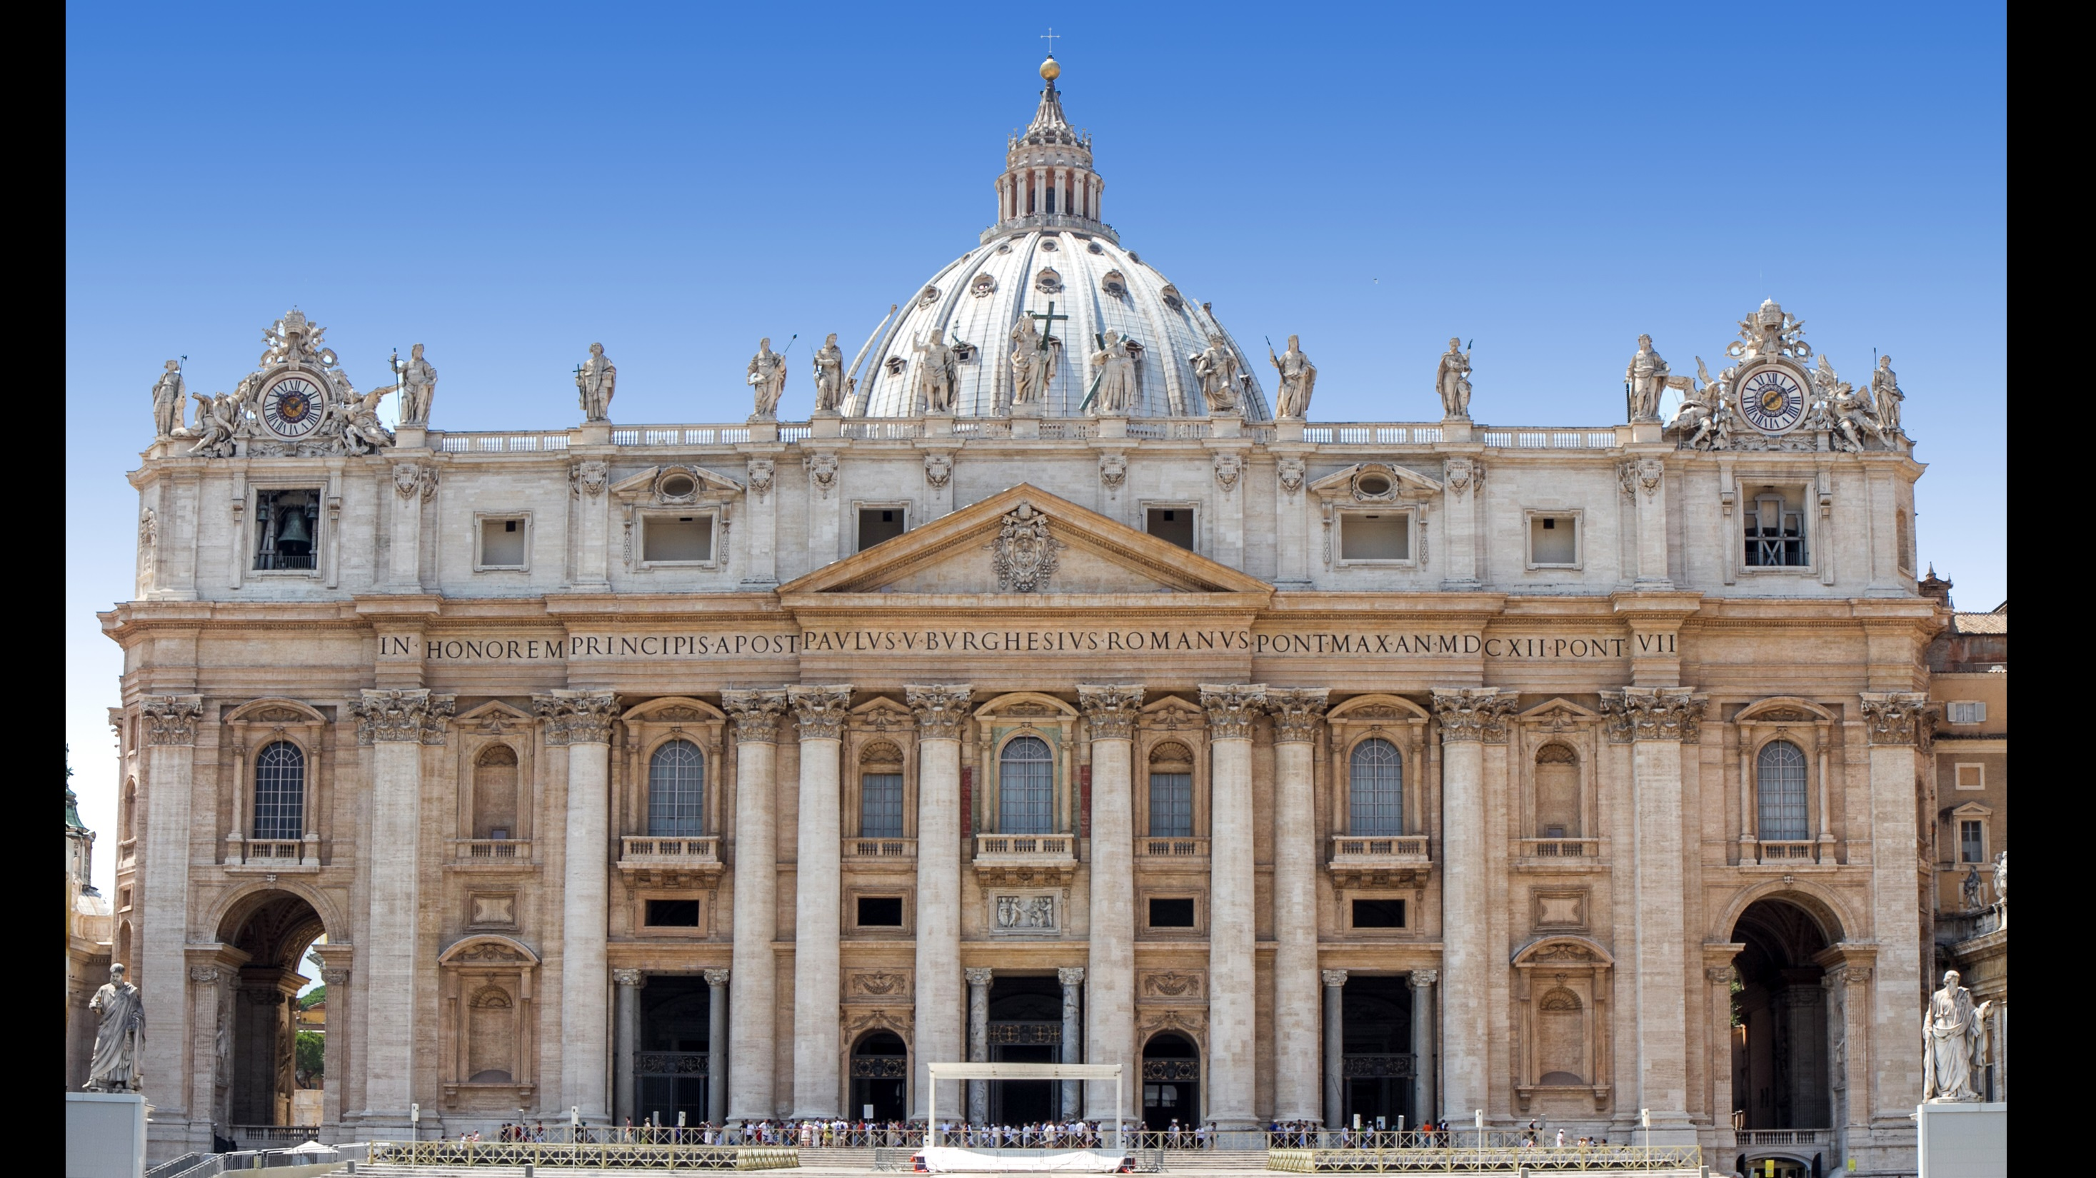

Slide 88
= = = = =
I
C
I
V
L
I
I
VICARIVS FILII DEI
V
I
D
I
5 1 100 1 5
= = = =
= =
500 1
1 50 1 1
+
+
112
53
501

Slide 89
666
666
…and his number is Six hundred
threescore and six
Revelation 13:18

Slide 90
www.bcfellowship.org teaching@bcfellowship.org

