Slide 1
The Original Sin
The Mystery in the Garden of Eden
Part 1

Slide 2
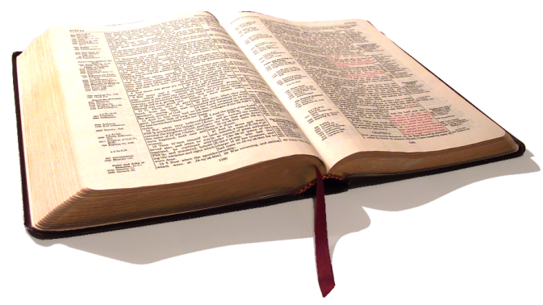
Matthew 13:24-26
²⁴Another parable put he forth unto them, saying, The kingdom of heaven is likened unto a man which sowed good seed in his field:
²⁵But while men slept, his enemy came and sowed tares among the wheat, and went his way.
²⁶But when the blade was sprung up, and brought forth fruit, then appeared the tares also.
Biblical Study on the Original Sin

Slide 3
Matthew 13:27-28
²⁷So the servants of the householder came and said unto him, Sir, didst not thou sow good seed in thy field? from whence then hath it tares?
²⁸He said unto them, An enemy hath done this. The servants said unto him, Wilt thou then that we go and gather them up?
Biblical Study on the Original Sin

Slide 4
Matthew 13:29-30
²⁹But he said, Nay; lest while ye gather up the tares, ye root up also the wheat with them.
³⁰Let both grow together until the harvest: and in the time of harvest I will say to the reapers, Gather ye together first the tares, and bind them in bundles to burn them: but gather the wheat into my barn.
Biblical Study on the Original Sin

Slide 5
Matthew 13:36-37
³⁶Then Jesus sent the multitude away, and went into the house: and his disciples came unto him, saying, Declare unto us the parable of the tares of the field.
³⁷He answered and said unto them, He that soweth the good seed is the Son of man;
Biblical Study on the Original Sin

Slide 6
Matthew 13:38-40
³⁸The field is the world; the good seed are the children of the kingdom; but the tares are the children of the wicked [one];
³⁹The enemy that sowed them is the devil; the harvest is the end of the world; and the reapers are the angels.
⁴⁰As therefore the tares are gathered and burned in the fire; so shall it be in the end of this world.
Biblical Study on the Original Sin

Slide 7
Matthew 13:41-43
⁴¹The Son of man shall send forth his angels, and they shall gather out of his kingdom all things that offend, and them which do iniquity;
⁴²And shall cast them into a furnace of fire: there shall be wailing and gnashing of teeth.
⁴³Then shall the righteous shine forth as the sun in the kingdom of their Father. Who hath ears to hear, let him hear.
Biblical Study on the Original Sin

Slide 8
The Original Sin
The Mystery in the Garden of Eden

Slide 9
Terms from
Matthew
Owner
Lord God
Enemy
Devil
Sowers
Wheat
Children of God
Seeds
Tares
Children of the Devil
Field
Harvest Time
Reapers
Biblical Study on the Original Sin

Slide 10
I John 3:10
¹⁰In this the children of God are manifest, and the children of the devil: whosoever doeth not righteousness is not of God, neither he that loveth not his brother.
John 8:47
⁴⁷He that is of God heareth God's words: ye therefore hear them not, because ye are not of God.
Biblical Study on the Original Sin

Slide 11
Terms from
Matthew
Owner
Lord God
Enemy
Devil
Sowers
Wheat
Children of God
Seeds
Tares
Children of the Devil
Field
= World
Harvest Time
= End of the World
Reapers
= Angels
Biblical Study on the Original Sin

Slide 12
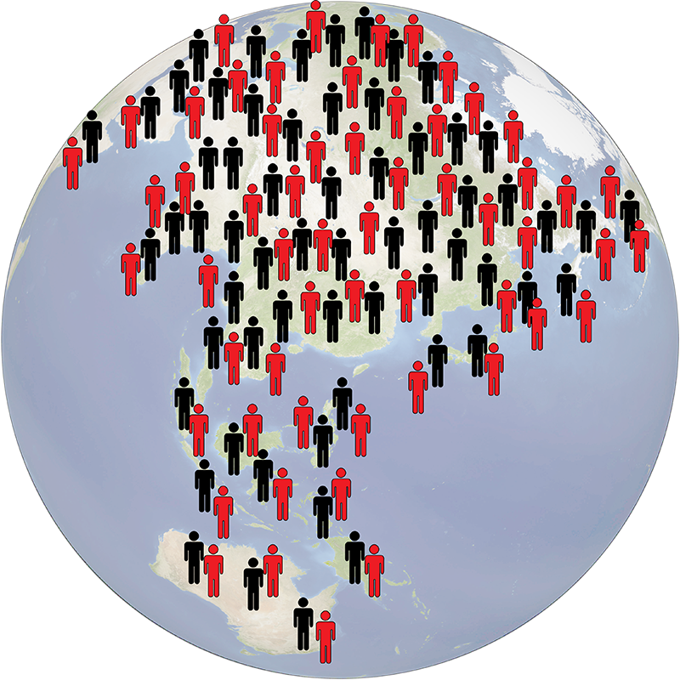
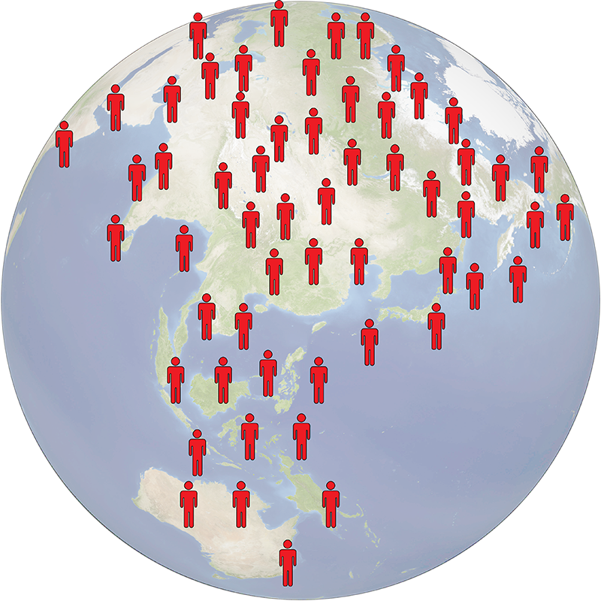
Biblical Study on the Original Sin

Slide 13
Genesis 3:1-2
¹Now the serpent was more subtil than any beast of the field which the LORD God had made. And he said unto the woman, Yea, hath God said, Ye shall not eat of every tree of the garden?
²And the woman said unto the serpent, We may eat of the fruit of the trees of the garden:
Biblical Study on the Original Sin

Slide 14
Genesis 3:3-5
³But of the fruit of the tree which [is] in the midst of the garden, God hath said, Ye shall not eat of it, neither shall ye touch it, lest ye die.
⁴And the serpent said unto the woman, Ye shall not surely die:
⁵For God doth know that in the day ye eat thereof, then your eyes shall be opened, and ye shall be as gods, knowing good and evil.
Biblical Study on the Original Sin

Slide 15
Genesis 3:6-7
⁶And when the woman saw that the tree [was] good for food, and that it [was] pleasant to the eyes, and a tree to be desired to make [one] wise, she took of the fruit thereof, and did eat, and gave also unto her husband with her; and he did eat.
⁷And the eyes of them both were opened, and they knew that they [were] naked; and they sewed fig leaves together, and made themselves aprons.
Biblical Study on the Original Sin

Slide 16
Serpent
Adam
WOMAN

Slide 17
Genesis 3:14-15
¹⁴And the LORD God said unto the serpent, Because thou hast done this, thou art cursed above all cattle, and above every beast of the field; upon thy belly shalt thou go, and dust shalt thou eat all the days of thy life:
¹⁵And I will put enmity between thee and the woman, and between thy seed and her seed; it shall bruise thy head, and thou shalt bruise his heel.
Biblical Study on the Original Sin

Slide 18
Genesis 3:16-17
¹⁶Unto the woman he said, I will greatly multiply thy sorrow and thy conception; in sorrow thou shalt bring forth children; and thy desire shall be to thy husband, and he shall rule over thee.
¹⁷And unto Adam he said, Because thou hast hearkened unto the voice of thy wife, and hast eaten of the tree, of which I commanded thee, saying, Thou shalt not eat of it: cursed is the ground for thy sake; in sorrow shalt thou eat of it all the days of thy life;
Biblical Study on the Original Sin

Slide 19
Terms from Genesis 3
Eat
Natural
Spiritual
Garden
Garden of Eden
Midst of the Garden
Trees
Natural
Spiritual
LIFE
Tree of Life
Tree of the Knowledge of Good and Evil
Fruits
Natural
DEATH
Biblical Study on the Original Sin

Slide 20
John 10:10
¹⁰The thief cometh not, but for to steal, and to kill, and to destroy: I am come that they might have life, and that they might have [it] more abundantly.
John 15:1
¹I am the true vine, and my Father is the husbandman.
Biblical Study on the Original Sin

Slide 21
Terms from Genesis 3
Eat
Natural
Spiritual
Garden
Garden of Eden
Midst of the Garden
Trees
Natural
Spiritual
LIFE
Tree of Life
Tree of the Knowledge of Good and Evil
Fruits
Natural
DEATH
Biblical Study on the Original Sin

Slide 22
Proverbs 30:20
²⁰Such is the way of an adulterous woman; she eateth, and wipeth her mouth, and saith, I have done no wickedness.
Biblical Study on the Original Sin

Slide 23
Serpent
Adam
WOMAN
CAIN
ABEL

Slide 24
Genesis 4:1-2
¹And Adam knew Eve his wife; and she conceived, and bare Cain, and said, I have gotten a man from the LORD.
²And she again bare his brother Abel. And Abel was a keeper of sheep, but Cain was a tiller of the ground.
Biblical Study on the Original Sin

Slide 25
Serpent
Adam
WOMAN
CAIN
Born at the same time, but not twins
ABEL

Slide 26
Genesis 3:20
²⁰And Adam called his wife’s name Eve; because she was the mother of all living.
Biblical Study on the Original Sin

Slide 27
Serpent
Adam
EVE
WOMAN
Mother of all living
CAIN
Born at the same time, but not twins
ABEL

Slide 28
Serpent
Adam
EVE
Mother of all living
CAIN
ABEL
SETH

Slide 29
Serpent
Adam
EVE
WOMAN
Mother of all living
CAIN
Born at the same time, but not twins
ABEL
SETH

Slide 30
Genealogy of Joseph
Jacob
Luke 3:34
³⁴Which was the son of Jacob, which was the son of Isaac, which was the son of Abraham, which was the son of Thara, which was the son of Nachor,
Isaac
Abraham
Thara
Nachor
Biblical Study on the Original Sin

Slide 31
Saruch
Luke 3:35
³⁵Which was the son of Saruch, which was the son of Ragau, which was the son of Phalec, which was the son of Heber, which was the son of Sala,
Ragua
Phalec
Heber
Sala
Biblical Study on the Original Sin

Slide 32
Cainan
Luke 3:36
³⁶Which was the son of Cainan, which was the son of Arphaxad, which was the son of Sem, which was the son of Noe, which was the son of Lamech,
Arphaxad
Sem
Noe
Lamech
Biblical Study on the Original Sin

Slide 33
Mathusala
Luke 3:37
³⁷Which was the son of Mathusala, which was the son of Enoch, which was the son of Jared, which was the son of Maleleel, which was the son of Cainan,
Enoch
Jared
Maleleel
Cainan
Biblical Study on the Original Sin

Slide 34
Enos
Luke 3:38
³⁸Which was the son of Enos, which was the son of Seth, which was the son of Adam, which was the son of God.
Seth
Adam
God
Biblical Study on the Original Sin

Slide 35
Enos
Luke 3:38
³⁸Which was the son of Enos, which was the son of Seth, which was the son of Adam, which was the son of God.
Seth
Adam
God
Biblical Study on the Original Sin

Slide 36
Jude 1:14
¹⁴And Enoch also, the seventh from Adam, prophesied of these, saying, Behold, the Lord cometh with ten thousands of his saints…
Adam
seth
enos
cainan
Mahalaleel
Jared
enoch
1
2
3
4
5
6
7

Slide 37
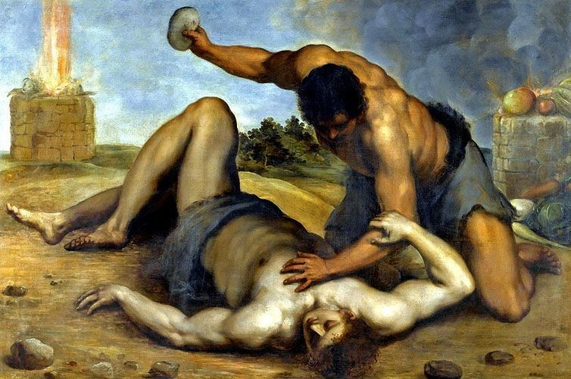
I John 3:12
¹²Not as Cain, who was of that wicked one, and slew his brother. And wherefore slew he him? Because his own works were evil, and his brother's righteous.
Biblical Study on the Original Sin

Slide 38
The Original Sin
The Mystery in the Garden of Eden
Part 1

Slide 39
The Original Sin
The Mystery in the Ark
Part 2

Slide 40
Genesis 6:1-2
¹And it came to pass, when men began to multiply on the face of the earth, and daughters were born unto them,
²That the sons of God saw the daughters of men that they were fair; and they took them wives of all which they chose.
Biblical Study on the Original Sin

Slide 41
Genesis 6:3-4
³And the LORD said, My spirit shall not always strive with man, for that he also is flesh: yet his days shall be an hundred and twenty years.
⁴There were giants in the earth in those days; and also after that, when the sons of God came in unto the daughters of men, and they bare children to them, the same became mighty men which were of old, men of renown.
Biblical Study on the Original Sin

Slide 42
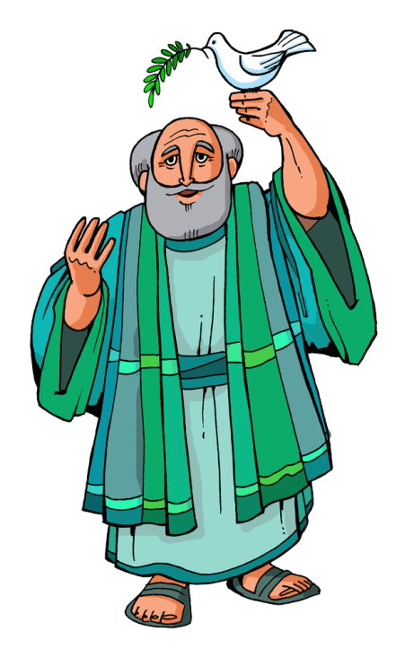
Genesis 6:8
⁸But Noah found grace in the eyes of the LORD.
Biblical Study on the Original Sin

Slide 43
Serpent
Adam
EVE
Children
of
Men
CAIN
ABEL
Sons
of
God
SETH
Noah
Genesis 6

Slide 44
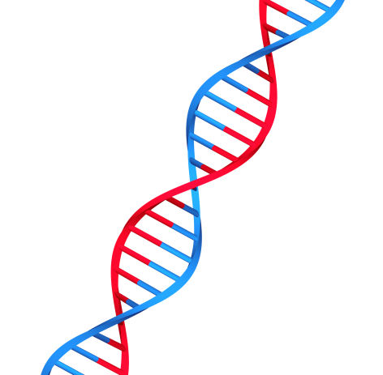
Serpent
Adam
EVE
Children
of
Men
CAIN
ABEL
Sons
of
God
SETH
Mixed Blood
Noah
Genesis 6

Slide 45
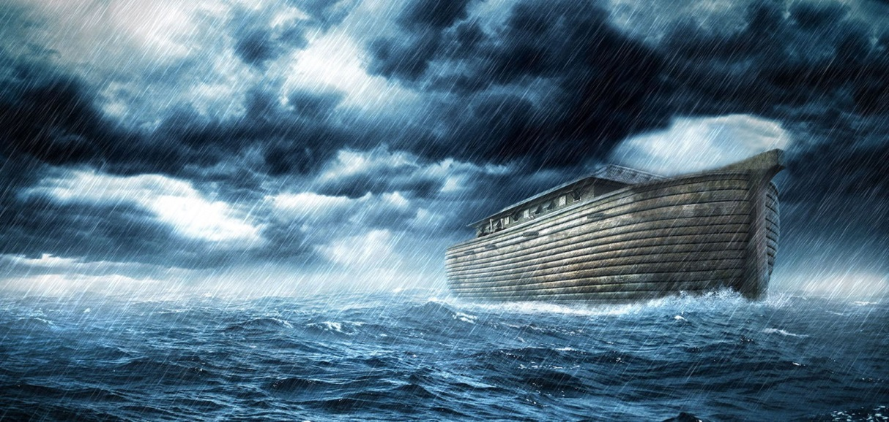
Serpent
Adam
EVE
Children
of
Men
CAIN
ABEL
Sons
of
God
TWINS
SETH
Noah
Genesis 6
The Flood
Mixed Blood

Slide 46
Genesis 7:7
⁷And Noah went in, and his sons, and his wife, and his sons' wives with him, into the ark, because of the waters of the flood.
Genesis 7:13
¹³In the selfsame day entered Noah, and Shem, and Ham, and Japheth, the sons of Noah, and Noah's wife, and the three wives of his sons with them, into the ark;
Biblical Study on the Original Sin

Slide 47
Genesis 9:18-19
¹⁸And the sons of Noah, that went forth of the ark, were Shem, and Ham, and Japheth: and Ham is the father of Canaan.
¹⁹These are the three sons of Noah: and of them was the whole earth overspread.
Biblical Study on the Original Sin

Slide 48
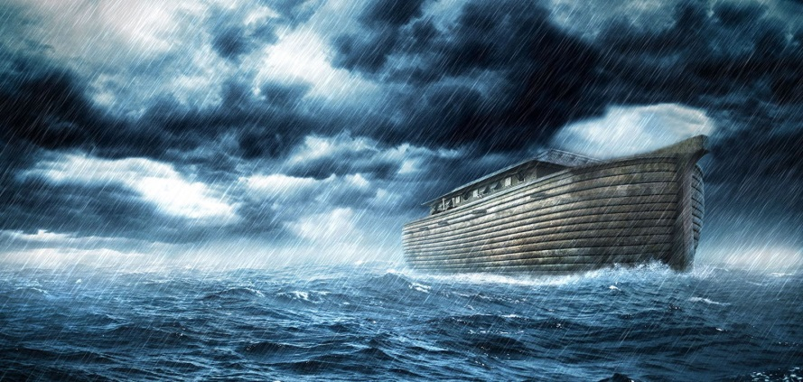
…eight souls were saved by water.
Noah
Noah’s wife
Shem
Shem’s wife
Japheth
Japheth’s wife
Ham
Ham
Ham’s wife
Biblical Study on the Original Sin

Slide 49
Genesis 9:20-22
²⁰And Noah began to be an husbandman, and he planted a vineyard:
²¹And he drank of the wine, and was drunken; and he was uncovered within his tent.
²²And Ham, the father of Canaan, saw the nakedness of his father, and told his two brethren without.
Biblical Study on the Original Sin

Slide 50
Genesis 9:23-24
²³And Shem and Japheth took a garment, and laid it upon both their shoulders, and went backward, and covered the nakedness of their father; and their faces were backward, and they saw not their father's nakedness.
²⁴And Noah awoke from his wine, and knew what his younger son had done unto him.
Biblical Study on the Original Sin

Slide 51
Genesis 9:25-27
²⁵And he said, Cursed be Canaan; a servant of servants shall he be unto his brethren.
²⁶And he said, Blessed be the LORD God of Shem; and Canaan shall be his servant.
²⁷God shall enlarge Japheth, and he shall dwell in the tents of Shem; and Canaan shall be his servant.
Biblical Study on the Original Sin

Slide 52
Noah
Noah’s wife
Shem
Shem’s wife
Japheth
Japheth’s wife
CANAAN
Ham
Ham’s wife
Biblical Study on the Original Sin

Slide 53
Genesis 9:25
Genesis 9:22
²²And Ham, the father of Canaan, saw the nakedness of his father, and told his two brethren without.
²⁵And he said, Cursed be Canaan; a servant of servants shall he be unto his brethren.
Biblical Study on the Original Sin

Slide 54
Genesis 9:22-23
²²And Ham, the father of Canaan, saw the nakedness of his father, and told his two brethren without.
²³And Shem and Japheth took a garment, and laid it upon both their shoulders, and went backward, and covered the nakedness of their father; and their faces were backward, and they saw not their father's nakedness.
Biblical Study on the Original Sin

Slide 55
Leviticus 20:11
¹¹And the man that lieth with his father's wife hath uncovered his father's nakedness: both of them shall surely be put to death; their blood [shall be] upon them.
Biblical Study on the Original Sin

Slide 56
Genesis 10:6
⁶And the sons of Ham; Cush, and Mizraim, and Phut, and Canaan.
Biblical Study on the Original Sin

Slide 57
CANAAN
CUSH
MIZRAIM
PHUT
Noah
Noah’s wife
Shem
Shem’s wife
Japheth
Japheth’s wife
Ham
Ham’s wife
Biblical Study on the Original Sin

Slide 58
Genesis 9:25-27
²⁵And he said, Cursed be Canaan; a servant of servants shall he be unto his brethren.
²⁶And he said, Blessed be the LORD God of Shem; and Canaan shall be his servant.
²⁷God shall enlarge Japheth, and he shall dwell in the tents of Shem; and Canaan shall be his servant.
Biblical Study on the Original Sin

Slide 59
Brethren
CUSH
MIZRAIM
PHUT
Noah
Noah’s wife
Shem
Shem’s wife
Japheth
Japheth’s wife
CANAAN
Ham
Ham’s wife
Biblical Study on the Original Sin

Slide 60
CANAAN
Brethren
CUSH
MIZRAIM
PHUT
Noah
Noah’s wife
Shem
Shem’s wife
Japheth
Japheth’s wife
Ham
Ham’s wife
Biblical Study on the Original Sin

Slide 61
CUSH
SEMIRAMIS
NIMROD
Mother and son worship
Biblical Study on the Original Sin

Slide 62
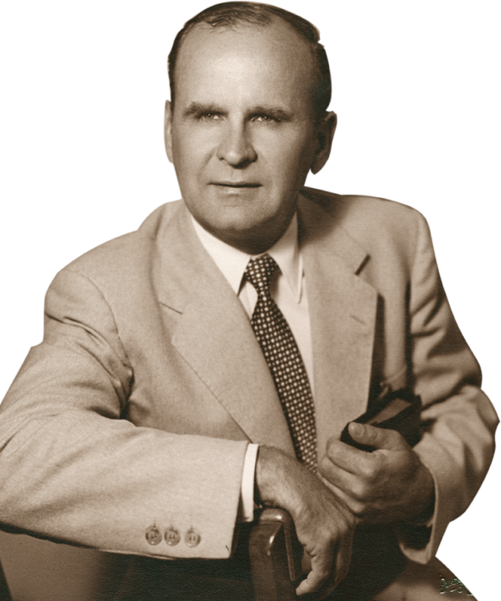
The Serpent’s Seed - Jeffersonville, IN [58-0928E]
197 Now, Noah and his sons which come out, Ham, Shem, and Japheth, come out in the righteous line. How did the seed ever get over? The seed come over
in the ark, just like it did in the beginning
through the woman, their wives. They carried
the seed of Satan through the ark, just as
Eve packed the seed of Satan to give birth
to Cain, through the woman.
Biblical Study on the Original Sin

Slide 64
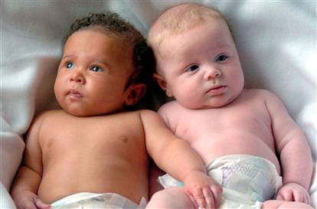
Heteropaternal
superfecundation
Biblical Study on the Original Sin

Slide 65
Romans 3:23
²³For all have sinned, and have come short of the glory of God;
Romans 6:23
²³For the wages of sin is death; but the gift of God is eternal life through Jesus Christ our Lord.
Biblical Study on the Original Sin

Slide 66
Ephesians 2:8-9
⁸For by grace are you saved through faith; and that not of yourselves: it is the gift of God:
⁹Not of works, lest any man should boast.
Biblical Study on the Original Sin

Slide 67
Ecclesiastes 3:18-19
¹⁸I said in mine heart concerning the estate of the sons of men, that God might manifest them, and that they might see that they themselves are beasts.
¹⁹For that which befalleth the sons of men befalleth beasts; even one thing befalleth them: as the one dieth, so dieth the other; yea, they have all one breath; so that a man hath no preeminence above a beast: for all [is] vanity.
Biblical Study on the Original Sin

